Slide 1
SPORTS CENTER MANAGEMENT SYSTEM-SADPEPE GROUP 10

Slide 2
Group Members
EGE UÇAK | 21527467
BAHADIR ADAK | 21526619
SERHAT SAĞLIK | 21527285
EYÜP CAN BODUR | 21526753
BERK CAN ÖZEN | 21485591

Slide 3
Project Organization
EGE UÇAK | Software Project Manager
BAHADIR UÇAK | Software Analyst
SERHAT SAĞLIK | Software Configuration Manager
EYÜP CAN BODUR | Software Architect
BERK CAN ÖZEN | Software Tester

Slide 4
Technologies
Our project is developed as desktop application using Java.
We use MySQL database management system and Jsf Framework to do our database operations
We designed the interfaces in Windows Form Application.

Slide 5
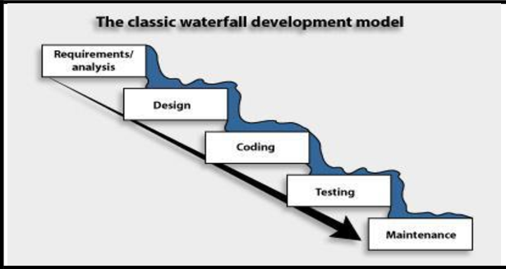
Development Model
We use Waterfall Development Model in our project.

Slide 6
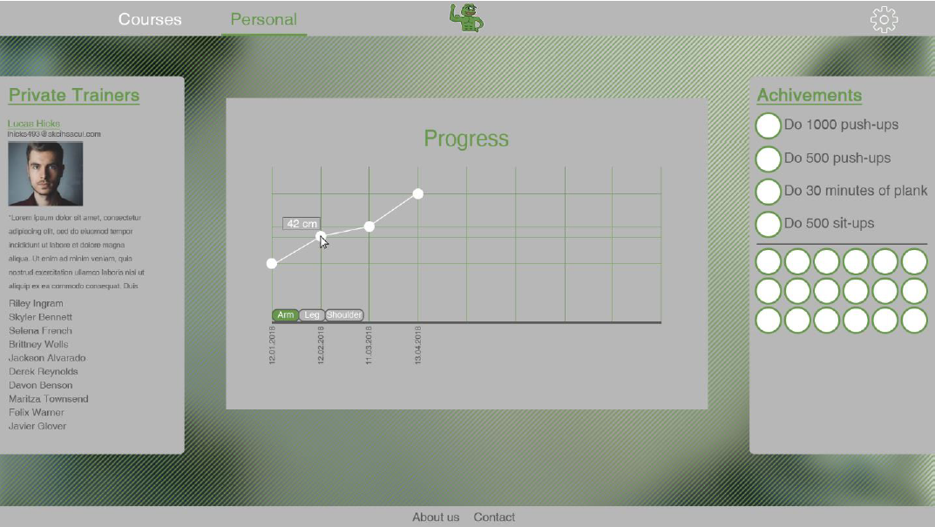
Process Ex:

Slide 7
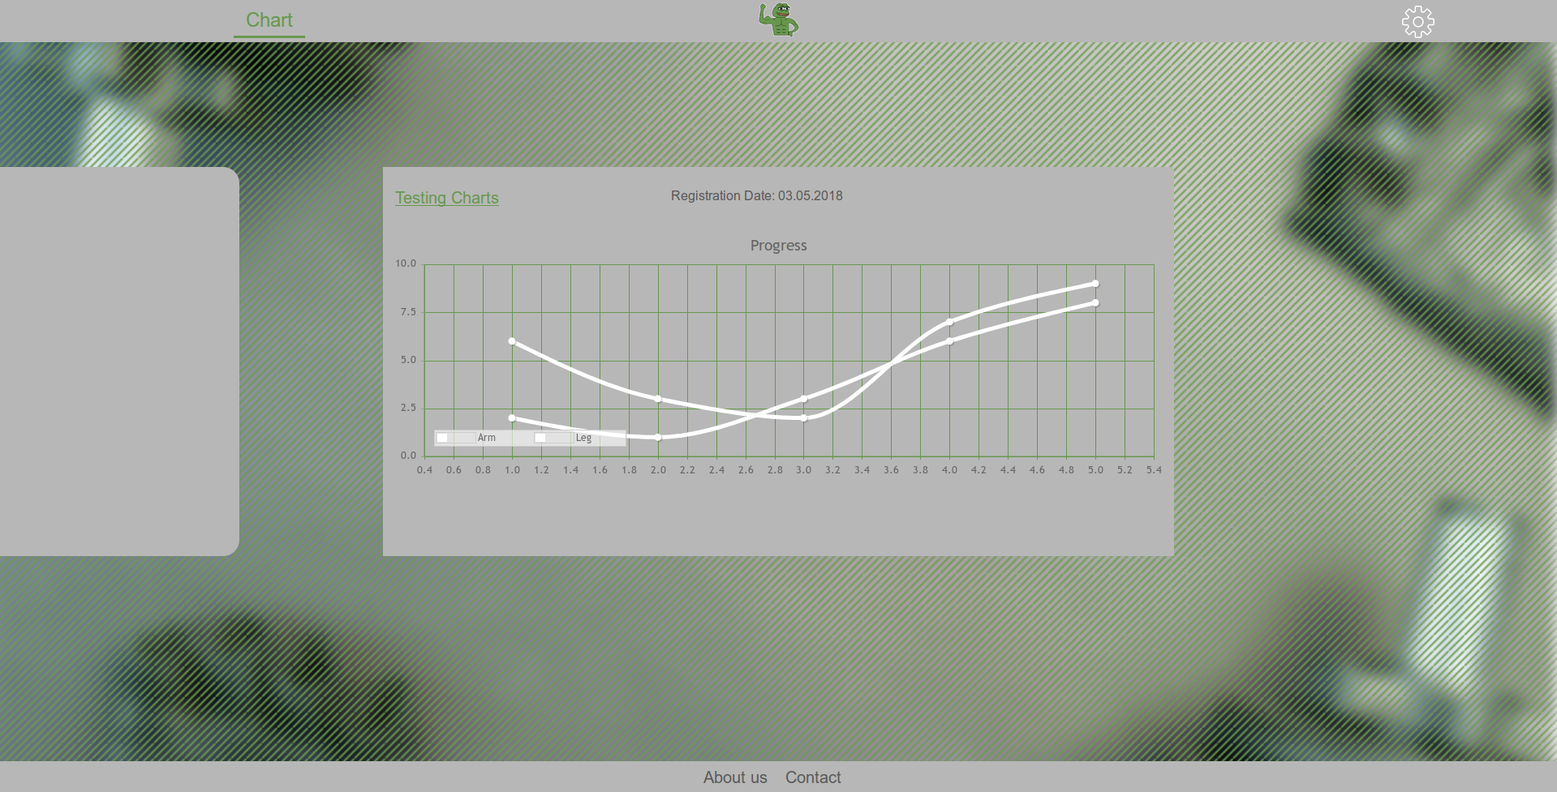

Slide 8
Thanks!

