Slide 1
Socıal Interest clubs
Umut Sunal 21727705
Mehmet Ali Gavcar 21803366
Şafak aplay 21426591
OSMAN FATİH ÇAKIR 21827258
Emirhan SELİM 21827789

Slide 2
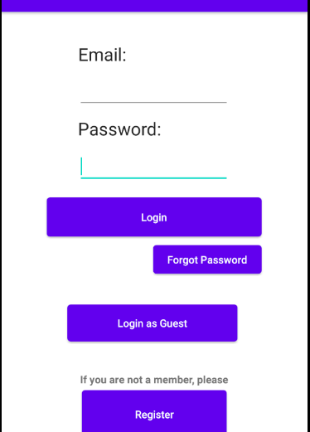
Logın screeN
This is the first screen when the app opens. The user can register, login, reset password from this screen.
The user can login as guest to application.

Slide 3
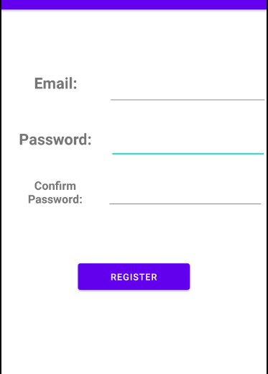
Regıster
The user must open an account in order to have access to many features of the app.
The user only need to have a valid email adress and a password for register.
Creating password has constraints, for instance 6 character min. limit.

Slide 4
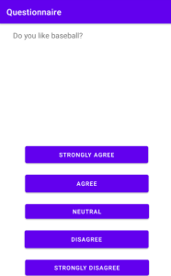
questıonnaıre
The user should answer questions about created clubs.
The app stores the interest rates of each club for current user.

Slide 5
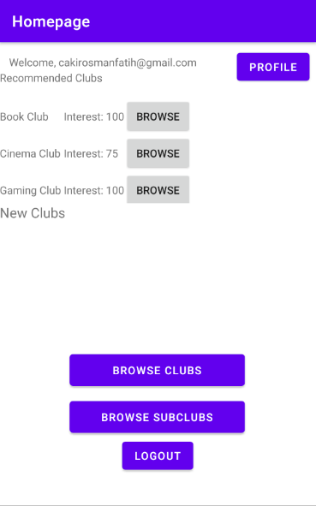
homepages
After registering, the user goes to homepage.
From this panel:
The user can go to profile panel
The user can browse clubs and subclubs
The user can see recommened clubs and interest rates
The user can logout safely.
Unregistered members does not have a profile.

Slide 6
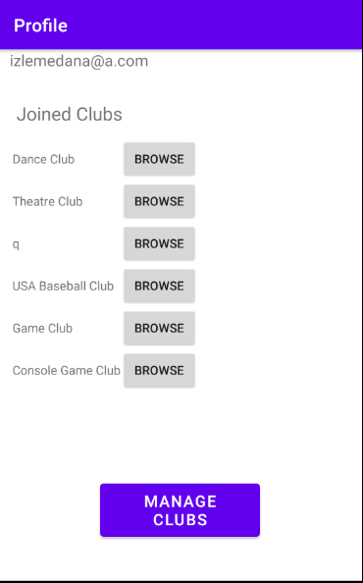
Profıle screen
Admins can manage club and subclubs. They can create/delete/update/see the clubs.
They can also check subclub requests from here.
The users does not have access to manage clubs.
All the users can see clubs that then joined from profile panel.

Slide 7
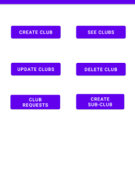
Admın club/subclub management
Admin can create/delete/see/update clubs.
Admin can also see requested clubs from this screen.

Slide 8
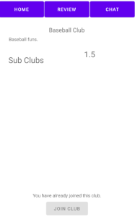
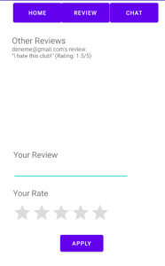
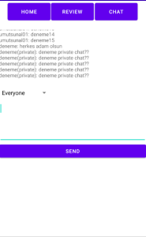
Clubs and subclubs
Each club and subclub has three pages:
Homepage of club/subclub
Review page
Chat page
(Subclubs does not have "Sub Clubs" section)

Slide 9
Thanks for lıstenıng

