Slide 1
Access Methods
Sequential
  Memory is organized in units of data (records)
  Access must be made in linear sequence
  Time to access an arbitrary record is highly variable
  e.g. tape
Direct
  Individual blocks have unique address
  Access is by jumping to vicinity plus sequential search
  Access time depends on location and previous location
  e.g. disk

Slide 2
Access Methods
Random
  Individual addresses identify locations exactly
  The time to access a given location is independent of the sequence of prior accesses (constant)
  e.g. RAM
Associative
  Data is located by a comparison with contents of a portion of the store
  Access time is independent of location or previous access
  e.g. cache

Slide 3
Performance
Access time
  Time between presenting the address and getting the valid data
Memory Cycle time
  Time may be required for the memory to “recover” before next access
  Cycle time is access + recovery (maybe rewrite)

Slide 4
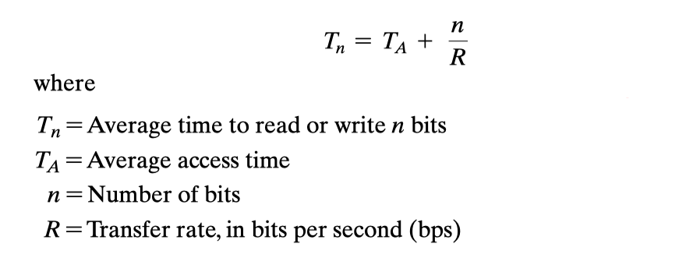
Performance
Transfer Rate
  Rate at which data can be moved

Slide 5
Physical Characteristics
Decay
Volatility
Erasable
Power consumption

Slide 6
Physical Types
Semiconductor
  RAM
Magnetic
  Disk & Tape
Optical
  CD & DVD [& Magneto-optical (MO)]
Others
  Bubble
  Hologram
  ……

