Slide 1
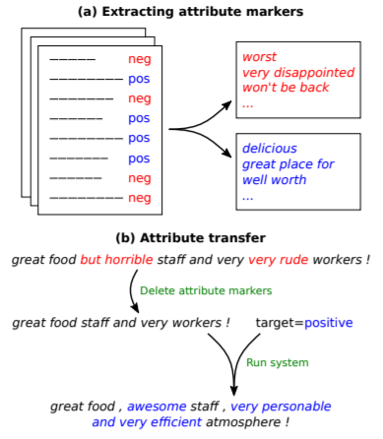
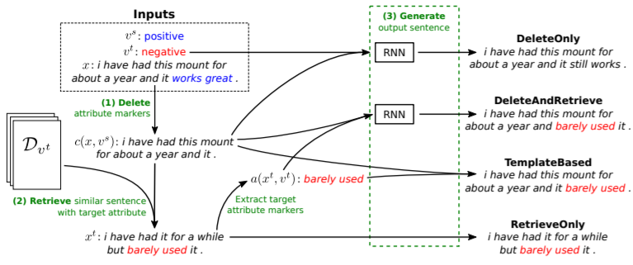
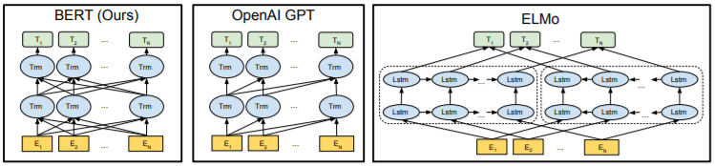
Delete, Retrieve, Generalize
Nathan Dass, David Golub, David Liang
CS 229 Autumn 2018
Stanford University
Computer Science
Motivation
Model
Results
Improve generalization of natural language generation models
Recent advances in text-attribute transfer
Delete Retrieve Generate
Recent advances in sentence embeddings
Deep contextualized word representations (ELMo)
BERT: Pre-training of Deep Bidirectional Transformers for Language Understanding
TODO
TODO
Future Work
TODO
References
[1] Li, Juncen, et al. "Delete, Retrieve, Generate: A Simple Approach to Sentiment and Style Transfer." arXiv preprint arXiv:1804.06437 (2018).
[2] Peters, Matthew E., et al. "Deep contextualized word representations." arXiv preprint arXiv:1802.05365 (2018).
[3] Devlin, Jacob, et al. "Bert: Pre-training of deep bidirectional transformers for language understanding." arXiv preprint arXiv:1810.04805 (2018).

