Slide 1
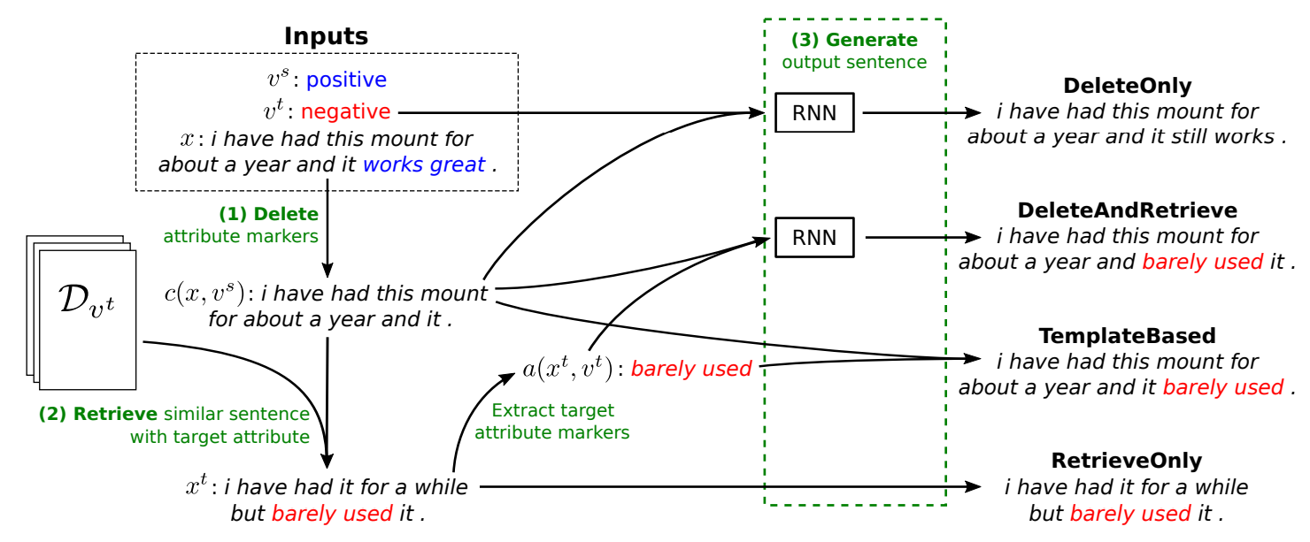
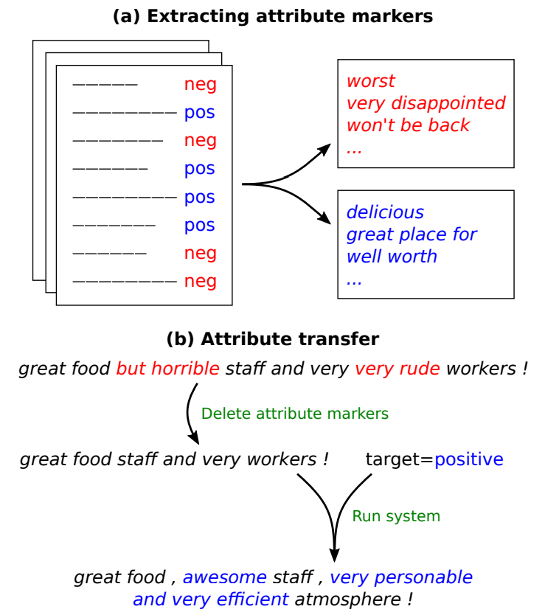
Delete, Retrieve, Generalize
Nathan Dass, David Golub, David Liang
CS 229 Autumn 2018
Stanford University
Computer Science
Motivation
Model
Discussion
Investigate generalization of natural language generation models
Many recent advances in text-attribute transfer
Doesn’t make sense to train a new model to generate or edit sentences that
There should be some knowledge that can be transferred from one domain to another
Delete, Retrieve, Generate
TODO
Results
TODO
Future Work
Replace TF-IDF with sentence embeddings
Deep contextualized word representations (ELMo)
BERT: Pre-training of Deep Bidirectional Transformers for Language Understanding
Data
Amazon, Yelp, image captions, Reddit subreddits
Each dataset has a positive class and negative class
Preprocess the data to determine which text attributes occur more often in one class
References
[1] Li, Juncen, et al. "Delete, Retrieve, Generate: A Simple Approach to Sentiment and Style Transfer." arXiv preprint arXiv:1804.06437 (2018).
[2] Peters, Matthew E., et al. "Deep contextualized word representations." arXiv preprint arXiv:1802.05365 (2018).
[3] Devlin, Jacob, et al. "Bert: Pre-training of deep bidirectional transformers for language understanding." arXiv preprint arXiv:1810.04805 (2018).
Challenges
Research code can be very disorganized, hard to understand, and brittle
Natural language generation is hard!
No good objective evaluation metric

