Slide 1
Software Engineering Project
Group 29
Siddhesh Ayyathan (B22CS016)
Devansh Panchal (B22CS021)

Slide 2
A system that can auto-capture selfie by detecting smile
We have designed an ML model on smile detection using Haar Cascade Algorithm , we deployed the model on website using Flask and StreamLit Framework . We have added features so that user can download image , is notified when selfie is captured .
We have implemented SE approaches such as SRS , Risk Analysis, Software Versioning, Testing and Project Management tools like Gantt Chart

Slide 3
Real Life Applications
Photography and Events: At events like weddings, parties, or corporate gatherings, our software could be integrated into photo booths or event photography setups. It would automatically capture candid and genuine smiles, ensuring that every attendee gets a perfect shot without needing to manually trigger the camera.
Healthcare and Wellness: In healthcare settings, our software could be used for mood tracking and assessment. For example, it could be integrated into mobile apps designed to help individuals manage stress or depression. By analyzing changes in smile frequency over time, users and their healthcare providers could monitor emotional well-being and track progress. It could be incorporated as a activity by counsellors in SWC , corporate offices .
Market Research and User Experience Testing: In market research studies or user experience testing sessions, our software could be used to gauge people's reactions to advertisements, product designs, or user interfaces.We could analyze which stand-up comedian is more hilarious by checking the reaction of their crowd .By analyzing the frequency and intensity of smiles, researchers can gather valuable insights into people's emotional responses.

Slide 4
Some Points about Our Project
As there are many applications ,Our is a Product-line software composed of reusable components and designed to provide specific capabilities for use by different customers.
Currently, our ML model would work on laptops only as different parameters are required for different devices to detect faces , smile optimally
We have used the advantages of distributed version control system , by uploading our code on Github , and verifying each other pull request before merging it into our codebase. This has also helped us in software versioning . Our github link smile-detection_repo
Scalability : We have deployed the ML model locally instead of the Internet . We tried to deploy the ML model using StreamLit as well as Flask Framework .
We have employed Haar Cascade for smile detection as it is computationally inexpensive , easier to implement

Slide 5
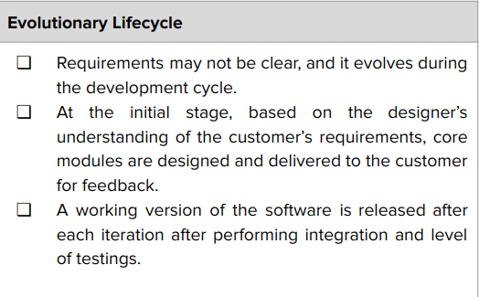
Evolutionary Life Cycle in SDLC process

Slide 6
Software Requirements Specification
We have pasted the link of the initial version and final versions of our SRS , As we were following Evolutionary Life Cycle , our requirements kept changing with time , hence the SRS was updated frequently .
SRS_1.0
SRS_4.0

Slide 7


Software Architecture : - Hybrid Architecture

Slide 8
Why Hybrid Architecture ?
Flexibility: Hybrid architecture allows us to leverage the benefits of both microservices and client-server architecture. We can use microservices for complex backend functions and while utilizing client-server architecture for interactive user interfaces and real-time communication.
Modularity: By separating client-side and server-side components, we promote modularity and maintainability. Changes or updates to one component can be made without affecting the other, facilitating easier maintenance and development.
Development Agility: By decoupling the client and server components, me and Devansh can work independently on frontend and backend development. This promotes faster iteration cycles

Slide 9
Machine Learning Model
We have used two ML models:
1. Haar Cascade for Face Detection: This model is specifically trained to detect faces in images. It is a machine learning-based approach where a cascade function is trained from a lot of positive and negative images. It is then used to detect objects (faces) in other images.
2.Haar Cascade for Smile Detection: Similarly, this is a pre-trained model used to detect smiles within the regions identified as faces from the previous model.
These are not deep learning models but rather machine learning models based on the Haar features which were traditionally used in computer vision before the advent of deep learning techniques.

Slide 10
Basic Functionality
The frames from the webcam are fed to the model which if classifies the frame has a face then further smile is tested. If smile is also detected, then the frame is downloaded as a ‘jpg’ file.
To integrate this software with webpage, we used Flask framework. We initially used Streamlit but it was sluggish,used to disrupt the layout of the page so we switched to Flask.

Slide 11
Tuning of Parameters through manual testing
These were the optimal parameters which we had obtained for detectMultiScale Function . I had assumed the optical/typical distance between the integrated camera from laptop face is approximately 50 cm .
scale factor which specifies how much the image size is reduced at each image scale. Using a value of 1.1 means we reduce the size of the image by 10%
minNeighbors number of neighbors each window should have to retain it
minSize : minimum possible object size of the image

Slide 12
Project Management

Slide 13
Risk Analysis
Privacy Breach (1)
ML Model Inaccuracies (2)
Performance Decline with Time (3)
Data bias (4)
Hardware Compatibility (5)
Legal Compliance (6)
Resource Intensiveness (7)
Accessories (8)
Psychological Impact (9)
Cultural Sensitivity (10)
Monitoring and updates all the time (11)
Testability (12)
Server Maintenance (13)

Slide 14
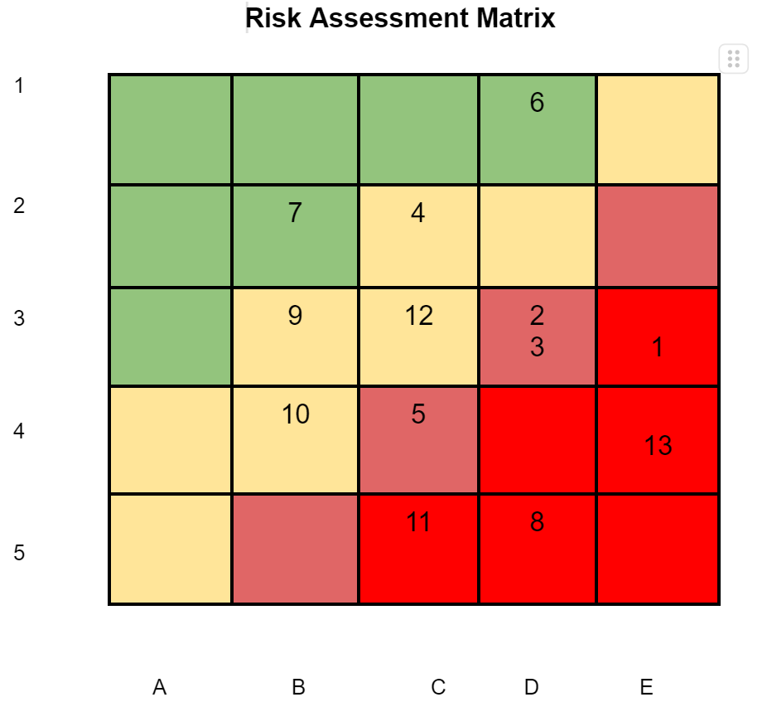
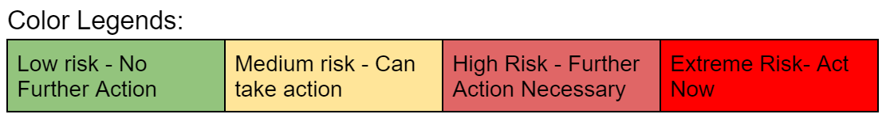
Likelihood | Consequences
1- Unlikely | A- Insignificant
2- Seldom | B- Marginal
3- Occasional | C- Moderate
4- Likely | D- Critical
5- Definite | E- Catastrophic

Slide 15
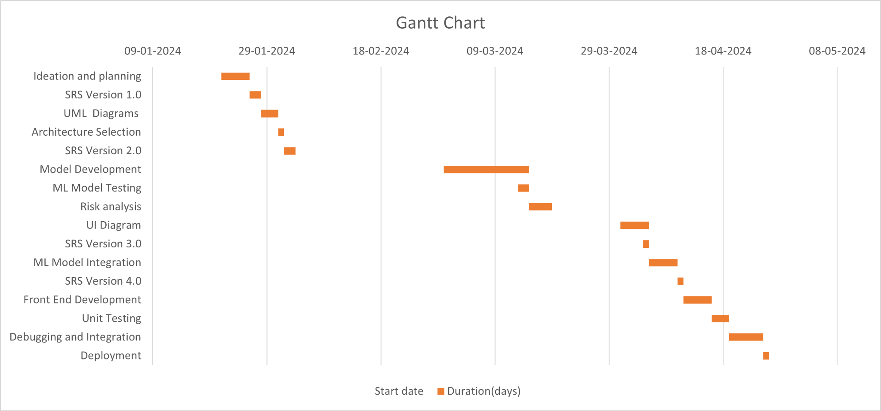
Gantt Chart

Slide 16
Software Metrics
Lines of Code (LOC): Final version:
index.html - 87 lines
script.js - 80 lines
app.py - 61 lines
For ML Model : 50 LOC ; Using StreamLit : 130 LOC ;
Cycolmatic Complexity : 4 Using StreamLit
COCOMO: We would define our project in the category organic as team size required is adequately small, the problem is well understood and has been solved in the past .

Slide 17
Software Versioning
Version 1.0.0 : Final ML model deployed, until stopped by user the model keeps running
Version 1.1.0 : URL for downloading images added , model automatically stopped
Version 1.2.0 : FavIcon added to the webpage
Version 2.0 : Used Flask framework instead of Streamlit
Version 2.1: Enhanced the model parameters, finishing and styling added

Slide 18
Testing
After integrating the ML model we would employ system testing before adding styling to the website to ensure that it is properly integrated and resolve issues if they arise
After adding features , we would run our code to check whether it has affected the working of our previous code and if it has been integrated to our code .
ML model testing : As explained in the earlier section we would manually test our model to change the parameters of detectMultiScale function . We would perform partition testing to find the optimal parameters , keeping the face at absurd distances to the camera and check the responses by the ML model .

Slide 19
Challenges Faced Vs Solution
Streamlit used to elongate our website , multiple image frames used to be posted on the website | Switched to Flask Framework
False Positives being detected | Reduced by optimizing our parameters
User wasn’t alerted if they were standing far away from the computer screen | User is alerted to stay closer to the screen
Images were being clicked during smile transition | 1 second delay has been added so that smile transition takes place

Slide 20
Thank You !!!

