Slide 1
GlucoTwin
A digital twin that warns people with Type 2 Diabetes of a blood-sugar spike two hours before it happens
Sarah Dhamija and Yashas Tarakaram
Team I Dont Think We Can Code | XLRI, PGD-BM 2025–27
Happiest Health Reimagining and Reforming Healthcare in India Summit 2026, Bengaluru
Notes:
Hello, we are Sarah and Yashas from XLRI. Our team name is honest: neither of us had written code before this challenge. In the next few minutes we'll show you GlucoTwin, a digital twin for people with Type 2 Diabetes that predicts blood-sugar spikes two hours before they happen, explains why, and lets a doctor test what would prevent them.

Slide 2



Spikes are discovered after the damage is done
101 million
Spikes above 180 mg/dL after meals
Over years they damage blood vessels, nerves, eyes and kidneys.
Indians live with diabetes, and 136 million more have prediabetes (ICMR-INDIAB study, 2023)
Common with carb-heavy Indian meals
Rice-heavy lunches and late dinners push glucose up daily.
Found out too late
A glucometer reading or a lab report weeks later, not a warning beforehand.
What if the warning came two hours before the spike, while there is still time to act?
GlucoTwin | I Dont Think We Can Code, XLRI
2
Notes:
India has around 101 million adults with diabetes. After a heavy meal, glucose often shoots above 180, and repeated spikes damage the body over years. The problem is timing: patients only find out after the spike, from a finger-prick or a lab test. We asked: what if the warning came two hours earlier?

Slide 3




One virtual copy of each patient that does three things
Predict
Explain
Simulate
Every 15 minutes: the chance that glucose crosses 180 mg/dL in the next 2 hours.
The reasons in plain language, e.g. 95 g of carbs 40 minutes ago, no walk, 5 hours of sleep.
What happens if the patient walks for 30 minutes or halves the rice? See the curve before it happens.
Built for diabetologists and primary-care doctors who monitor many patients remotely; a patient app is the next step.
GlucoTwin | I Dont Think We Can Code, XLRI
3
Notes:
GlucoTwin keeps a virtual copy of each patient. It does three things. Predict: every 15 minutes it estimates the chance of a spike in the next two hours. Explain: it tells the doctor why, in plain language. Simulate: the doctor can test changes, like a walk or a smaller meal, and see the effect before it happens.

Slide 4
The twin fuses two data streams
All 100 patients are synthetic, as the challenge requires (DPDP Act, HIPAA)
Health record
Wearables
Static, from the hospital file
Dynamic, every 5 minutes for 14 days
Age, sex, BMI, years with diabetes
HbA1c, fasting glucose, cholesterol, creatinine
Medication, blood pressure, past diagnoses
Family history and TCF7L2 genetic risk marker
Diet pattern and activity level
Continuous glucose monitor
Heart rate and steps
Sleep stages: light, deep, REM
Overnight heart-rate variability
Meals logged in an app (carbs)
Twin
GlucoTwin | I Dont Think We Can Code, XLRI
4
Notes:
The challenge asks us to fuse two streams. The health record is the static side: who the patient is, their labs, medicines and even a genetic marker, TCF7L2, the strongest known genetic risk factor for Type 2 Diabetes. The wearable side is dynamic: glucose every five minutes, heart rate, steps, sleep stages and logged meals. All of it is synthetic, as the rules require.

Slide 5
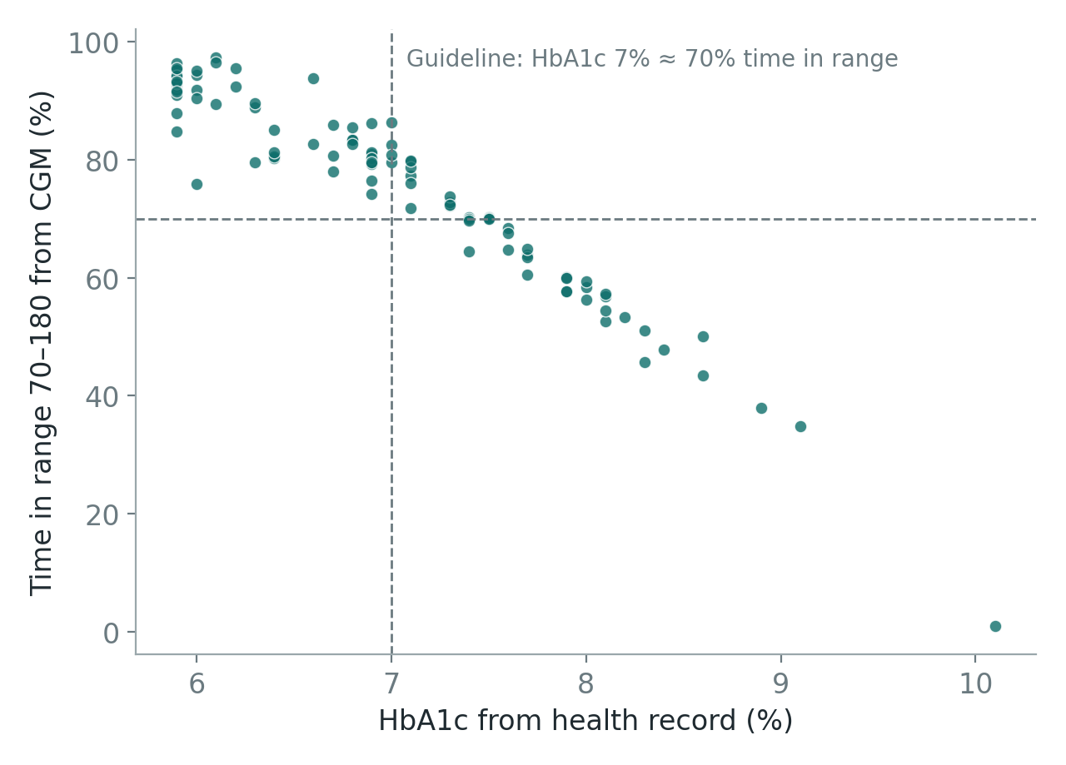
Synthetic, but behaving like real patients
Indian routines
Rice or wheat diets, heavy lunch, evening chai, late dinner, weekend and festival meals.
Real-life mess
15% of meals unlogged, portions misjudged by ±20%, sensor noise and signal gaps.
Checked against medicine
Average glucose matches the ADAG formula from HbA1c; time in range vs HbA1c correlation −0.96; median 5,200 steps and 6.8 h sleep.
Health records and wearable data agree: patients with worse HbA1c spend less time in the healthy range.
GlucoTwin | I Dont Think We Can Code, XLRI
5
Notes:
We didn't just generate random numbers. Each patient has a hidden physiology, an Indian daily routine and realistic mess: forgotten meal logs, misjudged portions, sensor gaps. Then we checked the data against clinical benchmarks. This chart shows the hospital record and the wearable data agree: higher HbA1c means less time in the healthy range, just as international guidelines describe.

Slide 6
How it works: a hybrid twin with two engines
1 Data sources
2 Processing
3 Twin engines
4 Doctor dashboard
Health record (EHR)
Age, BMI, HbA1c, medication, BP, lipids, diagnoses, TCF7L2 gene
Clean
Cap readings to 40–400 mg/dL; fill sensor gaps up to 30 min
Engine 1: Early warning
LightGBM, 400 trees, trained on 60 patients. Every 15 min: spike risk %, alert at 60% or more. TreeSHAP gives the reasons.
Ward overview
All patients ranked by spike risk, like a triage board
Wearable stream, every 5 min
Glucose monitor, heart rate, steps, sleep stages, meal log
Build 53 features from past data only
Wearable 28, EHR 20, twin memory 5 (this patient's own history), time of day. Nothing from the future is ever used.
Patient twin
Record, risk gauge, 24-hour timeline, why the twin thinks so, what-if sliders, reveal what actually happened
Daily summary
Sleep hours, deep sleep, overnight HRV
Engine 2: What-if simulator
4 personal parameters (baseline, carb response, clearance, walk effect) refitted to the last 3 days. 3-hour forecast for any meal or walk.
Future: real devices
CGM and watch APIs, consent-based ABDM health records
Label (training only)
Did glucose exceed 180 mg/dL in the next 2 hours?
How well it works
Model comparison and data-source influence
Evaluation: split by patient 60 train / 10 validation / 30 test; AUROC, spikes caught, warning time, false alarms per day. Deployment: Colab notebooks (seeded, reproducible) → GitHub → Streamlit Community Cloud. Synthetic data only (DPDP Act, HIPAA).
GlucoTwin | I Dont Think We Can Code, XLRI
6
Notes:
Here's the architecture. On the left, the two data streams. They are cleaned and turned into 53 features, using only past data. Then two engines. Engine one is machine learning for early warning. Engine two is a small physiology model personalised to each patient, for what-if questions. Both feed the doctor dashboard on the right. Everything is reproducible and deployed online.

Slide 7


Engine 1: early warning, tested honestly
28
20
Tested on 30 patients it never saw
Split by person: 60 train, 10 to set the alert level, 30 test.
Wearable clues
Health record
Glucose now and its trend, recent carbs, steps, heart rate, last night's sleep and HRV
HbA1c, BMI, medication, blood pressure, lipids, kidney function, genetics
No peeking at the future
Only data available at that moment; today's total steps are never used.
5
LightGBM
Warns before, not after
Twin memory
Model
How much this patient's glucose usually rises per gram of carbs, learned from their own past
400 decision trees; TreeSHAP explains every single prediction
No predictions while glucose is already above 180.
GlucoTwin | I Dont Think We Can Code, XLRI
7
Notes:
The early-warning engine uses 53 clues in three groups: wearable clues, the health record, and twin memory, which is what this specific patient's body usually does after a meal. We tested it honestly: on 30 patients it never saw during training, using only data available at that moment, and only warning while glucose is still below 180, because warning about a spike that has already started is useless.

Slide 8
Fusing both streams beats either one alone
AUROC on 30 unseen patients (0.5 = coin toss, 1.0 = perfect)
97%
of spikes flagged in advance
~95 min
median warning before glucose crosses 180
0.7
false alarms per patient per day
GlucoTwin | I Dont Think We Can Code, XLRI
8
Notes:
This is the key result. A simple clinical rule scores 0.57, barely better than a coin toss. The health record alone scores 0.63. Wearables alone 0.93. Fusing both with the twin's memory scores highest, 0.94. In doctor terms: 97% of spikes flagged in advance, a median of about 95 minutes of warning, and fewer than one false alarm per patient per day, which matters because too many alarms make people ignore them.

Slide 9
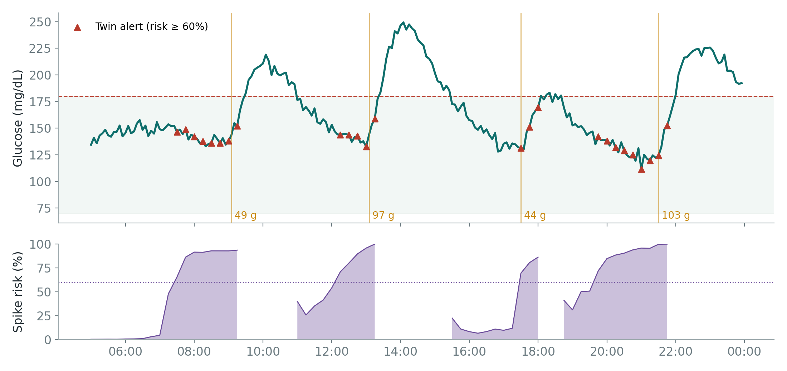
A day in the life of patient P077
Red triangles: twin alerts. Orange lines: logged meals. The alerts come before each crossing of 180.
GlucoTwin | I Dont Think We Can Code, XLRI
9
Notes:
Here is one unseen patient's day. The purple area is the twin's risk score. Before breakfast, lunch, the evening snack and dinner, the risk climbs above 60% and the twin raises an alert, shown as red triangles, well before the glucose line crosses 180. Gaps in the risk chart are when glucose is already high and no warning is needed.

Slide 10
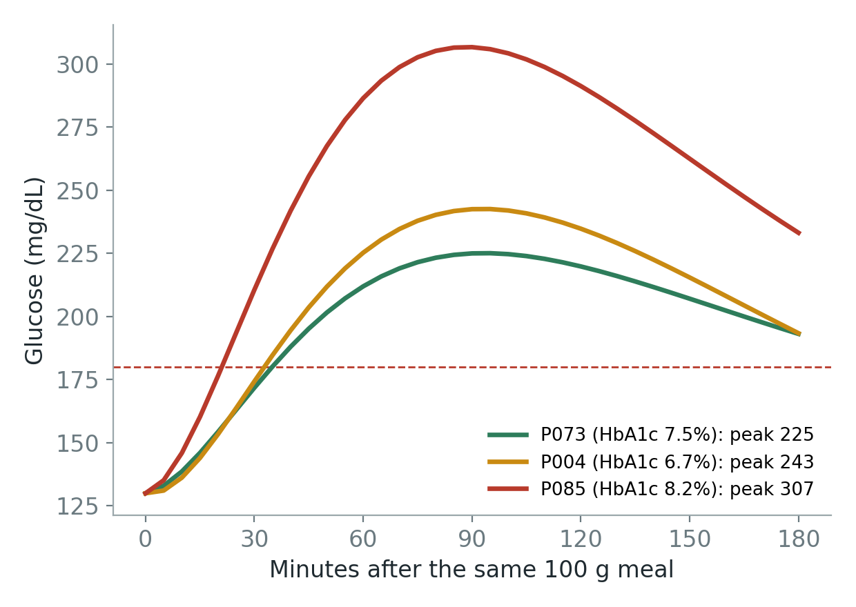
Same meal, different bodies: why each patient needs a twin
The twin learns four facts about each body from the last 3 days
Normal glucose level
Rise per gram of carbs
How fast sugar is cleared
How much walking helps
P004 has a better HbA1c than P073, yet spikes higher after the same 100 g meal. A lab report alone would miss this; the twin doesn't.
GlucoTwin | I Dont Think We Can Code, XLRI
10
Notes:
This slide shows why a personal twin matters. Three patients, the same 100-gram meal, very different curves. Surprisingly, P004 has a better HbA1c than P073 but spikes higher. You can't see this from a lab report. The twin learns four facts about each body from its own recent data, so it knows.

Slide 11
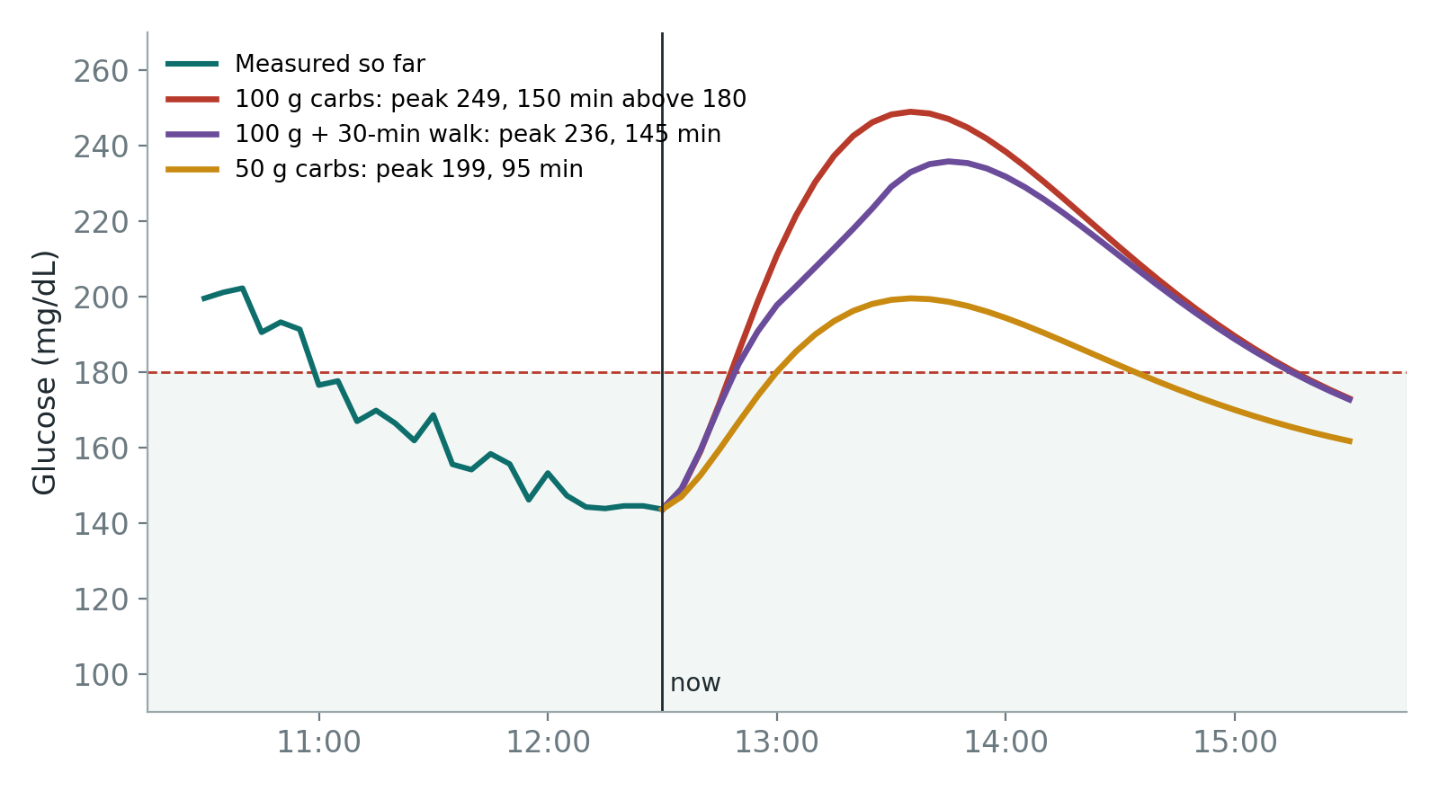
Engine 2: the what-if simulator
Patient P077 at 12:30, just before lunch
Forecast accuracy on 30 unseen patients
12 mg/dL
typical error 1 hour ahead (vs 23 if you assume no change)
14 mg/dL
typical error 2 hours ahead (vs 37)
Why a physiology model? Machine learning finds patterns; it can't be trusted to answer "what would happen if…". A small model of the body can.
GlucoTwin | I Dont Think We Can Code, XLRI
11
Notes:
The second engine answers what-if questions. At 12:30, before lunch, the doctor can see that a 100-gram lunch would push this patient to about 250 and keep them above 180 for over two hours. Halving the carbs keeps the peak near 200. The simulator's forecasts are off by about 12 milligrams per decilitre one hour ahead, half the error of assuming nothing changes. We used a physiology model here because machine learning finds patterns, but can't be trusted with cause and effect.

Slide 12
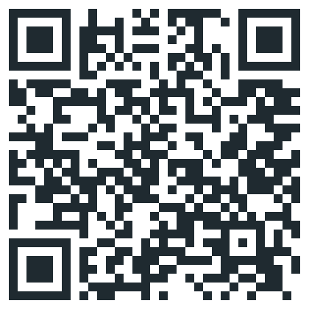


The doctor dashboard is live
idontthinkwecancodexlri.streamlit.app
Ward overview
All patients ranked by spike risk, like a triage board.
Patient twin
Health record, risk gauge, 24-hour timeline, and why the twin thinks so.
What if…
Meal and walk sliders with a 3-hour forecast; reveal what actually happened.
How well it works
Model comparison and which data sources drive decisions.
Scan to try it yourself. No installation, works on a phone.
Clinic clock
Replays 14 days as if live; the twin only ever sees the past.
GlucoTwin | I Dont Think We Can Code, XLRI
12
Notes:
Everything you've seen is in a live dashboard that anyone can open. The ward overview ranks patients by risk. The patient view shows the record, the risk, the reasons and the what-if simulator. A clinic clock replays two weeks as if live. Please scan the code and try it.

Slide 13



Built to be trusted by doctors
Unseen patients
No future data
Alarm fatigue measured
All results come from 30 people the model never trained on.
Every prediction uses only what was known at that moment.
Under 1 false alarm per patient per day at the chosen alert level.
Explainable
Actionable
Privacy by design
Every risk score shows its top reasons, labelled by data source.
What-if forecasts turn a warning into a concrete choice: walk, eat less, or both.
Synthetic data only; ready for consent-based ABDM records later.
GlucoTwin | I Dont Think We Can Code, XLRI
13
Notes:
We made design choices so a doctor could trust this. Results only on unseen patients. No future data. False alarms measured, not ignored. Every prediction explained. Every warning paired with an action. And privacy by design.

Slide 14
Honest limits, and the road to real patients
What we know it can't do yet
Next steps
Synthetic patients follow steadier routines than real people, so the twin partly anticipates meals from the time of day.
Real-world accuracy will be lower than on synthetic data.
What-if forecasts are decision aids, not treatment instructions.
Validate on public CGM datasets (OhioT1DM, Shanghai T2DM).
Stress-test with irregular routines and unlogged meals.
Pilot with a diabetes clinic, doctor in the loop.
Connect to affordable CGMs and ABDM health records.
Patient app with nudges in Indian languages.
GlucoTwin | I Dont Think We Can Code, XLRI
14
Notes:
We want to be honest about limits. Our patients are synthetic and more regular than real people, so real-world accuracy will be lower. What-if forecasts support conversations, not prescriptions. Our next steps: validate on public glucose datasets, stress-test with messy routines, pilot with a clinic, and connect to affordable sensors and India's ABDM health records.

Slide 15
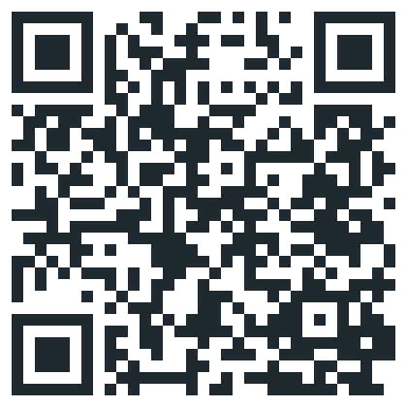
Thank you
Sarah Dhamija | Yashas Tarakaram
Team I Dont Think We Can Code, XLRI
Live dashboard: idontthinkwecancodexlri.streamlit.app
Code: github.com/b25474-sudo/IDontThinkWeCanCode_XLRI
Dashboard
GitHub
Notes:
Thank you. Both links are on screen, and we're happy to take questions.

