Slide 1
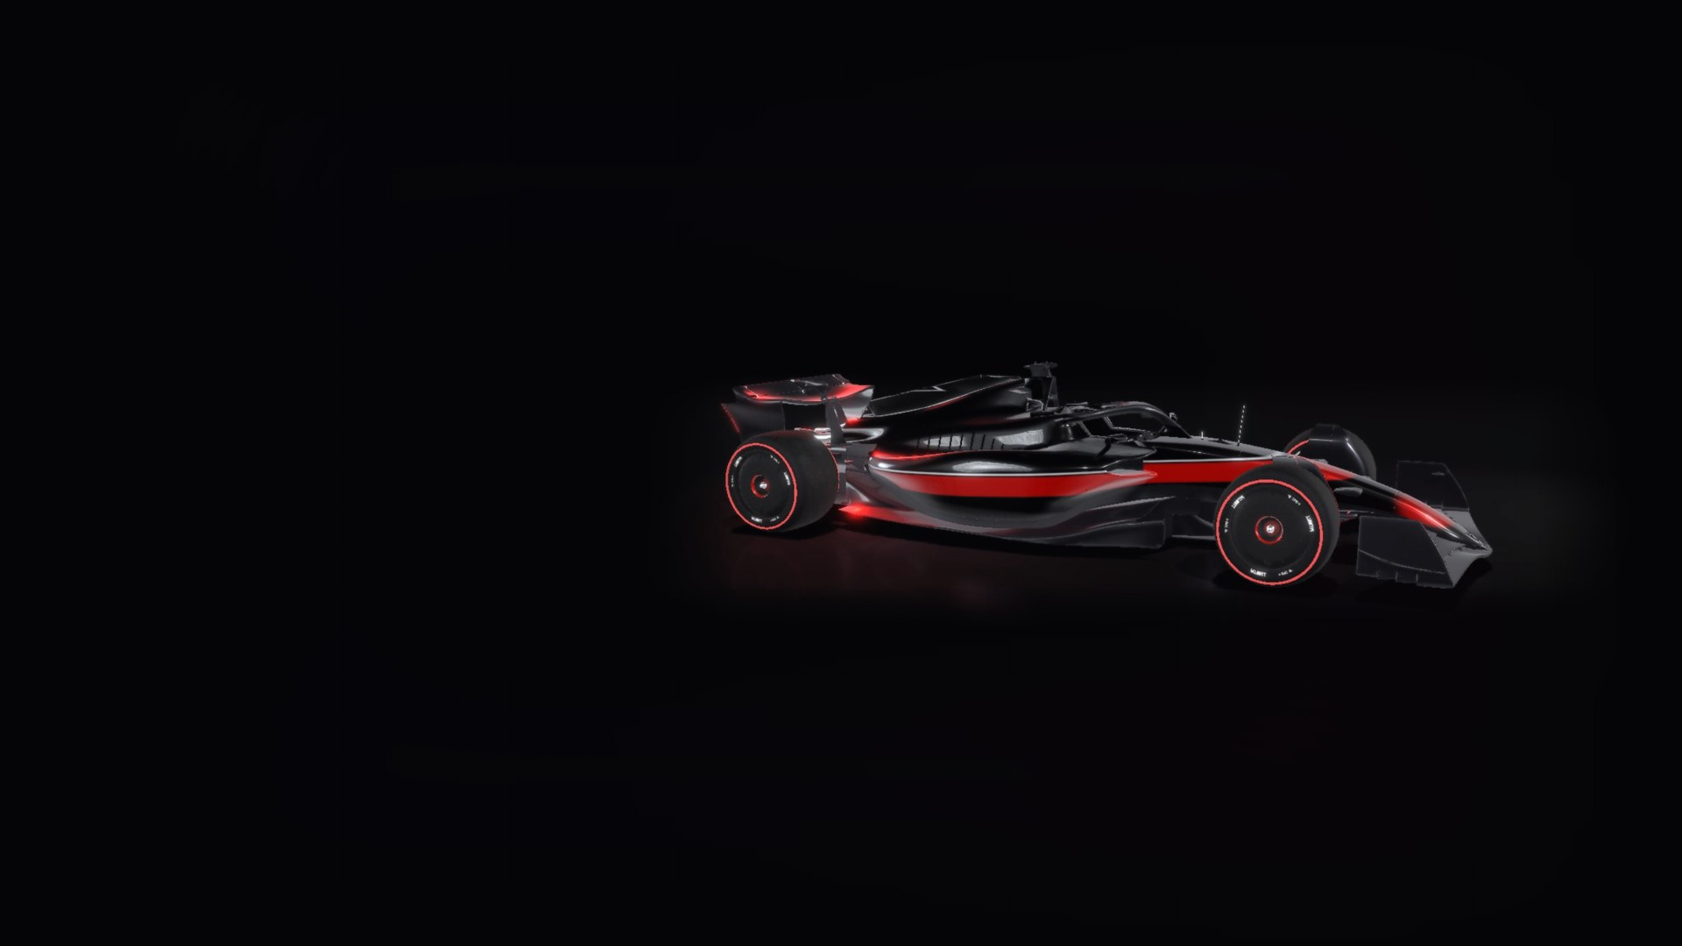
F1 STRATEGY ENGINE · FASTF1 DATA 2021-2025
PITWALL
Predicting lap times, tyre wear and the pit call from 125,046 laps of Formula 1.
LAP TIME
TYRE WEAR
BOX OR STAY OUT
WHAT IF
ARNAV YADAV · 2026-10-06
// PITWALL · LIGHTS OUT
LAP 01 / 20
Notes:
Pitwall answers the question a Formula 1 pit wall asks every lap: box now, or stay out? It predicts lap times, models how tyres wear, measures what a stop costs and makes the call, trained on every race from 2021 to 2025. This is the story of how it works, how it failed, and how it evolved.

Slide 2

THE QUESTION
EVERY LAP, ONE QUESTION.
“Box, or stay out?”
SCHEMATIC · THE INTUITION
BOX
A pit stop costs about 22.6 seconds. Old tyres cost a little more every lap. The pit wall has to find the lap where fresh tyres win back more than the stop costs, knowing a Safety Car could make the stop almost free.
PIT STOP · 22.6 S
time lost to worn tyres,
added up lap by lap
01
02
03
PREDICT
MODEL
DECIDE
the lap time
the tyre
the call
LAPS ON THIS SET →
The engine solves the whole remaining race, Safety Car odds included.
// PITWALL · THE QUESTION
LAP 02 / 20
Notes:
Every lap the tyres get a little slower, and a stop costs about 22.6 seconds. The pit wall's job is finding the lap where fresh tyres win back more than the stop costs, while a Safety Car can make a stop nearly free. So the project has three jobs: predict the lap time, model the tyre, decide the call.

Slide 3
THE DATA
FIVE SEASONS. ONE HONEST TEST.
114
125,046
26
5
RACES
LAPS
CIRCUITS
SEASONS · 2021-2025
FIT · 2021-2023
TUNE · 2024
TEST · 2025
Model parameters learned only from these three seasons.
Every knob, threshold and prior chosen here.
Touched once, after everything was frozen.
Every lap kept: in-laps, out-laps and Safety Car laps are exactly what a pit-stop model needs. Representative laps (90,709) are flagged for fitting pace.
// PITWALL · THE DATA
LAP 03 / 20
Notes:
Every race from 2021 to 2025 from FastF1 timing, rebuilt offline: 114 races and 125,046 laps. Unlike v1, every lap is kept, including in-laps, out-laps and Safety Car laps, because those are exactly what a pit-stop model needs. The split is by whole seasons: fit on 2021 to 2023, tune on 2024, and score 2025 exactly once at the end.

Slide 4
ACT I · V1 · JULY TO SEPTEMBER 2026
IT LOOKED GREAT.
RIDGE REGRESSION ON LAP TIME · 71 FEATURES
SAME MODEL, CIRCUIT AND DRIVER REMOVED
R² 0.91
R² 0.02
on the 2024 dev season. RMSE about 3.5 s.
It knew Monaco laps are slow. It knew nothing about tyres.
DUPLICATED RACES
ROUND_NUMBER CORRUPTED
TYRE AGE BACKWARDS
inflated an earlier R² to 0.948
in 82% of training rows
−0.0045 s per lap older
// PITWALL · ACT I · V1
LAP 04 / 20
Notes:
Version 1, July to September 2026: a Ridge regression on absolute lap time scored R squared 0.91 on the 2024 dev season. It looked great. Then the ablation: remove circuit and driver and it collapses to 0.02. It had learned that Monaco laps are slow, not how tyres wear. The tyre-age coefficient even came out backwards. Along the way the data had duplicated races, which had inflated an earlier score to 0.948, and a round_number column corrupted in 82 percent of training rows.

Slide 5
ACT II · THE REBUILD
GIVE EVERY DRIVER THEIR OWN PACE.
Each driver in each race gets a base pace, so tyres and fuel are learned only from changes inside that race. That was the step v1 was missing.
01
02
03
04
05
06
BASE PACE
COMPOUND
FUEL
TYRE WEAR
TEMPERATURE
TRAFFIC
per driver, per race
soft / medium / hard
per kg on board
by tyre age
track temp × age
car ahead within 1 s
free
3 levels
0.0333 s
6 knots
faster wear
+0.41 s
car + driver + track today
global → circuit → race
per kg per 90 s lap
0, 4, 10, 18, 28, 40 laps
when the track is hotter
per lap; +0.20 s at 1-2 s
lap time = base[driver, race] + L · ( compound + 0.0333·fuel + wear(age) + age·(temp + circuit + race) + traffic )
One penalised least-squares fit, about 2,500 parameters, solved in closed form. Gaussian priors shrink thin data toward the circuit, then the global value. L scales everything to a 90 s lap. Lap-to-lap noise: 0.41 s.
// PITWALL · ACT II · THE REBUILD
LAP 05 / 20
Notes:
The rebuild starts with one idea: give every driver in every race their own base pace. Then the model never needs tyre or fuel terms to explain why one car or one track is faster, and tyre wear and fuel are learned only from changes within a driver's race. Every other term has a physical meaning: compound offsets shrunk from global to circuit to race, fuel, a piecewise-linear wear curve, temperature times age, and traffic. It is one penalised least-squares fit with about 2,500 parameters, solved in closed form.

Slide 6
THE TRICK
THE PIT STOP SPLITS FUEL FROM WEAR.
Inside one stint, fuel falls and tyre age rises together, lap for lap. You cannot tell them apart.
At a pit stop the tyres reset to zero but the fuel keeps falling. That break is where the model learns each effect.
FUEL LOAD
PIT
PIT
fuel keeps falling
0.0333 s/kg
TYRE AGE
About 0.058 s per lap of fuel burned: inside the range quoted for current F1 cars.
tyres reset to zero
LAP 1 → 57
// PITWALL · THE TRICK
LAP 06 / 20
Notes:
Inside one stint, fuel falls and tyre age rises together, lap for lap, so you cannot tell them apart. At a pit stop the tyres reset to zero but the fuel keeps falling. That break is where the model separates the two. The learned fuel effect, 0.0333 seconds per kilogram, about 0.058 seconds per lap, sits inside the range quoted for current F1 cars, which is the main sanity check that the separation worked.

Slide 7
WHAT THE TYRES DO
WEAR, MEASURED.
Time lost per lap against a fresh set of the same compound, fuel removed. Fitted on all seasons.
SOFT
+1.72 s
per lap at 30 laps old
MEDIUM
+2.00 s
per lap at 30 laps old
HARD
+1.59 s
per lap at 30 laps old
TRAFFIC
+0.41 s
per lap, within 1 s of a car
// PITWALL · WHAT THE TYRES DO
LAP 07 / 20
Notes:
These are the learned wear curves, fuel removed, as time lost against a fresh set of the same compound. At 30 laps old a soft costs about 1.7 seconds a lap, a medium about 2.0 and a hard about 1.6. Running within a second of the car ahead costs another 0.41 seconds a lap. Beyond the 95th-percentile stint length at each circuit the optimiser adds a cliff penalty rather than trusting the extrapolation.

Slide 8
WHAT A STOP COSTS
22.6 SECONDS. UNLESS THE SAFETY CAR IS OUT.
GREEN FLAG
22.6 s
SAFETY CAR RISK · PER-CIRCUIT MARKOV CHAIN
100% of a green stop
VIRTUAL SAFETY CAR
13.3 s
GREEN
59% of a green stop
1.2% per lap
mean 4.1 laps
0.95% per lap
mean 2.1 laps
SAFETY CAR
1.9 s
9% of a green stop
↑ how teams treat it: about 50%
SC
VSC
Green: in-lap + out-lap minus the two laps the model expected. 1.53 s error per stop vs 2.16 s for a fixed 22 s (465 stops).
Safety Car: gap to the leader three laps later, against cars that did not stop.
Shrunk toward the global rate with a 200-lap prior.
// PITWALL · WHAT A STOP COSTS
LAP 08 / 20
Notes:
Pit loss is measured, not assumed: for every real stop, the in-lap plus out-lap minus what those laps would have taken without stopping. That is 1.53 seconds of error per stop against 2.16 for a fixed 22 seconds. Under a Safety Car a lap-time comparison is misleading because the queue gives the time back, so those stops are measured by the gap to the leader three laps later against matched cars that did not stop. An SC stop costs 9 percent of a green one, a VSC stop 59 percent, but teams behave as if an SC stop costs about half, because track position is hard to win back.

Slide 9
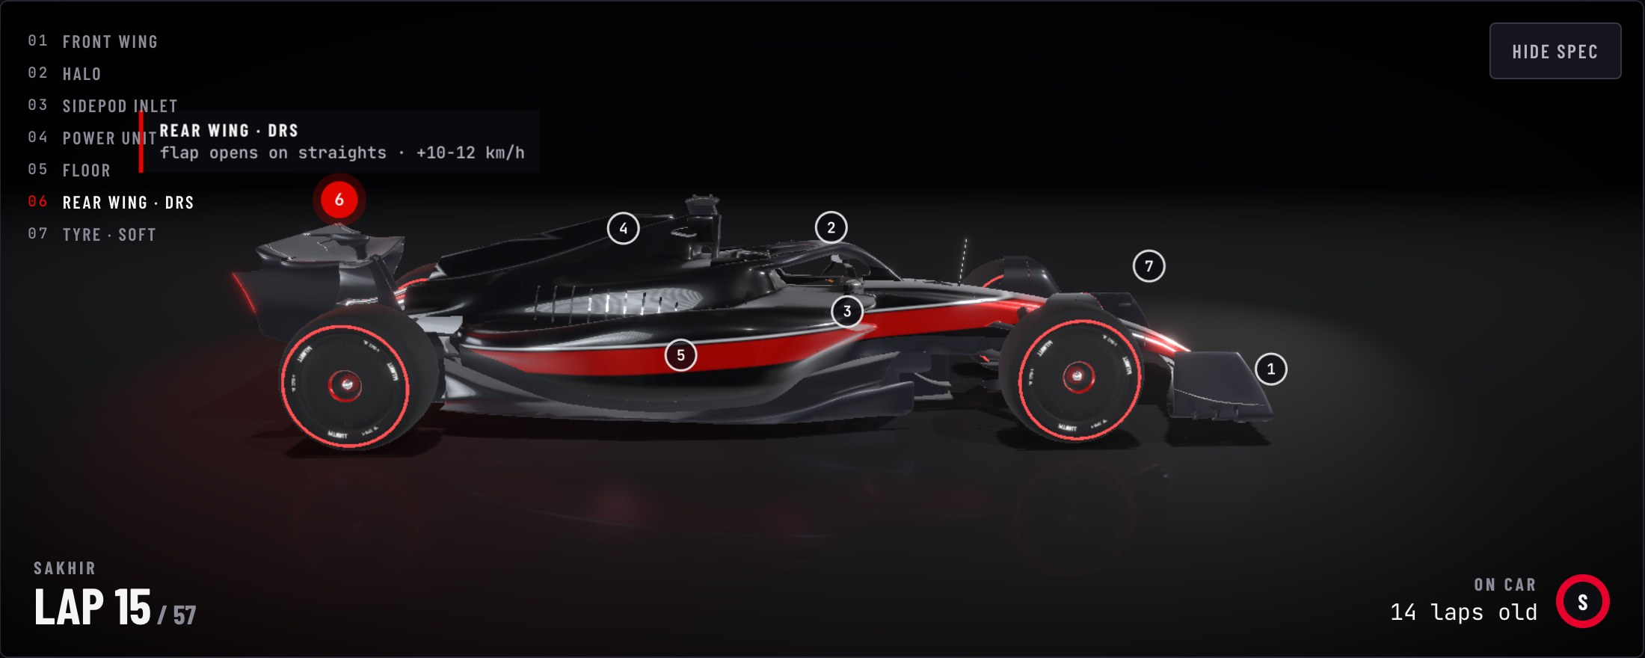
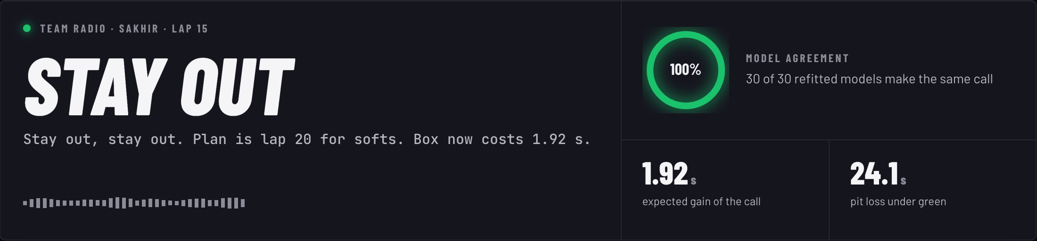
THE CALL
SOLVE THE REST OF THE RACE BACKWARDS.
STATE lap 15 · soft · 14 laps old · green
STAY OUT
BOX
lap on worn tyres
+ best future from age + 1
lap + pit loss(status)
+ best future on a fresh set
CALL the cheaper branch · then 30 refits vote
The Pit Wall view: the call as team radio, 30-model agreement, the time it is worth. The browser runs a line-for-line port of the optimiser, tested against Python.
Safety Car states follow the circuit's chain, so staying out for a cheap stop has value. No finish without two compounds. Past the 95th-percentile stint, a cliff penalty instead of extrapolation.
// PITWALL · THE CALL
LAP 09 / 20
Notes:
The call comes from a stochastic dynamic programme. At each lap the state is the compound, tyre age, whether two compounds have been used, and the track status. Working backwards from the flag, it computes the best expected remaining race time from every state, staying out or pitting. Safety Car states follow the circuit's chain, so it values staying out for a cheap stop. 30 refits of the tyre model on resampled races vote, which gives the agreement ring. The same optimiser runs in the browser, and a test checks it makes the same calls as Python.

Slide 10
RESULTS · 2025, NEVER SEEN IN FITTING
45% LESS ERROR THAN THE OBVIOUS GUESS.
LAP-TIME ERROR DURING A RACE · SECONDS (MAE)
0.446 s
1.556 s
1-5 LAPS AHEAD
BEFORE THE RACE
error forecasting the next few laps
v1 Ridge: 1.708 s · R² 0.955
1.53 s
0.49%
PIT LOSS PER STOP
REST-OF-RACE TIME
fixed 22 s: 2.16 s · 465 stops
from lap 10 · naive: 1.32%
109,883 predictions across the 2025 season
// PITWALL · RESULTS
LAP 10 / 20
Notes:
Results on 2025, a season the model never saw. During a race, the average lap-time error is 0.616 seconds, against 1.111 for simply repeating the last lap: 45 percent less error. Before the race it is 1.556 seconds, better than the v1 Ridge. Pit loss per stop: 1.53 seconds of error. Remaining race time from lap 10: within 0.49 percent.

Slide 11
THE 0.81 TRAP
THE BEST-LOOKING SCORE WAS A LEAK.
PREDICTING REAL PIT STOPS, PER LAP · F1 SCORE
A lap that ends in the pit lane is slow because of the stop.
Give a model that lap's time and it reads the answer off the lap.
LEAKY
F1 0.84 · ROC-AUC 0.994
HONEST
F1 0.27 · ROC-AUC 0.876
Our own leak: end-of-lap gap features lifted F1 from 0.27 to 0.32 until they were moved to lap n−1.
2025 season · 22,331 lap states · 625 real stops
// PITWALL · THE 0.81 TRAP
LAP 11 / 20
Notes:
A published Bi-LSTM pit predictor reports F1 0.81. Pitwall can match it: give the classifier the lap's own time and it scores 0.84, ROC-AUC 0.994. But a lap that ends in the pit lane is slow because of the stop, so the model is reading the answer off the lap. Using only what is known before the lap, the honest pit-call model scores F1 0.27, ROC-AUC 0.876. We had our own version of this leak: end-of-lap gap features lifted F1 to 0.32 until they were moved to lap n minus 1.

Slide 12
WHAT BROKE · THE MODEL
DID NOT FINISH.
#
SYMPTOM
CAUSE
FIX
1
R² 0.948 THAT WOULD NOT REPRODUCE
popular races counted several times in the data
deduplicated; honest baseline R² 0.91
FIXED
2
RACES MIXED TOGETHER
round_number corrupted in 82% of training rows
race IDs rebuilt from file names
FIXED
3
NO PIT LAPS TO LEARN FROM
FastF1 IsAccurate drops in-laps, out-laps and SC laps
keep every lap; flag representative ones
FIXED
4
SILENT GARBAGE IN THE FIT
groupby returned index labels, not positions
factorise + argsort split
FIXED
5
SOLVER CRASHED MID-FIT
SciPy positive-definite solve segfaulted
numpy.linalg.solve
FIXED
6
PIT LOSS NONSENSE UNDER SC
the Safety Car queue gives the time back
gap to leader vs matched non-stoppers
FIXED
7
F1 0.32, TOO GOOD
end-of-lap gap leaked the in-lap
features from lap n−1: honest 0.27
FIXED
// PITWALL · WHAT BROKE · THE MODEL
LAP 12 / 20
Notes:
Here is what broke while building the model, as a DNF board. Each one cost time; each one changed how the project works. The most important: the pit and Safety Car laps were being thrown away by a FastF1 filter, and a groupby returned labels instead of positions, which silently corrupted the design matrix without raising any error.

Slide 13
WHAT BROKE · THE APP
AND ON THE TRACK.
#
SYMPTOM
CAUSE
FIX
1
3D VIEW CRASHED WITH NAN
service worker served a stale tracks.json
network-first for data; cache-first only for hashed files
FIXED
2
RACE REPLAY FROZE FOR GOOD
one exception inside requestAnimationFrame
schedule the next frame first
FIXED
3
CHASE CAM 100S OF METRES BEHIND
position lerp at 64× playback
rig derived from the car's own pose
FIXED
4
CAR FLIPPED IN CORNERS
rotation degenerate near a 180° heading
roll-free yaw + pitch poses
FIXED
5
CAMERA WOBBLE AT 1×
telemetry jitter, arc-length error
smoothed centreline, damped shared heading
FIXED
6
FRONT-WING LABEL NEVER DREW
one of seven Html roots failed to mount
one projected DOM overlay
FIXED
7
CHICANES MISSING
smoothing flattened the geometry
corners from braking zones in the speed trace
FIXED
// PITWALL · WHAT BROKE · THE APP
LAP 13 / 20
Notes:
The app broke in its own ways. A stale cached file crashed the 3D view, one exception could freeze the replay forever, the car flipped in corners because a rotation was degenerate near a 180 degree heading, and smoothing the track to stop the wobble also erased chicanes, so corners are now found from braking zones in the real speed trace.

Slide 14
HOW IT EVOLVED
FROM NOTEBOOK TO PIT WALL.
2026-07-10
2026-09-03
2026-10-06
2026-10-06
2026-10-06
2026-10-06
V1
V1.X
V2
V2.1
V2.2
V2.3
FastF1 pull, dedup and splits; Ridge baseline on lap time
per-compound models; tyre effect barely visible; round_number fix
structural model, measured pit loss, SC chain, DP optimiser
recency-weighted in-race fit (−18% error); leak-free pit-call model
cinematic 3D app: real car model, race theatre
F1 broadcast redesign, What If, onboard, guide, corner cinematics
WHAT EACH STEP TAUGHT
ABLATE FIRST
NEGATIVES COUNT
MODEL THE BASE
LEAKS HIDE IN TIME
MAKE IT WATCHABLE
MAKE IT STABLE
Same data from July to October. What changed was the question asked of it: not “how fast is this lap?” but “how much slower than this driver's own pace today, and why?”
// PITWALL · HOW IT EVOLVED
LAP 14 / 20
Notes:
The timeline. v1 in July 2026 built the data pipeline and the Ridge baseline. September brought per-compound models and mostly negative results, plus the round_number fix. On 2026-10-06 v2 rebuilt everything around the structural model, the measured pit loss, the Safety Car chain and the optimiser. v2.1 added recency weighting, which cut in-race error by 18 percent, and the leak-free pit-call model. v2.2 turned the dashboard into a cinematic 3D app, and v2.3 is the F1 broadcast redesign with the What If engine, onboard telemetry, the race-engineer guide and the corner cinematics.

Slide 15
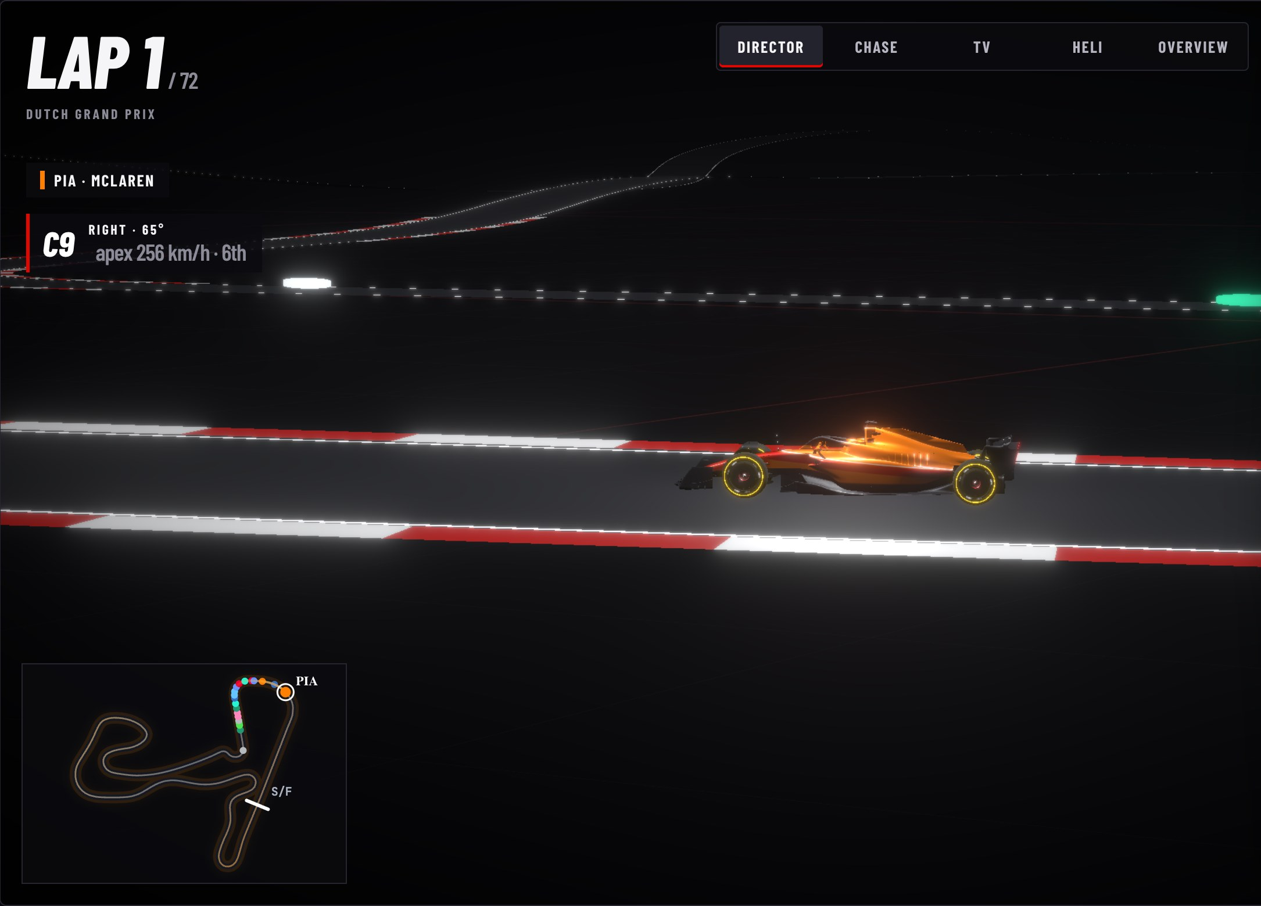
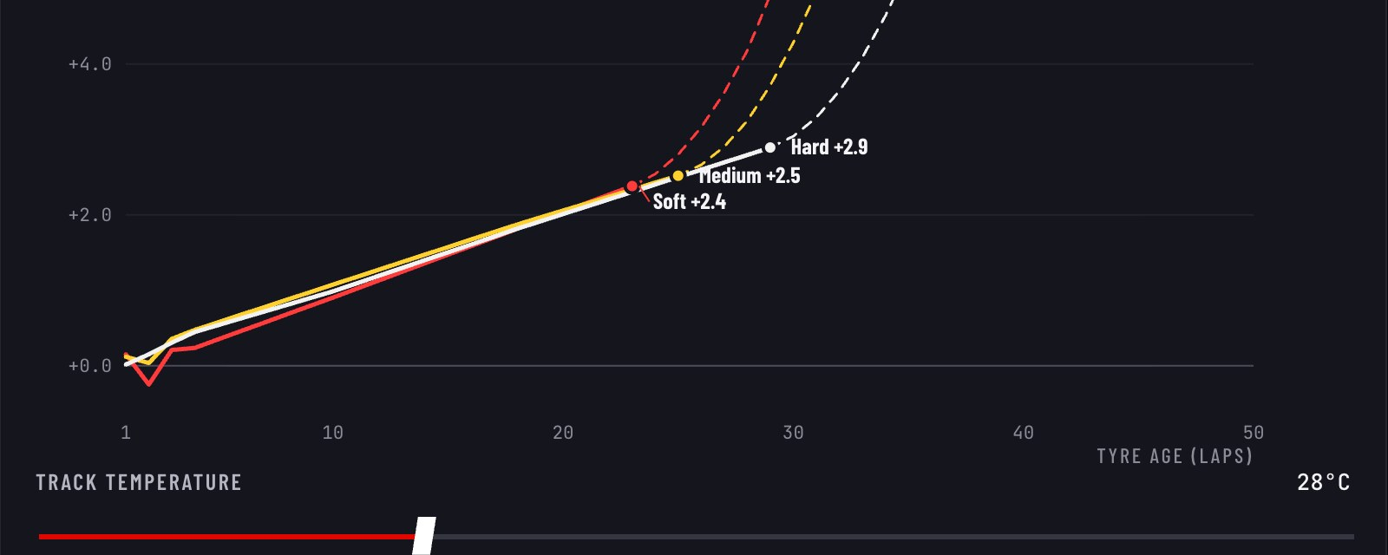
THE PRODUCT
SIX VIEWS. ONE RACE ENGINEER.
PIT WALL · SPEC HOTSPOTS
RACE THEATRE · DIRECTOR CAMERA
TYRE LAB · LIVE CURVES
Pit Wall · Race Theatre · Onboard · What If · Tyre Lab · Proof live: b25bb1004-wq.github.io/F1-Pitstop_Strategy
// PITWALL · THE PRODUCT
LAP 15 / 20
Notes:
The model became an app you can watch. Six views: Pit Wall for the call, Race Theatre replaying every 2025 race in 3D on the real circuits with all 20 cars at their recorded pace, Onboard with real telemetry, What If, Tyre Lab and Proof. A personal race-engineer guide tours it at your level, and Explain mode explains anything you click.

Slide 16
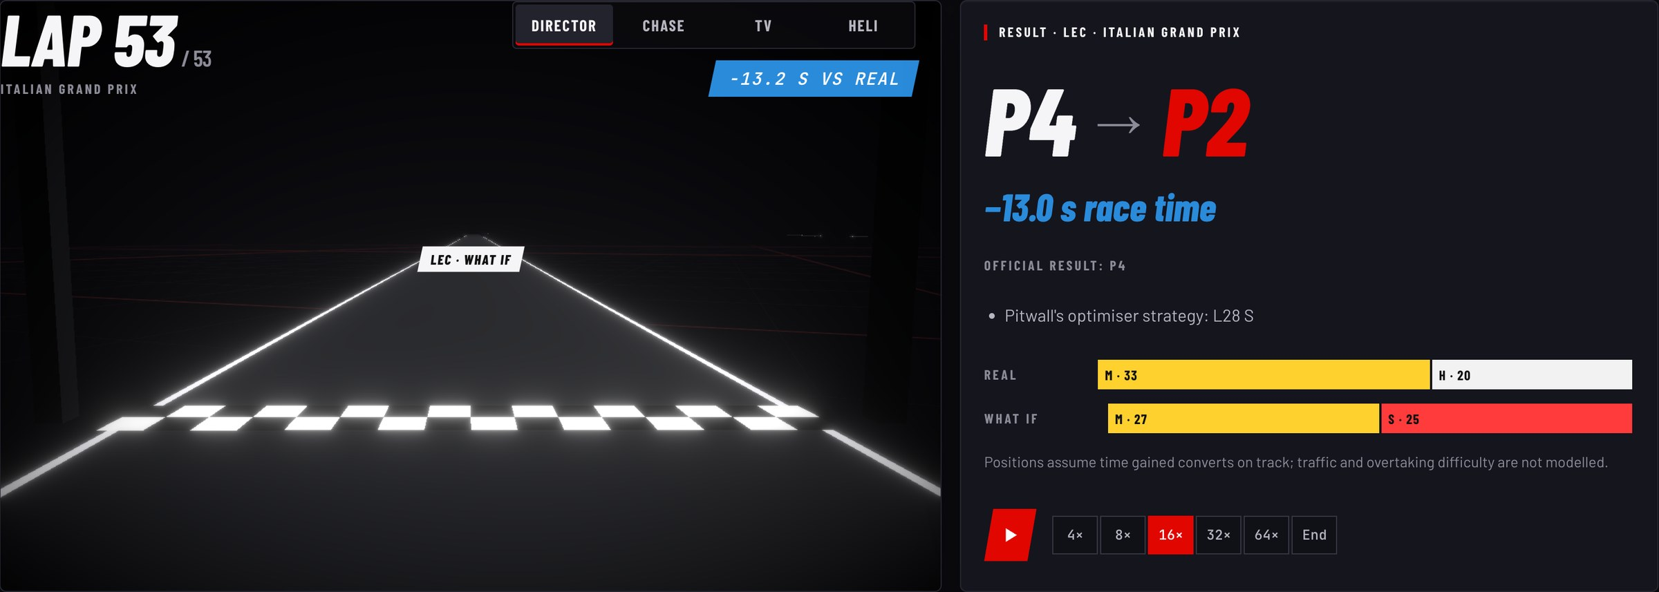
WHAT IF
CHANGE ONE THING. RERUN THE RACE.
What if Leclerc had followed Pitwall's strategy at Monza?
RUN IT
01
PARSE
Deterministic. Anything it cannot place is reported, never guessed.
02
REAL PACE
Each driver's clean pace, lap by lap, pit-lane time removed.
03
APPLY
Tyre curves, pit loss and the optimiser change the laps that differ.
04
SAFETY CARS
Queue events; lapped cars keep their deficit.
RESULT
RACE TIME
05
ANCHOR
STRATEGY
P4 → P2
−13.0 s
lap 28 for softs
what-if clock = real clock + (what-if − baseline). No change = reality.
// PITWALL · WHAT IF
LAP 16 / 20
Notes:
What If reruns a real 2025 race with one thing changed. You ask in plain English; the parser shows what it understood and reports anything it cannot place. Each driver's real clean pace is taken lap by lap, the change goes through the model, and Safety Cars are queue events where lapped cars keep their deficit. Each what-if clock is the real clock plus the modelled difference, so an unchanged race reproduces reality exactly. Here, if Leclerc had followed Pitwall's strategy at Monza, he finishes second instead of fourth, 13 seconds quicker.

Slide 17
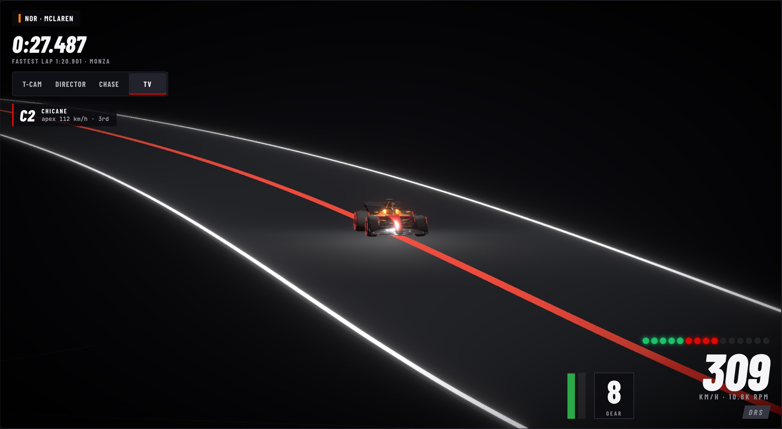
MAKING IT FEEL REAL
DIRECTED LIKE A BROADCAST.
CORNERS FROM BRAKING
Δv ≥ 20 km/h
Monza: all 6 braking zones found
LONG-LENS TRACKSIDE CAMS
fov = 2·atan(7.5 m / d)
outside each corner, zooming to hold the car
STEERING FROM CURVATURE
δ = atan(3.6 m × κ)
front wheels turn into each corner
ROLL-FREE POSES
yaw + pitch only
the car can never flip
ONBOARD · LONG LENS THROUGH MONZA'S ROGGIA
DIRECTOR CUTS
Corner caption, apex speed and gear come from the real fastest lap.
cut at every corner
chase, side and aerial on straights; steady at 8×+
// PITWALL · MAKING IT FEEL REAL
LAP 17 / 20
Notes:
Making it feel real. Corners are found from braking zones in the fastest-lap speed trace: every minimum at least 20 kilometres per hour below its run-up. At Monza that finds all six real braking zones. A trackside camera sits on the outside of each corner with a long lens that zooms to hold the car's size. The front wheels steer from the real curvature, and every pose is yaw and pitch only, so the car can never flip. The Director mode cuts like a broadcast.

Slide 18
LESSONS
FIVE THINGS THIS TAUGHT ME.
01
A HIGH R² CAN BE A LOOKUP TABLE.
Ablate before you believe it: 0.91 became 0.02.
02
SEPARATE EFFECTS WHERE THEY DECOUPLE.
The pit stop resets the tyres, not the fuel.
03
LEAKS HIDE IN TIME.
Use only what was known before the lap.
04
HOLD OUT WHOLE SEASONS.
Tune on 2024, score 2025 once.
05
STABILITY IS A FEATURE.
Smooth inputs and damped rigs beat clever cameras.
// PITWALL · LESSONS
LAP 18 / 20
Notes:
Five lessons. A high R squared can be a lookup table, so ablate before you believe it. Separate effects where they decouple: the pit stop resets the tyres but not the fuel. Leaks hide in time, so use only what was known before the lap. Hold out whole seasons and score the test year once. And stability is a feature: smooth inputs and damped rigs beat clever cameras.

Slide 19
NEXT RACE
WHAT'S NEXT.
01
02
03
TWO-CAR UNDERCUT MODEL
C1-C5 ALLOCATION
FP2 LONG RUNS
The optimiser minimises one car's own time. Undercuts and covering rivals are why real calls differ. The gap features already exist.
Soft, medium and hard are relative per event. Mapping them to Pirelli's compounds would separate the curves.
Very old tyres are mostly seen on cars where they held up. Practice long runs counter that survivorship bias.
Known limits today: What If assumes time gained becomes positions (traffic and overtaking are not modelled). Wet races are excluded. Before a race, a new season's car pace is the main unknown.
// PITWALL · NEXT RACE
LAP 19 / 20
Notes:
What's next. A two-car undercut and overcut model to close the gap between the time-minimising optimiser and what teams actually do. Mapping soft, medium and hard to Pirelli's C1 to C5 per event. And FP2 long runs to counter survivorship bias in the tyre curves.

Slide 20

CHEQUERED FLAG
BOX, BOX.
LIVE APP
b25bb1004-wq.github.io/F1-Pitstop_Strategy
CODE
github.com/b25bb1004-wq/F1-Pitstop_Strategy
HOW THE MODEL WORKS
notes/how_the_model_works.md
Arnav Yadav · FastF1 timing data 2021-2025 · frontend built with Claude Code · car model “Ferrari F1-75” by Sketcher, CC-BY-NC-4.0, de-branded · fonts: Barlow, JetBrains Mono (OFL)
// PITWALL · CHEQUERED FLAG
LAP 20 / 20
Notes:
That's Pitwall: a structural model that knows why a lap is slow, a decision engine that solves the rest of the race, an honest evaluation, and an app that lets you watch it and ask it what if. The live app and all the code are linked here.

