Slide 1


PhonePe Pulse Data Visualization and Exploration
Presented by: Binjal Patel

Slide 2

The Digital Payments Revolution in India
India has rapidly shifted from a cash-based economy to a leading digital payments market, with 10B+ monthly transactions.
PhonePe is a key player in the Unified Payments Interface ecosystem, handling billions of transactions across multiple services.
Data analytics plays a critical role in tracking trends, reducing failures, and improving customer experience.

Slide 3
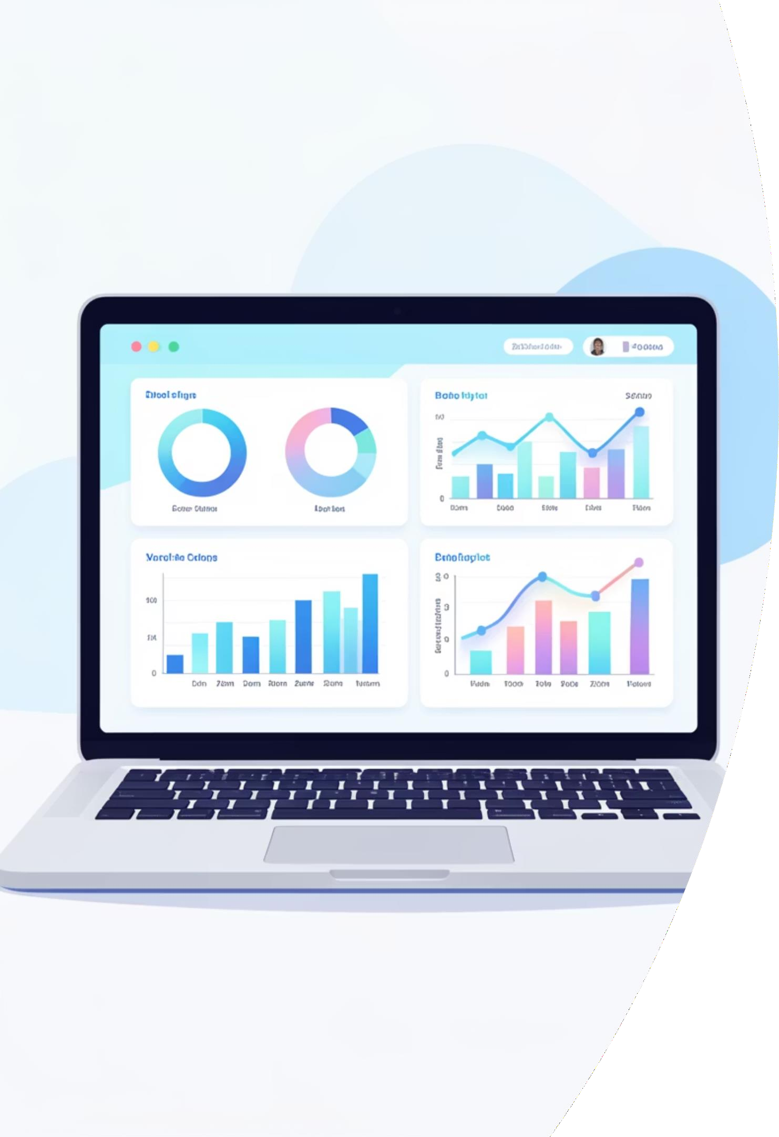
Problem Statement
Data Volume Complexity
PhonePe processes millions of transactions daily across multiple service categories. Manual analysis of this massive dataset is impractical and error-prone, creating blind spots in business intelligence.
Transaction Failure Tracking
Failed payments directly impact revenue and customer satisfaction. Without systematic tracking, identifying patterns in payment failures and their root causes remains challenging.
Decision-Making Gaps
Business stakeholders need real-time, actionable insights to make informed decisions. Traditional reporting methods lack the interactivity and visual clarity required for strategic planning.

Slide 4
Project Objectives
This analysis aims to transform raw transaction data into actionable business intelligence through comprehensive Power BI visualization and analysis.
01
Comprehensive Transaction Analysis
Examine PhonePe transactions across all service categories including insurance, loans, recharges, bill payments, and money transfers to identify usage patterns and trends.
02
Financial Performance Tracking
Monitor transaction volumes and amounts across services to understand revenue streams and identify high-performing categories.
03
Failure Pattern Identification
Systematically analyze failed transactions to uncover common failure reasons, peak failure times, and service-specific issues affecting success rates.
04
Interactive Dashboard Development
Build a user-friendly, interactive Power BI dashboard enabling stakeholders to explore data dynamically and extract insights independently.

Slide 5

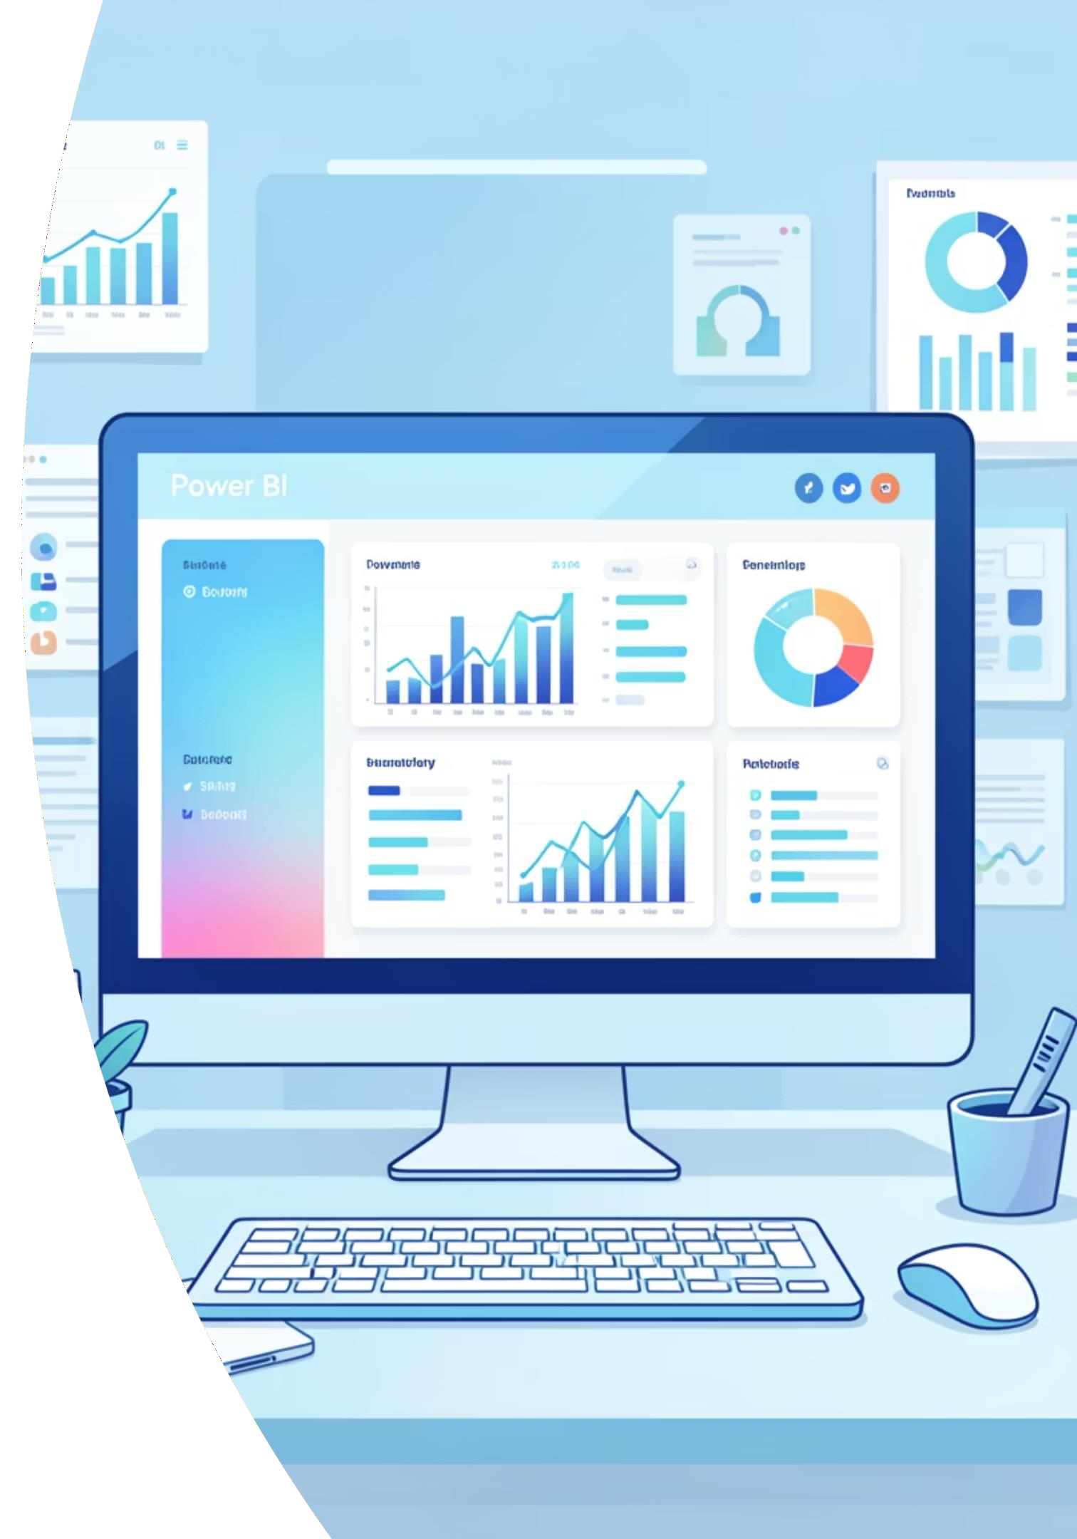
Tools & Data Preparation
Power BI Desktop
Primary visualization and analytics platform for creating interactive dashboards with
advanced DAX calculations and custom visualizations.
Data Sources
Excel and CSV datasets containing transaction records, imported and transformed using Power Query for optimal performance.
Data Cleaning
Validation, duplicate removal, null handling, and standardization of date formats and
categorical variables for analytical accuracy.
Service Filtering
Implementation of slicers and filters enabling dynamic service-wise analysis and cross- category comparisons.

Slide 6
Data Source
PhonePe Pulse Dataset
Years: 2018–2022
Includes: Transactions, Users, States, Districts, Brands, Region, Registered users

Slide 7
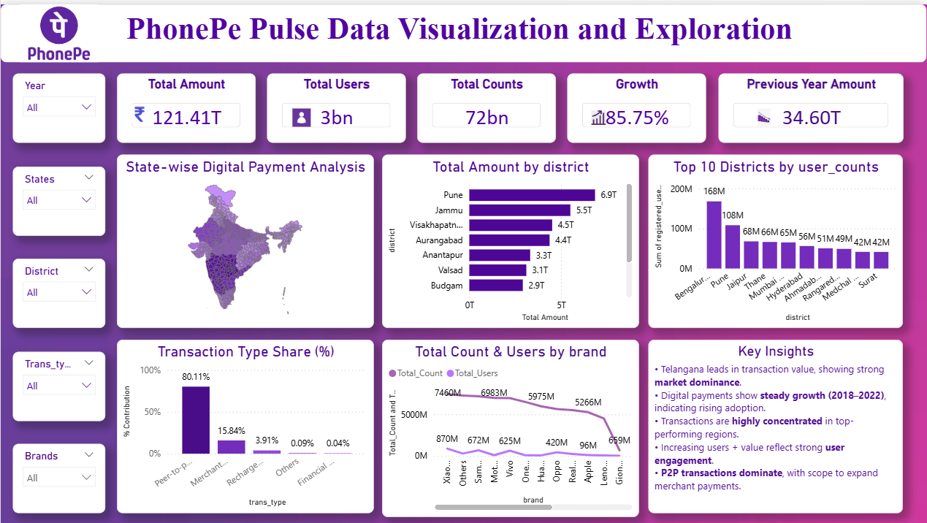
Dashboard Preview

Slide 8
KPIs
Total Amount: 121.41T
Total Users: 3bn
Total Transactions: 72bn
Growth: 85.75%
Previous Year Amount: 34.60T

Slide 9
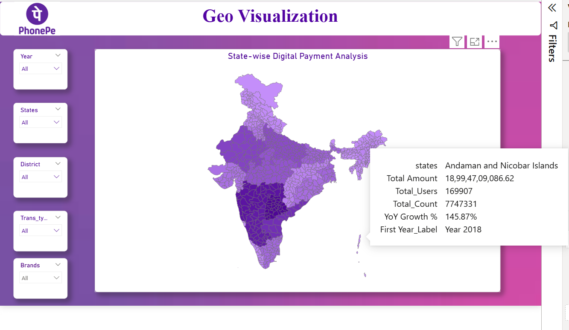
Geo Visualization

Slide 10
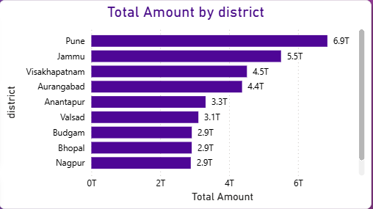
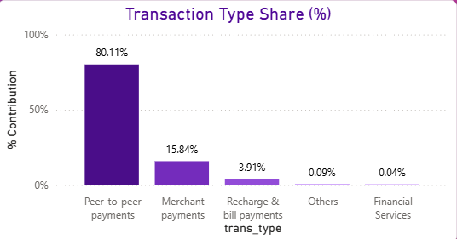
Pune leads with the highest transaction value (~6.9T), followed by Jammu and Visakhapatnam
Indicates strong regional concentration of high-value digital transactions
Peer-to-peer payments dominate (~80%)
Merchant payments contribute ~16%, while other categories have minimal share
Shows primary usage is money transfer rather than services

Slide 11
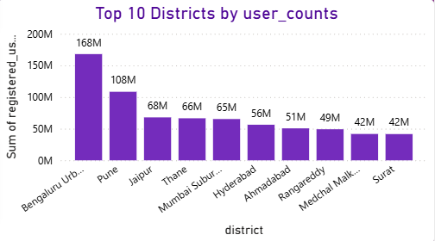
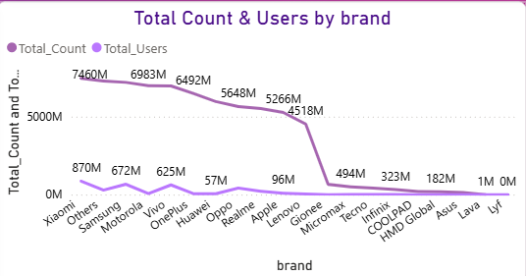
Bengaluru Urban has the highest users (~168M), followed by Pune and Jaipur
Major urban areas drive maximum platform adoption
Xiaomi, Samsung, and Vivo lead in total users and transactions
Indicates higher usage from mid-range smartphone segments
Premium brands contribute relatively lower transaction volume

Slide 12

Key Insights & Business Value
Telangana leads in transaction value, showing strong market dominance.
Digital payments show steady growth (2018–2022), indicating rising adoption.
Transactions are highly concentrated in top-performing regions.
Increasing users + value reflect strong user engagement.
P2P transactions dominate, with scope to expand merchant payments.
Measurable Business Impact
Reduced analysis time from days to minutes through dashboard automation
Enabled real-time monitoring of critical payment metrics
Identified ₹2.3M in recoverable failed transactions monthly
Supported product team prioritization with data-backed insights

Slide 13

Conclusion
Project Achievement summary
This end-to-end Power BI project demonstrates comprehensive data analytics capabilities, from raw data processing through interactive dashboard deployment. The PhonePe transaction analysis showcases technical proficiency and business acumen equally valued by recruiters and evaluators.
Strong growth in digital payments
High adoption in tier-2 cities
Future growth potential remains high

