Slide 1
Search
Get to the info! [Logo]
Home
Blog
Brian
Spencer
Mark
Store
Header
What’s New [Wrapper]
Most recent blog post
Body text the quick brown fox jumped over the lazy dog
Blog Post Title
Picture
Social Media
[Author]
Video of the Week
Topic
Quote / Joke

Slide 2
Get to the info! [Logo]
Home
Blog
Brian
Spencer
Mark
Store
What’s New [Wrapper]
Most recent blog post Most recent blog post Most recent blog ost Most recent blog post Most recent blog post Most recent blog ost Most recent blog post Most recent blog post Most recent blog ost Most recent blog postMost recent blog post Most recent blog post Most recent blog ost Most recent blog post Most recent blog post Most recent blog ost M
We’re Building a Website
Picture
Social Media
[Author]
Video of the Week
8/28: We’re having dinner at Kuma’s Corner
[Video of the Day]
“Why do they build fences around graveyards? Because everyone is dying to get in!”

Slide 3
Get to the info! [Logo]
Home
Blog
Brian
Spencer
Mark
Store
Header
[Filter Bar – Date, Author, HashTag, Most Shared/Commented/Liked]
Most recent blog post
Body text the quick brown fox jumped over the lazy dog
Blog Post Title
Picture
Social Media
[Author]
[Collapsible Comments]
Second most recent blog post
Blog Post Title
Picture
Social Media
[Author]
[Collapsible Comments]

Slide 4
SPLASH PAGE

Slide 5
Home
Blog
Brian
Spencer
Mark
Private Forum

Slide 6
Home
Blog
Brian
Spencer
Mark
Store

Slide 7
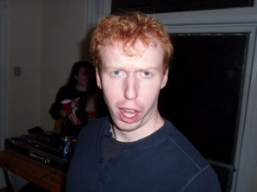
Home
Blog
Brian
Spencer
Mark
Store
Blurb
My Story
My Favorite Things
My Projects

Slide 8
Home
Blog
Brian
Spencer
Mark
Store
ABOUT PAGE

