Slide 1
Varnish at The BBC
Andy “Bob” Brockhurst
Principal Engineer
BBC Frameworks
b3cft on your soshul meedja of choice
or www.kingkludge.net

Slide 2
What Frameworks look after at Auntie
PAL & Zend Framework.
BBC Micro.
Spectrum.
Barlesque.
JQuery.
PHP Binaries.
Wurfl (Java).
Varnish.

Slide 3
Tonight's Talk
Varnish.
Related BBC Architecture.
BBC Usage of Varnish.
Walk through of our VCL.
Extending Varnish.
Some of our experiences.

Slide 4
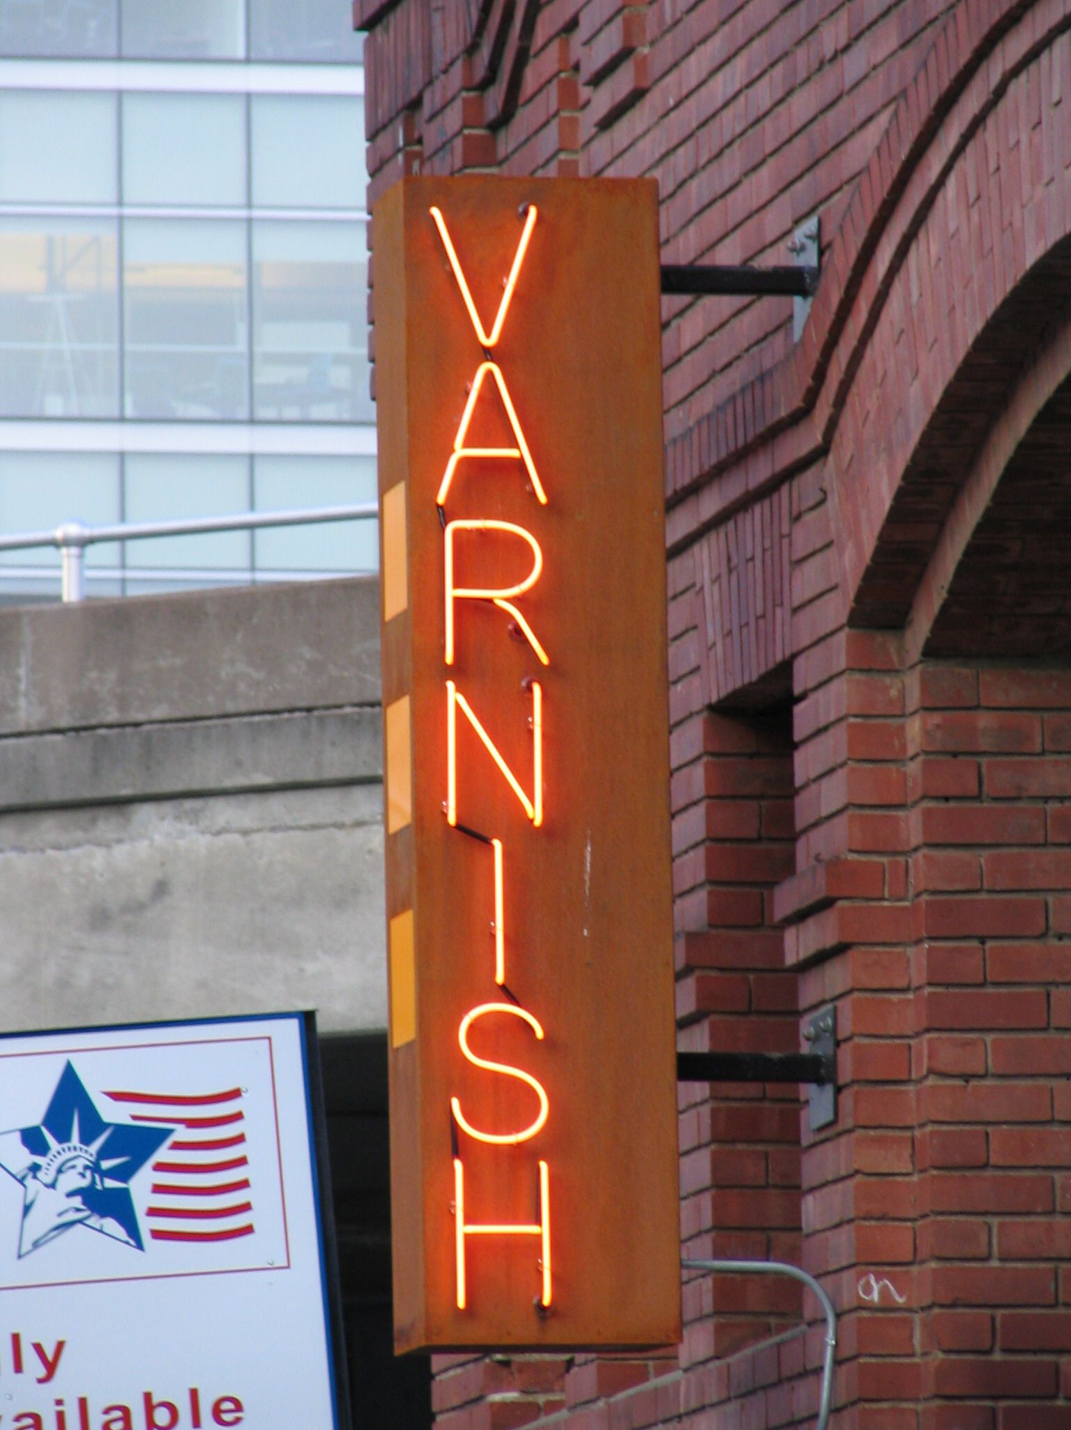
What is Varnish?
Web Accelerator.
Reverse Caching Proxy.
Load Balancer.
Scripting Engine.
Edge Side Includes.

Slide 5
Getting Varnish
www.varnish-cache.org
May need to add sources to package manager.
Debian/Ubuntu.
sudo apt-get install varnish
Centos/Debian/Fedora.
sudo yum install varnish

Slide 6
Varnish out of the box
/etc/sysconfig/varnish
Listens on port 6081 talks to 127.0.0.1:80
/etc/varnish/default.vcl
Roughly standard http proxy

Slide 7
Some Terminology
pass
do not cache
lookup
go directly to cache (in vcl_recv)
pipe
do not look at the content just pipe it in/out
deliver
send response back to client (normally in vcl_fetch)
esi
process esi directives
restart
redo the request with the backend

Slide 8
Request lifecycle
Request ------> vcl_recv -----> cacheable? ---.
yes | no |
| |
yes v |
.--------- in cache? <---- vcl_hash |
| no | |
| | |
v v |
vcl_hit vcl_miss |
| | |
| | |
| v |
| vcl_fetch<--------------------.
| |
| |
| v
.-------->vcl_deliver---------> Response

Slide 9
Edge Side Includes
Limited set of ESI implemented
esi:include
<esi:include src=“/includes/fragement.php” />
esi:remove
<esi:remove>You ain’t seen me</esi:remove>

Slide 10
Logging in Varnish
Very verbose.
Logs to memory or binary files.
varnishlog ‐c ‐i RxHeader ‐I \^User‐Agent
varnishlog -w /tmp/varnish.log
varnishlog -r /tmp/varnish.log
varnishreplay -a server:port -r /tmp/varnish.log
varnishncsa

Slide 11
Logging in Varnish
varnishstat
Varnish server vital statistics.
Hint. `varnishstat -1` and bash fu for monitoring
varnishtop
Aggregated logs sorted by frequency.
varnishhist
Ascii-art graph of hit/miss request times.

Slide 12
varnishstat
1+04:21:22 pal007.back.int.cwwtf.local
Hitrate ratio: 10 100 1000
Hitrate avg: 0.0028 0.0287 0.0486
32341 0.00 0.32 Client connections accepted
100624 1.00 0.99 Client requests received
533 0.00 0.01 Cache hits
3722 0.00 0.04 Cache hits for pass
5661 0.00 0.06 Cache misses
34511 1.00 0.34 Backend conn. success
65346 0.00 0.64 Backend conn. reuses
31262 1.00 0.31 Backend conn. was closed
96615 1.00 0.95 Backend conn. recycles
21939 0.00 0.21 Fetch head
52188 0.00 0.51 Fetch with Length
22908 1.00 0.22 Fetch chunked
2811 0.00 0.03 Fetch wanted close
7 0.00 0.00 Fetch zero len
28 . . N struct sess_mem
2 . . N struct sess
4114 . . N struct object
4126 . . N struct objectcore
1267 . . N struct objecthead
8196 . . N struct smf
1 . . N small free smf
5 . . N large free smf
7 . . N struct vbe_conn
1600 . . N worker threads
1600 0.00 0.02 N worker threads created
6 . . N backends
1152 . . N expired objects
117 . . N LRU moved objects
55653 1.00 0.55 Objects sent with write
32341 0.00 0.32 Total Sessions
100624 1.00 0.99 Total Requests

Slide 13
varnishtop
list length 175 pal007.back.int.cwwtf.local
108.12 VCL_return pass
81.57 RxProtocol HTTP/1.1
81.57 TxProtocol HTTP/1.1
41.26 RxHeader Cache-Control: max-age=259200
41.26 RxHeader Connection: keep-alive
41.26 VCL_call recv
41.26 VCL_acl MATCH allow_cluster_client_ip 212.58.246.0/23
41.26 VCL_call hash
41.26 VCL_return hash
41.26 TxHeader X-ESI-Capability: 1
41.26 TxHeader X-Country: gb
41.26 TxHeader X-IP_Is_Advertise_Combined: no
41.26 TxHeader X-IP_Is_UK_Combined: yes
41.26 TxHeader X-Quova-Status: Success
41.26 TxHeader X-GeoIP-Cache: hit
41.26 TxHeader X-DEMI-Browser:
41.26 TxHeader X-DEMI-OS:
41.26 TxHeader X-DEMI-Captions:
41.26 TxHeader X-DEMI-Display: 800x600
41.26 TxHeader X-DEMI-Wallpaper:
41.26 TxHeader X-DEMI-XHTML-Level: 4
41.26 TxHeader X-DEMI-Navigation: mouse
41.26 TxHeader X-DEMI-OS-Version:
41.26 TxHeader X-DEMI-Version: 0.3.10
41.26 TxHeader X-DEMI-Type: desktop
41.26 TxHeader X-DEMI-Input-Map:
41.26 TxHeader X-DEMI-Cache: hit
40.35 RxHeader Host: www.int.bbc.co.uk
40.35 TxHeader Host: www.int.bbc.co.uk
40.32 RxHeader Server: Apache
40.32 VCL_call fetch
40.32 ObjProtocol HTTP/1.1
40.32 ObjHeader Server: Apache

Slide 14
varnishhist
1:10, n = 959 pal007.back.int.cwwtf.local
#
#
#
#
#
#
#
##
###
###
###
#####
##### ##
##### ###
##### # # # # ### #
###### # ## ## # ####### #### # #
+---------+---------+---------+---------+---------+---------+---------+---------+---------
|1e-6 |1e-5 |1e-4 |1e-3 |1e-2 |1e-1 |1e0 |1e1 |1e2

Slide 15

HTTP Caching
Some examples
Live coding time ☺

Slide 16
BBC Varnish
iPlayer
Internal usage for APIs
BBC Homepage
Coming soon…
Weather
Sport
News

Slide 17
Why use Varnish?
Need to vary on user-agent
Varying on user-agent is a bad idea
Need to vary on IP
Also a bad idea
Best possible use of limited resources.

Slide 18
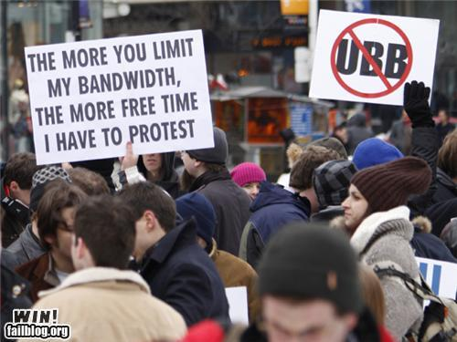

Slide 19
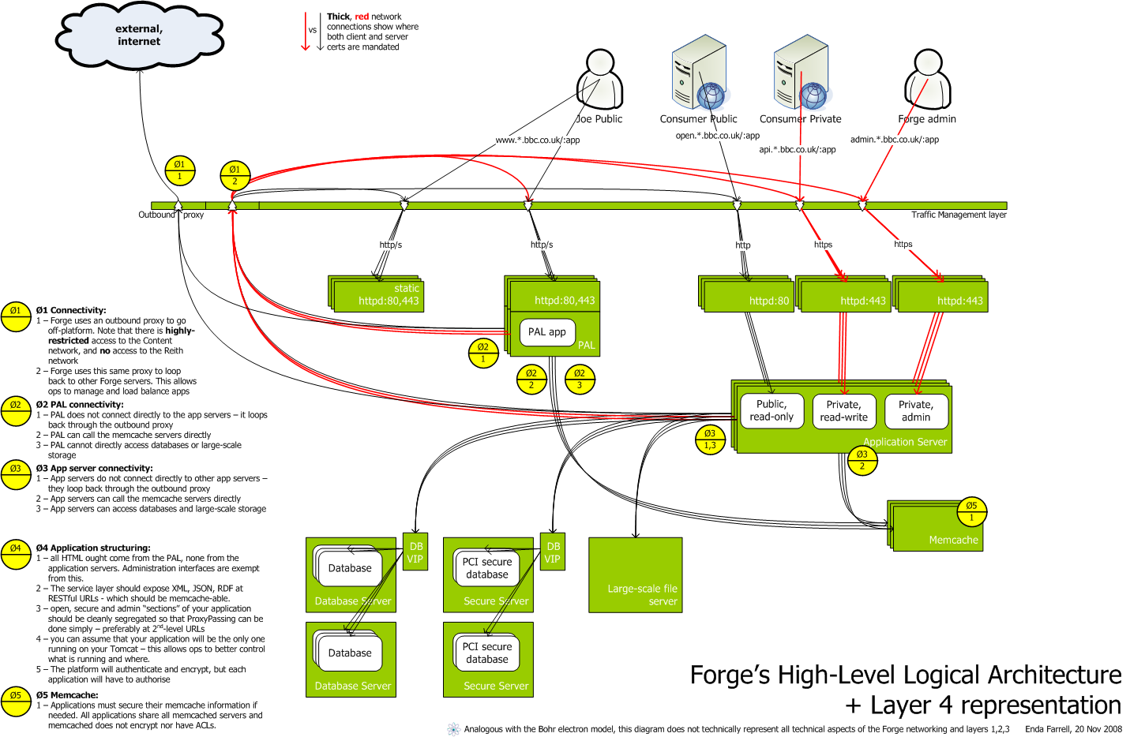

Slide 20
Simplified version
Request
iplayer | \ everything else
| \
v \
ZXTM .-> ZXTM .--> ZXTM .--> ZXTM
| / | / | / |
| / | / | / |
v / v / api v / v
Varnish PAL Varnish Dynamite

Slide 21
BBC VCL – Looking under the hood
Probably the bit everyone’s been waiting for.
Please ask questions during walk-through.

Slide 22
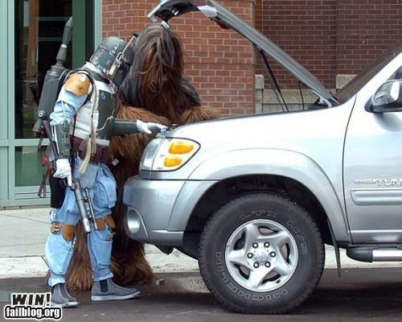

Slide 23
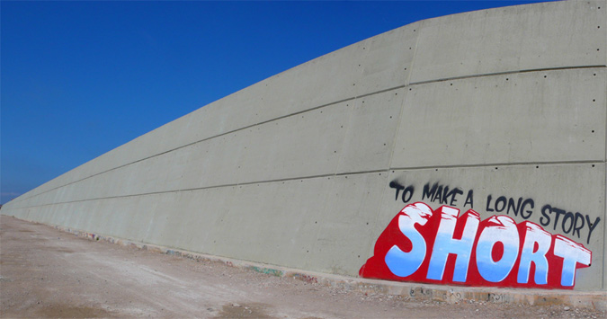
Things we’ve discovered
Do use 64bit environment.
Don’t use 32bit environment.
Expect customisations to take a long time.

Slide 24

Questions?

Slide 25
Code available at:
https://github.com/b3cft/PHP-London-Varnish
Photos:
www.failblog.com
hahabusiness.com
Flickr:
Varnish by Peter Kaminski
Question Everything by dullhunk

