Slide 1
Constraint Satisfaction Problems
CS 3793/5233 – AI
Summer 2021
-Kevin Desai

Slide 2
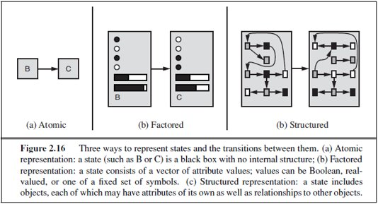
State Representations

Slide 3
Constraint Satisfaction Problems
Until now – atomic state representations
Factored representation
  Set of variables
  Each variable has a value
Constraint Satisfaction Problem or CSP
  A problem is solved when each variable has a value that satisfies all the constraints on the variable
CSPs use ‘general-purpose’ rather than ‘problem-specific’ heuristics to enable solution to complex problems
Eliminate large portions of the search space all at once by identifying variable/value combinations that violate the constraints

Slide 4
CSP
3 main components of a CSP
  X: set of variables, {X₁, . . . , X_{n}}.
  D: set of domains, {D₁, . . . , D_{n}}, one for each variable.
  C: set of constraints that specify allowable combinations of values.
Each D_{i} consists of a set of allowable values {v₁, . . . , v_{k}} for variable X_{i}
Each C_{i} consists of a pair <scope, rel>
  scope – tuple of variables that participate in the constraint
  rel – relation that defines the values that those variables can take on
Solve a CSP
  Define the state space – by an assignment of values to some or all variables
  Consistent or legal assignment – does not violate any constraints
  Complete assignment – every variable is assigned
  Solution to CSP – complete and consistent assignment
  Partial assignment – assigns values to only some of the variables

Slide 5
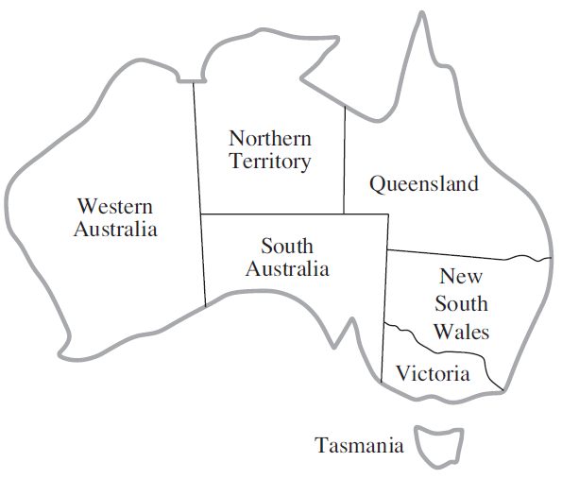
CSP – Map Coloring
Color each territory of Australia with Red, Green or Blue
  Constraint – no neighboring regions have the same color
X = {WA, NT, Q, NSW, V, SA, T}
D_{i} = {red, green, blue}
Constraints
  C = {SA ≠ WA, SA ≠ NT, SA ≠ Q, SA ≠ NSW, SA ≠ V, WA ≠ NT, NT ≠ Q, Q ≠ NSW, NSW ≠ V}
One of many possible solutions
  {WA = red, NT = green, Q = red, NSW = green, V = red, SA = blue, T = red}

Slide 6
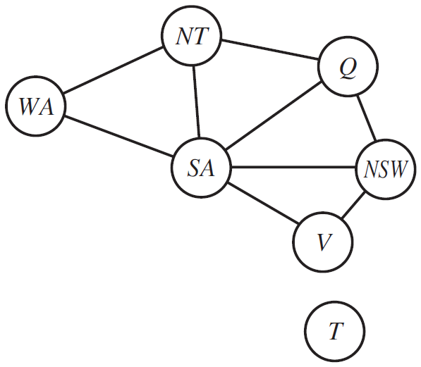
CSP as Constraint Graph
After expanding SA, in normal search (without constraints) assignments possible –
  3^5 = 243
With constraints –
  SA = blue
  Possible values for the 5 successors can be 2 (red/green)
  2^5 = 32 assignments

Slide 7
CSP – Job-shop Scheduling
Small car assembly with 15 tasks
  install axles (front and back), affix all four wheels (right and left, front and back), tighten nuts for each wheel, affix hubcaps, and inspect the final assembly
  X = {Axle_{F}, Axle_{B}, Wheel_{RF}, Wheel_{LF}, Wheel_{RB}, Wheel_{LB}, Nuts_{RF}, Nuts_{LF}, Nuts_{RB}, Nuts_{LB}, Cap_{RF}, Cap_{LF}, Cap_{RB}, Cap_{LB}, Inspect}
Constraints
  Axle before wheel & 10 min for axle
    Axle_{F} + 10 ≤ Wheel_{RF}
    Axle_{F} + 10 ≤ Wheel_{LF}
    Axle_{B} + 10 ≤ Wheel_{RB}
    Axle_{B} +10 ≤ Wheel_{LB}
  Wheel (1 min) -> tighten nut (2 min) -> attach cap (1 min)
    Wheel_{XX} + 1 ≤ Nuts_{XX}
    Nuts_{XX} + 2 ≤ Cap_{XX}
  Four workers share a tool for axle
    (Axle_{F} + 10 ≤ Axle_{B}) or (Axle_{B} + 10 ≤ Axle_{F})
  Inspect comes last and takes 3 min
    X + d_{X} <= Inspect
  Whole assembly finish in 30 min
    D_{i} = {1, 2, 3, . . . , 27}

Slide 8
CSP Formalism
Finite vs Infinite
  Finite – map coloring, scheduling & Infinite – scheduling with no deadline
Discrete vs Continuous
  Discrete – map coloring, scheduling & Continuous – telescope experiment scheduling with precise continuous-valued timing of observations
Constraint types
  Unary – restricts the value of a single variable
    SA ≠ green
  Binary – relates two variables in the constraint
    SA ≠ WA
  Higher order – ternary constraints
  Global constraint – arbitrary number of variables
    Alldiff – all the variables involved must have different values
  Absolute vs Preference constraints

Slide 9
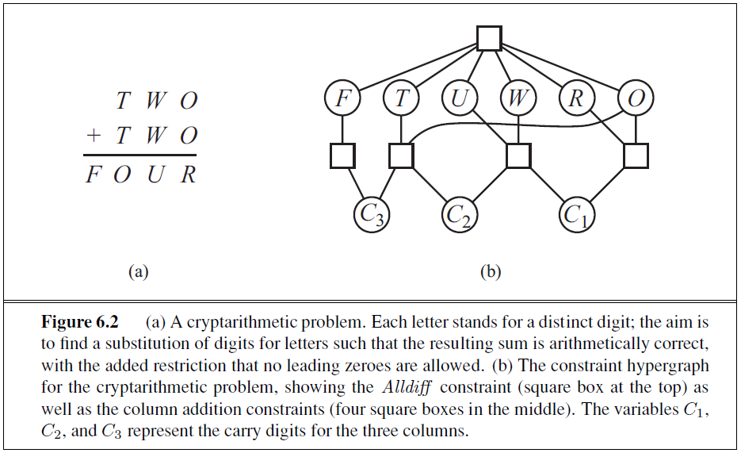
Crypt-arithmetic Problem

Slide 10
Constraint Propagation
In regular state-space search, an algorithm only does 1 thing – search
In CSP, an algorithm can do 2 things –
  Search
  Constraint propagation – using constraints to reduce the number of legal values for a variable, which in turn reduces the legal values for another
  Constraint propagation can be done with search or before as pre-processing
Constraint satisfaction as pre-processing sometimes solves the entire problem, no search required at all
Key idea – local consistency
  Each variable is a node in the graph
  Each binary constraint is an arc in the graph
  Enforce local consistency in each part of graph propagated throughout graph

Slide 11
Constraint Propagation – Node Consistency
A single variable is node consistent if all values in the variable’s domain satisfy unary constraints
A network is node consistent if every variable in the network is node consistent
E.g. map coloring where South Australians dislike green
  SA starts with domain {red, green, blue}
  Make node consistent by eliminating green – new domain {red, blue}
Easily satisfy all unary constraints in a CSP by running node consistency
Possible to reduce all n-ary constraints to binary constraints
  Hence, CSP solvers are defined to work only with binary constraints

Slide 12
Constraint Propagation – Arc Consistency
A variable is arc consistent if every value in its domain satisfies the variable’s binary constraints
A network is arc consistent if every variable is arc consistent with every other variable
E.g., consider the constraint Y = X², domain of X & Y is set of digits
Constraint – <(X, Y ), {(0, 0), (1, 1), (2, 4), (3, 9)}>
To make X arc-consistent wrt Y
  Reduce domain for X to {0, 1, 2, 3}
To make Y arc-consistent wrt X
  Reduce domain for Y to {0, 1, 4, 9}

Slide 13
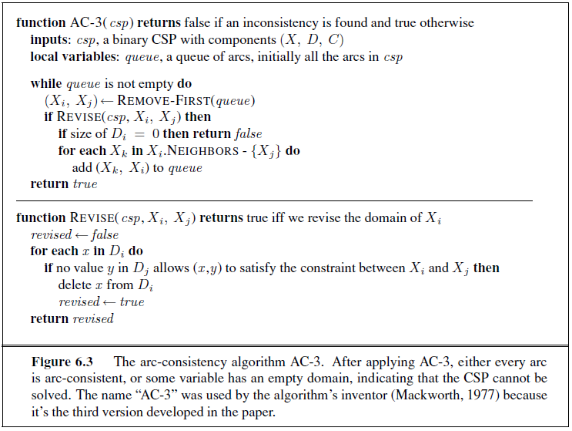
Constraint Propagation – Arc Consistency
Queue contains all arcs in the CSP
Pops arc (X_{i}, X_{j})
  Make X_{i} arc-consistent w.r.t. X_{j}
If D_{i} is revised (domain smaller)
  Add to the queue all arcs (X_{k}, X_{i}) where X_{k} is a neighbor of X_{i}
If D_{i} is revised to nothing
  CSP has no consistent solution
  Return failure
Do this until no more arcs in queue
The new CSP after this algorithm is equivalent to the original CSP – both have same solutions
Arc-consistent CSP variables have smaller domains
Arc-consistent CSP faster to search than normal CSP

Slide 14
Constraint Propagation – Path Consistency
Path consistency tightens binary constraints by using implicit constraints that are inferred by looking at triples of variables
A two-variable set {X_{i}, X_{j}} is path consistent w.r.t. a third variable X_{m}
  For every assignment {X_{i} = a, X_{j} = b} consistent with the constraints on {X_{i}, X_{j}}
  There is an assignment to X_{m} that satisfies the constraints on {X_{i}, X_{m}} and {X_{m}, X_{j}}
Look for a path from X_{i} to X_{j} with X_{m} in the middle
K-consistency – if for any set of k-1 variables and for any consistent assignment to those variables, a consistent value can always be assigned to any kth variable
  1-consistency, 2-consistency, 3-consistency (for binary constraints)
  Node, arc, path correspondingly

Slide 15
Sudoku Example – Arc Consistency
 | 1 | 2 | 3 | 4 | 5 | 6 | 7 | 8 | 9
A |  |  | 3 |  | 2 |  | 6
B | 9 |  |  | 3 |  | 5 |  |  | 1
C |  |  | 1 | 8 |  | 6 | 4
D |  |  | 8 | 1 |  | 2 | 9
E | 7
F |  |  | 6 | 7 |  | 8 | 2 |  | 8
G |  |  | 2 | 6 |  | 9 | 5
H | 8 |  |  | 2 |  | 3 |  |  | 9
I |  |  | 5 |  | 1 |  | 3
1
Domain for filled square – single value
Domain for empty squares – {1,2,3,4,5,6,7,8,9}
Constraints
  27 Alldiff – 1 for each row, column and box
Consider square E6
  Original domain – {1,2,3,4,5,6,7,8,9}
  After arc-consistency – {4}
Consider square I6
  Original domain – {1,2,3,4,5,6,7,8,9}
  After arc-consistency – {7}
Consider square A6
  Original domain – {1,2,3,4,5,6,7,8,9}
  After arc-consistency – {1}
Arc-consistency can solve the entire problem
4
7

Slide 16
Backtracking Search for CSP
Standard depth first/limited search with ‘n’ variables of domain size ‘d’
  Depth 0 – any of the ‘d’ values can be assigned to any of ‘n’ variables – nd
  Depth 1 – any of the ‘d’ values can be assigned to any of ‘n-1’ variables – (n-1)d
  Tree leaves – n!d^{n}
  Total possible assignments – n!d^{n}
Commutativity
  Order of application of any given set of actions has no effect on outcome
  CSPs are commutative because when assigning values to variables, we reach the same partial assignment regardless of order
  Hence, single variable at each node in search tree
  E.g. at root node SA, we choose between SA = red, SA = green and SA = blue; but never choose between SA = red and WA = blue
  Hence, total tree leaves in CSP = d^{n}

Slide 17
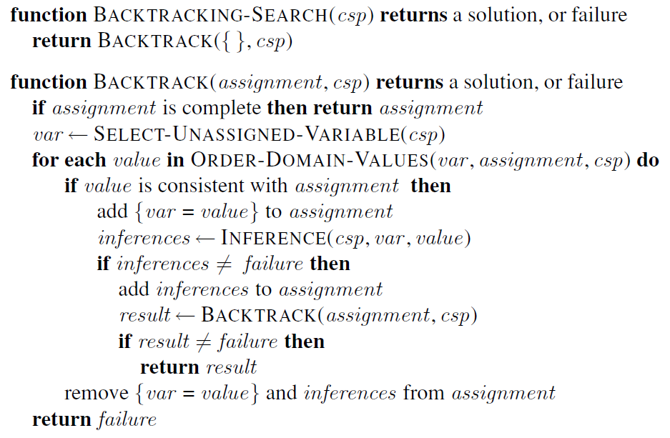
Backtracking Search for CSP
Notes:
It repeatedly chooses an unassigned variable, and then tries all values in the domain of that variable in turn, trying to find a solution. If an inconsistency is detected, then BACKTRACK returns failure, causing the previous call to try another value

Slide 18
Backtracking Search for CSP
Which variable should be assigned next (SELECT-UNASSIGNED-VARIABLE), and in what order should its values be tried (ORDER-DOMAIN-VALUES)?
What inferences should be performed at each step in the search (INFERENCE)?
When the search arrives at an assignment that violates a constraint, can the search avoid repeating this failure?

Slide 19
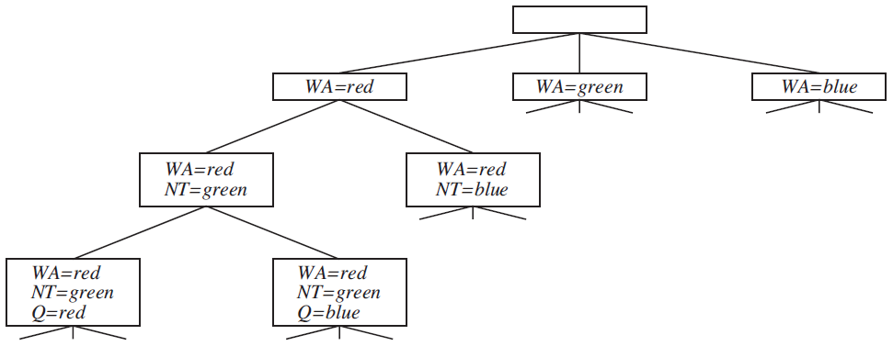
Variable and Value Ordering
var ← SELECT-UNASSIGNED-VARIABLE(csp)
Next after this?
In order, then Q
Better to go with SA
Minimum Remaining Values (MRV)

Slide 20
Variable and Value Ordering
var ← SELECT-UNASSIGNED-VARIABLE(csp)
Start?
Better to go with SA
Degree Heuristics
Reduce the branching factor on future choices by selecting the variable that is involved in the largest number of constraints on other unassigned variables

Slide 21
Variable and Value Ordering
(ORDER-DOMAIN-VALUES)
Value for next – Q?
Better to go with Q = red
Least Constraining Value
prefers the value that rules out the fewest choices for the neighboring variables in the constraint graph

Slide 22
Interleaving Search & Inference
inferences ←INFERENCE(csp, var , value)
Forward Checking – Whenever a variable X is assigned, establish arc consistency for it : for each unassigned variable Y that is connected to X by a constraint, delete from Y ’s domain any value that is inconsistent with the value chosen for X
WA
NT
Q
NSW
V
SA
T
Initial Domains
R G B
R G B
R G B
R G B
R G B
R G B
R G B
After WA = red
R
G B
R G B
R G B
R G B
G B
R G B
After Q = green
R
B
G
R B
R G B
B
R G B
After V = blue
R
B
G
R
B
R G B

Slide 23
Interleaving Search & Inference
inferences ←INFERENCE(csp, var , value)
Forward Checking
Variable Selection – Minimum Remaining Values, Degree Heuristics
Value Ordering – Least Constraining Value
WA
NT
Q
NSW
V
SA
T
Initial Domains
R G B
R G B
R G B
R G B
R G B
R G B
R G B
After SA = red
G B
G B
G B
G B
G B
R
R G B
After NT = green
B
G
B
G B
G B
R
R G B
After Q = blue
B
G
B
G
G B
R
R G B
After NSW = green
B
G
B
G
B
R
R G B
After WA = blue
B
G
B
G
B
R
R G B
After V = blue
B
G
B
G
B
R
R G B
After T = red
B
G
B
G
B
R
R

