Slide 1
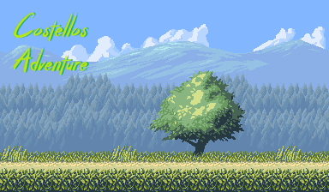
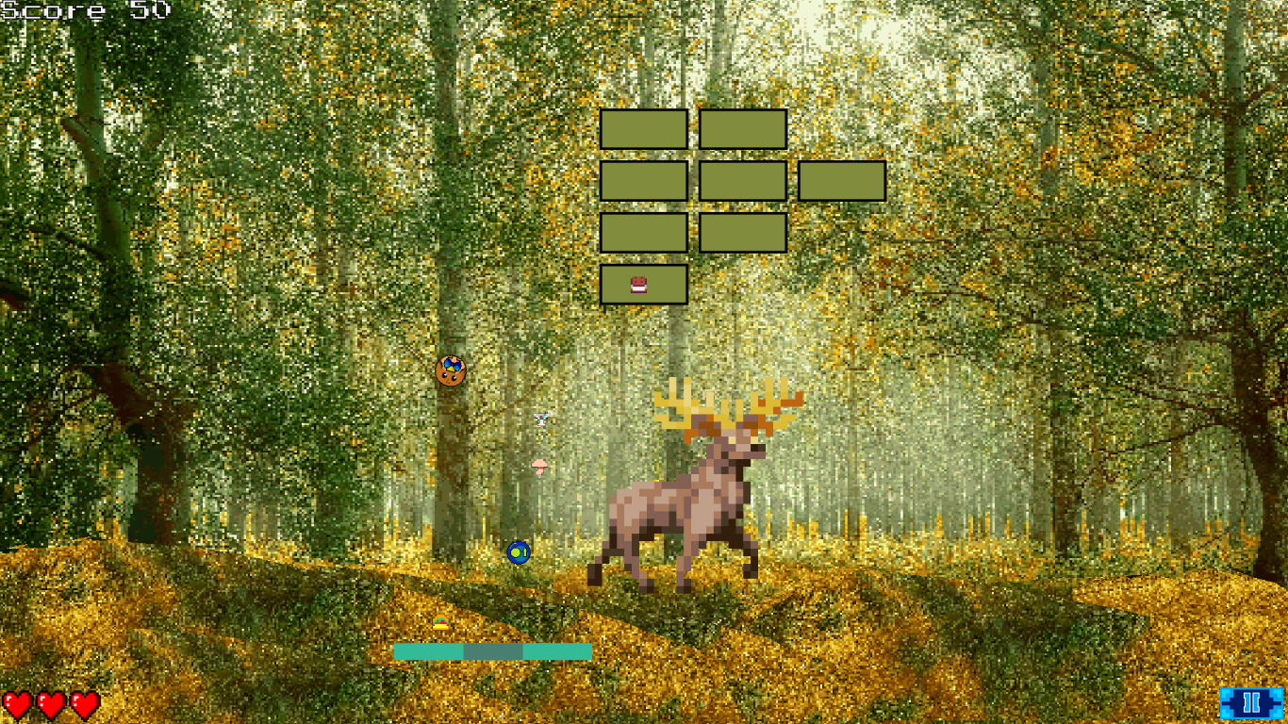
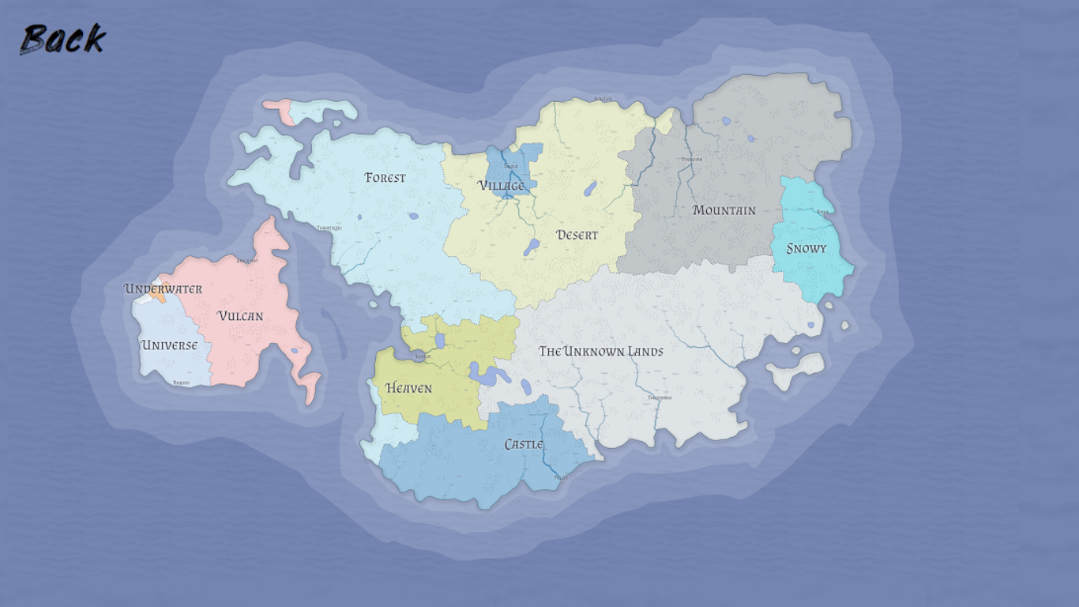
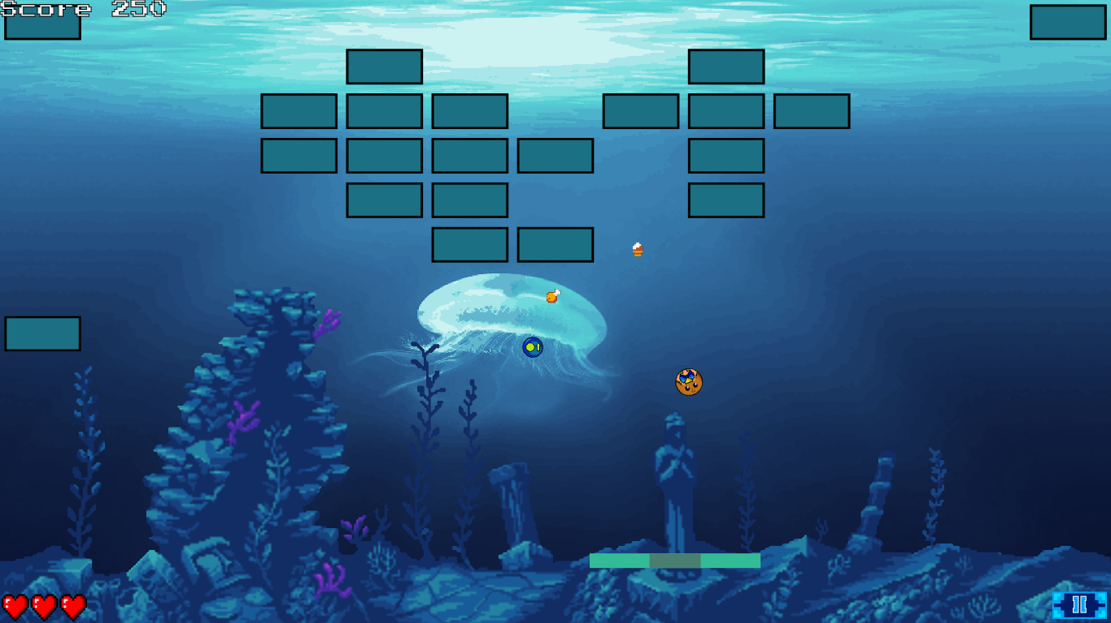

A breakout-clone featuring an owl
10 different worlds with 3 levels each
An additional world to add your own level.json
Choose your favorite world to play in the world-selector
Comes with music and sound effects
Bricks have three different strengths
Collect powerups and food
Pause the game at will
Benedikt Egenter & Max Gummersbach | Projektgruppe: ma bene!

