Slide 1




Software architecture: page, backend, model
SOFTWARE ENGINEERING & MACHINE LEARNING
SESSION 05
Monolith, three layers, REST services, events with NATS
Monolith
→
3 layers
→
Two services
→
Events
Notes:
Session 4 ended with a model behind a REST API. Today we put a web page in front of it and ask the basic architecture questions: which parts does the app have, where does each part run, and how do they talk?

Slide 2




Which parts, and how do they talk?
WHAT IS SOFTWARE ARCHITECTURE?
Web page
Backend
Model
Data
index.html
app.py
random forest
FMP + SQLite
shows data, sends requests
answers requests
predicts tomorrow
prices, predictions
ARCHITECTURE = THE DECISIONS ABOUT
Which parts are there, and what is each one responsible for?
Where does each part run: in one program, or in several?
How do the parts talk: function call, REST call, ...?
Notes:
Architecture is not about algorithms. Same four parts today, two different answers: everything in one program (monolith), or the model in its own program (two services).

Slide 3
One program does everything
STEP 1 · MONOLITH
ONE PROGRAM · PORT 8000
The browser is not part of the program: it only loads the page and calls the API.
browser
index.html
app.py
page + REST endpoints
POST /api/predict/AAPL
JSON
logic.py
features + model.predict()
FMP API
data.py
FMP + SQLite
stock.db
Notes:
Start: cd 01_monolith, python train.py, python -m uvicorn app:app --port 8000, open http://127.0.0.1:8000. One process does page, API, model and database. The model is a normal function call inside logic.py.

Slide 4
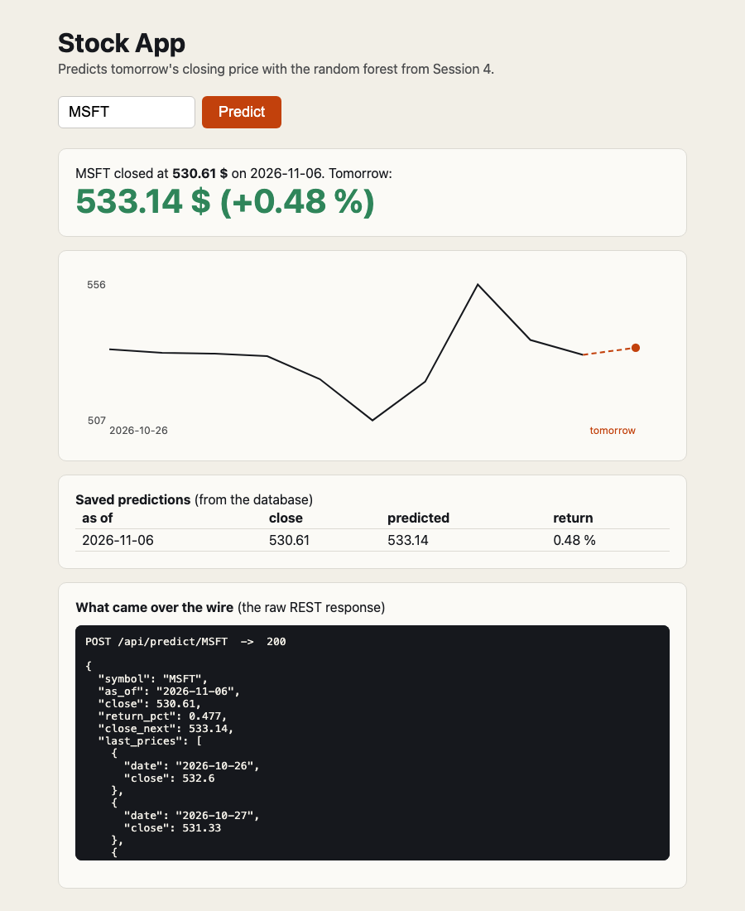
From button to prediction in 7 steps
WHAT HAPPENS ON ONE CLICK
1
index.html
fetch("/api/predict/AAPL", {method: "POST"})
2
app.py
receives it, calls logic.predict_tomorrow()
3
logic.py
asks data.fetch_prices("AAPL")
4
data.py
GET from FMP, saves prices in stock.db
5
logic.py
10 returns → model.predict() → −0.01 %
6
data.py
saves the prediction in stock.db
7
app.py → index.html
returns JSON (200), the page draws it
Real page, MSFT, 6 Nov 2026
Notes:
Colours: blue = presentation layer, orange = business layer, green = data layer. The request goes down the layers and the answer comes back up. Steps 1 and 7 cross the network (browser to server), steps 2 to 6 are function calls inside one program.

Slide 5
The browser and the backend talk HTTP + JSON
REST IN ONE SLIDE
Request
 | means | in our app
GET | read, no body | GET /api/predictions/AAPL
POST | send / do something | POST /api/predict/AAPL
200 | OK | prediction in the body
404 | not found | unknown symbol NOPE123
422 | invalid input | ML service: fewer than 11 prices
503 | service unavailable | ML service down (step 2)
POST /api/predict/AAPL HTTP/1.1
Host: 127.0.0.1:8000
Response
200 OK
{
"symbol": "AAPL",
"close": 342.37,
"return_pct": -0.012,
"close_next": 342.33,
"last_prices": [ ... ]
}
Notes:
Why POST for predict? It does something with a side effect: it writes into the database. GET only reads. The status codes are the same ones the students saw in Session 4b.

Slide 6
Inside the monolith: three layers
THREE-LAYER ARCHITECTURE
Presentation
Shows data, takes input, speaks HTTP and JSON
knows: HTTP, HTML. Not: SQL, the model
THE RULE
index.html
app.py
Each layer only calls the layer directly below it.
Business logic
What the app does: features → model → prediction
knows: the model, the rules. Not: HTTP, SQL
app.py → logic.py → data.py
Never upwards, never skip one: app.py doesn't write SQL.
logic.py
Data
Reads and writes data: API calls, SQL
knows: SQLite, FMP. Not: HTTP, the model
data.py
stock.db, FMP
Notes:
This is the classic three-layer architecture, also for Java/C# business apps. In our monolith every layer is one Python file; in big apps every layer is a package with many files.

Slide 7
A change hits one layer, not the whole app
WHY LAYERS?
change | which file changes | layer
SQLite → PostgreSQL | data.py | data
CSV instead of a database | data.py | data
better model, other features | logic.py + models/ | business logic
Streamlit or a phone app instead of index.html | index.html (app.py stays as the API) | presentation
new endpoint GET /api/prices | one function in each of the three files | all three
CAREFUL WITH THE WORDS
Layer
a logical part of the code (a file, a package)
Tier
a physical place where code runs: browser, server, database server
Our monolith: 3 layers, 2 tiers (browser + one server).
Notes:
Exercise 3 in the README: replace SQLite with a CSV file. Answer: only data.py changes, in both folders.

Slide 8
Three files, one call chain
THE CODE, LAYER BY LAYER
app.py · presentation
logic.py · business logic
data.py · data
@app.post("/api/predict/{symbol}")
def predict(symbol: str):
try:
return logic.predict_tomorrow(symbol)
except logic.UnknownSymbol:
raise HTTPException(404, ...)
def predict_tomorrow(symbol):
prices = data.fetch_prices(symbol)
data.save_prices(symbol, prices)
X = make_features(closes).iloc[[-1]]
return_pct = load_model().predict(X)[0]
data.save_prediction(prediction)
return prediction
def save_prediction(p):
con = connect()
with con:
con.execute("INSERT INTO
predictions ... ON CONFLICT
... DO UPDATE ...", p)
con.close()
app.py knows HTTP (HTTPException, status 404) but no SQL. logic.py raises its own UnknownSymbol and knows nothing about status codes. data.py knows SQL and nothing else.
Notes:
Shortened for the slide; the full files are in 01_monolith. Point out the exception: logic.py raises UnknownSymbol, app.py translates it into HTTP 404. That translation is exactly the job of the presentation layer.

Slide 9
A layered monolith is a good start
STEP 1 · VERDICT
1
+ Good
− Bad
Simple: one start command, one log, one deployment
Fast: the model is a function call
Easy to debug: one process, one stack trace
Layers keep it tidy
Model update = restart the whole app
Needs sklearn + pandas + the model file everywhere
Scales only as a whole: 10× users = 10× the model in memory
One crash takes page, API and model down
program to start, test and deploy: python -m uvicorn app:app
14 ms
per model.predict() call
Notes:
Most projects should start exactly like this. The question for step 2: what if the model needs a GPU machine, or a different team updates it every week?

Slide 10
Split it: the model becomes its own service
STEP 2 · 02_TWO_SERVICES
Two programs, two ports, a REST call between them
backend :8000
→
REST
→
ml_service :8001
Notes:
Same page, same database, same model. Only the place where the model runs changes.

Slide 11
Backend and ML service talk REST
STEP 2 · TWO SERVICES
PROGRAM 1 · BACKEND · :8000
app.py
browser
index.html
POST /predict
{"closes": [11 prices]}
PROGRAM 2 · ML SERVICE · :8001
app.py
model.py
logic.py
{"return_pct": -0.012}
no page, no database, no FMP key
data.py → stock.db, FMP
Notes:
Two terminals: uvicorn app:app --port 8001 in ml_service, uvicorn app:app --port 8000 in backend. The browser only ever talks to the backend; it doesn't know the ML service exists.

Slide 12
One line in logic.py, plus a new service
WHAT CHANGED?
01_monolith/logic.py
FOLDERS
X = make_features(closes).iloc[[-1]]
return_pct = load_model().predict(X)[0]
02_two_services/
backend/
index.html same as 01
app.py + 503 when ML is down
logic.py REST instead of model
data.py same as 01
ml_service/
app.py POST /predict
model.py features + model
train.py trains its own model
02_two_services/backend/logic.py
r = requests.post(f"{ML_URL}/predict",
json={"closes": closes[-11:]},
timeout=5)
return_pct = r.json()["return_pct"]
The backend no longer needs pandas, scikit-learn or the model file.
Notes:
Show the diff live: index.html and data.py are byte for byte the same files. Thanks to the layers, the split touched only the business layer.

Slide 13
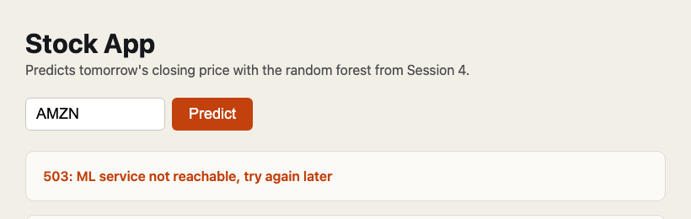
The page still works, the prediction doesn't
WHAT IF THE ML SERVICE IS DOWN?
The backend catches the network error and answers 503 instead of crashing
Prices from FMP are already saved, the prediction is missing
In the monolith this case can't happen, but then a crash takes everything down
Rule: every call over the network needs a timeout and an error case
Real page: ML service stopped, then Predict pressed
The same from the terminal
$ curl -X POST http://127.0.0.1:8000/api/predict/AMZN
{"detail": "ML service not reachable,
try again later"} -> 503
Notes:
Exercise 1 in the README. Let the students stop the ML service themselves and look into stock.db afterwards.

Slide 14
What the split costs and what it buys
MONOLITH VS. TWO SERVICES
 | 01 monolith | 02 two services
programs to run | 1 | 2
model call | function call: 14 ms | REST call: 15.5 ms (+1.3 ms network)
one whole click | ≈ 0.55 s (mostly FMP) | ≈ 0.55 s (mostly FMP)
model update | restart everything | restart only the ML service
model part down | everything down | page works, predict gives 503
backend needs sklearn | yes | no
SPLIT WHEN A PART
needs other hardware (GPU)
changes on its own rhythm (model every week)
belongs to another team
must scale on its own
Notes:
Measured on a laptop, Nov 2026: 50 calls each. The network between two programs on the same machine costs about a millisecond; the download from FMP costs half a second. The split is cheap in time, expensive in operations: two programs to start, watch and update.

Slide 15
Don't call the model, publish an event
STEP 3 · 04_EVENTS_NATS
Same two services, but they never call each other: NATS carries the messages
backend
→
NATS
→
ml_service
Notes:
Step 2 had one weakness: the backend waits for the ML service, and if it is down the request fails. Now the backend only says: here are new prices. Whoever is interested reacts.

Slide 16
Two events instead of one REST call
STEP 3 · EVENT-BASED
browser
index.html
backend
:8000
NATS · JetStream
POST
stream STOCK stores
every event
202
prices.updated
ml_service
no HTTP, no port
 | who | does what
1 | browser → backend | POST /api/predict/AAPL
2 | backend → NATS | publish prices.updated, 202
3 | NATS → ml_service | predict, publish result
4 | NATS → backend | save it in stock.db
5 | browser → backend | poll GET /api/predictions
predictions.created
Notes:
Nobody calls anybody: the backend doesn't know that an ML service exists, the ML service doesn't know the backend. Both only know NATS and the event names. 202 Accepted means: received, the result comes later. The page then polls.

Slide 17
Publish and subscribe instead of requests.post
WHAT CHANGED AGAINST 02?
backend/logic.py
04_EVENTS_NATS/
await events.publish("prices.updated",
{"symbol": symbol, "as_of": as_of,
"closes": closes[-11:]})
return {"status": "queued", ...} # -> 202
backend/
index.html + waits (polling)
app.py 202, listens to
predictions.created
logic.py publish, no requests
events.py NEW: NATS connect,
publish, subscribe
data.py same as 01
ml_service/
service.py NEW: no web server
events.py same as backend
model.py same as 02
ml_service/service.py
async def on_prices(event):
r = model.predict_return(rf, event["closes"])
await events.publish("predictions.created", {...})
await events.subscribe("prices.updated", "ml_service", on_prices)
Notes:
events.py is a new piece of infrastructure, like data.py: it hides NATS from the business layer. ack(): the handler tells NATS 'done', otherwise NATS delivers the event again after 30 s.

Slide 18
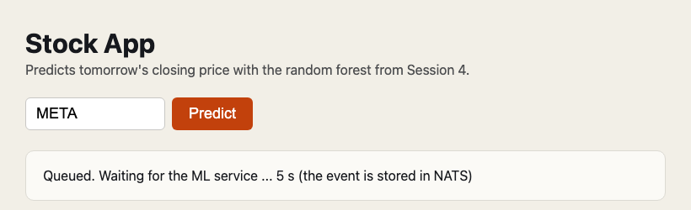
The event waits, nothing is lost
WHAT IF THE ML SERVICE IS DOWN?
Backend still answers 202 in 0.5 s: it doesn't depend on the ML service
The events wait in the JetStream stream
ML service restarted: it processed both waiting events, the page showed the prediction
Compare step 2: there the same case gave 503 and the prediction was missing
Real page: ML service stopped, then Predict pressed
What NATS says (http://127.0.0.1:8222/jsz)
stream STOCK messages 4
consumer backend pending 0
consumer ml_service pending 2 <- waiting
Notes:
Live demo: stop service.py, press Predict, show the waiting page and the jsz endpoint, start service.py again. Important: this needs JetStream (-js). Plain NATS without JetStream is fire and forget: the event would be lost.

Slide 19
Not faster, but nobody waits for anybody
REST VS. EVENTS
 | 02 REST | 04 events (NATS)
model round trip (measured) | 15.5 ms | 16.3 ms (14 ms of it is the model)
backend answers | 200 with the prediction | 202 at once, result later
ML service down | 503, prediction missing | event waits, done later
more ML power | load balancer needed | start service.py twice: NATS shares the events
new consumer (alerts) | change the backend | subscribe, change nothing
extra to run | nothing | the NATS server
USE EVENTS WHEN
the work is slow or comes in batches
the caller must not wait
several services react to the same thing
parts must survive each other's outages
Notes:
Measured on a laptop, Nov 2026, 30 to 50 calls. Two ML services were tested: NATS shared the events between them (in our run unevenly, 5 to 1, because one started first and took the backlog).

Slide 20
Start as a monolith, split when needed
TAKEAWAY
Clean layers make a split cheap. REST when the caller needs the answer now, events when nobody should wait
Monolith
→
3 layers
→
REST services
→
Events
Notes:
Exercises in the README. Exercise 4 shows the strongest point of events: a new alert service without changing any existing file.

