Slide 1
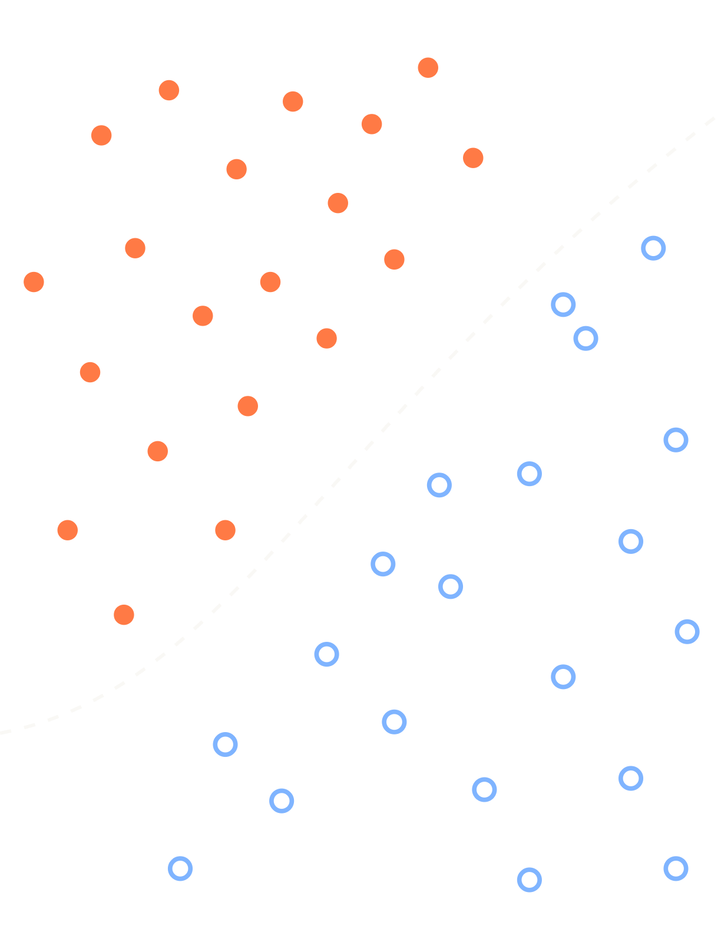
From raw data to a trained model
SOFTWARE ENGINEERING & MACHINE LEARNING
SESSION 03
Data analyst and data scientist, hands-on with 398 cars
1 Look
→
2 Clean
→
3 Features
→
4 Pipeline + train
Notes:
Today we continue chapter 02 Data and end with training. Everything is live-coded in the notebook; the slides are the scaffold.

Slide 2
Today we walk through steps 02 to 05, live
RECAP · CHAPTER 02
01
02
03
04
05
06
Ask
Collect
Clean
Explore
Model
Communicate
What exactly do we want to know?
APIs, databases, files, scraping
Missing values, duplicates, wrong types
Statistics and plots: look at it
Find the pattern, maybe with ML
A number or chart someone acts on
≈ 80% of the time
TODAY WITH AUTO MPG
↺ back to 01 anytime
How efficient will a car be?
one CSV file, 398 cars
missing values, outliers
groupby, plots, correlation
baseline → linear → forest
MAE in mpg, next session
Notes:
Same process as last time, now with a real dataset. Why not the stock data? Time series need special care (no shuffling, split by time); we come back to it in the feature slide.

Slide 3
Where the slope comes from, in one example
FROM LAST TIME · THE SLOPE
w | ŷ = w · 2 | Error ŷ − 6 | Loss | Slope
1.00 | 2.00 | −4.00 | 16.00 | −16.0
1.80 | 3.60 | −2.40 | 5.76 | −9.6
2.28 | 4.56 | −1.44 | 2.07 | −5.8
Sign = direction
−16: the loss falls when w grows, so w goes up.
Size = steepness
Far from w = 3 it is steep: big step. At w = 3 the slope is 0.
INPUT x = 2 · TARGET y = 6 · LEARNING RATE η = 0.05
loss = (ŷ − y)² = (w · x − y)²
outer 2 · (ŷ − y) × inner d(w·x − y)/dw = x
slope = 2 · (ŷ − y) · x = 2 · (−4) · 2 = −16
Check by nudging
next w = w − η · slope = 1 − 0.05 · (−16) = 1.80
w = 1.01 gives loss 15.84. (15.84 − 16) / 0.01 ≈ −16.
Chain rule: outer derivative × inner derivative. For the bias b the inner derivative is 1, so: 2 · (ŷ − y).
Notes:
Promised last time. Smallest possible example: one weight, one data point, no bias. Model y_hat = w*x with x = 2, true y = 6, so the right answer is w = 3. Start w = 1: y_hat = 2, error -4, loss 16. Slope without maths: nudge w to 1.01, the loss drops to 15.84, change -0.16 divided by 0.01 = -16. Same with the chain rule: d/dw (w*x - y)^2 = 2*(w*x - y)*x = 2*(-4)*2 = -16. Negative: increase w. Step with lr = 0.05: w = 1 - 0.05*(-16) = 1.8. Next round the slope is only -9.6, the steps get smaller by themselves, until w = 3 where error and slope are 0. In the NumPy code from last time this is grad_w, averaged over all points. For a network, loss.backward() computes this for every weight, given the current values of all other weights.

Slide 4

Data analyst vs. data scientist
02 · TWO ROLES, TWO QUESTIONS
 | Data analyst | Data scientist
Main question | What happened, and why? | What will happen?
Looks at | the past, as it is | patterns that generalise
Typical output | a chart, a dashboard, a number | a model that predicts
Typical tools | SQL, Excel, pandas, Power BI | pandas, scikit-learn, PyTorch
Success means | a decision gets made | good predictions on new data
Today | Part A: clean and explore | Part B: features, pipeline, train
Both start the same way: load, clean, look. Only the last steps differ.
Notes:
In small companies this is one person. The analyst answers questions about the past, the scientist builds something that predicts the future. Today the students play both roles.

Slide 5
Meet the data: Auto MPG
02 · THE DATASET
first_look.py
pandas
398 cars
Built 1970–1982 in the USA, Europe and Japan.
URL = "https://raw.githubusercontent.com/mwaskom/"
"seaborn-data/master/mpg.csv"
df = pd.read_csv(URL)
df.shape # (398, 9)
mpg cyl displ hp weight accel year origin
0 18.0 8 307.0 130 3504 12.0 70 usa
1 15.0 8 350.0 165 3693 11.5 70 usa
2 18.0 8 318.0 150 3436 11.0 70 usa
# target: mpg = miles per gallon, higher = better
7 features
Cylinders, displacement, horsepower, weight, acceleration, year, origin.
1 target
mpg: fuel efficiency. A regression problem.
Why this one?
Small, real, and dirty in all the right places.
Notes:
Live: load it, df.head(), df.info(). Let students spot that horsepower has 392 instead of 398 values. The name column is also there (305 unique names). Not the house-price project dataset on purpose.

Slide 6
Clean it, then look at it
A
PART A · DATA ANALYST
Answer questions about the past, with data.
Notes:
Part A divider.

Slide 7
Four checks, one decision each
02 · DATA QUALITY
 | What we found | Options | Our decision
Wrong types | all fine | convert with astype() | nothing to do
Duplicates | none | drop them | nothing to do
Outliers | 10 cars above 205 hp | drop, cap, keep | keep: real cars, no typos
Missing values | 6 × horsepower | drop rows, fill with median | fill, later, inside the pipeline
Rule: never delete or fill without asking why the value is odd.
Notes:
Live: df.isnull().sum(), df.duplicated().sum(), boxplots, IQR rule. Point out that the high-horsepower cars are a Chevrolet Impala, a Buick Estate Wagon... real 1970s cars, not data errors. Filling the missing values happens inside the pipeline after the split, see the leakage slide.

Slide 8
Answer questions with data
02 · EXPLORE · AS AN ANALYST
eda.py
pandas
groupby
Split by a category, then summarise each group.
# Q1: which region builds the most efficient cars?
df.groupby("origin")["mpg"].mean()
# Q2: do more cylinders mean lower mpg?
df.groupby("cylinders")["mpg"].mean()
# Q3: weight vs. mpg
sns.scatterplot(data=df, x="weight", y="mpg")
# Q4: did cars get better over the years?
df.groupby("model_year")["mpg"].mean().plot()
scatterplot
Two numbers against each other: is there a relationship?
plot over time
Trends that no single statistic shows.
Start with a question
Not with a chart. The question decides the chart.
Notes:
Live in the notebook. Let students guess the answers first.

Slide 9
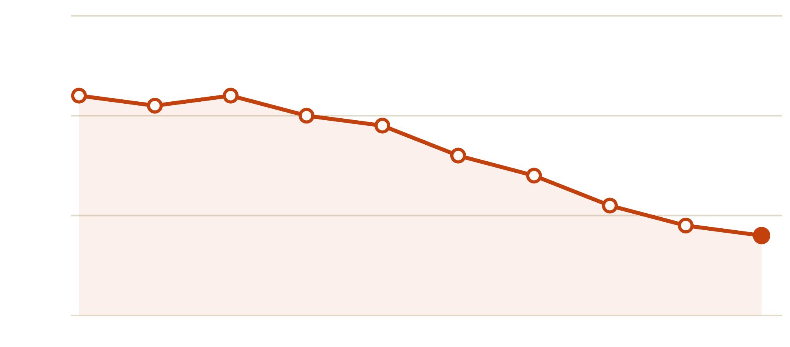
Japanese cars go 50% further on a gallon
02 · EXPLORE · WHAT THE DATA SAYS
By origin
Japan 30.5, Europe 27.9, USA 20.1 mpg.
By cylinders
4 cylinders: 29.3 mpg. 8 cylinders: 15.0 mpg.
By year
Rising steadily from 1973: the oil crises.
Careful: US cars were simply heavier.
Notes:
Real numbers from the notebook. Reuse correlation vs. causation from last session: the confounder here is weight. US cars in the 1970s were large; that, not the country, explains the low mpg.

Slide 10
From columns to a model
B
PART B · DATA SCIENTIST
Features, split, pipeline, and finally: train.
Notes:
Part B divider.

Slide 11
From columns to features
02 · FEATURE ENGINEERING
ENCODE
DROP
CREATE
origin → three columns
name goes
power_to_weight
Models only understand numbers. One-hot: usa, europe, japan, each 0 or 1.
305 different names for 398 cars. There is no pattern to learn, only noise.
horsepower ÷ weight. Your own idea, written down as a new column.
IN CODE
IN CODE
IN CODE
OneHotEncoder()
df.drop(columns=["name"])
df.hp / df.weight
Never usa=1, europe=2, japan=3
Less is often more
Domain knowledge in a column
Notes:
Why not usa=1, europe=2, japan=3? The model would think Japan is "three times" USA and Europe lies in between. One-hot avoids that fake order.

Slide 12
Our Stock App features are home-made too
02 · FEATURE ENGINEERING · STOCK APP
features.py
pandas
Returns
Change instead of price: comparable across stocks.
# raw data: one closing price per day
df["ret"] = df["close"].pct_change()
df["ma_20"] = df["close"].rolling(20).mean()
df["ma_50"] = df["close"].rolling(50).mean()
df["trend"] = df["ma_20"] / df["ma_50"]
df["rsi"] = rsi(df["close"], 14)
# target: what happens over the next 5 days?
future = df["close"].shift(-5) / df["close"]
# time series: split by date, never shuffle
Moving averages
A smoothed trend over 20 or 50 days.
RSI
Has the stock risen too fast? A classic indicator.
shift(-5)
The target looks into the future, the features must not.
Notes:
Bridge to the red thread. The same idea as power_to_weight: the raw price alone says little, the engineered features carry the signal. Important difference: in a time series the split must be by date.

Slide 13
Split first, then touch the data
02 · SPLIT FIRST
TRAIN · 318 CARS
TEST · 80
DATA LEAKAGE
fill, scale, fit: here only
locked away
The test set must stay a surprise.
split.py
X_train, X_test, y_train, y_test = train_test_split(
X, y, test_size=0.2, random_state=42)
# median hp, all data: 93.5 train only: 92.0
If you fill missing values with the median of all data, a bit of the test set slips into training. The model looks better in the test than it will be in reality.
RULE
Every value you compute (median, mean, scale) comes from the training data only.
Small here (93.5 vs. 92.0), dangerous in real projects.
Notes:
Leakage is the most common silent error in student projects. Here the effect is tiny on purpose, so students see the principle without drama. The pipeline on the next slides makes this mistake impossible.

Slide 14
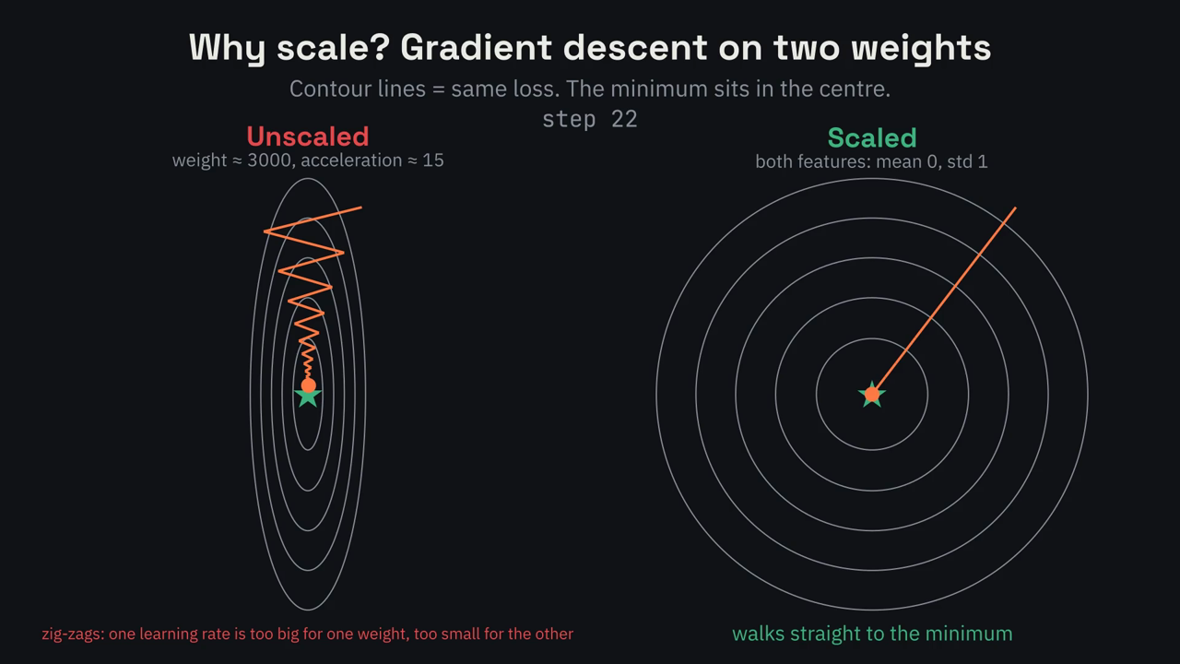
Unscaled features make gradient descent zig-zag
VIDEO · WHY SCALE?
WHAT YOU SEE
Unscaled
weight ≈ 3000, acceleration ≈ 15
One learning rate
too big for one, too small for the other
Scaled
mean 0, standard deviation 1
Result
a straight walk to the minimum
Notes:
Link to session 2: the slope for the weight of "weight" is huge because the values are huge. The notebook shows it for real: SGDRegressor on unscaled data ends with weights around 10^12, after StandardScaler they are below 1.

Slide 15
A pipeline makes leakage impossible
02 · PIPELINE
pipeline.py
sklearn
SimpleImputer
Fills the 6 gaps with the median of the training data.
numeric = Pipeline([
("impute", SimpleImputer(strategy="median")),
("scale", StandardScaler()),
])
prep = ColumnTransformer([
("num", numeric, num_cols),
("cat", OneHotEncoder(), ["origin"]),
])
model = Pipeline([("prep", prep), ("rf", RandomForestRegressor())])
model.fit(X_train, y_train) # learns medians + scale here
model.predict(X_test) # only applies them
StandardScaler
Mean 0, standard deviation 1, learned on train only.
ColumnTransformer
Different treatment for number and text columns.
Pipeline
One object: fit() on train, predict() on test. No leakage.
Notes:
The pipeline is also what goes into deployment later: one file that contains cleaning, scaling and the model.

Slide 16
First a baseline, then real models
03 · FINALLY: TRAIN
 | MAE | RMSE | In words
Baseline: always the mean | 5.96 | 7.35 | off by 6 mpg on average
Linear regression | 2.29 | 2.89 | already 2.6 × better
Linear + power_to_weight | 2.22 | 2.78 | our own feature helps a little
Random forest | 1.63 | 2.18 | off by 1.6 mpg on average
Without a baseline, “MAE = 1.63” means nothing. With one, it means: 3.7 × better than guessing.
Notes:
Real numbers from the notebook (test set, 80 cars, random_state=42). MAE = mean absolute error in mpg. RMSE punishes big misses more. Next session (chapter 04 Testing): is one split enough? Cross-validation and overfitting.

Slide 17
The forest relies on engine size and weight
03 · WHAT THE MODEL LEARNED
Engine and weight
displacement, weight and cylinders: 71% together.
They are redundant
All three describe “big car”. Importance gets split between them.
origin ≈ 0
Once the forest knows the weight, the country adds nothing.
Importance shows what the model uses, not what causes mpg.
Notes:
Nice callback to the EDA slide: origin looked important in the groupby, but once weight is known it carries almost no extra information. That is the confounder from earlier, now visible in the model. power_to_weight is low here but helped the linear model: different models use features differently.

Slide 18

First: one decision tree asks questions
03 · RANDOM FOREST · STEP 1
displacement ≤ 198?
313 cars · mean 23.6 mpg
yes
no
horsepower ≤ 84?
horsepower ≤ 127?
176 small engines · 29.0 mpg
137 big engines · 16.7 mpg
yes
no
yes
no
32.2 mpg
24.6 mpg
19.4 mpg
14.6 mpg
101 cars: small and weak
75 cars
59 cars
78 cars: big V8s
A new car walks down the tree and gets the mean mpg of its leaf. Training picks each question so that the groups below are as uniform as possible. No gradient descent here.
Notes:
A real depth-2 tree trained on the Auto MPG training data (rows with missing horsepower dropped). The tree found by itself that engine size is the first question to ask. Training a tree: try every feature and every threshold, keep the split that makes the two groups most uniform (lowest squared error). Then repeat inside each group. Honest point for the loop story from session 2: trees do not use gradient descent. A single deep tree gets MAE 2.21 in our test, but it memorises the training data.

Slide 19
Then: 300 different trees, one average
03 · RANDOM FOREST · STEP 2
1 · ROWS
2 · COLUMNS
3 · AVERAGE
Every tree gets its own sample
Every question sees a few features
The forest votes
Draw 318 cars with replacement: some twice, some not at all.
At each split only a random subset of columns may be used.
Prediction = mean of all 300 trees. Single trees err wildly, but in different directions.
EFFECT
EFFECT
EFFECT
every tree sees
slightly different data
the trees don’t all
ask the same thing
the errors cancel out:
MAE 2.21 → 1.63
bootstrap
max_features
n_estimators=300
Notes:
Wisdom of the crowd. One deep tree: MAE 2.21. 300 trees on random rows and random columns, averaged: MAE 1.63. For classification the forest takes a majority vote instead of the mean. Why it is the strong default for tables: little tuning, no scaling needed, handles mixed features, gives feature importance for free.

Slide 20
Classical machine learning: the toolbox for tables
03 · ML ARCHITECTURES · 1/2
Architecture | Good for | Data | Example
Linear / logistic regression | simple, fast, explainable | tables | price, yes/no
Decision tree | rules a human can read | tables | credit approval
Random forest | strong default, little tuning | tables | our mpg model
Gradient boosting (XGBoost) | often the best on tables | tables | churn, fraud
k-nearest neighbours | “similar to these ones” | tables | recommendations
k-means · PCA | groups, compression (no labels) | tables | customer segments
Rule of thumb: tabular data → start with a random forest or gradient boosting.
Notes:
Not to memorise, a map. Classical ML wins on tables, almost always. Trees and forests are the exception to the gradient-descent story: they learn by splitting.

Slide 21
Deep learning: neural networks for everything else
03 · ML ARCHITECTURES · 2/2
Architecture | Good for | Data | Example
MLP (fully connected) | stacked perceptrons, any numbers | vectors | small classifiers
CNN (convolutional) | local patterns in grids | images | skin cancer
RNN · LSTM | order matters | sequences | energy demand
Transformer | attention: text and almost anything | text, images | ChatGPT, Claude
Autoencoder | compression, anomalies | any | failing machine
Diffusion model | generating images | images | Stable Diffusion
DQN · PPO (reinforcement) | decisions by trial and error | rewards | data-centre cooling
All of these learn with the loop from session 2: loss, slope, gradient step.
Notes:
Deep learning wins on images, text, audio. The perceptron from session 2 is the smallest MLP, the autoencoder video was a small MLP-autoencoder, LLMs are transformers.

Slide 22
Same steps, your project dataset
LAB · YOUR TURN
PART A
PART B
TRAIN
Clean and explore
Features and split
Pipeline and baseline
Load, info, missing values, duplicates, outliers. Then three questions you answer with groupby or a plot.
Encode categories, drop useless columns, build at least one feature of your own. Split before anything else.
ColumnTransformer plus model in one Pipeline. Compare against a Dummy baseline.
DELIVER
DELIVER
DELIVER
one decision per problem,
written down
X_train, X_test,
y_train, y_test
a results table
like ours
Heart disease or house prices
Classification: stratify=y
Classification: accuracy, F1
Notes:
For the classification project: DummyClassifier(strategy="most_frequent") as baseline, train_test_split(..., stratify=y).

Slide 23
What you should take home
RECAP
01
02
03
04
Look first
Features
Split first
Baseline first
info, describe, groupby, plots. Every odd value gets a decision, not a reflex.
Encode, drop, create. The model can only learn from what you give it.
Every statistic comes from the training data. A pipeline enforces it.
A number means nothing until you compare it to guessing.
Notes:
Next session: chapter 04 Testing. Cross-validation, overfitting, and metrics for classification.

