Slide 1
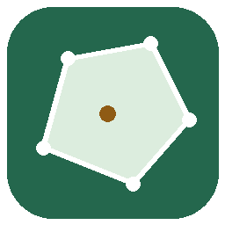
GeoViz
Computational Geometry Visualizer and Spatial Security Analytics Console
Name: Satyam Dhal
ID: b425050
Branch: CSE-B
Course: Object Oriented Programming
Topic: Lab Project Presentation
College: International Institute of Information Technology, Bhubaneswar

Slide 3
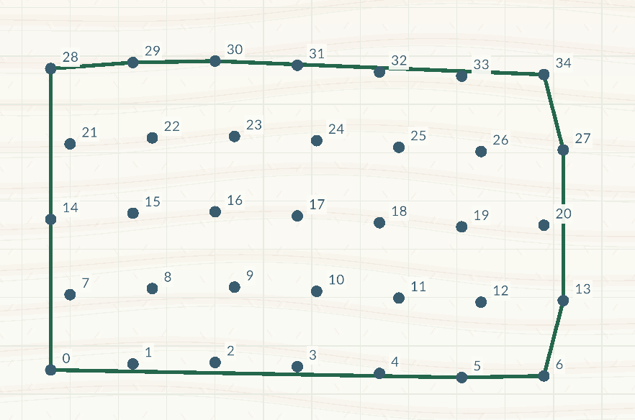
Convex Hull
Problem Statement
GeoViz Output
Given planar points, compute the smallest convex boundary containing every point.
Applications
Drawing boundaries around GPS survey points.
Creating simple collision shapes for games.
Analysing class separation in machine learning.
The green outline encloses every input point.

Slide 4
Convex Hull: Pseudocode
Sort points left to right. Break horizontal ties from bottom to top.
Remove duplicate coordinates.
Build the lower boundary, adding one point at a time.
If the last three points turn clockwise or stay collinear, remove the middle point.
Repeat from right to left to build the upper boundary.
Join both boundaries without repeating endpoints.

Slide 5
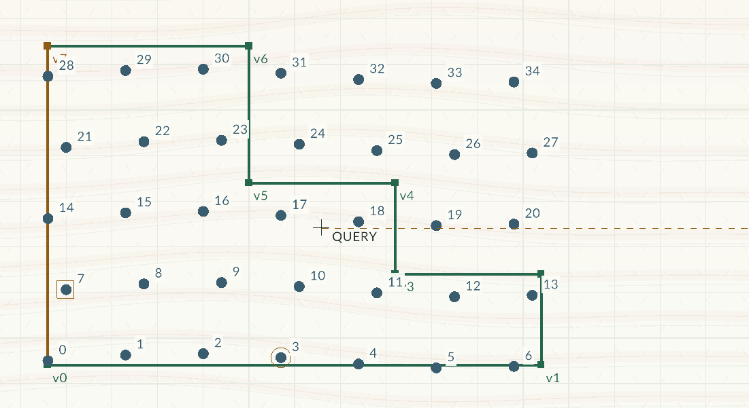
Point-in-Polygon: Ray Casting
Problem Statement
GeoViz Output
Given a simple polygon and a query point, classify the point as inside, outside, or on the boundary.
Applications
Alerting when a car leaves a permitted area.
Checking whether an address is inside a delivery zone.
The query lies inside the polygon.

Slide 6
Point-in-Polygon: Ray Casting: Pseudocode
Check that the polygon is valid.
Test each edge. If the query lies on an edge or vertex, report Boundary and stop.
Cast an imaginary horizontal ray to the right.
Count crossed edges, counting each polygon corner only once.
Report Inside when the crossing count is odd.
Report Outside when the crossing count is even.

Slide 7
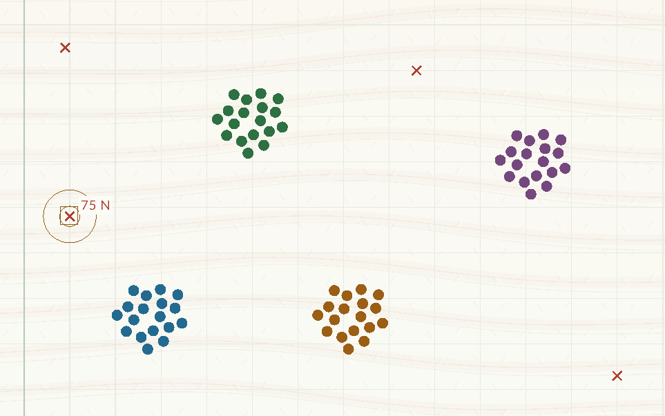
DBSCAN: Direct Scan
Problem Statement
GeoViz Output
Given points, radius ε, and MinPts, find density-connected clusters and label core, border, and noise points.
Applications
Finding taxi-pickup hotspots.
Grouping devices with similar activity.
Reviewing isolated observations.
Colours separate clusters. Crosses mark noise.

Slide 8
DBSCAN: Direct Scan: Pseudocode
Mark every point as unvisited and unassigned.
Choose the next unvisited point in input order and visit it.
Scan all points for neighbours within the radius, including the point itself.
With fewer than MinPts neighbours, mark provisional noise and continue.
Otherwise, mark a core point, start a cluster, and queue its other neighbours.
Take the next queued point. If unvisited, visit it and find its neighbours.
If it is core, add neighbours not already queued during this expansion.
Assign unassigned or noisy points to the cluster. Non-core members become border points.
Empty the queue, then continue with the next unvisited point.

Slide 9
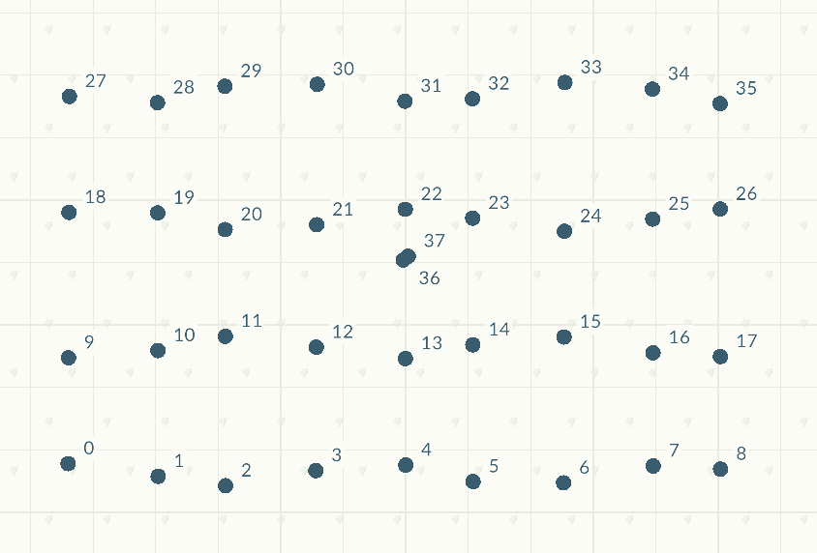
Closest Pair: Divide and Conquer
Problem Statement
GeoViz Output
Given at least two planar points, find the pair with the smallest Euclidean distance.
Applications
Checking minimum spacing between point features.
Finding the two closest sensors or objects.
Two neighbouring points give the minimum distance.

Slide 10
Closest Pair: Divide and Conquer: Pseudocode
Sort points from left to right.
Check adjacent sorted points for duplicates. A duplicate gives distance zero.
Otherwise, split into two halves and solve each half recursively.
For groups of at most three points, compare every pair.
Keep the best pair and merge both halves from bottom to top.
Form a strip around the split using the current best distance.
Compare each strip point with the next seven points. Stop if vertical separation is too large.
Return the best pair and distance. Break equal-distance ties by point IDs.

Slide 11
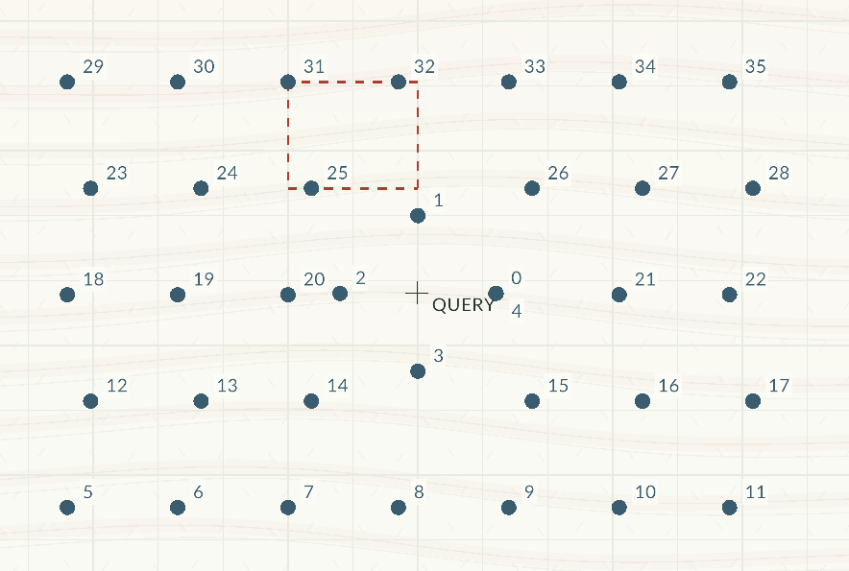
K-d Tree: Nearest Neighbour
Problem Statement
GeoViz Output
Given planar points and a query location, find the input point nearest to the query.
Applications
Finding the nearest hospital or charging station.
Locating the closest sensor.
Dashed regions are pruned from the search.

Slide 12
K-d Tree: Nearest Neighbour: Pseudocode
Build a balanced tree with middle points, alternating horizontal and vertical splits.
Start with no nearest point and an infinite best distance.
Visit a point and compare its distance from the query with the best distance.
Update the nearest point if closer. For a tie, choose the smaller point ID.
Search the side containing the query first, then consider the other side.
Skip a region only when its minimum possible distance exceeds the best distance.
Return the nearest point after checking all necessary regions.

Slide 13
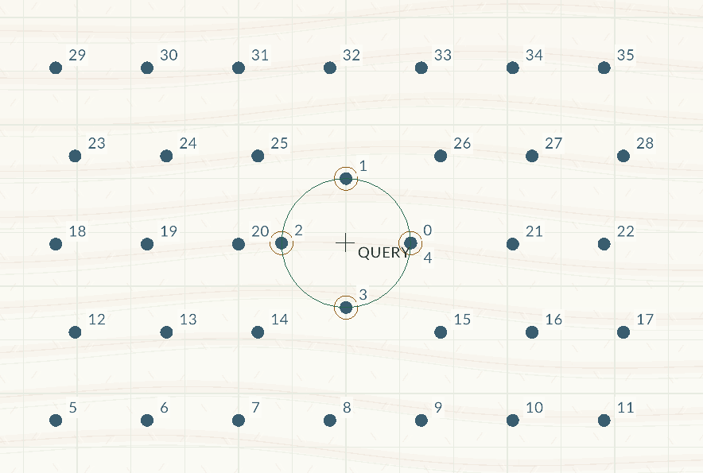
K-d Tree: Radius Search
Problem Statement
GeoViz Output
Given planar points, a query location, and radius r, return every point within or on the radius.
Applications
Finding all restaurants within 5 km.
Locating nearby vehicles, sensors, or events.
Four points lie within the query radius.

Slide 14
K-d Tree: Radius Search: Pseudocode
Build the balanced k-d tree.
Start with an empty result list.
Skip a region if its minimum possible distance from the query exceeds the radius.
Check each remaining point's distance from the query.
Add points within or exactly on the radius.
Search the query side first, followed by the other side.
Sort the collected point IDs and return them.

Slide 15
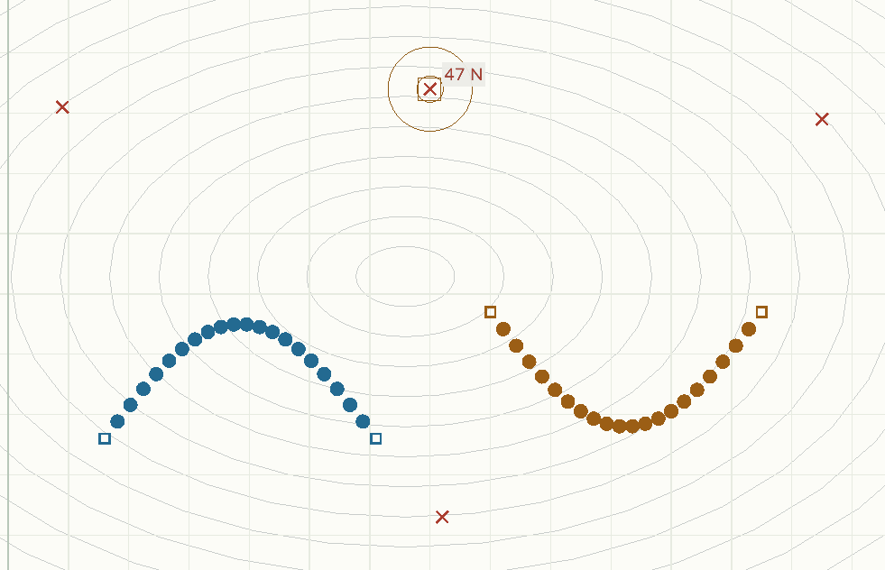
DBSCAN: Spatially Indexed
Problem Statement
GeoViz Output
Given points, ε, and MinPts, compute DBSCAN clusters and point labels using k-d-tree neighbourhood queries.
Applications
Clustering larger collections of GPS observations.
Grouping spatial event and sensor records.
The indexed run finds two clusters and four noise points.

Slide 16
DBSCAN: Spatially Indexed: Pseudocode
Build a k-d tree for the points once.
Follow the same clustering steps as direct DBSCAN.
Find neighbours by searching the tree instead of scanning every point.
Skip tree regions outside the search radius.
Return neighbour IDs in increasing order.
Use the same queue expansion and core, border, and noise labels.

Slide 17
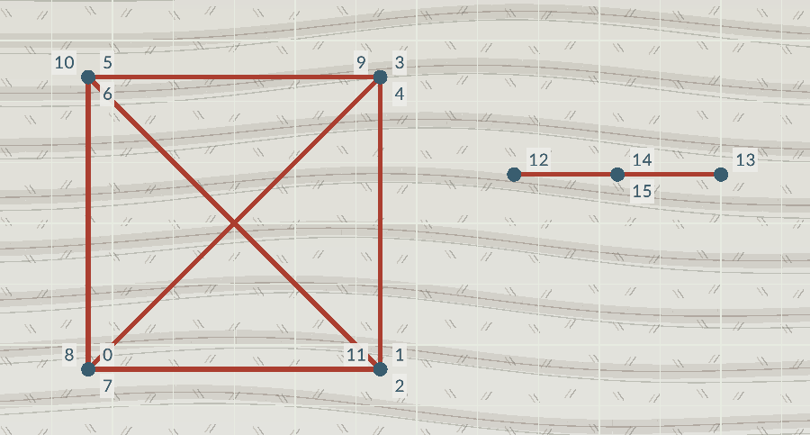
Segment Collision Detection
Problem Statement
GeoViz Output
Given planar segments, find intersecting pairs, including endpoint touches and collinear overlaps.
Applications
Checking robot paths against walls.
Finding crossings between roads on maps.
Checking intersections of 2D game-object edges.
Red segments belong to intersecting pairs.

Slide 18
Segment Collision Detection: Pseudocode
Treat each consecutive point pair as a segment. Ignore an unmatched final point.
Compare each segment with every later segment, testing each pair once.
Check for crossings, endpoint touches, and collinear overlaps.
Increase the collision count for each intersecting pair.
Highlight every involved segment once.
Return the number of intersecting segment pairs.

Slide 19
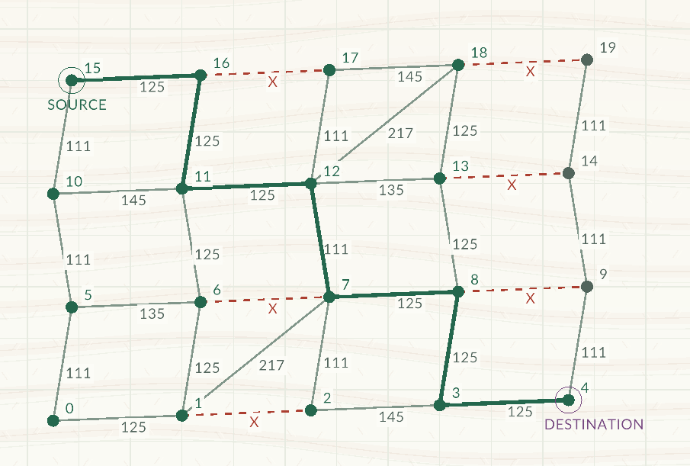
Dijkstra: Shortest Path
Problem Statement
GeoViz Output
Given a graph with nonnegative edge costs, find the cheapest source-to-goal path, or report no path.
Applications
Finding routes on road or campus maps.
Routing data through computer networks.
The green path connects source and destination.

Slide 20
Dijkstra: Shortest Path: Pseudocode
Ignore blocked edges. Set the start cost to zero and all other costs to infinity.
Add the start to the waiting list.
Choose the lowest-cost entry. Skip processed points and outdated entries.
Mark the selected point as processed. Stop if it is the destination.
Check each unprocessed neighbour for a cheaper route through the selected point.
If cheaper, update its cost and previous point, then add a new waiting entry.
Repeat until the destination is processed or the waiting list is empty.
Follow previous points backward to recover the route, or report No Path.

Slide 21
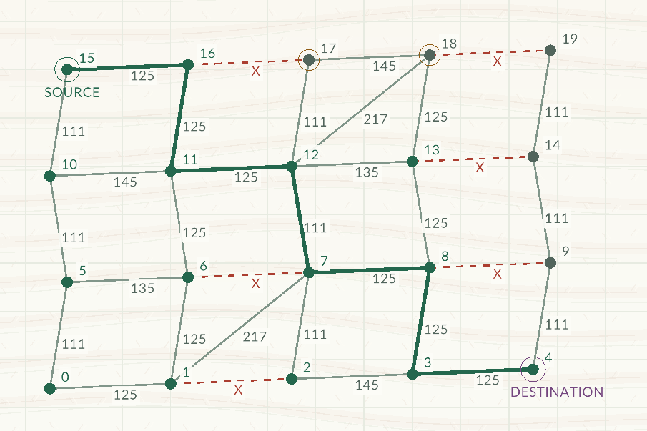
A*: Goal-Directed Shortest Path
Problem Statement
GeoViz Output
Given nonnegative edge costs and a suitable distance estimate, find an optimal source-to-goal path.
Applications
Moving game characters around obstacles.
Guiding warehouse robots through a map.
A* finds a route around blocked edges.

Slide 22
A*: Goal-Directed Shortest Path: Pseudocode
Ignore blocked edges.
Estimate remaining distance using grid steps or straight-line distance.
Check the estimate against edge costs. If incompatible, use zero throughout.
Follow Dijkstra's steps, choosing the lowest cost so far plus estimated remaining cost.
Update a neighbour's cost and previous point whenever a cheaper route is found.
Stop when the destination is processed or no waiting entries remain.
Reconstruct the route, or report No Path.

Slide 23
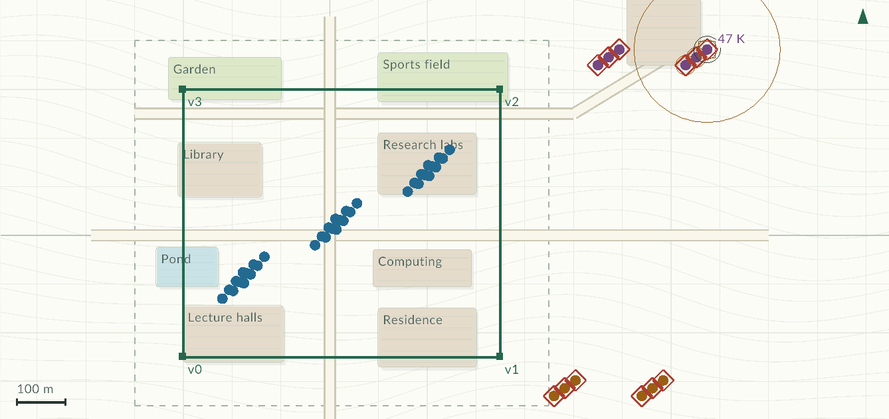
Spatial Security Console
Problem Statement
GeoViz Output
Given event logs, identify unusual locations and device activity for analyst review.
Applications
Review events outside a permitted area.
Find devices with unusual activity rates.
Inspect source records and export evidence.
Local CSV input.
Nine synthetic scenarios.
Notes:
C:\GeoViz\GeoViz-Computational-Geometry-Visualizer--main\docs\USER_GUIDE.md
C:\GeoViz\GeoViz-Computational-Geometry-Visualizer--main\src\security.cpp
C:\GeoViz\GeoViz-Computational-Geometry-Visualizer--main\data\security_samples.csv

Slide 24
Security Workflow
Input and Preparation
Analysis and Output
Load a sample, event CSV or saved security session.
Validate identities, counts and analysis settings.
Filter by the UTC window [start, end), user and device.
Build event locations or device activity points.
Adapt observations into a Scene and run geometry algorithms.
Inspect clusters, fence membership and linked records.
Record an analyst verdict and optional review note.
Save the session or export reproducible evidence.
Notes:
C:\GeoViz\GeoViz-Computational-Geometry-Visualizer--main\docs\USER_GUIDE.md
C:\GeoViz\GeoViz-Computational-Geometry-Visualizer--main\docs\WORKFLOW.md
C:\GeoViz\GeoViz-Computational-Geometry-Visualizer--main\src\security.cpp
C:\GeoViz\GeoViz-Computational-Geometry-Visualizer--main\src\security_io.cpp

Slide 25
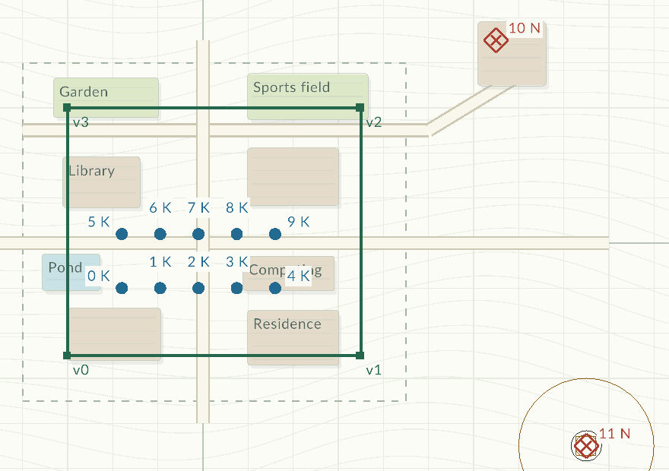
Security Map
Problem Statement
GeoViz Output
Project each filtered event into local east/north coordinates measured in metres.
Geographic Analysis
Geofence: inside, boundary or outside. Boundary is permitted.
DBSCAN: find location clusters and noise.
K-d queries: inspect nearby events.
Diamonds mark events outside the permitted fence.
Notes:
C:\GeoViz\GeoViz-Computational-Geometry-Visualizer--main\docs\USER_GUIDE.md
C:\GeoViz\GeoViz-Computational-Geometry-Visualizer--main\src\security.cpp
C:\GeoViz\GeoViz-Computational-Geometry-Visualizer--main\src\app_inspector.cpp

Slide 26
Review Candidates: Pseudocode
Device Activity
Geography and Evaluation
Filter events, then group selected records by device.
Convert totals into scaled rates over the full time window.
Run indexed DBSCAN with the feature radius and MinPts.
Flag source events linked to noise devices.
Add selected events strictly outside the permitted fence.
Treat fence-boundary events as permitted.
Compare the combined flags with known sample truth labels.
Report unknown labels and analyst reviews separately.
Notes:
C:\GeoViz\GeoViz-Computational-Geometry-Visualizer--main\src\security.cpp
C:\GeoViz\GeoViz-Computational-Geometry-Visualizer--main\src\security_selection.hpp

Slide 27
Conclusion
Project Outcome
Ten algorithm modes explain geometry decisions through recorded steps.
Security views reuse the engine for event locations and device activity.
Source-linked reviews and saved snapshots support reproducible analysis.
C++ interfaces separate the model, computation and presentation.
Thank you
Notes:
C:\GeoViz\GeoViz-Computational-Geometry-Visualizer--main\README.md
C:\GeoViz\GeoViz-Computational-Geometry-Visualizer--main\docs\DESIGN.md
C:\GeoViz\GeoViz-Computational-Geometry-Visualizer--main\docs\USER_GUIDE.md

