Slide 1
Loss, noise and two Friis equations

Slide 2
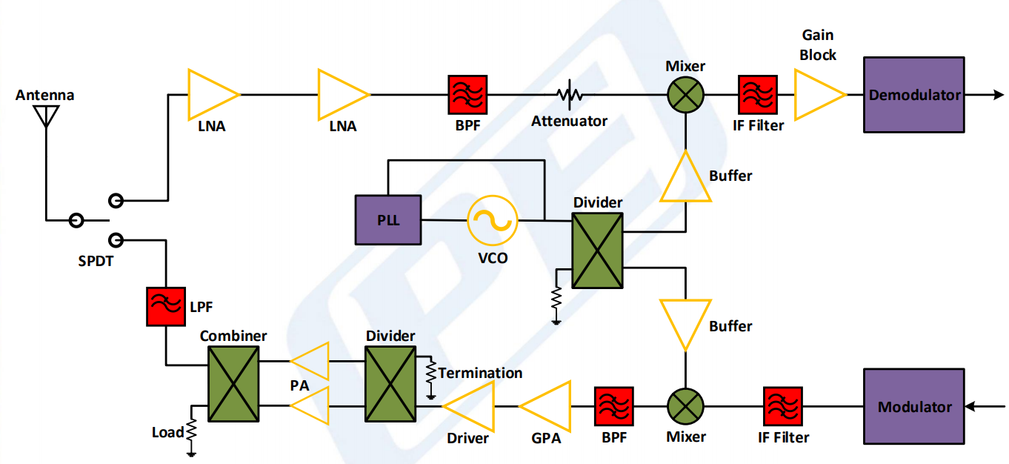
RF transceiver block diagram
Common RF transceiver includes:
RX chain
TX chain
One or more antennas
Image source:
www.pasternack.com/pages/Technical-Charts/RF-Transceiver.pdf

Slide 3
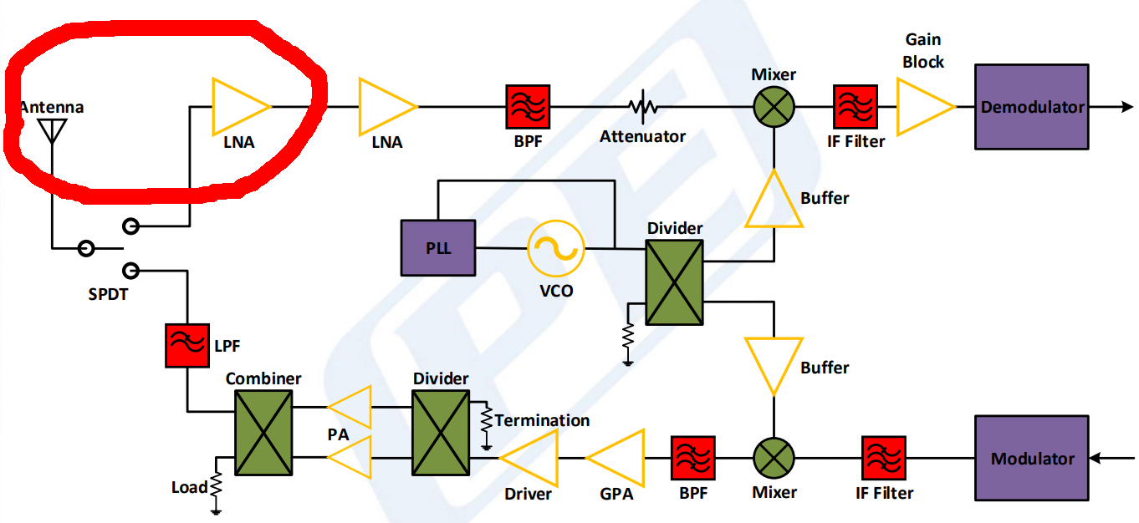
RF transceiver block diagram
Common RF transceiver includes:
RX chain
TX chain
One or more antennas
Image source:
www.pasternack.com/pages/Technical-Charts/RF-Transceiver.pdf

Slide 4
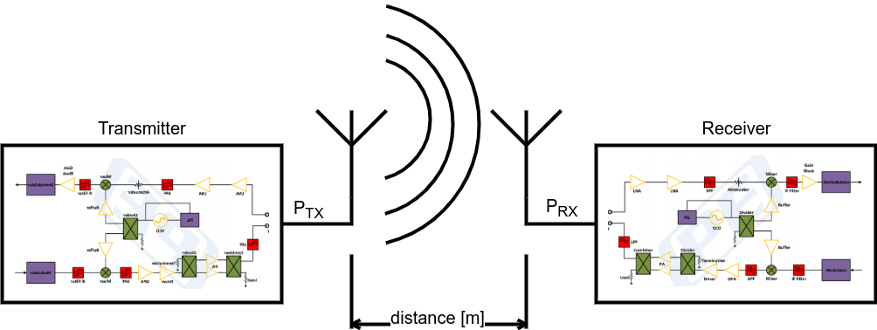
RF link budget
Common RF communication system consists of one or several transceivers.
It is important to determine relation between transmitted power, distance and received power to design system properly.

Slide 5
RF link budget
Friis transmission equation is often used to calculate received signal power:
where
P_{RX} – received power [W]
P_{TX} – transmitted power [W]
D_{RX} – receiver antenna directivity
D_{TX} – transmitter antenna directivity
λ – wavelength of signal [m]
d – distance between RX and TX [m]

Slide 6
RF link budget logarithmic form
Example of RF link budget calculation:
P_{TX} = 1 W, D_{TX} = 10, D_{RX} = 1, d = 100 m, f=800 MHz
The logarithmic form of the equation allows you to simplify calculations, which consist of a large number of arguments and a lot of multiplications:
W → dBm
Ratio → dB
Multiplication → Summation
Division → Subtraction

Slide 7
RF link budget logarithmic form
Logarithmic conversion formulas:
dB basic formula
W → dBm conversation formula
Friis equation logarithmic form
Previous example in logarithmic form:

Slide 8
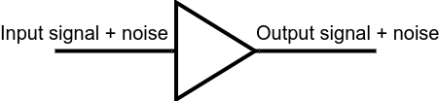
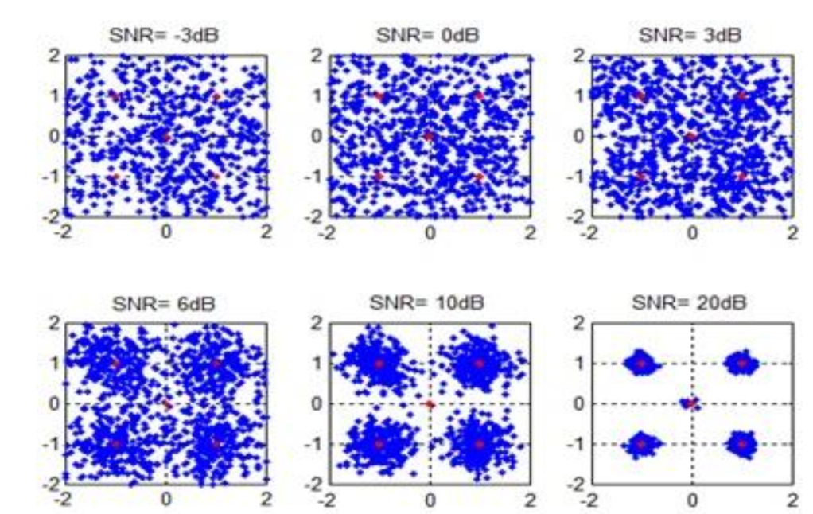
Noise figure
Noise figure is a measure of degradation of the signal-to-noise ratio (SNR) in a signal chain.
SNR degradation on QPSK constellation
Image source:
https://docplayer.net/45205148-Dsp-based-phase-lock-loops-for-carrier-and-timing-recovery-at-low-signal-to-noise-ratio-a-thesis-presented-to-the-faculty-of.html

Slide 9
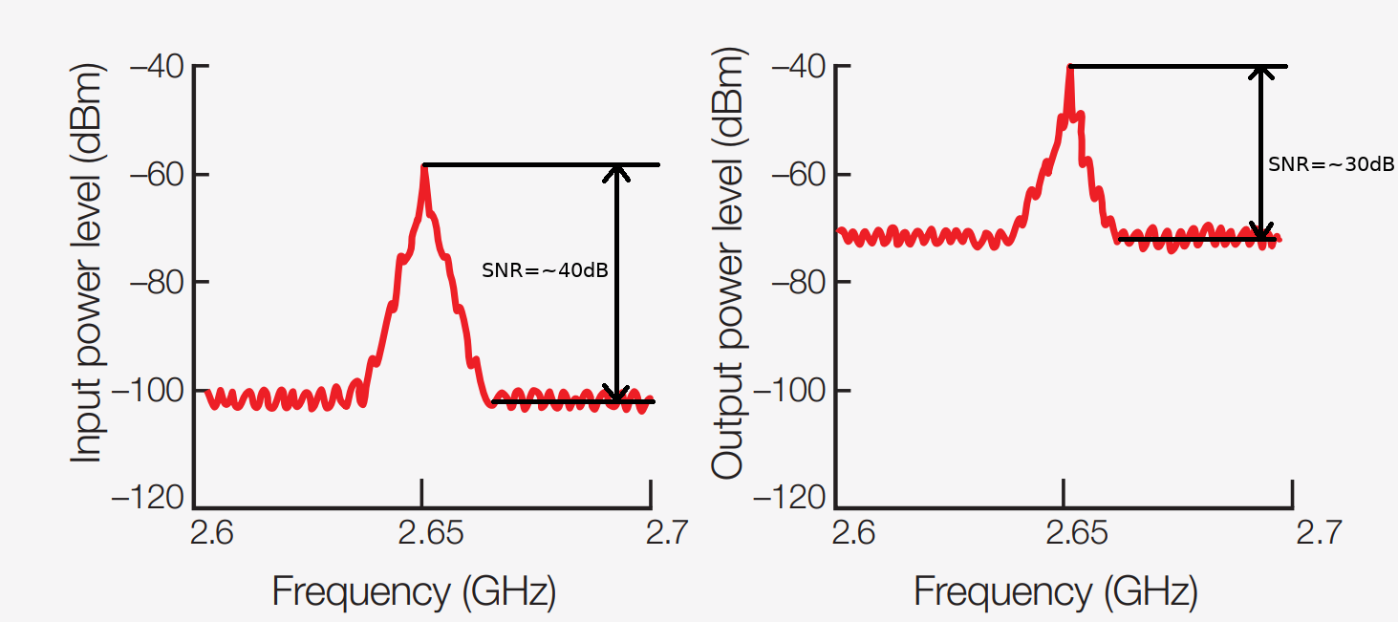
Noise figure
Noise figure formula:
NF of ideal element is 0 dB. In fact it is always >0 dB
Image source:
https://literature.cdn.keysight.com/litweb/pdf/5952-8255E.pdf

Slide 10
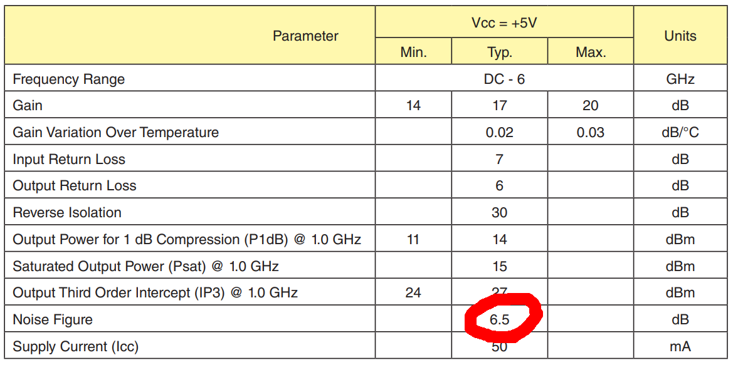
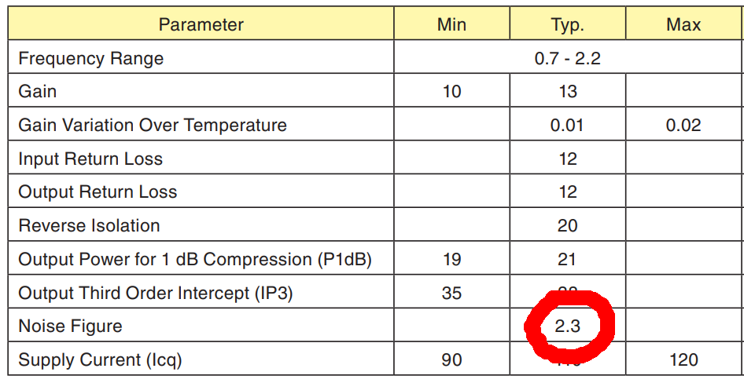
Noise figure
In noise-sensitive applications low-noise amplifiers (LNA) are used.
Noise figure is usually described in amplifier datasheet.
There are 2 datasheet parameter tables for general-purpose amplifier (on the left picture) and for LNA (on the right picture) for example
Image sources:
https://www.analog.com/media/en/technical-documentation/data-sheets/hmc313.pdf
https://www.analog.com/media/en/technical-documentation/data-sheets/hmc639.pdf

Slide 11
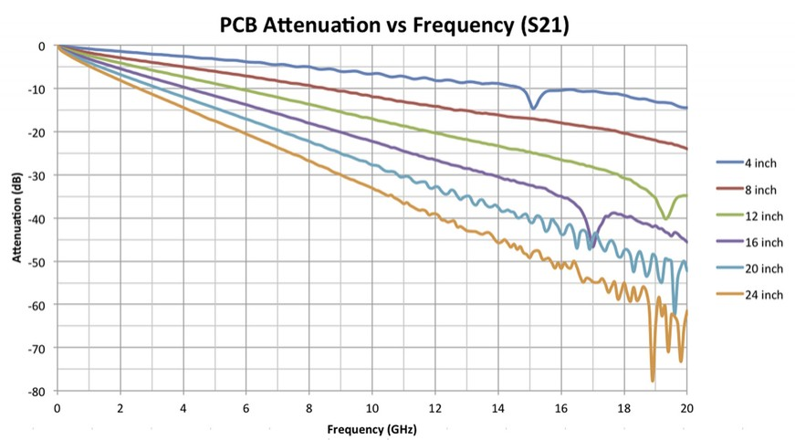
Noise figure
Noise figure of passive device (e.g. filter, cable, switch, attenuator) is equal to its loss
For example, 4 inch long trace can attenuate Wi-Fi 5GHz signal
by 3 dB and add 3 dB noise due to noise figure
Image source:
http://signal-processing.mil-embedded.com/articles/can-pcb-handle-speed/

Slide 12
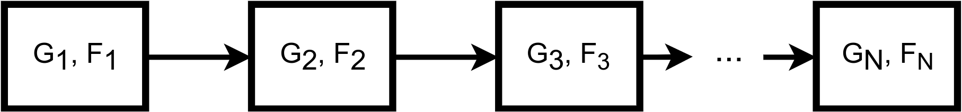
Noise figure
Friis formula for cascaded devices
where
F_{N} is device noise factor (noise figure converted to ratio)
G_{N} is device gain (linear, not in dB)
This formula shows that first device noise factor (i.e. noise figure) and gain are most important for overall system noise factor

Slide 13
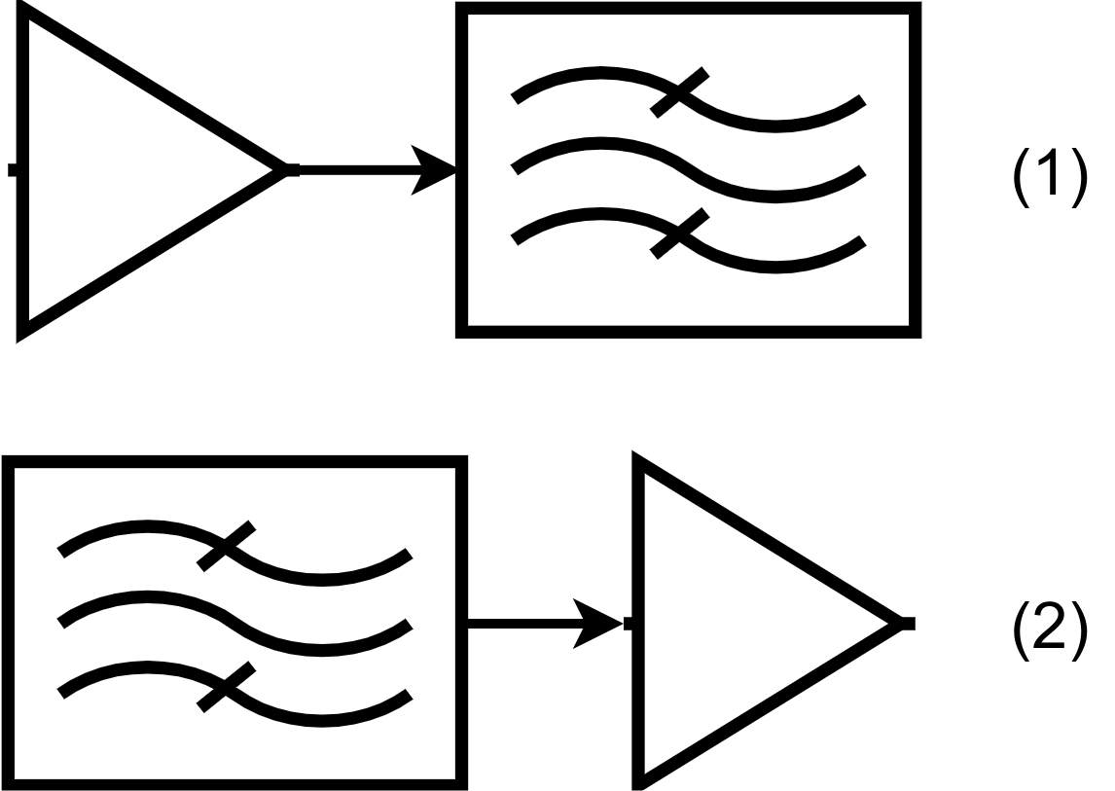
Noise figure
Let’s consider a simple GPS-receiver input circuit consists of two elements: low noise amplifier and band-pass filter. There are two variants of cascade connection for two elements:
Noise figure of system decreased by ~2.6 dB (almost 2 times) due to components rearrangement. BTW, BPF+LNA connection has some pros (i.e. better out-of-band signal immunity)
Device | Description | NF, dB | G, dB
LNA | BGU7004 (LNA for GPS application) | 0.85 | 16.5
Band-pass filter | SF1186B-2 (BPF for GPS application) | 2.7 | -2.7
(1) | LNA + BPF | 0.92 | 13.8
(2) | BPF + LNA | 3.55 | 13.8

Slide 14
Noise figure
Conclusions
It is important to calculate noise figure of RX chain for noise-sensitive applications
It is important to place LNA as close to the antenna as possible
Active antenna can be used to reduce noise figure of receiver
Properly designed RX chain can increase range of wireless connection and increase battery life

Slide 15
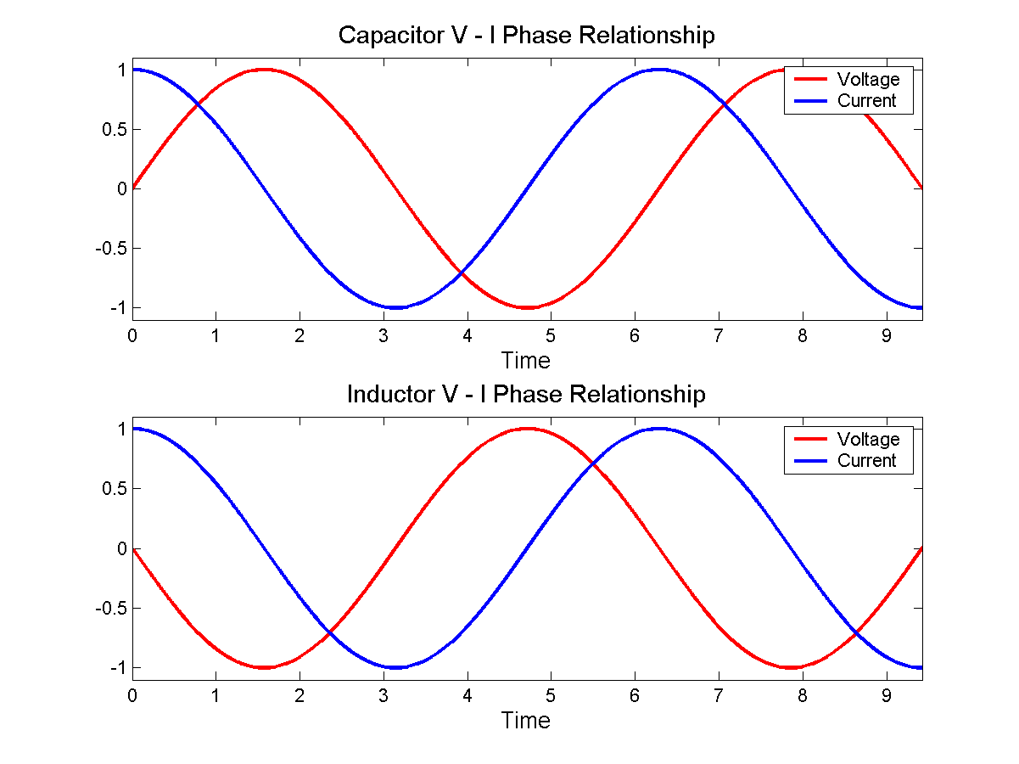
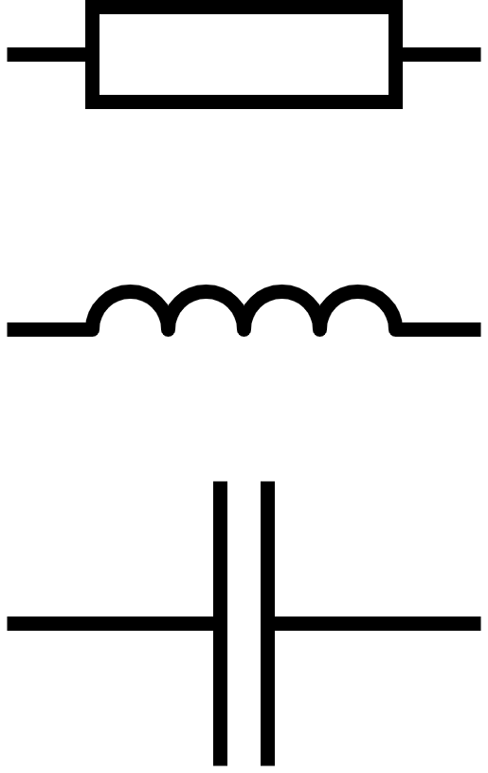
Matching networks
Complex impedance
Impedance is the measure of current response when a voltage is applied. It can be represented in a complex form:
Image source:
https://en.wikipedia.org/wiki/Electrical_impedance

Slide 16
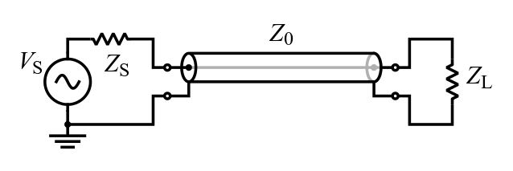
Matching networks
Complex impedance
Any system can be represented as a source with output impedance of Z_{S}, load with impedance of Z_{L} and a transmission line with characteristic impedance of Z₀
There is an maximum power transfer theorem: to obtain maximum power from a source, the resistance of the load must equal the resistance of the source.
Image source:
https://en.wikipedia.org/wiki/Characteristic_impedance

Slide 17
Matching networks
Transmission lines
Transmission line is any structure designed to conduct AC signal at a frequency high enough that their wave nature must be taken into account.
Main parameter is characteristic impedance Z₀
where V and I are voltage and current respectively of a wave propagating along the line.
Examples:
USB-cable (90Ω impedance);
Coaxial TV cable (75Ω impedance);
Coaxial RF cable (50Ω impedance);

Slide 18
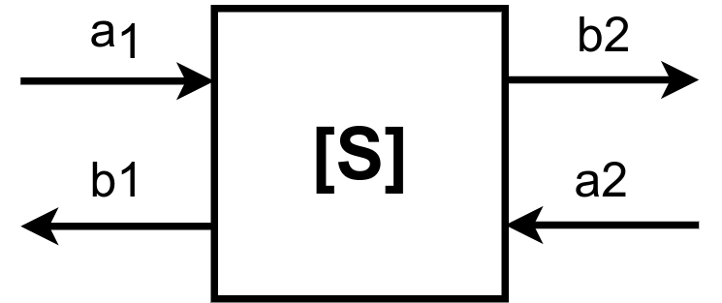
Matching networks
S-parameters
Most of RF devices (amplifier, filter, attenuator etc) can be represented as a two-port network. S-parameters show relationship between power of
incident (a₁ and a₂) and reflected waves (b₁ and b₂)

Slide 19
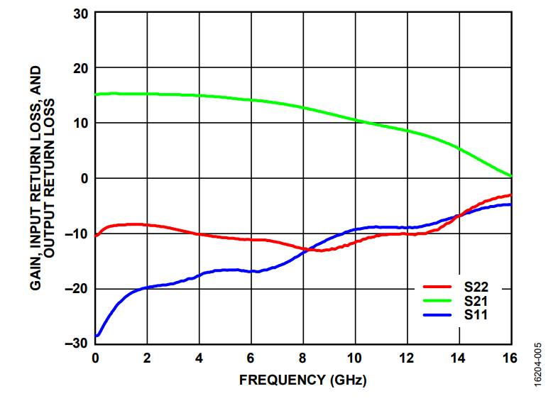
Matching networks
S-parameters example
S-parameters
- gain
- input reflection coefficient
- output reflection coefficient
Image source:
https://www.analog.com/media/en/technical-documentation/data-sheets/HMC788A.pdf

Slide 20
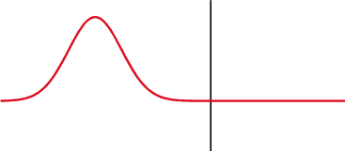
Matching networks
Reflection coefficient
Reflection coefficient shows how much power of wave is reflected by device input.
The aim of circuit matching is to decrease reflection coefficient
Image source:
https://en.wikipedia.org/wiki/Reflection_coefficient

Slide 21
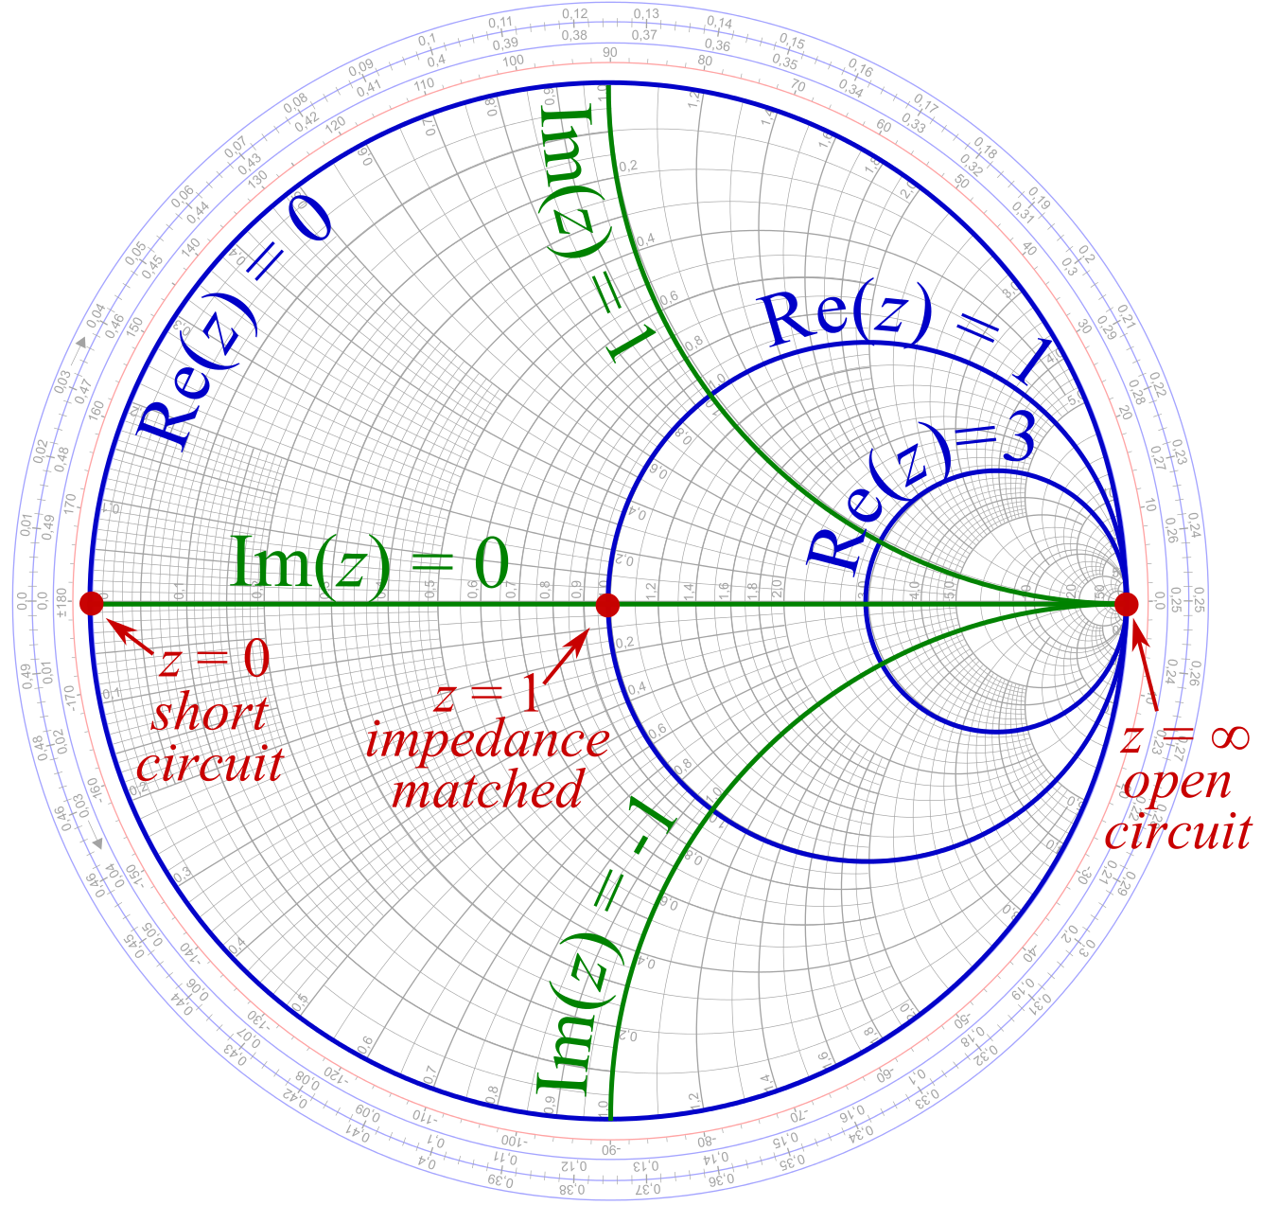
Matching networks
Smith chart
Smith chart shows element impedance normalized to desired impedance on a polar plot.
Image source:
https://en.wikipedia.org/wiki/Smith_chart

Slide 22
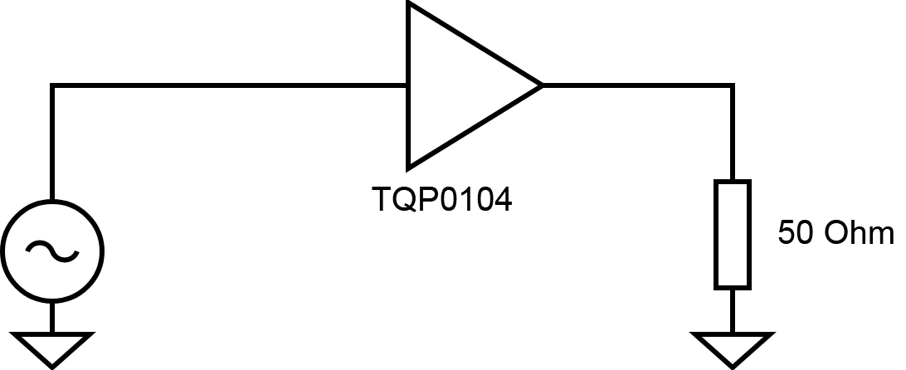
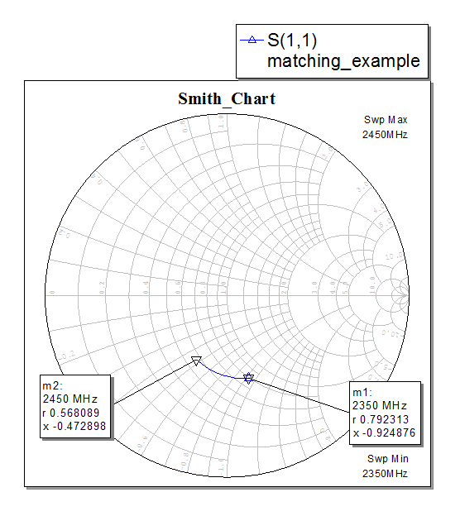
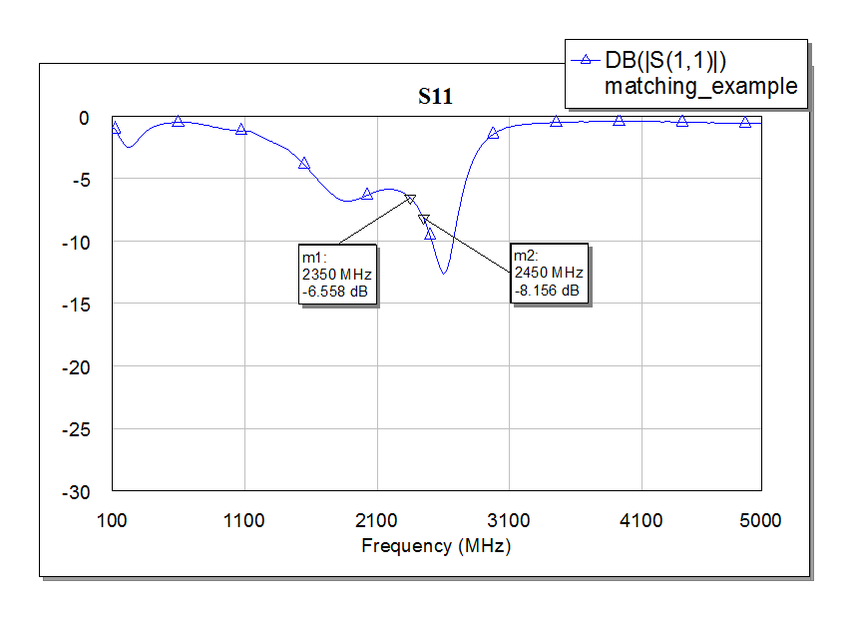
Matching networks
Unmatched case

Slide 23
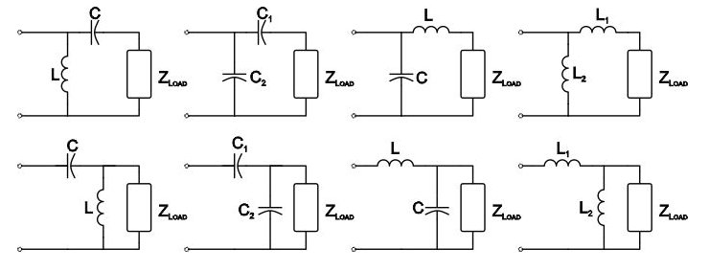
Matching networks
L-matching network
Consists of two components connected in L-shape
Image source:
https://www.allaboutcircuits.com/textbook/radio-frequency-analysis-design/selected-topics/understanding-matching-networks/

Slide 24
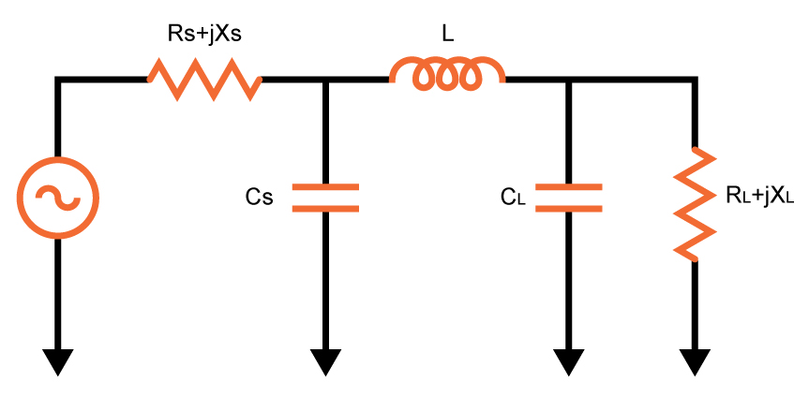
Matching networks
Pi-matching network
Consists of three components connected in π-shape
Image source:
https://www.allaboutcircuits.com/tools/pi-match-impedance-matching-calculator/

Slide 25
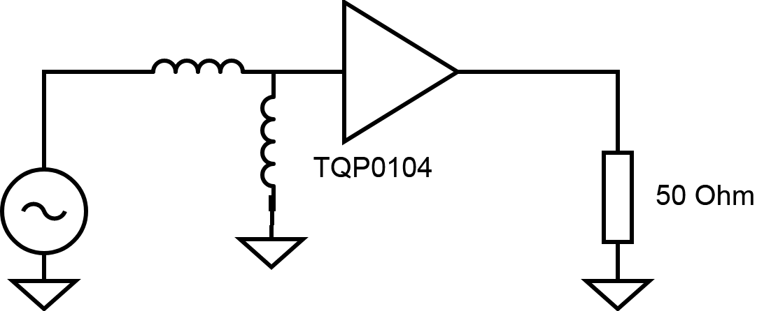
Matching networks
Matching example

Slide 26
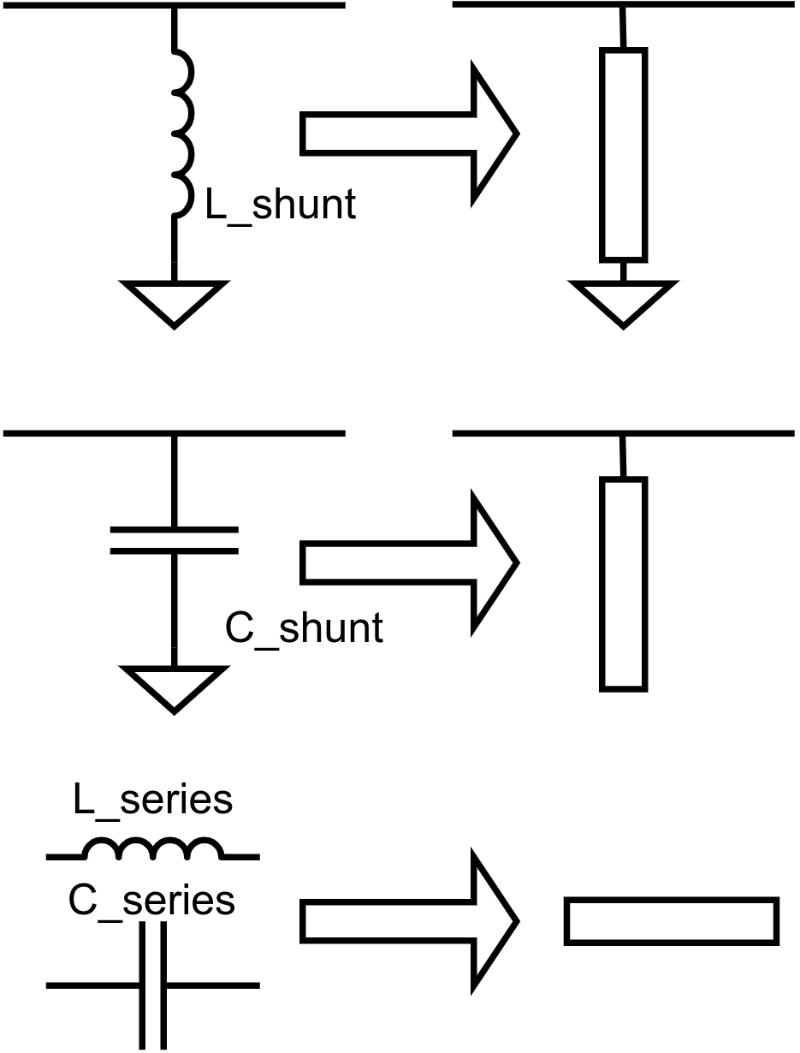
Matching networks
Transmission line matching
Any reactive component can be replaced with a transmission line segment (“distributed element”)

Slide 27
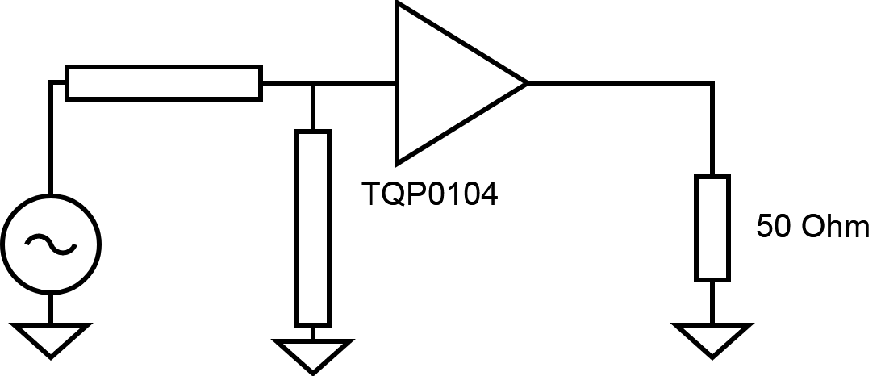
Matching networks
Transmission line matching

Slide 28
Noise figure
Conclusions
Simple matching circuits (L- and Pi-pad) can provide good matching in narrow band only
Length of transmission line is important for matching and transmission line should be taken into account at matching circuit design phase
There is a lot of parameters which are difficult to factor at design phase so it is better to verify all RF-solutions at prototypes
S-parameters and Smith chart can make RF-issues solving easier

Slide 29
Thank You!

Slide 30
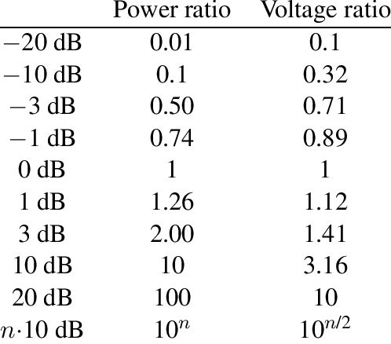
dB conversion

