Slide 1

Notes:
Slide 1: Title Slide

Slide 2
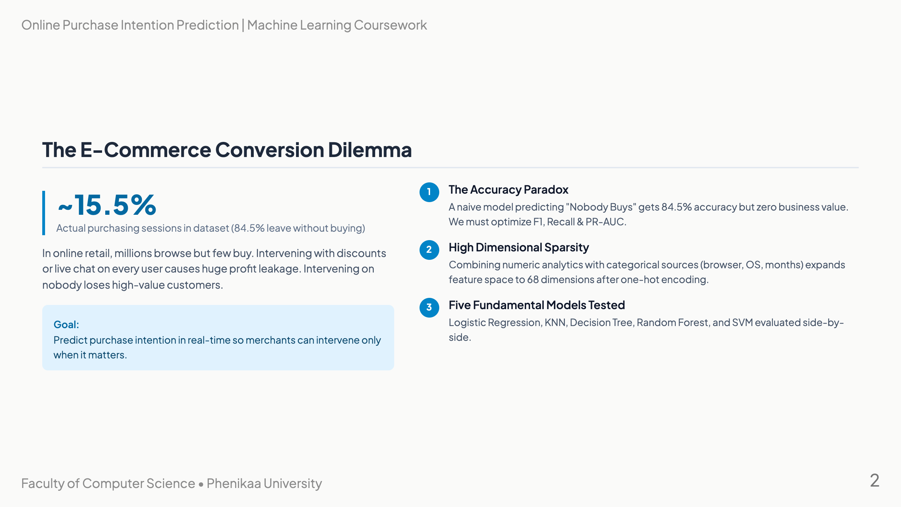
Notes:
Slide 2: The Problem Context

Slide 3
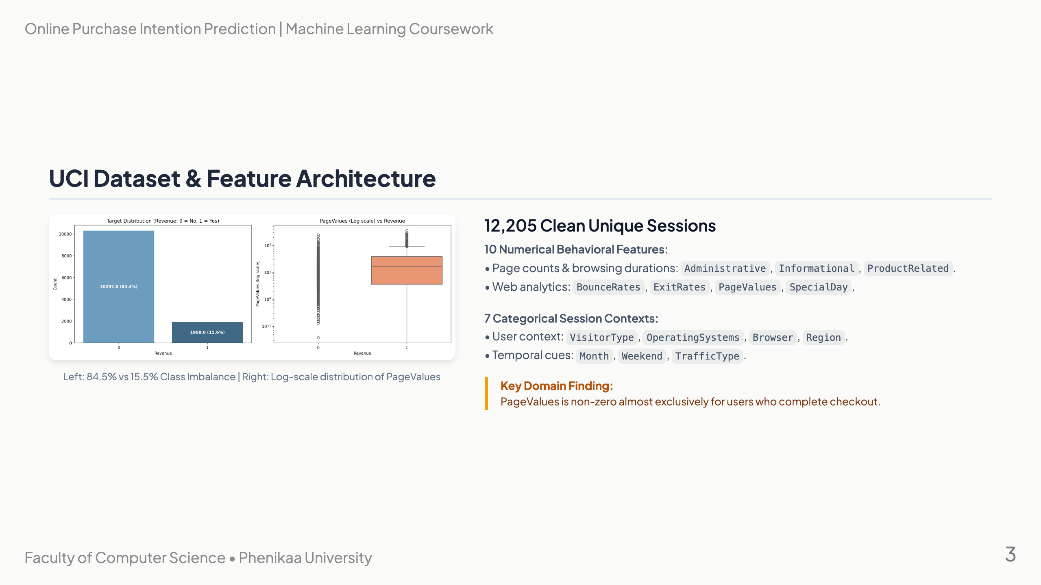
Notes:
Slide 3: Dataset Anatomy

Slide 4
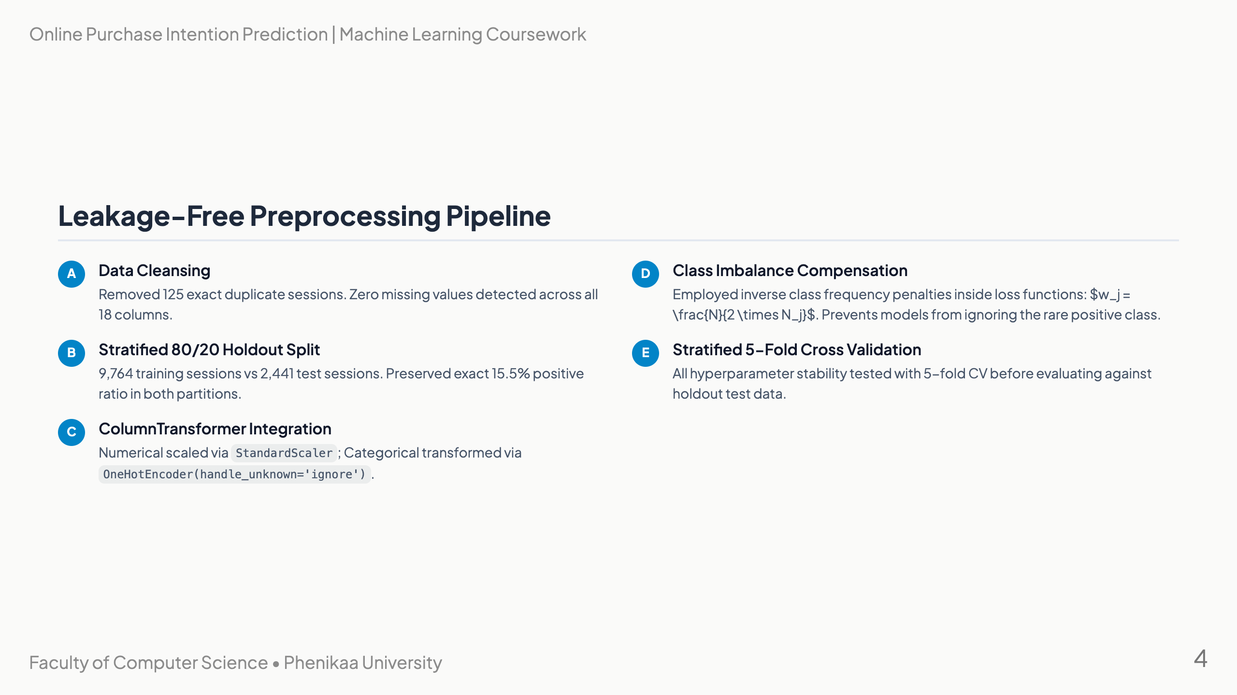
Notes:
Slide 4: End-to-End Preprocessing Pipeline

Slide 5
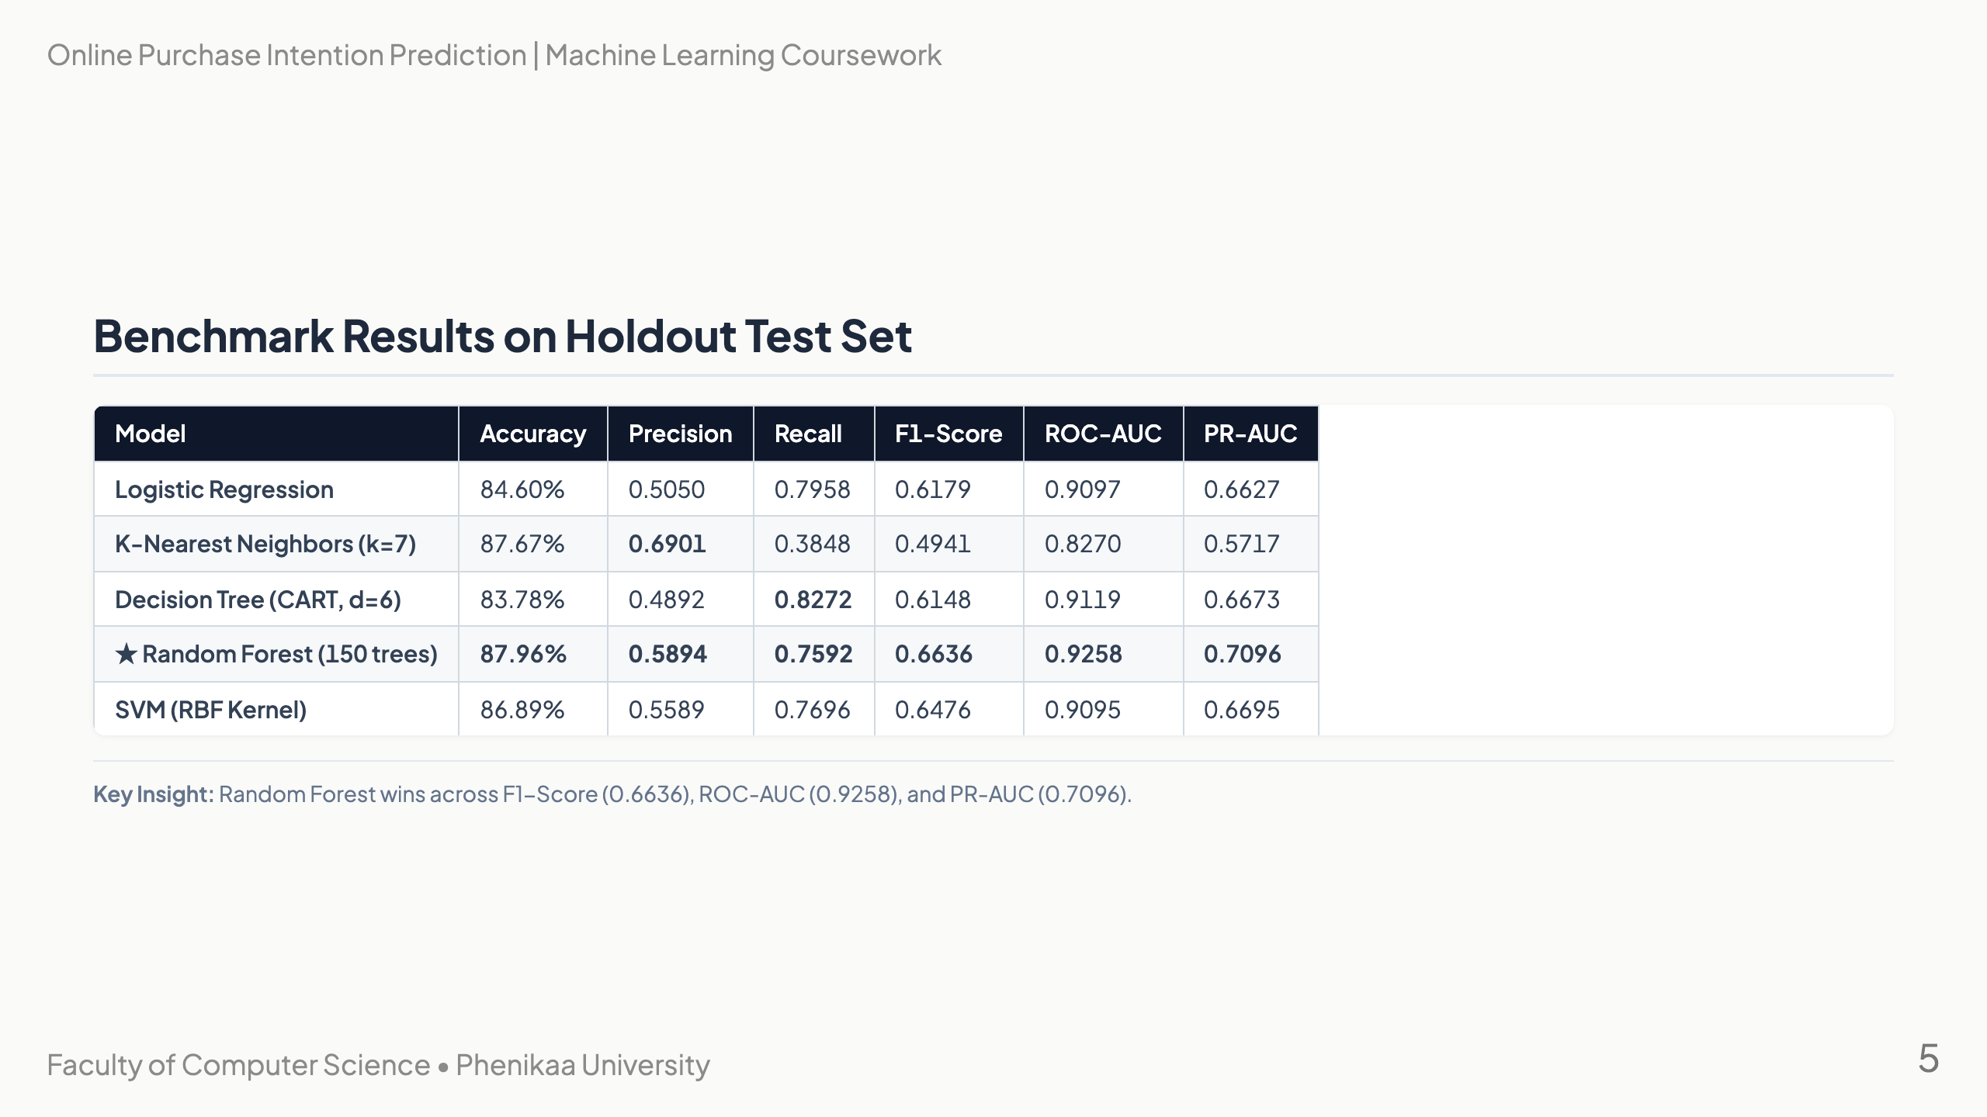
Notes:
Slide 5: Benchmark Results Table

Slide 6
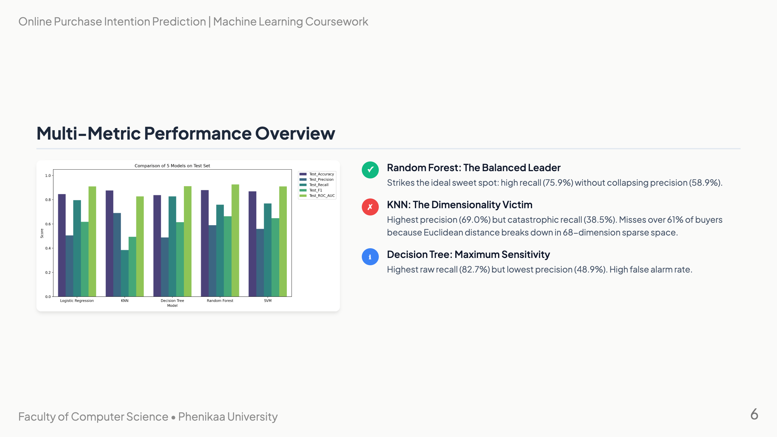
Notes:
Slide 6: Visual Comparison & Metrics

Slide 7
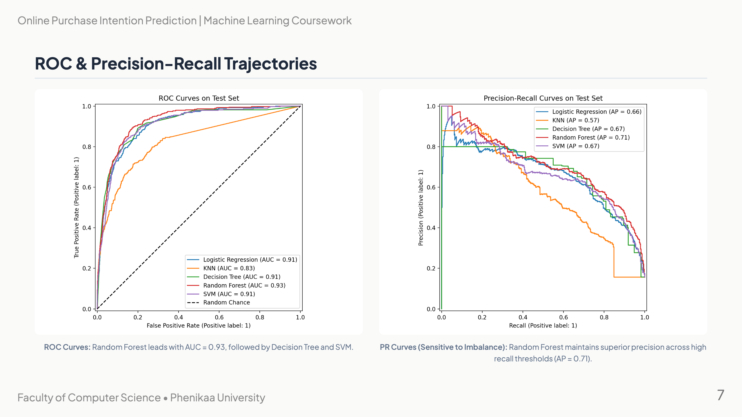
Notes:
Slide 7: ROC and PR Discrimination Curves

Slide 8
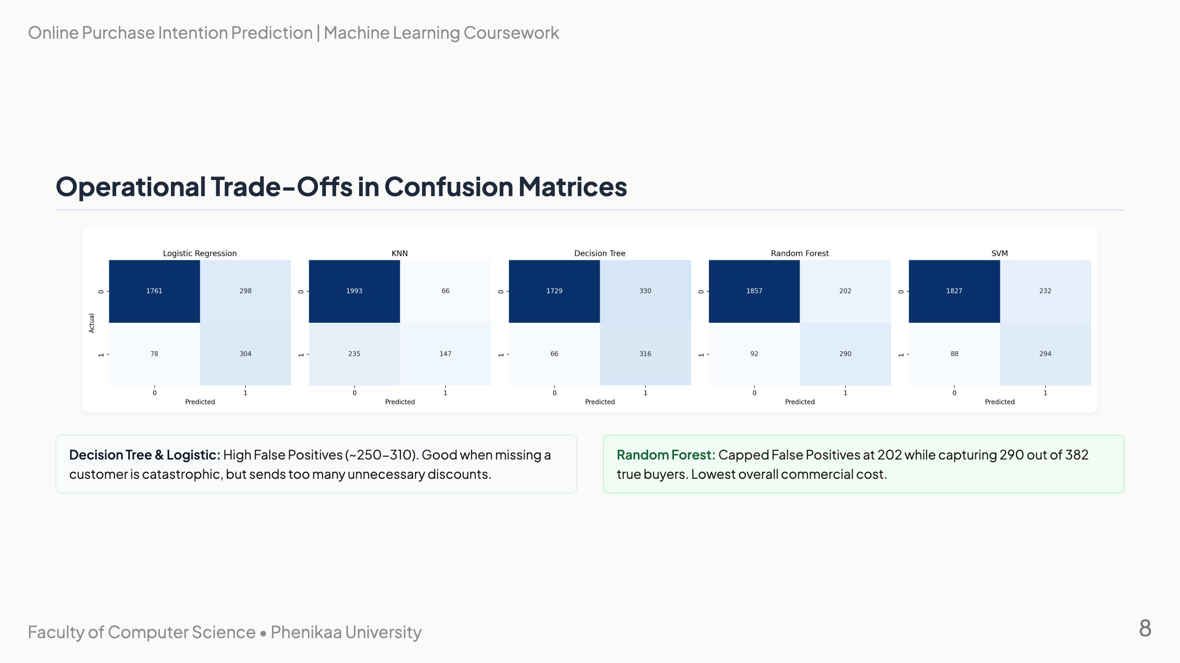
Notes:
Slide 8: Confusion Matrix Breakdown

Slide 9

Notes:
Slide 9: Feature Importance & Explainability

Slide 10
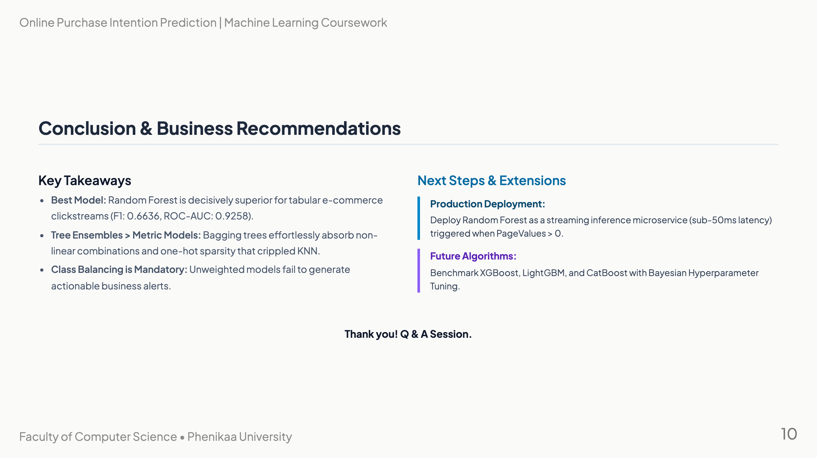
Notes:
Slide 10: Conclusion & Recommendations

