Slide 1
Dominik Bamberger
SUSE Linux
Twitter: @bamb00zzle
GitHub: b4mboo

Slide 2
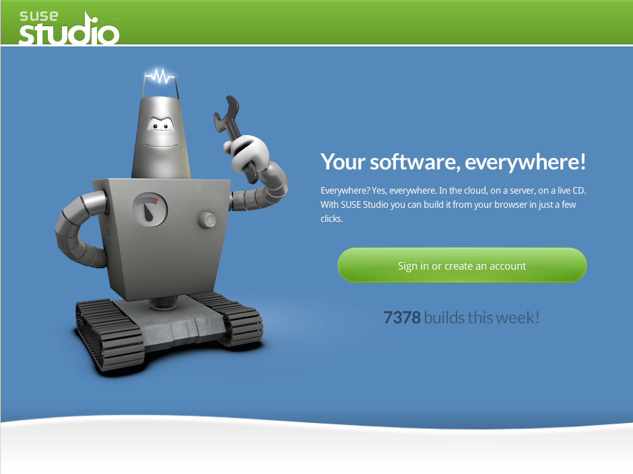

Slide 3
Create your own tools
(and share them)

Slide 4

http://www.flickr.com/photos/timetraveler2012/2351236435/

Slide 5


Slide 6
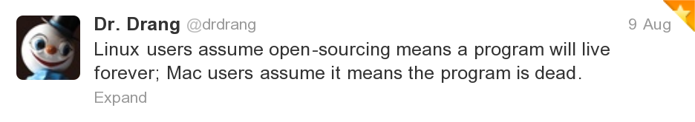
The living dead

Slide 7
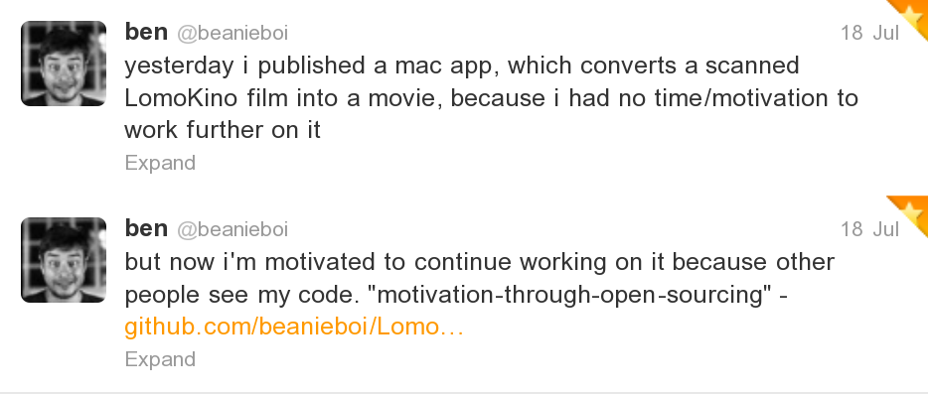
Sometimes they come back

Slide 8

http://www.flickr.com/photos/epsos/4916557151/

Slide 9
The relation between
money and work
is like the relation between
code and ideas.

Slide 10

http://www.fanpop.com/spots/home-improvement-tv-show/

Slide 11
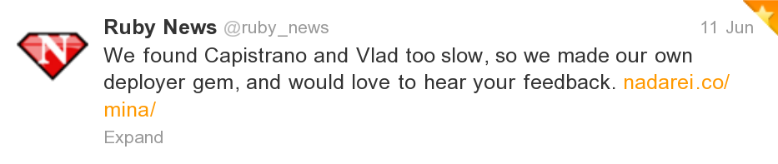

Slide 12

ruby user groups
http://rug-n.de

Slide 13


Slide 14
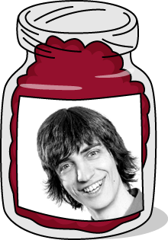
http://www.youtube.com/watch?v=YFzloW8F-nE

Slide 15
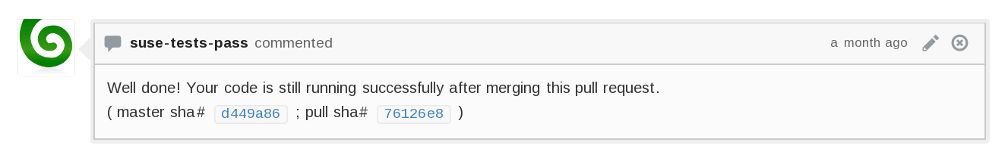
Pullermann
https://github.com/b4mboo/pullermann

Slide 16

http://24.media.tumblr.com/

Slide 17
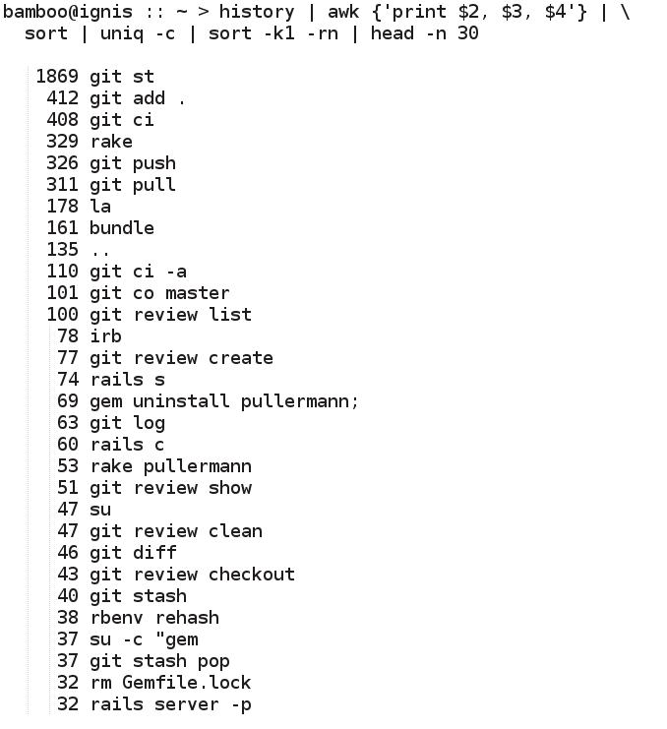

Slide 18
code review

Slide 19
A:
create feature branch
repeat:
write code
commit
push to remote
go to github
create pull request

Slide 20
A:
create feature branch
repeat:
write code
commit
push to remote
go to github
create pull request

Slide 21
A:
create feature branch
repeat:
write code
commit
push to remote
create pull request

Slide 22
A:
repeat:
write code
commit
create feature branch
push to remote
create pull request

Slide 23
A:
repeat:
write code
commit
git review create

Slide 24
B:
go to github
look at pull requests
review pull request
comment

Slide 25
B:
git review list
git review show #42
comment

Slide 26
B:
git review list
git review show #42
git review checkout #42
comment

Slide 27
B:
git review list
git review show #42
git review checkout #42
git review accept #42

Slide 28

http://octodex.github.com/oktobercat/

Slide 29
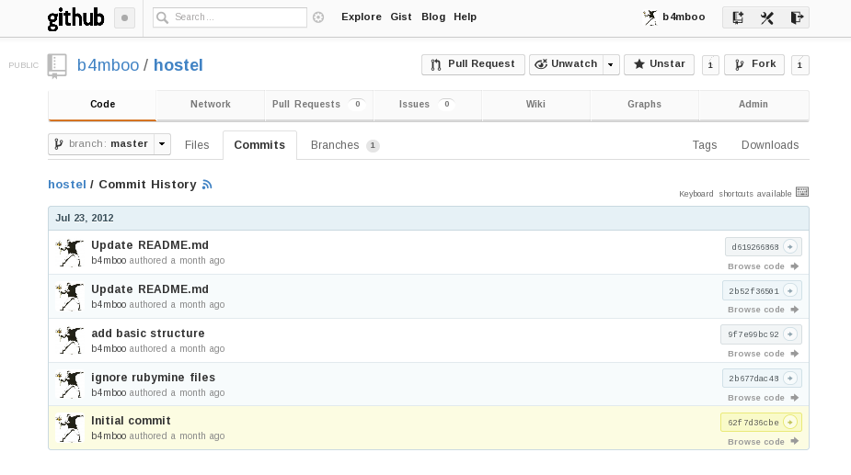

Slide 30
!

Slide 31
?

