Slide 1
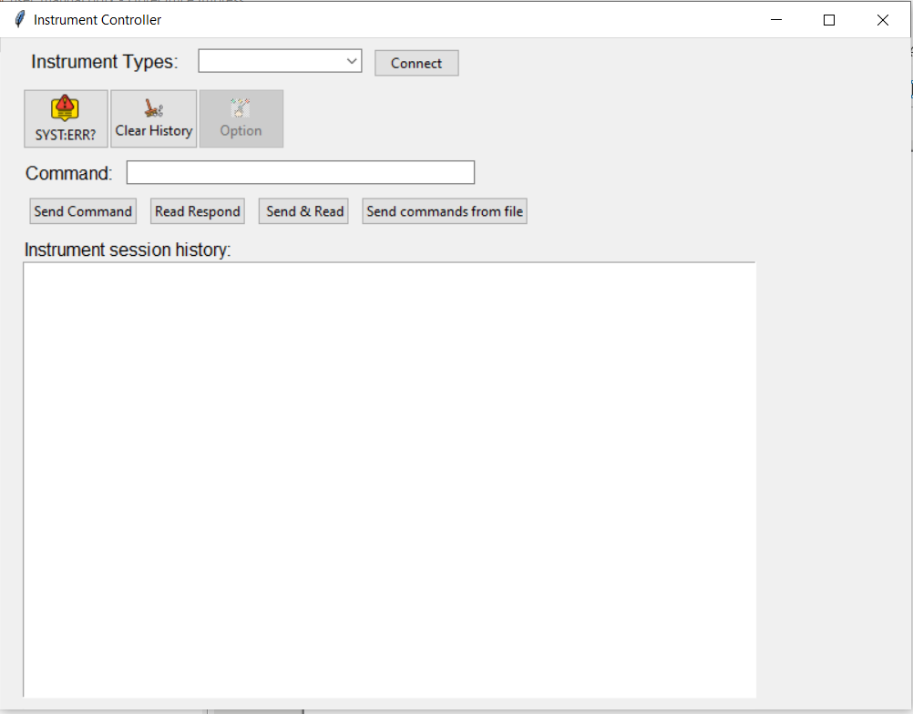
Choose Instrument Type
Click to connect Instrument
Check if the last command has error
Clear history screen
Enter Command here
1. Send command:
Send command to Instrument
2. Read Respond:
Read respond of last command
3. Send & Read:
Send command then read respond
4. Send commands from file
Choose a file contain list of command and sent each line to Instrument
(skip with line begin with “\”)

Slide 2
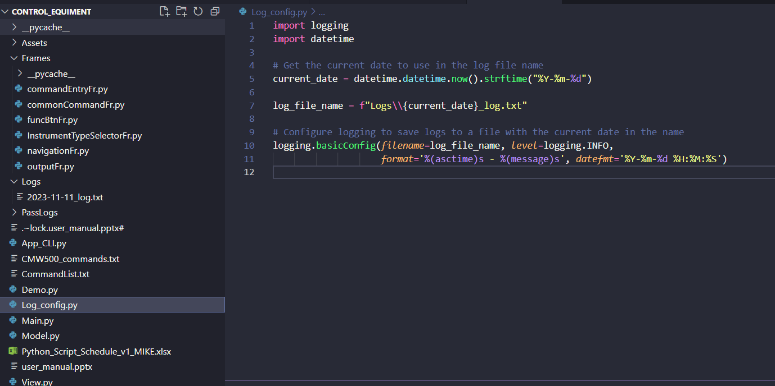
Open Log_config to change log path

Slide 3
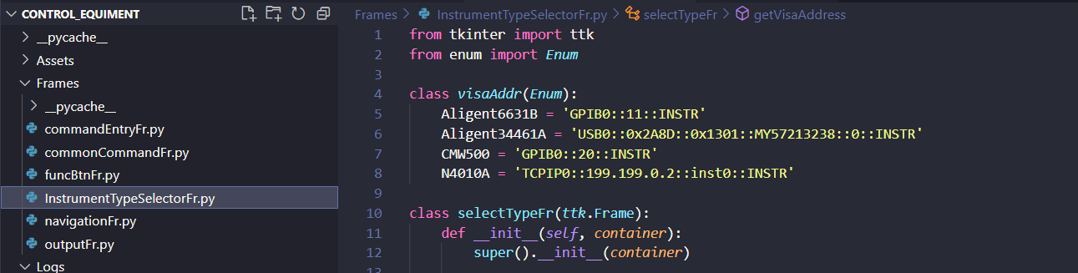
Open Frame \ InstrumentTypeSelectorFr.py to change visa address

