Slide 1

ALGORITHMIC TRADING
CMR COLLEGE OF ENGINEERING & TECHNOLOGY
Kandlakoya, Medchal, Hyderabad - 501401
Department of Computer Science and Engineering
BATCH NO. 62
L Bharadwaj 18H51A0517
M M Prathyush 18H51A0518
G Vineetkumar 18H51A0596
Under esteemed guidance of
Dr. Sarat Chandra Nayak

Slide 2
ABSTRACT

Slide 3

ABSTRACT
Stock market is a probabilistic trading where we can gain and have possibility of loss. Investing in stock market trading might be a risky task.
Algorithmic trading works on the previous trends of a particular stock and help us predicting the stock market movements.
Algorithmic trading use machine learning techniques to increase the probability of profit because it uses the technical analysis of stock, price action strategies, seasonal trends and help us to predict which time is better to invest in stocks.
We are developing an algorithm using machine learning and deep learning techniques such as RNN and LSTM for algorithmic trading.

Slide 4
INTRODUCTION

Slide 5

INTRODUCTION
Time-series prediction is a common technique widely used in many real-world applications such as weather forecasting and financial market prediction.
It uses the continuous data in a period to predict the result in the next time unit.
Many timeseries prediction algorithms have shown their effectiveness in practice.
The most common algorithms now are based on Recurrent Neural Networks (RNN), as well as its special type Long-short Term Memory (LSTM) and Gated Recurrent Unit (GRU).
Stock market is a typical area that presents time-series data and many researchers’ studies on it and proposed various models.
In this project, LSTM model is used to predict the stock price

Slide 6
MOTIVATION OF STUDY
Stock price prediction is an attractive area where we gain more profits to develop the business.
With a successful model for stock prediction, we can gain insight about market behavior over time.
Machine learning technique will be an efficient method to solve the problem of predicting stock movements

Slide 7
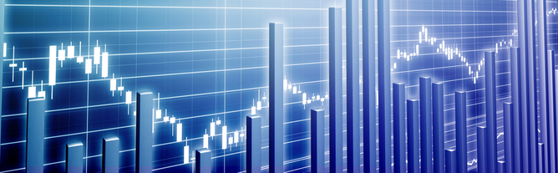
SCOPE & LIMITATIONS
We predict the stock market up to one month.
It is hard to predict in the pandemic situations

Slide 8
LITERATURE SURVEY

Slide 9
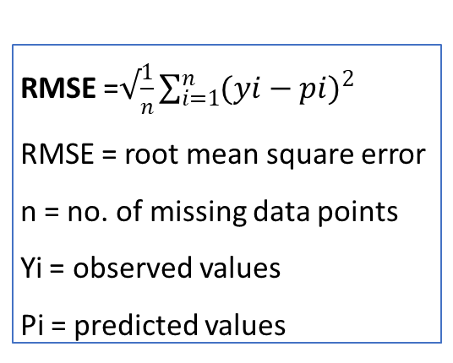
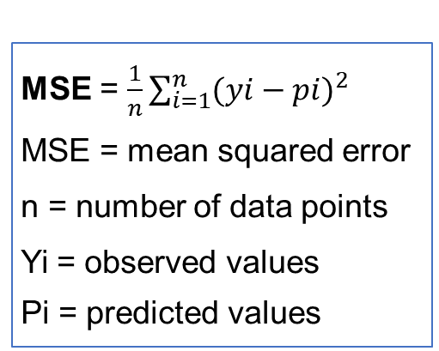
PERFORMANCE METRICS CALCULATIONS
MSE = $\frac{1}{n}\sum_{i=1}^{n}{{(yi−pi)}^{2}}$
MSE = mean squared error
n = number of data points
Yi = observed values
Pi = predicted values
RMSE =$√\frac{1}{n}\sum_{i=1}^{n}{{(yi−pi)}^{2}}$
RMSE = root mean square error
n = no. of missing data points
Yi = observed values
Pi = predicted values
𝑅² = 1-RSS/TSS
𝑅² = coefficient of determination
RSS = sum of squares of residuals
TSS = total sum of squares
Lower (MSE) is the best
Lower (RMSE) is the best
Higher (𝑅²) is the best

Slide 10
1. SIMPLE MOVING AVERAGE (SMA)
SMA FORMULA:
𝑆𝑀𝐴 = (𝐴1+𝐴2+⋯+𝐴𝑛 ) / n eq(1)
Where:
An= The price of an asset
n = The number of total periods
Example
closing prices over a 15-day period.
Week One (5 days): 20, 22, 24, 25, 23
Week Two (5 days): 26, 28, 26, 29, 27
Week Three (5 days): 28, 30, 27, 29, 28
Simple moving averages calculate the average of a range of prices by the number of periods within that range.
A simple moving average is a technical indicator that can help in determining if price will continue or if it will reverse a trend.
A simple moving average can be enhanced as an exponential moving average (EMA) that is more heavily weighted on recent price action.

Slide 11
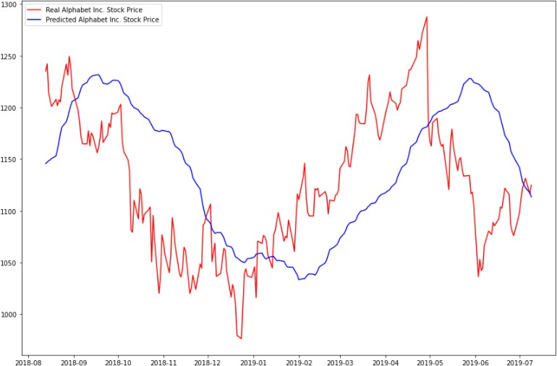
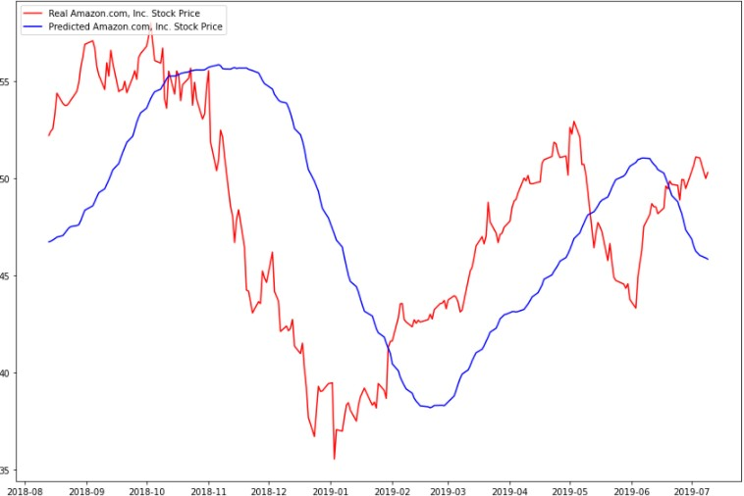
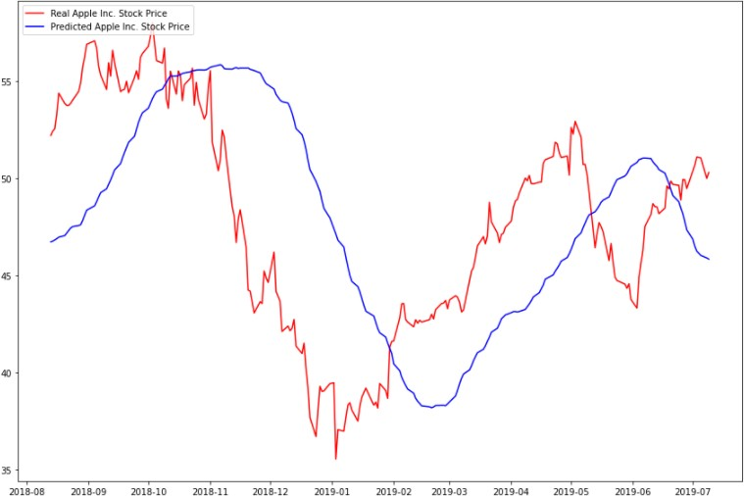
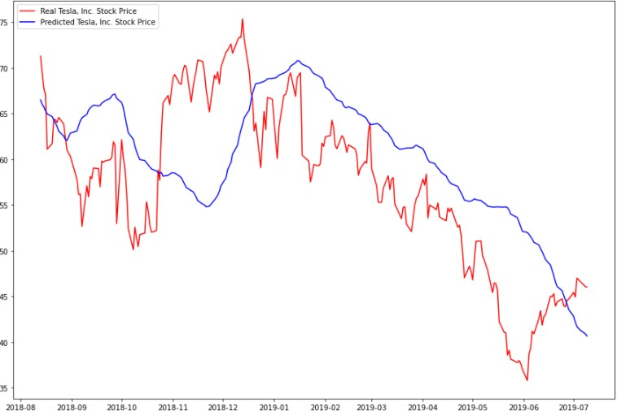
Fig 1: Google stock dataset 2015-22
SMA IMPLEMENTATION
Fig 2: Amazon stock dataset 2015-22
Fig 3: Apple stock dataset 2015-22
Fig 4: Tesla stock dataset 2015-22
Note: The difference between the predicted values and the actual values is extremely high. So SMA is not preferable

Slide 12
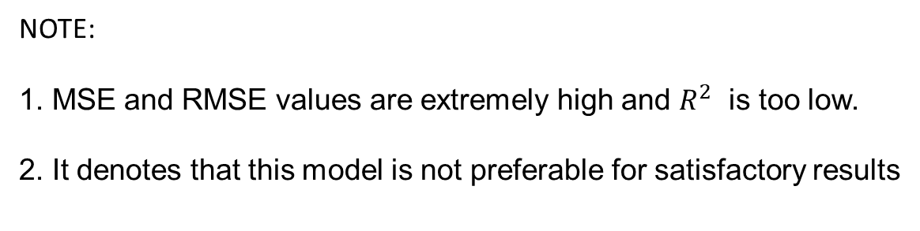
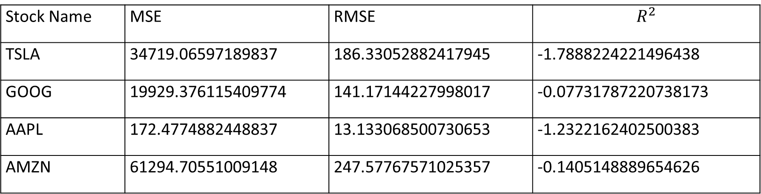
SMA PERFORMANCE METRICS
Stock Name | MSE | RMSE | $$R^{2}$$
TSLA | 34719.06597189837 | 186.33052882417945 | -1.7888224221496438
GOOG | 19929.376115409774 | 141.17144227998017 | -0.07731787220738173
AAPL | 172.4774882448837 | 13.133068500730653 | -1.2322162402500383
AMZN | 61294.70551009148 | 247.57767571025357 | -0.1405148889654626
Table 1: Performance Metrics for Stock Dataset 2015-22
NOTE:
1. MSE and RMSE values are extremely high and $R^{2}$ is too low.
2. It denotes that this model is not preferable for satisfactory results

Slide 13
2. ARIMA-Statistical Model
Auto-Regressive Integrated Moving Average
(ARIMA)
ARIMA models are known to be robust and efficient in financial time series forecasting
It constantly outperformed complex structural models in short-term prediction
But they work only for a particular time series data
It is categorized into linear that is it cannot handle nonlinear behavior of stock market

Slide 14
ARIMA Terminology
Model parameters
AR: Auto Regressive
It is the dependent relationship between an observation and predefined number of lagged observations
I: Integrated means the differencing of raw observations
MA: Moving Average
The relationship between the residual error and the observations.
p is the number of lag observations.
d is the degree of differencing.
q is the width of moving average window.

Slide 15
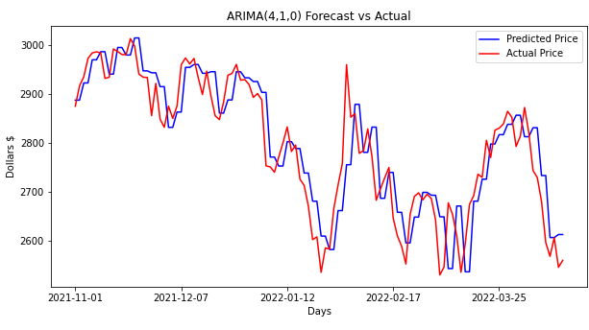
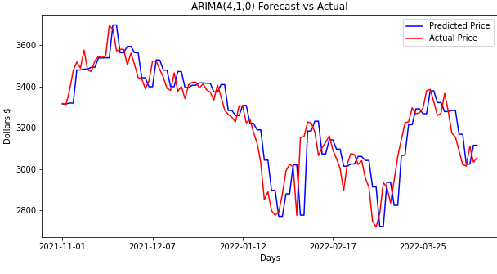
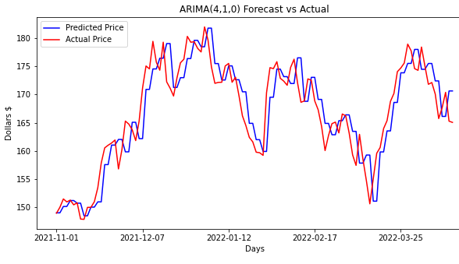
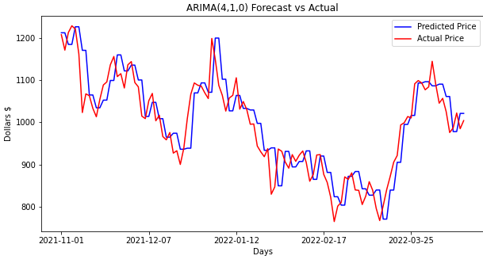
Fig 1: Google stock dataset 2021-22
ARIMA IMPLEMENTATION
Fig 2: Amazon stock dataset 2021-22
Fig 3: Apple stock dataset 2021-22
Fig 4: Tesla stock dataset 2021-22
Note: The difference between the predicted values and the actual values is low. So ARIMA is slightly preferable

Slide 16
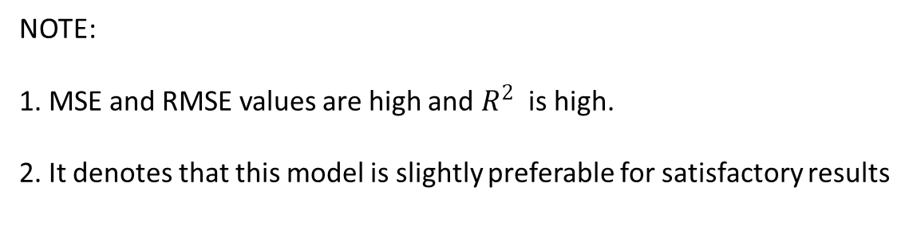
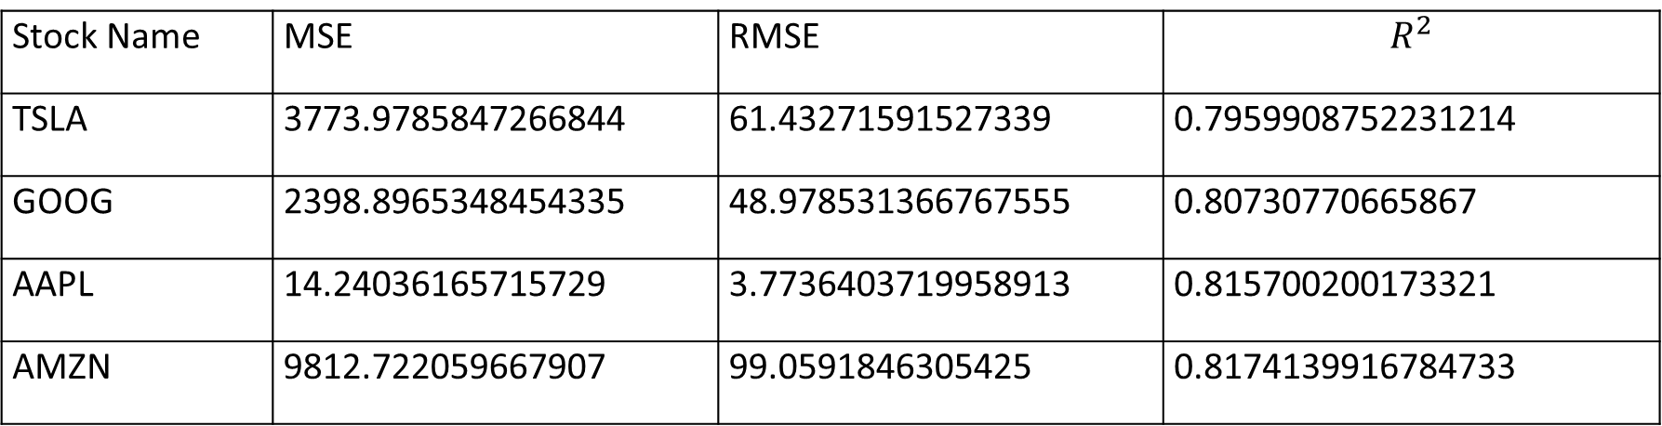
ARIMA PERFORMANCE METRICS
Stock Name | MSE | RMSE | $$R^{2}$$
TSLA | 3773.9785847266844 | 61.43271591527339 | 0.7959908752231214
GOOG | 2398.8965348454335 | 48.978531366767555 | 0.80730770665867
AAPL | 14.24036165715729 | 3.7736403719958913 | 0.815700200173321
AMZN | 9812.722059667907 | 99.0591846305425 | 0.8174139916784733
Table 1: Performance Metrics for Stock Dataset 2021-22
NOTE:
1. MSE and RMSE values are high and $R^{2}$ is high.
2. It denotes that this model is slightly preferable for satisfactory results

Slide 17

3. RNN (Recurrent Neural Network)
RNN is a class of advanced artificial neural network (ANN)
It is categorized into nonlinear
RNN takes input from two sources, one is from the present and the other from the past. Information from these two sources are used to decide how they react to the new set of data
But fails in forecasting long term duration

Slide 18

In a feed-forward neural network, the information only moves in one direction from the input layer, through the hidden layers, to the output layer.
The information moves straight through the network and never touches a node twice. Feed-forward neural networks have no memory of the input they receive and are bad at predicting what’s coming next.
RNN the information cycles through a loop. When it decide, it considers the current input and what it has learned from the inputs it received previously.
Fig: RNN

Slide 19
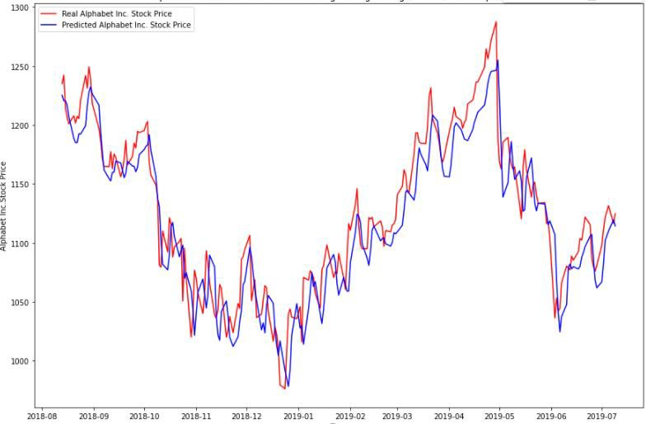
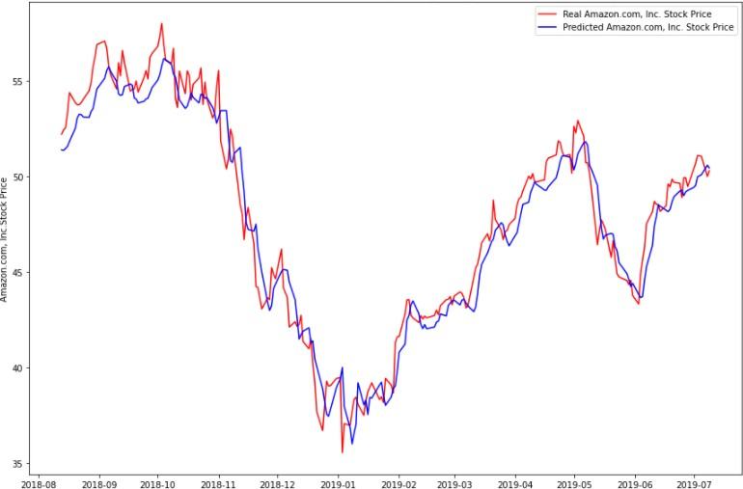
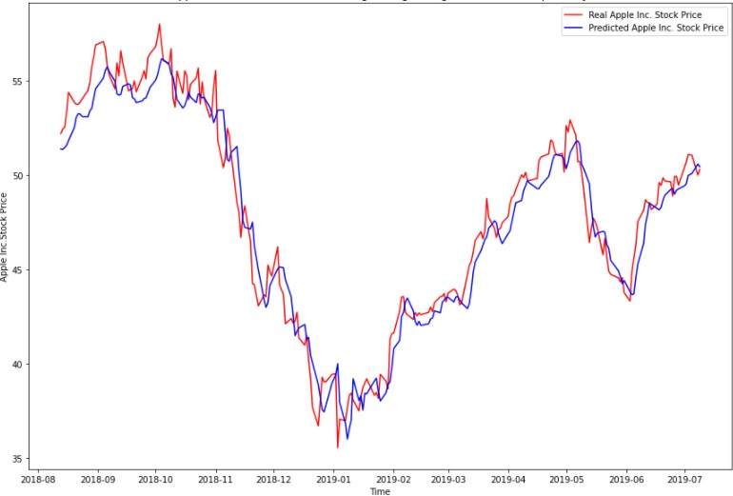
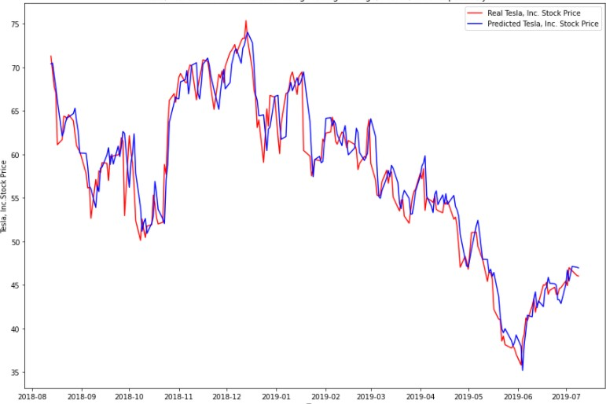
Fig 1: Google stock dataset 2018-22
RNN IMPLEMENTATION
Fig 2: Amazon stock dataset 2018-22
Fig 3: Apple stock dataset 2018-22
Fig 4: Tesla stock dataset 2018-22
Note: The difference between the predicted values and the actual values is low. So RNN is preferable

Slide 20
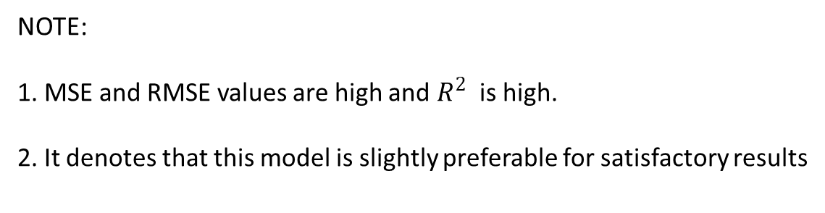
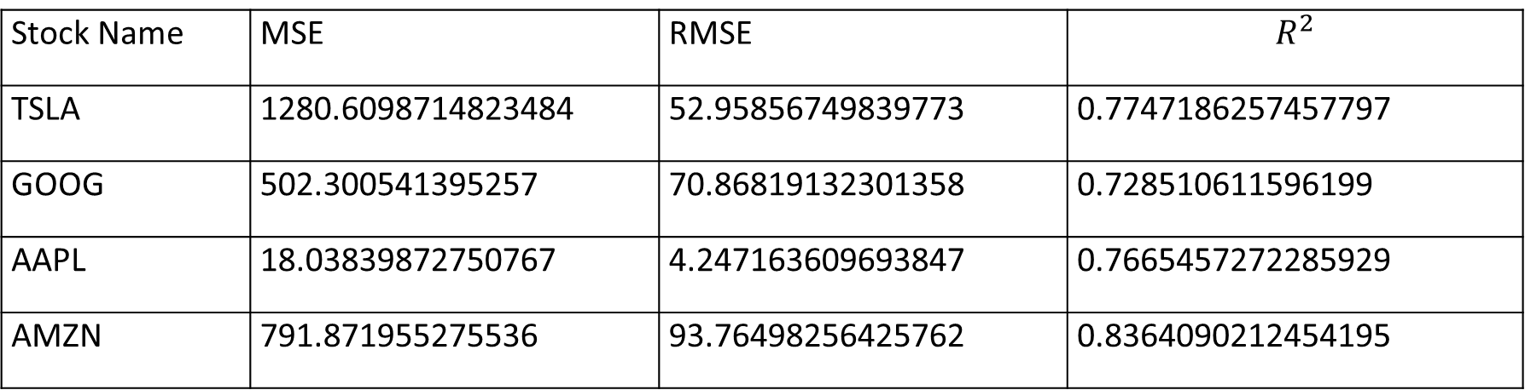
RNN PERFORMANCE METRICS
Stock Name | MSE | RMSE | $$R^{2}$$
TSLA | 1280.6098714823484 | 52.95856749839773 | 0.7747186257457797
GOOG | 502.300541395257 | 70.86819132301358 | 0.728510611596199
AAPL | 18.03839872750767 | 4.247163609693847 | 0.7665457272285929
AMZN | 791.871955275536 | 93.76498256425762 | 0.8364090212454195
Table 1: Performance Metrics for Stock Dataset 2028-22
NOTE:
1. MSE and RMSE values are high and $R^{2}$ is high.
2. It denotes that this model is slightly preferable for satisfactory results

Slide 21
OBJECTIVE

Slide 22

OBJECTIVE
To design efficient system for predicting the stock market movement using ML .
Specifically, use LSTM method to Predict stock price based on the historical data.
Compare existing methods to show the superiority of LSTM.

Slide 23
PROBLEM STATEMENT

Slide 24

PROBLEM STATEMENT
Predict stock market movement using machine learning techniques to improve the profit percentage in the trading
P/E * EPS = PRICE
If we can predict stocks future P/E and EPS, We will know accurate PRICE

Slide 25
RESEARCH WORK

Slide 26
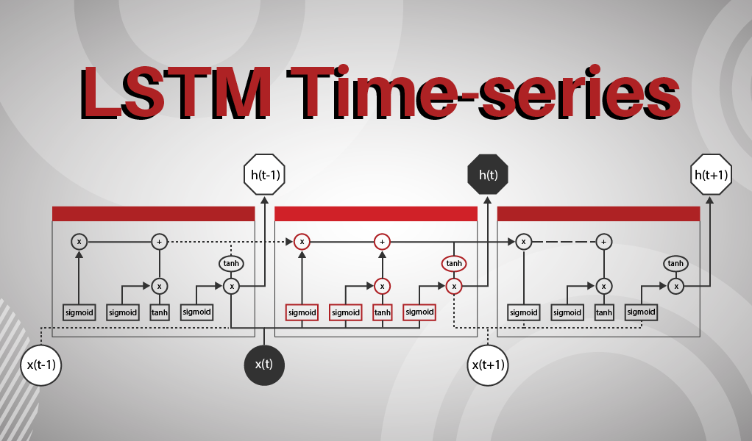

Slide 27
LSTM Long-Short-Term Memory
LSTM is an advanced type of RNN
LSTM is proficient in learning about long-term dependencies.
It solves the vanishing gradient problem
LSTM is popularly used on time-series data for classification, processing, and making predictions.
It doesn’t just use the previous prediction but rather retains data for longer-term
LSTMs are good at processing sequences of data such as text, speech and general time-series.

Slide 28

Vanishing gradient problem
It is encountered when training artificial neural networks with gradient-based learning methods
In such methods, during each iteration of training each of the neural network's weights receives an update
in some cases, the gradient will be vanishingly small, effectively preventing the weight from changing its value.
In the worst case, this may completely stop the neural network from further training.
Fig. problem symbol

Slide 29
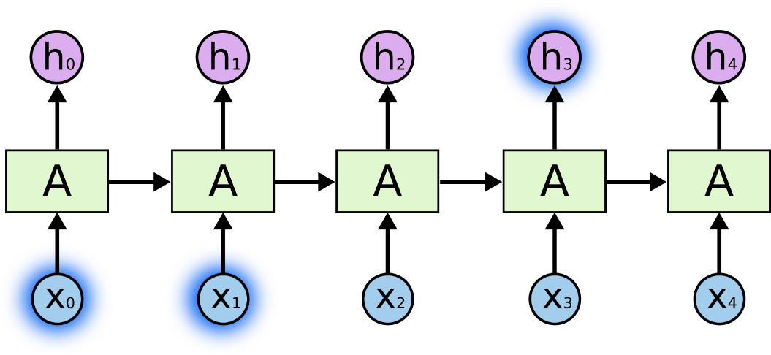
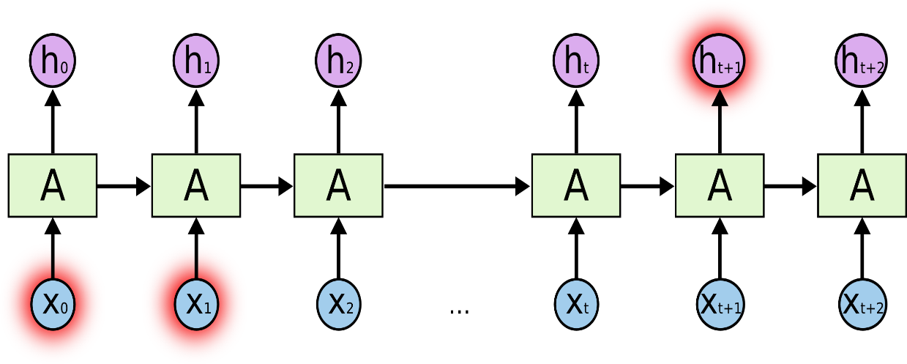
The Problem of Long-Term Dependencies
Fig. RNNs can learn to use the past information.
Fig. Unfortunately, as that gap grows, RNNs become unable to learn to connect the information.

Slide 30
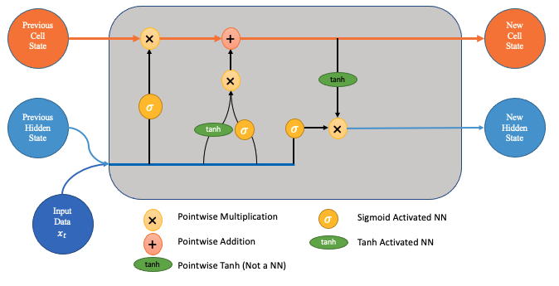
LSTM Long-Short-Term Memory

Slide 31
How do LSTM Networks Work?
The output of an LSTM at a particular point in time is dependent on :
▹ The current long-term memory of the network known as the cell state ▹ The output at the previous point in time known as the previous hidden state ▹ The input data at the current time step
LSTM series of gates control how the information in a sequence of data.
There are three gates in a typical LSTM;
forget gate,
input gate and
output gate.

Slide 32
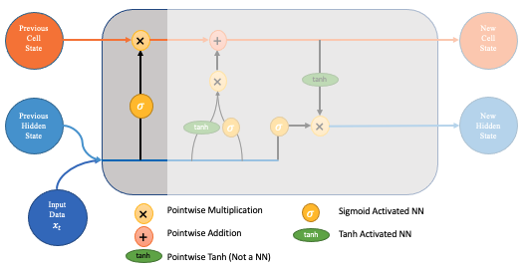
The forget gate decides which pieces of the long-term memory should now be forgotten (have less weight) given the previous hidden state and the new data point in the sequence.
Fig. Forget gate

Slide 33
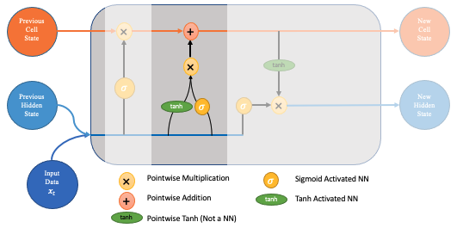
The goal of this step is to determine what added information should add to the networks long-term memory (cell state), given the previous hidden state and new input data.
Fig. Input gate

Slide 34
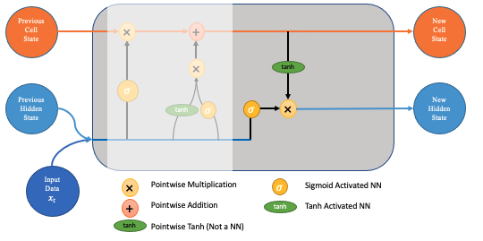
This ensures that only necessary information will be an output (saved to the new hidden state). However, before applying the filter, we pass the cell state through a tanh to force the values into the interval [-1,1].
Fig. Output gate

Slide 35
LSTM
Fig. LSTM process

Slide 36
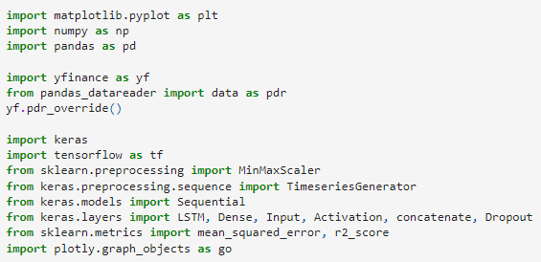
LSTM Implementation – Import Libraries
Fig. import Libraries

Slide 37
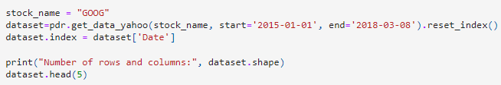

LSTM Implementation – Load Dataset
Fig. Google Stock Data from 2015-2018
Fig. Min Max Scalar for 0 – 1 range

Slide 38
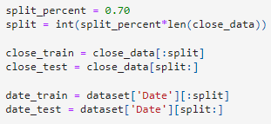
LSTM Implementation – Split Dataset
Fig. Train and Test Data

Slide 39
LSTM Implementation –LSTM Model Parameters
Hidden nodes : This is the number of neurons of the LSTM. If you have a higher number, the network gets more powerful.
Timesteps : the number of timesteps you want to consider.
Learning rate : Indicates, how much the weights are updated per batch.
Batch size : how many samples in each batch during training and testing
Features : how many dimensions are used to represent a data in one time step.
Units : Positive integer, dimensionality of the output space.
Activation : Activation function to use.
Dropout : Fraction of the units to drop for the linear transformation
Return sequences: Boolean. Whether to return the last output. in the output sequence, or the full sequence.

Slide 40
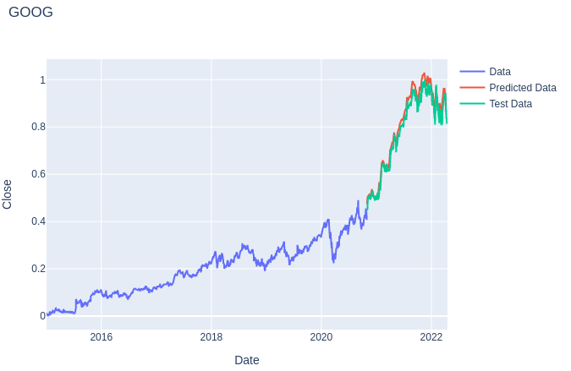
COMPARE LSTM TO OTHER MODELS
Fig: SMA-Google
Fig: ARIMA-Google
Fig: RNN-Google
Fig: LSTM-Google
NOTE: LSTM prediction is perfect

Slide 41
PERFORMANCE METRICS

Slide 42
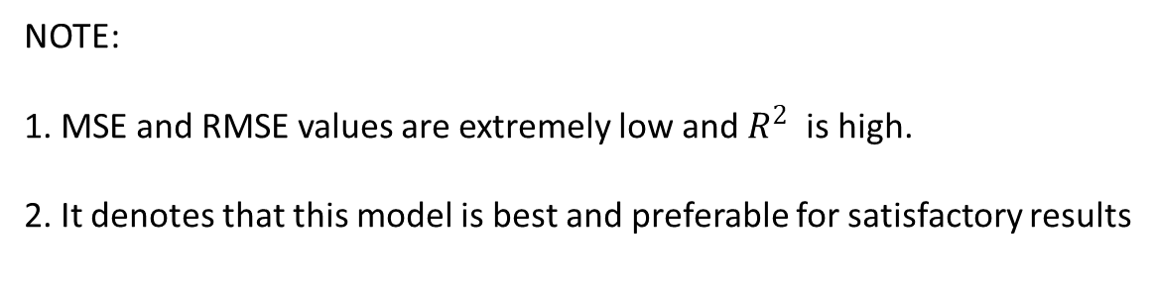
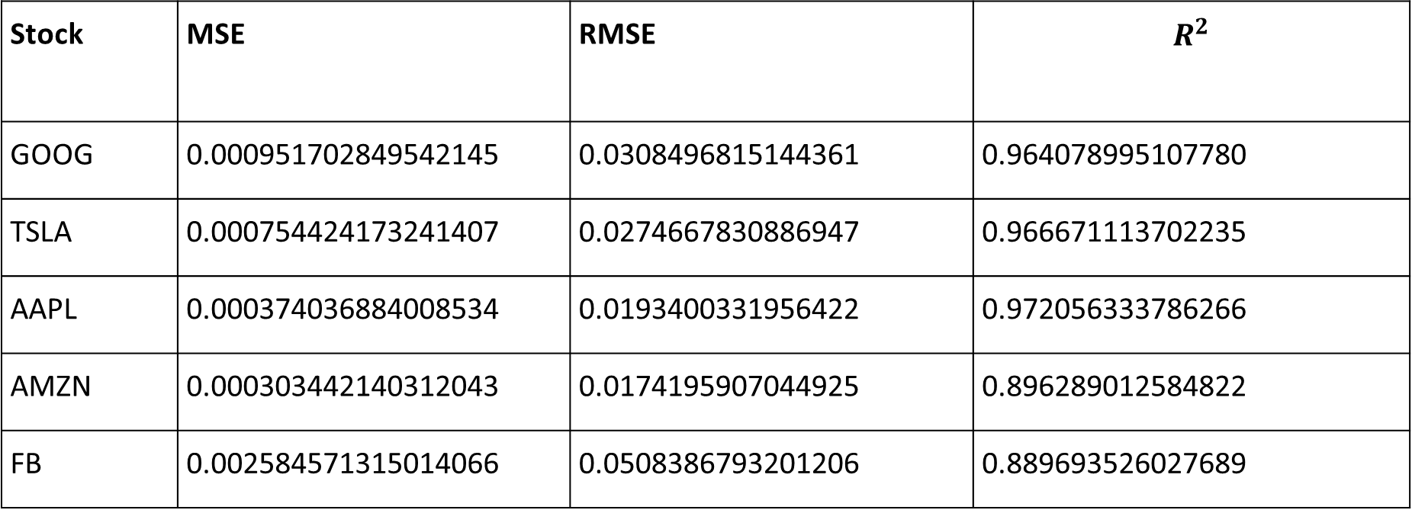
LSTM PERFORMANCE METRICS
Stock | MSE | RMSE | $$R^{2}$$
GOOG | 0.000951702849542145 | 0.0308496815144361 | 0.964078995107780
TSLA | 0.000754424173241407 | 0.0274667830886947 | 0.966671113702235
AAPL | 0.000374036884008534 | 0.0193400331956422 | 0.972056333786266
AMZN | 0.000303442140312043 | 0.0174195907044925 | 0.896289012584822
FB | 0.002584571315014066 | 0.0508386793201206 | 0.889693526027689
Table: LSTM performance metrics for Datasets 2015-22
NOTE:
1. MSE and RMSE values are extremely low and $R^{2}$ is high.
2. It denotes that this model is best and preferable for satisfactory results

Slide 43
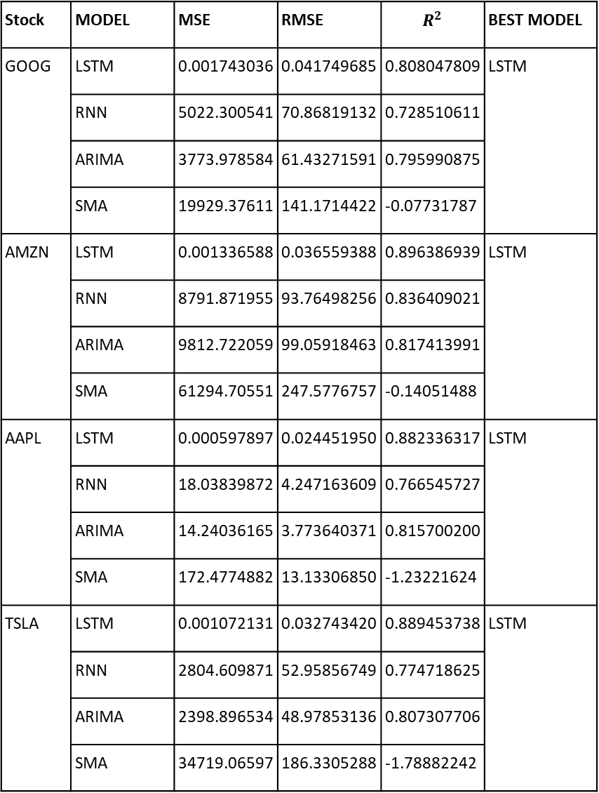
Stock | MODEL | MSE | RMSE | $$R^{2}$$ | BEST MODEL
GOOG | LSTM | 0.001743036 | 0.041749685 | 0.808047809 | LSTM
 | RNN | 5022.300541 | 70.86819132 | 0.728510611
 | ARIMA | 3773.978584 | 61.43271591 | 0.795990875
 | SMA | 19929.37611 | 141.1714422 | -0.07731787
AMZN | LSTM | 0.001336588 | 0.036559388 | 0.896386939 | LSTM
 | RNN | 8791.871955 | 93.76498256 | 0.836409021
 | ARIMA | 9812.722059 | 99.05918463 | 0.817413991
 | SMA | 61294.70551 | 247.5776757 | -0.14051488
AAPL | LSTM | 0.000597897 | 0.024451950 | 0.882336317 | LSTM
 | RNN | 18.03839872 | 4.247163609 | 0.766545727
 | ARIMA | 14.24036165 | 3.773640371 | 0.815700200
 | SMA | 172.4774882 | 13.13306850 | -1.23221624
TSLA | LSTM | 0.001072131 | 0.032743420 | 0.889453738 | LSTM
 | RNN | 2804.609871 | 52.95856749 | 0.774718625
 | ARIMA | 2398.896534 | 48.97853136 | 0.807307706
 | SMA | 34719.06597 | 186.3305288 | -1.78882242
Table:
PERFORMANCE METRICS COMPARE
LSTM TO OTHER MODELS
NOTE: LSTM performance is the best

Slide 44
RESULTS

Slide 45
RESULTS
LSTM is an existing model, but we have reimplemented the model to increase the performance of the model by changing different combinations of parameters.
check the model performance against different datasets.
To show how the LSTM model is superior to the other existing models in terms of performance matrix.

Slide 46
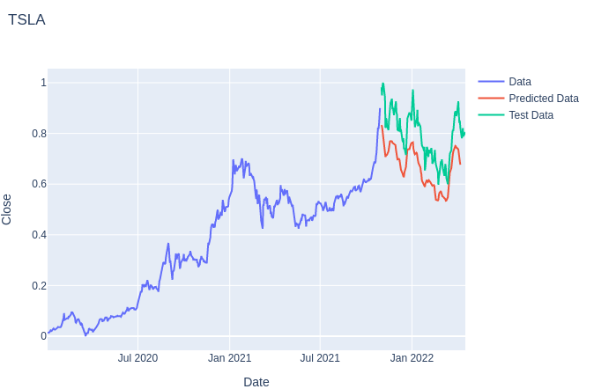
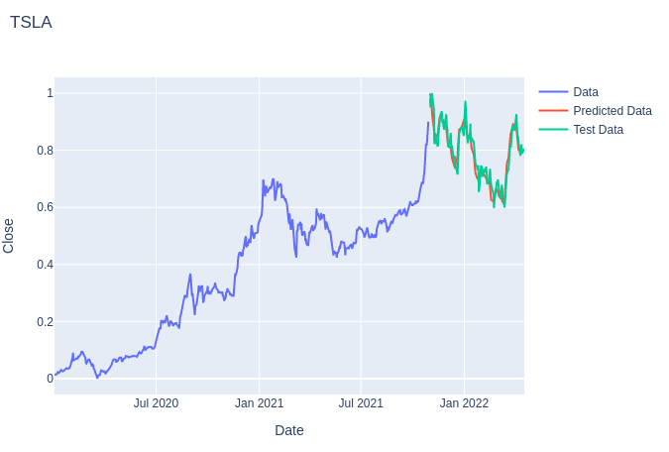
Fig 1: RMSProp optimizer for Tesla dataset
Fig 2: Adam optimizer for Tesla dataset
NOTE: Adam optimizer gives best prediction

Slide 47
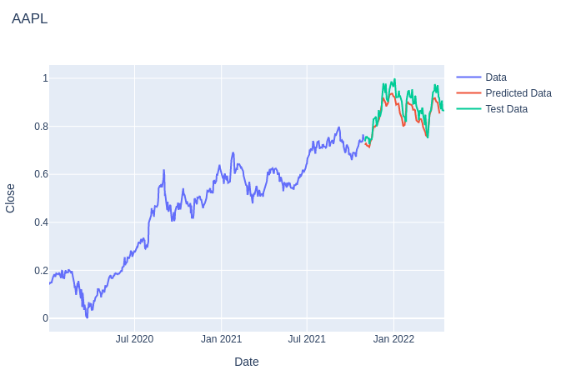
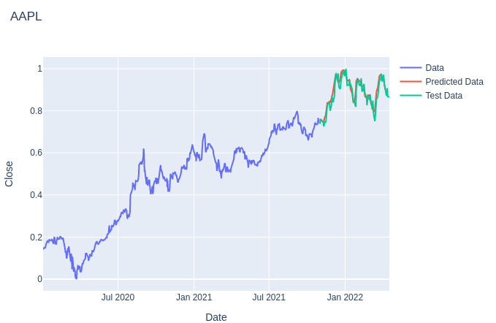
Fig 1: RMSProp optimizer for Apple dataset
Fig 2: Adam optimizer for Apple dataset
NOTE: Adam optimizer gives best prediction

Slide 48
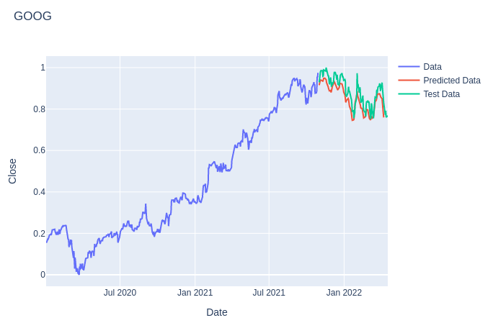
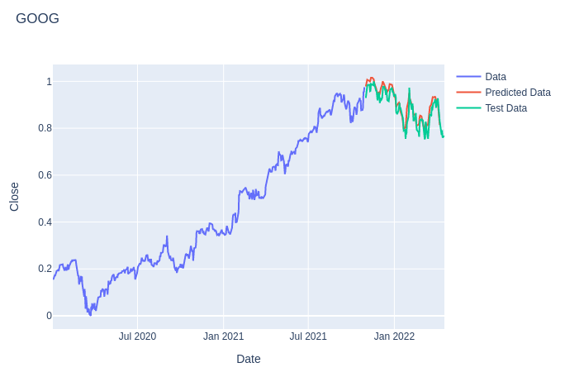
Fig 1: Binary Cross Entropy for Google dataset
Fig 2: MSE loss measure for Google dataset
NOTE: MSE loss measure gives best prediction

Slide 49
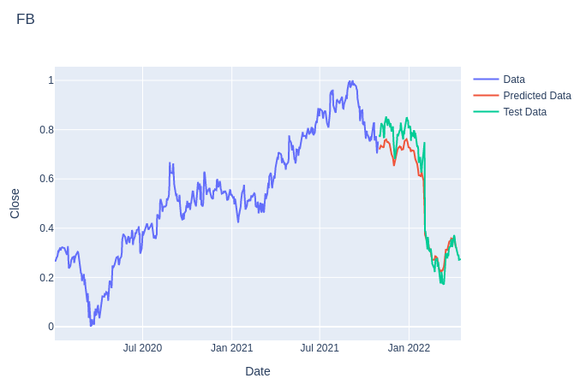
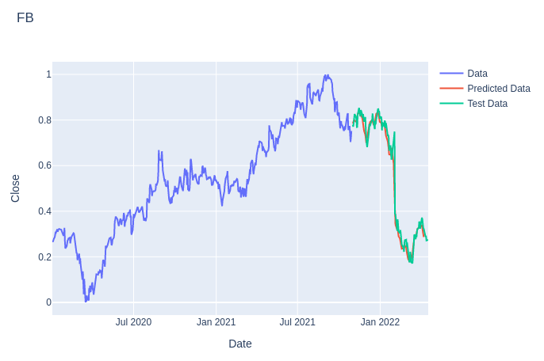
Fig 1: Binary Cross Entropy for FB dataset
Fig 2: MSE loss measure for FB dataset
NOTE: MSE loss measure gives best prediction

Slide 50
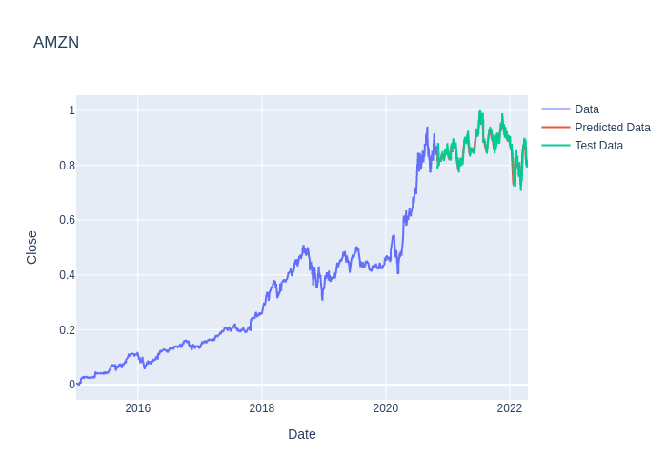
Fig: LSTM performance for dataset 2015-22 (perfect prediction)

Slide 51
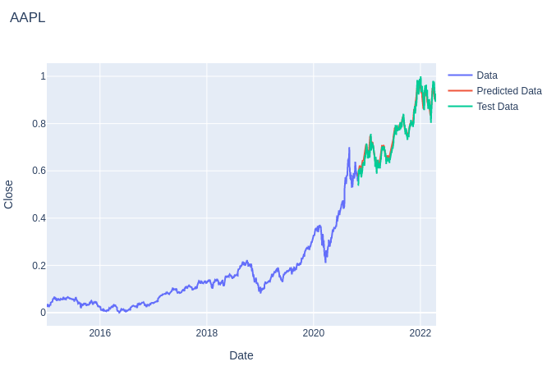
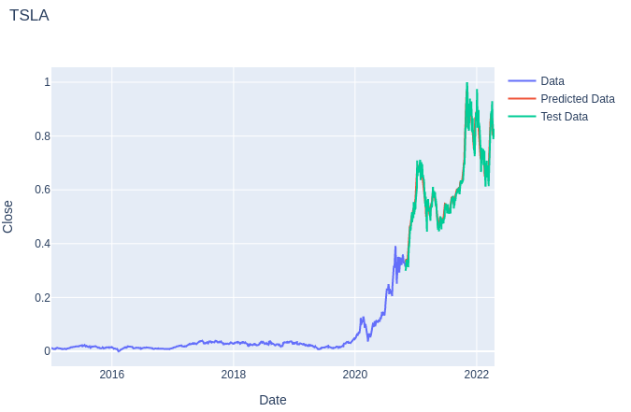
Fig: LSTM performance for dataset 2015-22 (perfect prediction)

Slide 52
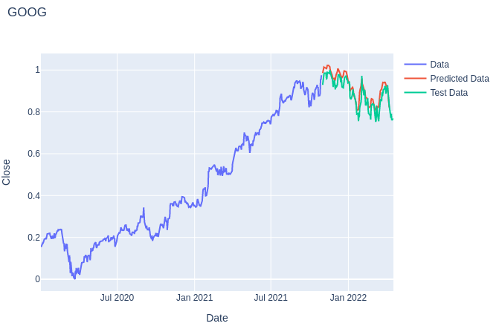
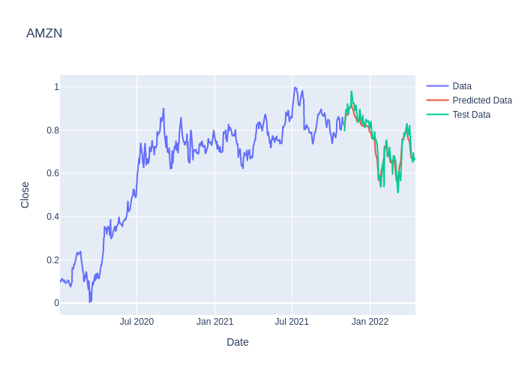
Fig: LSTM performance for dataset 2020-22 (perfect prediction)

Slide 53
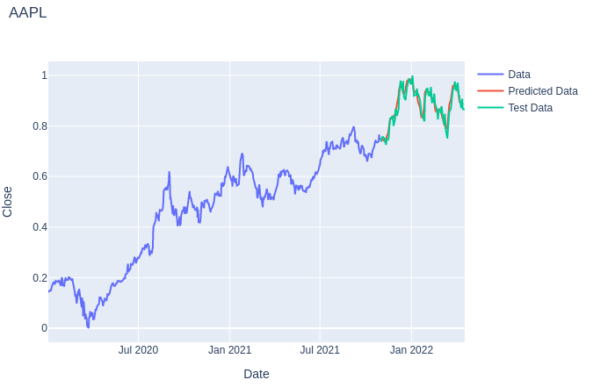
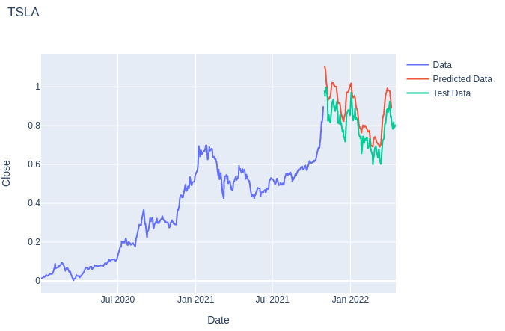
Fig: LSTM performance for dataset 2020-22 (perfect prediction)

Slide 54
CONCLUSION AND FUTURE WORK

Slide 55
CONCLUSION
From the above tables and figures we can infer that LSTM model with ADAM optimizer performs much better than other models such as ARIMA, SMA and RNN. We got satisfactory results that is above 80% accurate stock prediction.
FUTURE WORK
We add new features like finding the local minima and local maxima to buy and sell the stock respectively, add API’s or some other operations to let the algorithm do the trading for us.

Slide 56
REFERENCES

Slide 57
REFERENCES
[1] [For SMA description and formula]
https://www.investopedia.com/terms/s/sma.asp
[2] [For ARIMA terms and details]
https://journal.jis-institute.org/index.php/ijmhrr/article/view/235
https://www.investopedia.com/terms/a/autoregressive-integrated-moving-averagearima.asp
[3] [For RNN details and images]
https://www.ijert.org/research/future-stock-price-prediction-using-recurrent-neural-network-lstm-and-machine-learning-IJERTCONV9IS05065.pdf
https://builtin.com/data-science/recurrent-neural-networks-and-lstm
[4] [For SMA and ARIMA implementation]
https://github.com/0xpranjal/Stock-Prediction-using-different-models/blob/main/Notebooks/1.%20Time%20Series%20Forecasting%20with%20Naive%2C%20Moving%20Averages%2C%20and%20ARIMA.ipynb
[5] [For LSTM details and images]
https://www.researchgate.net/publication/348390803_Stock_Price_Prediction_Using_LSTM
https://www.analyticsvidhya.com/blog/2017/12/fundamentals-of-deep-learning-introduction-to-lstm/
https://en.wikipedia.org/wiki/Long_short-term_memory#:~:text=Long%20short%2Dterm%20memory%20(LSTM,networks%2C%20LSTM%20has%20feedback%20connections.
https://towardsdatascience.com/lstm-networks-a-detailed-explanation-8fae6aefc7f9
[6] [For LSTM implementation]
https://towardsdatascience.com/time-series-forecasting-with-recurrent-neural-networks-74674e289816
https://medium.com/visionary-hub/using-lstms-to-predict-future-stock-prices-61f4458fc860

Slide 58
Thank You

