Slide 1

Why Functional Programming
Andy Huang

Slide 2
OUTLINE
Functional Programming
High Order Function
Tail Recursion
Substitution Model
Functional Programming Side Effects
Race Condition

Slide 3
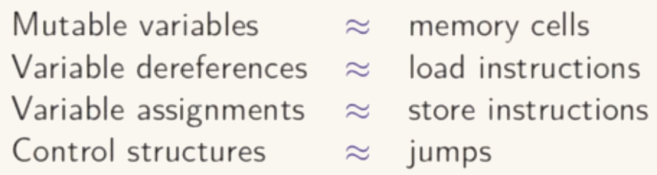
Functional Programming
Imperative programming: Java, C, etc..
processor
bus
Memory

Slide 4
Functional Programing
Functional programming:
Restricted Sense: Programming without mutable variables, assignment and loops.
Example: Pure Lisp, Haskell without IO Monad, and etc.
Wider sense: focusing on the functions and functions can be values that produced, consumed, and composed
Example: Lisp, Haskell, Scala, F#, and etc.

Slide 5
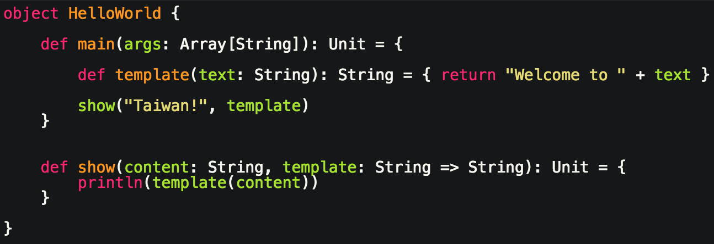
High Order Function
High Order Function: a function that has a value with function type as input parameter or return value.
Example

Slide 6
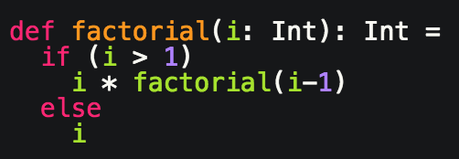
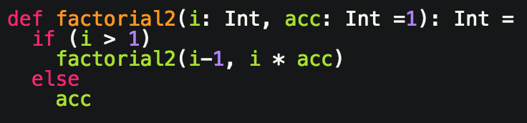
Tail Recursion
factorial(4)
4 * factorial(3)
4 * (3 * factorial(2))
4 * (3 * (2 * factorial(1)))
4 * (3 * (2 * 1))
24
factorial2(4)
factorial2(3, 4 * 1)
factorial2(2, 3 * 4)
factorial2(1, 2 * 12)
24

Slide 7
Substitution Model
The scheme of expression is called Substitution Model.
The idea is reducing expression to model
if (2>1) 2 * factorial(2-1) else 2
if (true) 2 * factorial(2-1) else 2
if (true) 2 * factorial(1) else 2
2 * factorial(1)
2 * if (1>1) 1 * factorial(1-1) else 1
2 * if (false) 1 * factorial(1-1) else 1
2 * if (false) 1 * factorial(0) else 1
2 * 1
2

Slide 8
Functional Programming Side effect
Side effect: A procedure changes a variable from outside its scope.
Benefits of functions not having side effects:
Methods more reliable and reusable since they are less entangled
Make your programs easier to test
Reduce the area of code where race conditions can happen

Slide 9
Race Condition
Process - an instance of a program that is executing in the OS
Each process can contain multiple concurrency units called Threads
Thread 1
Thread 2
Thread 1
Thread 2
Println(“Hello ”)
Println(“Hello ”)
Println(“Hello ”)
Println(“World “)
Println(“World “)
Println(“Hello ”)
Println(“World “)
Println(“World “)
Output: Hello Hello World World
Output: Hello World Hello World

Slide 10
Race Condition
Race Condition example
RaceConditionExample.++
Thread A
RaceConditionExample.count
Thread B
count := 0, 1, 1, 2, 3 …
count = count +1
update
update
count = count +1
count = count +1
update
update
count = count +1

Slide 11
Race Condition
How to solve it?
Synchronized block: make statements(i.e. count = count + 1) atomic by lock the object
Code block after a synchronized call on an object x is never executed by 2 threads at the same time
Thread A
Thread B
RaceConditionExample.++
RaceConditionExample.count
update
update
count = count +1
count = count +1

Slide 12
Race Condition
How to solve it?
The Actor Model, an amazing concept of concurrency/parallelism.
Create a counter actor to handle the share variable(i.e. counter)
Thread A
Add count request
Counter Actor
Display Request
Display Actor
mailbox
mailbox
counter
Add count request
The current counter value: 9, updated by thread1…
The current counter value: 10, updated by thread2…
Thread B

Slide 13
Future
Functional Programing
By-Name Parameter
Curry
Closure
Monaid
Scala Syntax Sugar
Type Reference
Companion object
Implicit Conversion
Lazy
Akka
Actor Model Introduction
Actors & Concurrency
Simple Crawler Implementation

