Slide 1
大數據平台
Roger

Slide 2
今天很雜
歷程工程 - Activity
Machine Learning API Service
Tensorflow Introduction

Slide 3
Part 1. 歷程工程

Slide 4
金融行為 + 動態消息

Slide 5

客戶Roger活動事件流
newest
Roger
從台幣存款戶 - 提款1000元
2015/05/27 20:48
- 於公館捷運1號ATM
Roger
兌換了紅利商品 - 茶葉蛋
2015/04/29 12:08
- 於MyRewards
Roger
開辦了信用卡戶 - 長榮無限
old
- 於信義分行
2015/02/29 9:34

Slide 6


動機
referer
觸發點
Trigger
開戶
開卡
刷卡
買產品
打客服
領錢
瀏覽
點擊
帳戶
消費店家
商品
其他客戶
客戶
Cookie
員工
Actor
object
Action
日期
時間
早中晚
星期幾
特定節日
Time
Channel
通路
網銀
XX分行
店家地點

Slide 7
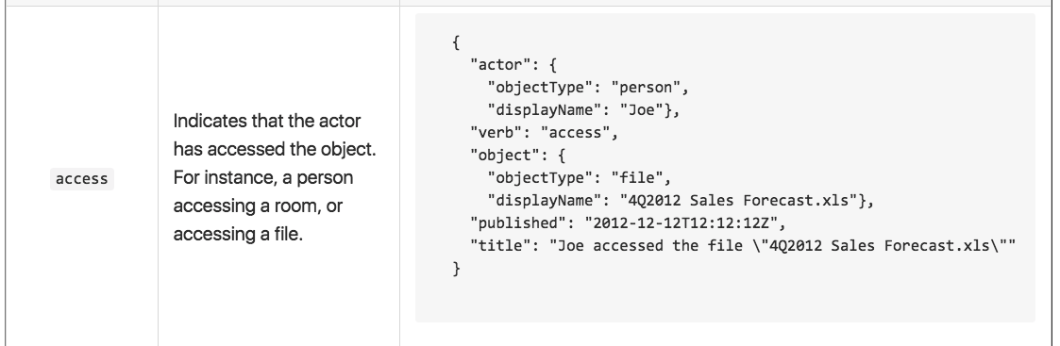
Activity Feed ?
https://github.com/activitystreams/activity-schema/blob/master/activity-schema.md

Slide 8
單一事件

Slide 9
簡單事件
{
actor: {…}, # 動作者（主詞）
action: {…}, # 動作（動詞）
object: {…}, # 目標物（受詞）
channel: {…}, # 通路
attributes: {…} # 補充說明（補充上述四者）
}

Slide 10
{
actor: {
type: “cookie_id",
id: “IHDONQWNIN….”,
},
action: {
type: "瀏覽",
timestamp: 1513511522521,
},
object: {
type: "網頁",
id: "信貸"
},
channel: {
type: “網路”,
id: “www.cathaybk.com”
},
attributes: {
actor: {
session: “UWRAW8012DW”,
device: “IOS”,
ip: “172.142.15.2”
},
action: {
duration: 2123,
active_duration: 5215,
loading_time: 521,
}
object: {
url: “www.cathaybk.com/….”,
intention: “美食”,
function: “資料查詢”
}
}
}
{
actor: {
type: "customer",
id: "A12xxxxx",
},
action: {
type: "刷卡消費",
timestamp: 1523653235,
},
object: {
type: "信用卡戶",
id: "信用卡卡號"
},
channel: {
type: “購買”,
id: “線下刷卡通路ID”
},
attributes: {
actor: {
name: "Roger"
},
action: {
amount: 40,000
},
object: {
card_type: “Play”,
card_level: “White”
},
channel: {
name: “信義微風”,
mcc_code: “…”,
address: “….”
}
}
}
申辦信用卡
開卡_01
MyRewards
WebEvent
刷卡
2015/02/29
2015/04/19
2015/04/29
2015/05/02
2015/05/27
{
actor: {
type: "customer",
id: "A12xxxxx",
},
action: {
type: "開卡",
timestamp: 125125151252,
},
object: {
type: "信用卡",
id: "信用卡卡號"
},
channel: {
type: “分行”,
id: “分行 Code”
},
attributes: {
actor: {
name: "Roger"
}
object: {
card_type: “Play”,
card_level: “White”
}
}
}
{
actor: {
type: "customer",
id: "A12xxxxx",
},
action: {
type: "開卡",
timestamp: 15236236223,
},
object: {
type: "信用卡",
id: "信用卡卡號"
},
channel: {
type: “ATM”,
id: “ATM Code”
},
attributes: {
actor: {
name: "Roger"
}
}
}
{
actor: {
type: "customer",
id: "A12xxxxx",
},
action: {
type: "兌換",
timestamp: 15236353353,
},
object: {
type: "紅利商品",
id: "紅利商品ID"
},
channel: {
type: “MyRewards”,
id: “MyRewards”
},
attributes: {
actor: {
name: "Roger"
},
object: {
name: “茶葉蛋”,
amount: 300
}
}
}

Slide 11
ATM 提款
{
"actor": {
"type": "customer",
"id": "A1XXX"
},
"action": {
"type": "提款",
"time": 1434322211
},
"object": {
"type": "存款戶",
"id": "0000023XXX"
},
"channel": {
"type": "ATM",
"id": "ATM machine/terminal ID"
},
"attributes": {
"actor": {
"name": "Roger"
},
"action": {
"txn_amt": 5000
},
"object": {
"currency_code": "TWD"
},
"channel": {
"location": "..."
}
}
}

Slide 12
雙向事件
僅紀錄動作者為「國泰世華客戶」

Slide 13
ATM 轉帳
{
"actor": {
"type": "customer",
"id": "A123XXX"
},
"action": {
"type": "轉帳-出",
"time": 1434322211
},
"object": {
"type": "存款戶",
"id": "0000023XXX"
},
"channel": {
"type": "ATM",
"id": "ATM machine/terminal ID"
},
"attributes": {
"actor": {
"name": "Roger"
},
"action": {
"txn_amt": 10000,
"in_bank_code": 012,
"in_bank_ nbr": "000002444XXX"
},
"object": {
"currency_code": "TWD"
},
"channel": {
"location": "..."
}
}
}
{
"actor": {
"type": "customer",
"id": "A124XXX"
},
"action": {
"type": "轉帳-入",
"time": 1434322211
},
"object": {
"type": "存款戶",
"id": "0000024XXX"
},
"channel": {
"type": "ATM",
"id": "ATM machine/terminal ID",
"attributes": {
"location": "..."
}
},
"attributes": {
"actor": {
"name": "Miles"
},
"action": {
"txn_amt": 10000,
"out_bank_code": 012,
"out_bank_ nbr": "000002444XXX"
},
"object": {
"currency_code": "TWD"
},
"channel": {
"location": "..."
}
}
}
轉出
轉入

Slide 14
Schema for SQL

Slide 15
actor_type: String # 動作者類型
actor_id: String # 動作者識別螞
action_type: String # 行為類型
action_time: Time or Int # 行為時間
object_type: String # 目標類型
object_id: String # 目標代碼
channel_type: String, # 通路類型
attributes: String # 補充說明（JSON stringify)

Slide 16


事件
特徵
商機
標籤

Slide 17
Cathay Graph
#Tag
$Feature
User Entity
Group by entity key generate features in event data
$Feature
Credit Card
Merchant
#Tag
Product Entity
$Feature
event
Product
#Tag
Customer
$Feature
on Entity
Identify
Cookie
#Tag
on Entity
$Feature
Loan
Calculate implicit similarity between entity based on Tags and Features
#Tag

Slide 18
怎麼開始進行？

Slide 19
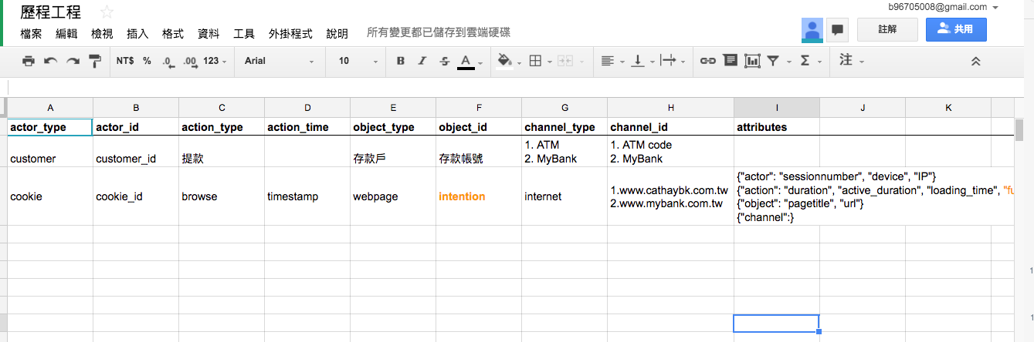
先盤點資料吧!

Slide 20
通路選擇
MMB (My Mobile Bank)
MyBank
MyATM
MyRewards
數位通路瀏覽、點擊行為
客服進線
ATM使用行為
信用卡交易

Slide 21
Part 2. ML API Service

Slide 22
有沒有想過模型做好了怎麼讓人用？

Slide 23
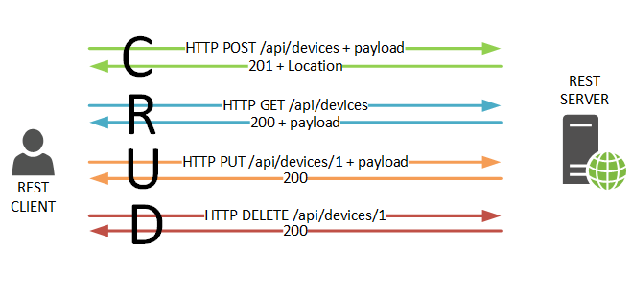
API?

Slide 24
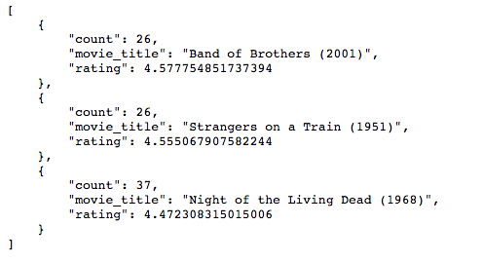
電影推薦API
GET http://localhost:8000/movielens/users/1/top/10

Slide 25


Iris類別預測API
GET http://localhost:8000/iris/features/2,3,4,1/class
GET http://localhost:8000/iris/features/2,3,4,1/probs

Slide 26
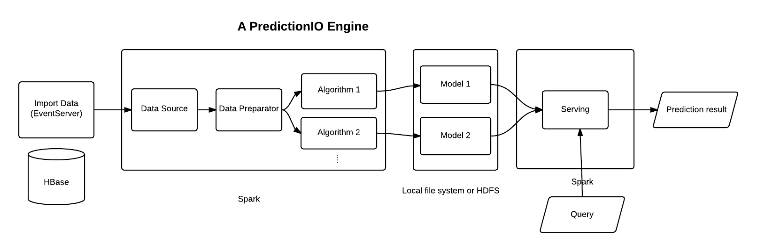
Machine Learning + API ?
http://predictionio.incubator.apache.org/system/

Slide 27








github.com/b96705008/MLServices
SkLearn
Keras
Tensorflow
Spark ML
Numpy
Pandas
RDD
Flask or
Other API framework
training
data
dump
load
read data
Dataset
Algorithm
Model
Serving
Source
Get Model
API
coordinate
Engine
luigi or other scheduler

Slide 28
Try it!

Slide 29
Part 3. Tensorflow Hello World

Slide 30
安裝
https://www.tensorflow.org/versions/r0.12/get_started/os_setup.html

Slide 31
