Slide 1

OpenStack Juno Release Press Kit Oct 16, 2014
Notes:
Elevate Cloud
SL & SaaS
Rallying the marketplace

Slide 2
With its 10th release, OpenStack supports the widest set of technologies, enabling new use cases across finance, manufacturing, technology and many industries.

Slide 3
OpenStack Juno Key Themes
Most widely-supported cloud platform, expanded testing for plugins
Storage policies for object storage
Federated identity enhancements
Operational improvements
Enterprise
Maturity
Laying the Foundation for NFV Support
OpenStack infrastructure natural home for implementing NFV
NFV workgroup established, new features landing in Nova
New Data Processing capability part of integrated release
Quickly provision and manage Hadoop and Spark
New Data Processing Capability
Notes:
Release Highlights
Overall focus on stability and maturity for the integrated release, with improvements to performance and upgrades
New data processing capability automates provisioning and management of big data clusters using Hadoop and Spark
Enterprise features such as storage policies for better control of cost and performance, the Identity service making it easier to connect to LDAP, and more HA networking options
New subteam and features landing in the Compute project to lay the foundation for Network Functions Virtualization (NFV), a massive shift in how many networking and telco services are developed and deployed

Slide 4
Key Themes Across the Community
Voice of the user & operator continues to shape software
Operator meetups continue to drive valuable feedback. Many operational enhancements and thousands of bug fixes accepted.
Users spanning enterprise and various verticals bringing new requirements, including NFV, Win The Enterprise and End User working group efforts
Marketplace offers new paths to adoption
One size does not fit all: that’s why OpenStack is still the right choice for many. Helping simplify options for users.
Added Hosted Private Cloud to Marketplace
New active consumption model
Mix and match technology options in every datacenter
Users desire more control and leverage with technology providers

Slide 5
Key Growth Stats
Contributor Growth | 1,419 contributors to Juno; a 16% increase from the Icehouse release
Total Number of Features | Approximately 310 new features in the Icehouse release
Bugs Fixed | 3,200 bugs fixed during the Juno release cycle, a 10% increase from Icehouse
Top Companies Committing Code | HP, Red Hat, Mirantis, Rackspace, IBM, Cisco, NEC, VMware, OpenStack Foundation, Independents; top users contributing include Yahoo!, Time Warner Cable and eBay
Documentation | Nearly 500,000 lines of documentation modified; new Architecture Design Guide produced during Juno cycle
Drivers | 97 drivers and plugins supported across the compute, storage and networking capabilities
Notes:
SDSS

Slide 6
Featured Case Studies
Top 10 automaker turning customer insights into action with OpenStack
Cloud & Heat brings OpenStack clouds to your basement
With OpenStack, Pacnet reduces provisioning time from weeks to seconds
Intelemage uses OpenStack-powered cloud for medical image sharing
GoDaddy Builds their Open Cloud with OpenStack

Slide 7

OpenStack’s Phenomenal Growth
2014 OCT 16
Release: Juno 2,084,291 lines of code
COMPANIES
COMMITS
408
130K
ACTIVE MEMBERS
LINES OF CODE
2014 APR 17
Release: Icehouse
1,766,546 lines of code
16000
2M
2013 OCT 17
Release: Havana
1,729,137 lines of code
2013 APR 4
Release: Grizzly
1,323,479 lines of code
2013 SEP 27
Release: Folsom
667,895 lines of code
2012 APR 5
Release: Essex
558.368 lines of code
2010 OCT 21
Release: Austin
52,796 lines of code
2011 SEP 22
Release: Diablo
478,671 lines of code
2011 APR 3
Release: Cactus
117,887 lines of code
2011 FEB 3
Release: Bexar
85,425 lines of code
Source: http://www.ohloh.net/p/openstack
Notes:
2,084,291 lines of code
129,579 commits
Updated on Oct 16th 2014 – sources include:
https://www.openstack.org
https://www.openstack.org/foundation/companies
http://www.ohloh.net/p/openstack/commits/summary
7

Slide 8

IBM Contributions to OpenStack: Road To Juno
Juno
Core Contributors: 15
Technical Contributors: 109
Commits: 1669
Blueprints: 48
Projects: 78
Folsom
Core Contributors: 4
Technical Contributors: 18
Commits: 181
Blueprints: 9
Projects: 20
Havana
Core Contributors: 13
Technical Contributors: 85
Commits: 1595
Blueprints: 71
Projects: 48
Key Contributions:
Federated Identity
Block Volume Replication
Dashboard Enhancements
Key Contributions:
Integration Tests
Crowd Sourced Translation
Membership Services
400
Grizzly
Key Contributions:
Enterprise Security
Ceilometer
Quality Assurance
Total IBMers
Core Contributors: 10
Technical Contributors: 38
Commits: 961
Blueprints: 35
Projects: 33
Total IBMers
100
380
Icehouse
Total IBMers
Core Contributors: 14
Technical Contributors: 107
Commits: 1722
Blueprints: 85
Projects: 61
Essex
Key Contributions:
API Stability
Storage Enhancements
21% of Nova design features
Core Contributors: 1
Technical Contributors: 2
Commits: 9
Blueprints: 0
Projects: 6
270
Key Contributions:
Quality Assurance
Authentication & Security 15% of Compute features
Total IBMers
Key Contributions:
Chinese Translation
Nova Hygiene
Storage Enhancements
380
Total IBMers
54
Total IBMers
Source http://www.stackalytics.com/
Notes:
IBM is proud to be a #2 contributor and to have made 12% of commits to OpenStack integrated projects in this latest release. IBM had a total of 109 technical contributors working on Juno with 1,636 commits across 78 projects and 175K lines of code. The IBM team should stand proud of our commitment and contributions to OpenStack!
IBM demonstrated very strong leadership in Identity Service (#1 with 33% commits), Storage (#1 with 14% commits), Compute (# 2 with 17% commits) and Dashboard projects (#2 for code reviews, 1636 reviews) for this release. Even more importantly, IBM is leading the development of the RefStack-client to support interoperability with 80% of overall commits.

Slide 9

IBM is helping to make OpenStack better for the community
IBM is 2nd in contributions to integrated projects with 12% commits
Deliver Optimization
Horizon Metadata generator
Keystone-to-Keystone Federation
Cloud Audit support for Keystone Federation
Keystone to Keystone Federation for hybrid
clouds
Cloud Foundry/OpenStack Keystone integrated authentication
OpenStack IaaS APIs
Security & Authentication
OVF Images
Contribute Platform Support
IBM DB2 support
Support IPv6 DHCPv6 Stateful and Stateless mode
Enable Neutron VPN as Service by Chef
Enable Cinder to use DB2 as a backing database
Replication support for Cinder volumes
QoS capability for IBM Storwize driver
Cinder
Nova
Neutron
Block
storage
Compute
Network
Contribute to community health
drivers
drivers
drivers
Certification process and interoperability tools, quality assurance, internationalization, audit support, Continuous Integration enablement, bug fixing
IBM Storage
IBM Servers
IBM Network
IBM had a total of 109 technical contributors working on Juno with 1,636 commits across 78 projects and 175K lines of code
Source http://www.stackalytics.com/ Oct 15, 2014

Slide 10
IBM Contributions to OpenStack Juno Release: Key Areas
Identity Service (Keystone)
Collaborating heavily with CERN and Rackspace, IBM implemented new features that enable Keystones from multiple clouds to work together using industry standard federation protocols thus laying a solid foundation for enabling OpenStack based hybrid clouds.
In addition, IBM continued to expand on its critical CADF Standard based auditing work and enhance the support for multiple identity backends.
Block Storage (Cinder)
For two consecutive releases, IBM has been the top contributor to Cinder implementing security and internationalization features as well as volume replication a critical feature in the case of a catastrophic storage system failure.
Dashboard (Horizon)
In an effort to improve the OpenStack user experience, IBM participated in over 1500 code review in Horizon and climbed to number three in contributions.
IBM implemented key features such as custom tooltip support, filtering and pagination support, improved help text and increased internationalization support. In addition IBM has been focused on improving performance and responsiveness by moving Horizon to a client-side rendering model.
Notes:
10

Slide 11
IBM Contributions to OpenStack Juno Release: Key Areas
Compute (Nova)
IBM led the development of the new V2.1 API design which will be completed early in the Kilo release. This work is the basis to simplify API enhancements in future releases. IBM also helped monitoring the health of the community development system and fixed over 350 bugs in this project.
RefStack
IBM has been one of the leaders in the effort around the OpenStack certification process and the interoperability tools. For Juno, IBM is the major contributor to the development of the Refstack-client which is a compliance test tool for OpenStack deployments. IBM also contributes to the development of the Refstack portal code that stores test results, performs analysis and reports compliance status.
Notes:
11

Slide 12
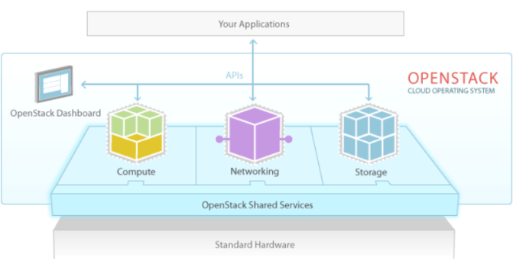
IBM Contributions to Juno Release: Enhancements
Compute (Nova)
Significant V2.1 API implementation
Numerous bug fixing : 369 for 18% of total bugs
Authentication & Security (Keystone)
Cloud Foundry/OpenStack Keystone integrated authentication
Keystone to Keystone Federation for hybrid clouds
Cloud Audit support for Keystone Federation
Keystone V3 Extension Discoverability
Keystone API Versions Discoverability
Orchestration
Image metadata to enable TOSCA based Image Query Selection
Heat translator for TOSCA – Storage support
TOSCA like lifecycle operations for Heat software components
Heat stack breakpoint support
Heat software lifecycle aware software config
Dashboard (Horizon)
Improved client & server side pagination support
JQuery and AngularJS Enablement
Hover-over help support
Consistent sorting and filtering
Usability and internationalization enhancements
Metering (Ceilometer)
Expanded Cloud Audit Data Federation (CADF) support
Internationalization enhancements
New Tempest test cases for internationalization support
New platform support for internationalization
Infrastructure
Enabled Continuous Integration testing for IBM PowerKVM based systems
Bare Metal Provisioning (Ironic)
Serial Console Support
Send Sensor Data to Ceilometer
Storage (Cinder & Swift)
Improved Swift profiling support
Enable Cinder to use DB2 as a backing database
Replication support for Cinder volumes
Internationalization support for Cinder
QoS capability for IBM Storwize driver
Shared File System (Manila)
Added GPFS support
Networking (Neutron)
Support IPv6 DHCPv6 Stateful and Stateless mode
Enable Neutron VPN as Service by Chef
Notes:
12
Nova
IBM led the development of the new V2.1 API design which will be completed early in the Kilo release. This work is the basis to simplify API enhancements in future releases. IBM also helped monitoring the health of the community development system and fixed over 350 bugs in this project. Also worked on infrastructure development to support upgrades.

Slide 13
IBM Contributions to Juno: Highlights
IBM #2 for commits to integrated projects with 12% commits (link to graph)
#1 contributor to Storage project (14% commits) and Identity Service project (33% commits)
#2 contributor to Compute project (17% commit)
#2 reviewer for Horizon with 1636 reviews
IBM #4 for commits to all OpenStack projects with (link to graph)
With 1636 commits over 78 projects
IBM #1 for commits to RefStack Client with 80% of overall commits
3 IBM developers in the top 15 contributors out of 1,529 total contributors.
Over 100 IBM developers :
Implemented 48 blueprints
Fixed 421 bugs
Wrote over 175,000 lines of code
Participated in over 10,000 code reviews
Notes:
Top contributors - Brant
IBM demonstrated very strong leadership in Identity Service (#1 with 33% commits), Storage (#1 with 14% commits), Compute (# 2 with 17% commits) and Dashboard projects (#2 for code reviews, 1636 reviews) for this release. Even more importantly, IBM is leading the development of the RefStack-client to support interoperability with 80% of overall commits.
Knudson, Matt Riedemann, Steve Martinelli

Slide 14
Read more about the OpenStack Juno release
OpenStack Juno Release Update webinar
https://www.brighttalk.com/webcast/499/129077
OpenStack Juno Press Release
http://www.openstack.org/software/Juno/press-release/
Thoughts on Cloud Blog (all about IBM's top contributions to Juno)
Open, hybrid cloud is about to rain down. Are you ready? by Angel Diaz
A Guide to the OpenStack Juno Release by Brad Topol
OpenStack Juno Video
OpenStack Foundation Juno PPT Overview
http://www.slideshare.net/openstack/openstack-juno-october-2014
Juno Release Notes and Documentation
http://www.openstack.org/software/
https://wiki.openstack.org/wiki/ReleaseNotes/Juno
Early Press Coverage
OpenStack Juno Packs in Features, Pursues Wider Adoption - InfoWorld
OpenStack Juno Brings Big Data to the Cloud - eWeek
OpenStack Juno update will support Hadoop for big data processing — V3.co.UK
OpenStack Juno Cloud Features Trove Database-as-a-Service Updates — eWeek

Slide 15
Reference material
Notes:
Elevate Cloud
SL & SaaS
Rallying the marketplace

Slide 16
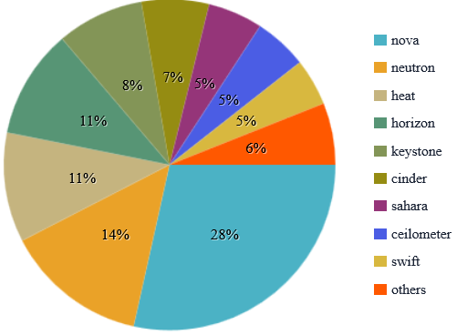
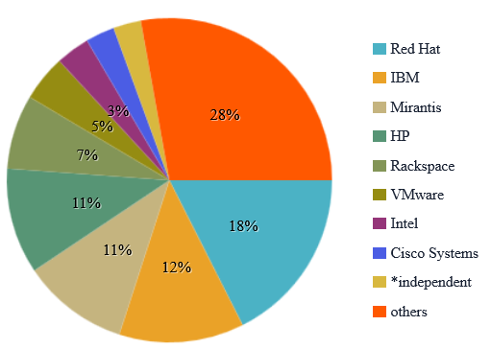
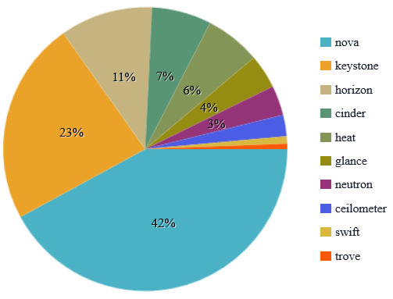
IBM #2 for commits to OpenStack Integrated projects
Community focus
Contributions by companies
IBM focus
By http://stackalytics.com/?project_type=integrated&metric=commits&release=juno Oct 9th

Slide 17
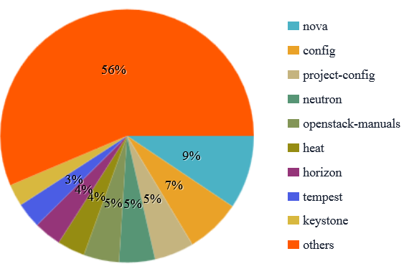
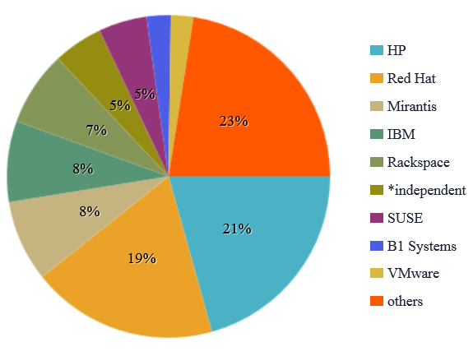
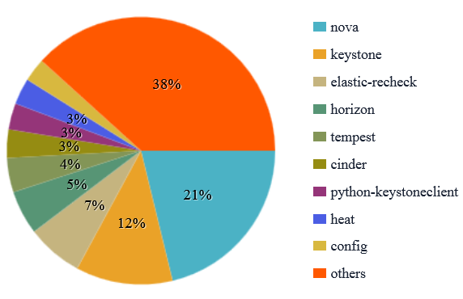
IBM #4 for commits to all OpenStack projects (Stackforge excluded)
Community focus
Contributions by companies
IBM focus
By http://stackalytics.com/?release=juno&metric=commits&project_type=openstack Oct 9th

