Slide 1
MPEG-1
MPEG is short for the ‘Moving Picture Experts Group‘.
The official page: http://cselt.it/mpeg.
The 'official' title of the committee is
“ISO/IEC JTC1 SC29 Working Group 11”.

Slide 2
Requirement
Baseline:
  MPEG I, IP, IPB with GUI (display)
Bonus:
  Real Time
  VCR functionality
    random access, fast-forward/backward
  MPEG encoder
  Can read the file with audio/video and system mixed together (.mpg)

Slide 3
Due day
Submit your code before 6/24 23:59
  Send to ITCT@cmlab.csie.ntu.edu.tw
Demo Time:
  6/25 14:20~17:00 @R102
  Fill Google doc out - http://tinyurl.com/mnbwc2c
  Please bring both executable and source code

Slide 4
MPEG-1 Encoding Flowchart
R
G
B
To Other
Color Space
(Optional)
DPCM
Huffman or
Arithmetic
Coding
Scan
I-Frame
DCT
Quant
Zig-Zag
Y
RLE
I
Q
01001...
P B-Frame
IQuant
Different Image
Motion
Estimation
Motion
Vector
IDCT
Y
Reconstruct &
Update
I
Q
Forward Frame Buffer
Y
I
Q
Backward Frame Buffer

Slide 5
Motion Estimation
Motion Vector
Motion Estimation
Frame N
Frame N+1
88 84 83 84 85 86 83 82 86 82 82 83 82 83 83 81 82 82 84 87 87 87 81 84 81 86 87 89 82 82 84 87 81 84 83 87 85 89 80 81 81 85 85 86 81 89 81 85 82 81 86 83 86 89 81 84 88 88 90 84 85 88 88 81
84 82 83 81 85 86 83 81 82 82 81 83 82 83 83 81 83 82 84 87 87 87 81 88 81 85 86 88 82 82 84 87 81 84 85 87 85 89 84 81 82 85 81 84 81 89 81 83 81 87 86 83 86 89 81 84 88 82 87 84 87 89 84 81
-4 -2 0 -3 0 0 0 -1 -4 0 -1 0 0 0 0 0 1 0 0 0 0 0 0 4 0 -1 -1 -1 0 0 0 0 0 0 2 0 0 0 4 0 1 0 -4 -2 0 0 0 -2 -1 6 0 0 0 0 0 0 0 -6 -3 0 2 1 -4 0
-
=
Notes:
不見得會剛好框到圈圈

Slide 6
Motion Compensation
Motion Compensation
  using motion vector between current frame and reference frame to reconstruct the prediction of current frame
Current frame
Reconstruct frame
Reference frame

Slide 7
Motion Compensation (conti.)
Coding Motion Vector by DPCM
Half pixel Motion Vector
A
B
a = A
a
b
b = (A+B+1)/2
c
d
c = (A+C+1)/2
d = (A+B+C+D+2)/4
C
D

Slide 8
P, B-Frames
The P-picture uses MC to de-correlate dependence between continuous frames
The B-picture is introduced for increasing the frame rate without increasing too much bitrate
Forward
prediction
Backward
prediction
I or P
B
I or P

Slide 9
Bitstream Structure
Sequence Layer
GOP Layer
Picture Layer
Slice Layer
Macroblock Layer (no header)
Block (no header)

Slide 10
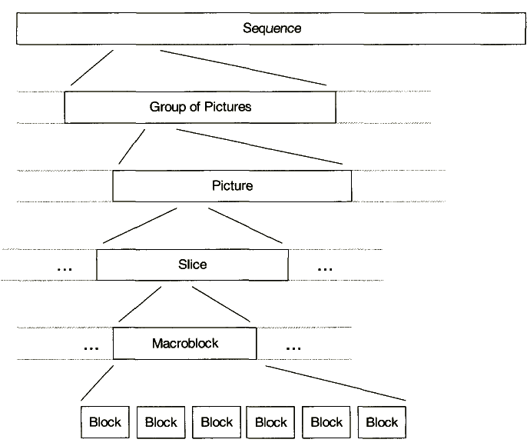
MPEG-1 Syntax hierarchy

Slide 11
Video Sequence Layer
video_sequence() {
next_start_code()
do {
sequence_header()
do {
group_of_pictures()
} while ( nextbits() == group_start_code )
} while ( nextbits() == sequence_header_code )
sequence_end_code | 32 | bslbf
}

Slide 12
Sequence Layer
Information in the Sequence Header:
  horizontal and vertical size
  pel_aspect_ratio
  picture rate
  bit-rate
  buffer size
  Constrained Parameter Set Flag

Slide 13
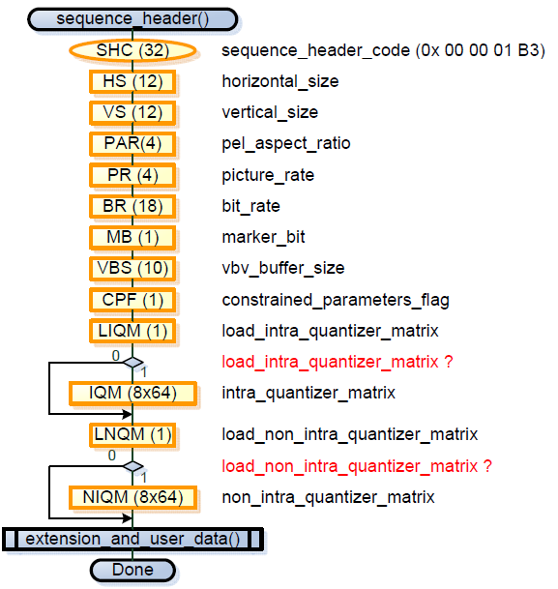

Slide 14
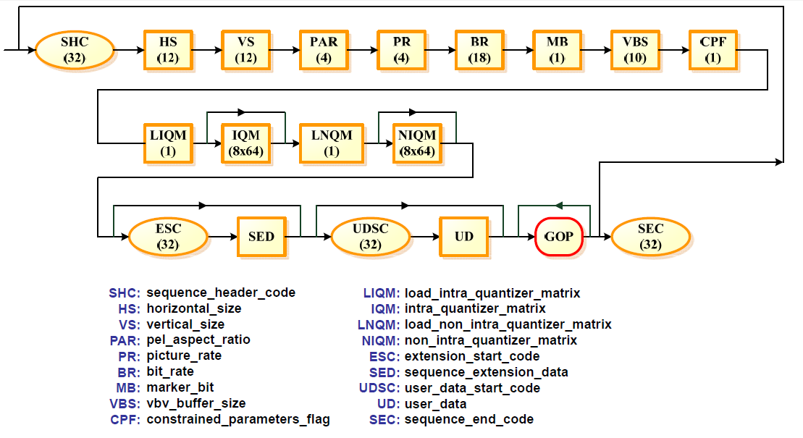

Slide 15
GOP Layer
I,P,B three type of picture to consist a GOP(group of picture)
Temporal : 1 2 3 4 5 6 7 8 9 10 11 12 13
Picture type : I B B P B B P B B P B B P
Coding seq : 1 3 4 2 6 7 5 9 10 8 12 13 11

Slide 16
3-Frame Buffers with Swapping
if (Pic_type = I,P){
Back -> For
Display (For)
}
Picture Decoding
if (Pic_type = I,P){
Back -> For
Cur -> Back
}
else if(Pic_type = B){
Display(Cur)
}
Sequence: I B P B P …
P
B
B
P
P
P
I
P
I
I
Forward Current Backward
Queue one frame then display as the above depicts.

Slide 17
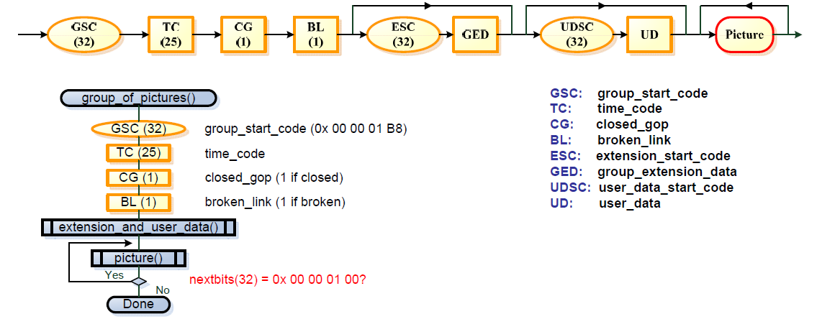

Slide 18
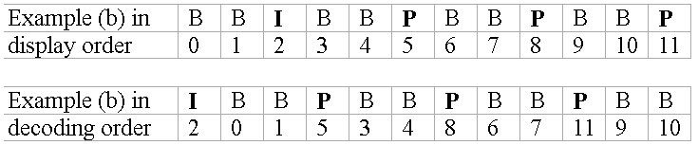
Picture Layer
Information in the Picture Header
  Temporal Reference
  Picture coding type
    001 : I Picture
    010 : P Picture
    011 : B Picture
  full_pel_vector
    zero for half pels
    one for integer pels
    only in the headers of P pictures and B pictures

Slide 19
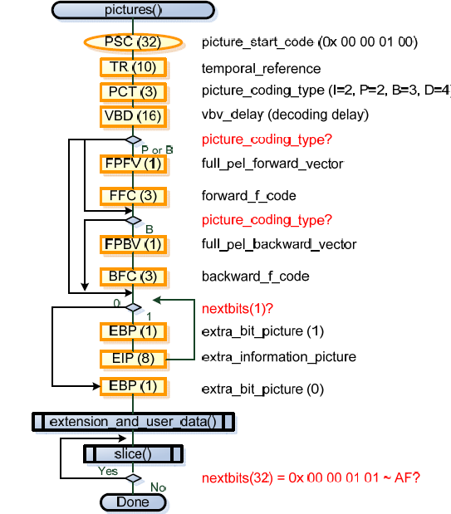

Slide 20
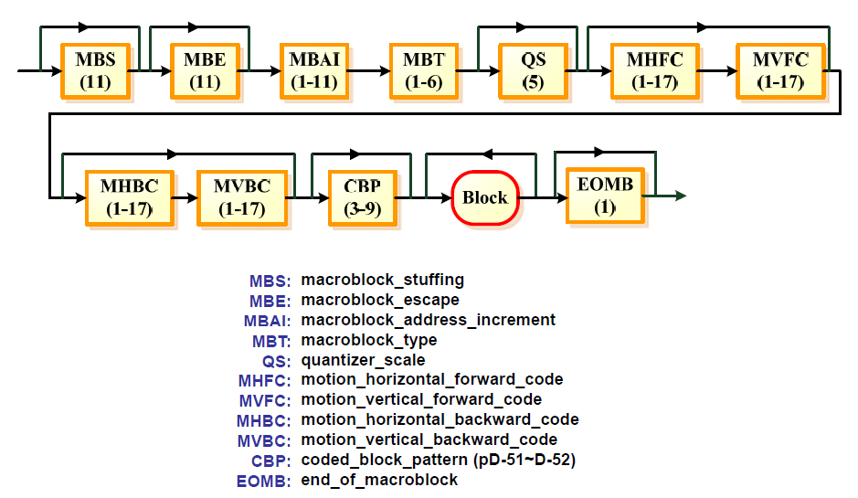
Macroblock Layer
Skipped MB
Motion Vector
Motion Vector

Slide 21
Macroblock Skip
In I-pictures, all macroblocks are coded and there are no skipped macroblocks
In P-pictures, the skipped macroblock is defined to be a macroblock with a reconstructed motion vector equal to zero and no DCT coefficients.
In B-pictures, the skipped macroblock is defined to have the same macroblock type as the prior macroblock, differential motion vectors equal to zero (use the motion vector predictor as its motion vector), and no DCT coefficients.

Slide 22
Macroblock Layer
macroblock_address_increment
  the difference between macroblock_address and previous_macroblock_address
macroblock_type
  macroblock_quant
  macroblock_motion_forward
  macroblock_motion_backward
  macroblock_pattern
    coded_block_pattern
  macroblock_intra

Slide 23
coded_block_pattern
Macroblock
  consisted of
    16 x 16 Luminance block
    8 x 8 Chrominance block
  basic unit for Motion Estimation
Block : 8 pixels by 8 lines
  basic unit for DCT
1
2
5
3
4
Cb
6
Y
Cr

Slide 24
Block Layer
DC: Predictive coding
  dct_dc_size_luminance
  dct_dc_differential
AC: Run–Length coding
  dct_coeff_first
  dct_coeff_next

Slide 25
The End
Any questions?
Thank you

