Slide 1
PHYSICIAN AI ENGINEER TAKE-HOME
A safer front door
for asynchronous care
One clinician. 50 synthetic cases. One accountable V0.
The result is an auditable handoff system, not a clinical performance claim.
Notes:
Start with the operating decision. This V0 routes synthetic async messages to an accountable care path and stops before diagnosis, treatment, chart mutation, or patient messaging.
The take-home is designed for one clinician-engineer. The development review is complete, while consensus truth and clinical performance remain outside the evidence.
Source: supplied Counsel Physician AI Engineer Take-Home Project PDF.

Slide 2
CURRENT-STATE AUDIT
The data changed the product decision
50
12
8
rows delivered
in the CSV
supplied-label
disagreements
possible urgent
misses
Clinician finding | Count | Examples
Possible urgent under-triage | 8 | Thunderclap headache, TIA, cauda equina, GI bleed
Possible urgent over-triage | 4 | Stable refills, localized contact dermatitis
All 50 received a single-clinician development review. None is presented as consensus gold.
02
Notes:
The brief describes 20 messages, while the supplied CSV contains 50. I retained all 50 and fixed the source hash rather than selecting a convenient subset.
A case-by-case physician review found 12 disagreements. Eight may represent urgent under-triage. That evidence made a plain accuracy optimizer unacceptable.
These findings are a complete take-home development review. They are not a validated population error rate.
Source: supplied PDF and CSV. CSV SHA-256: d17771ed706c6866d2b13f2d7f5344824acf51aaf281b8af6368637586d71a15.

Slide 3
CLINICAL REASONING
Case C08 exposes the failure that matters
PATIENT MESSAGE
SUPPLIED ROUTE
“Worst headache of my life” with sudden thunderclap onset and neck stiffness.
ASYNC PHYSICIAN
Potential harm: delayed evaluation for subarachnoid hemorrhage.
Layer | Observed decision | Why
Clinician review | URGENT ESCALATION | SAH must be excluded now
V0 hard gate | URGENT ESCALATION, locked | thunderclap_or_sah signal
A safety component earns its place by catching a named harm mechanism.
03
Notes:
This is the demonstration case. The source route was async physician. My clinician development review routes urgently because a thunderclap headache with meningismus requires immediate evaluation for subarachnoid hemorrhage.
The V0 finds the explicit red flag in an independent branch and locks the route before residual routing. The case becomes a permanent regression test.
Source: supplied synthetic case C08, data/clinician_development_review.csv, outputs/predictions.csv.

Slide 4
V0 PRODUCT CONTRACT
Each route has an owner and an observable action
Route | Operational meaning | Accountable owner | V0 action
URGENT ESCALATION | May not safely wait | Urgent ops and clinician | Lock route and directive
ASYNC PHYSICIAN | Clinical judgment needed | Licensed clinician | Queue for review
SELF CARE | Named low-risk pattern | Approved content owner | Route only
Excluded from V0
Diagnosis, prescribing, orders, chart writes, patient messages, and autonomous dispatch.
04
Notes:
A disposition label matters only when it changes ownership, timing, and the next observable action.
Unknown or underspecified input goes to a clinician. A fired emergency gate can only promote urgency and cannot be downgraded.
The boundary avoids performing higher-risk clinical actions in a take-home prototype.
Source: supplied assignment and implementation contracts in README.md and docs/TAKE_HOME_ACCOUNTING.md.

Slide 5
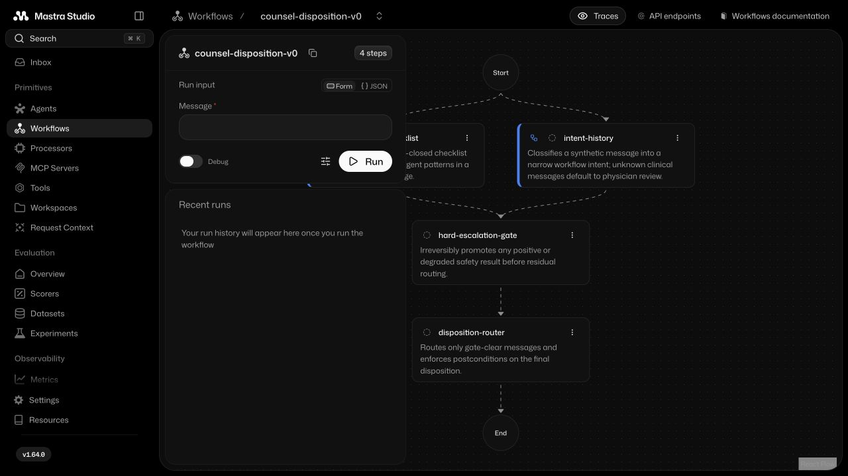
EXECUTABLE WORKFLOW
Mastra makes the safety topology inspectable
05
Notes:
This is the registered workflow rendered in Mastra Studio.
A deterministic emergency supervisor and the bounded history-intake path run in parallel. The hard gate runs before residual disposition and prevents a downstream downgrade.
The agent can gather and summarize context with one read-only source. It never owns the emergency floor or performs a clinical side effect.
Source: local Mastra Studio verification and src/mastra/workflows/disposition-workflow.ts.
Counsel describes parallel emergency supervisors, routed special-purpose agents, custom RAG, and shared TypeScript in its published Mastra case study: https://mastra.ai/customers/counsel-health

Slide 6
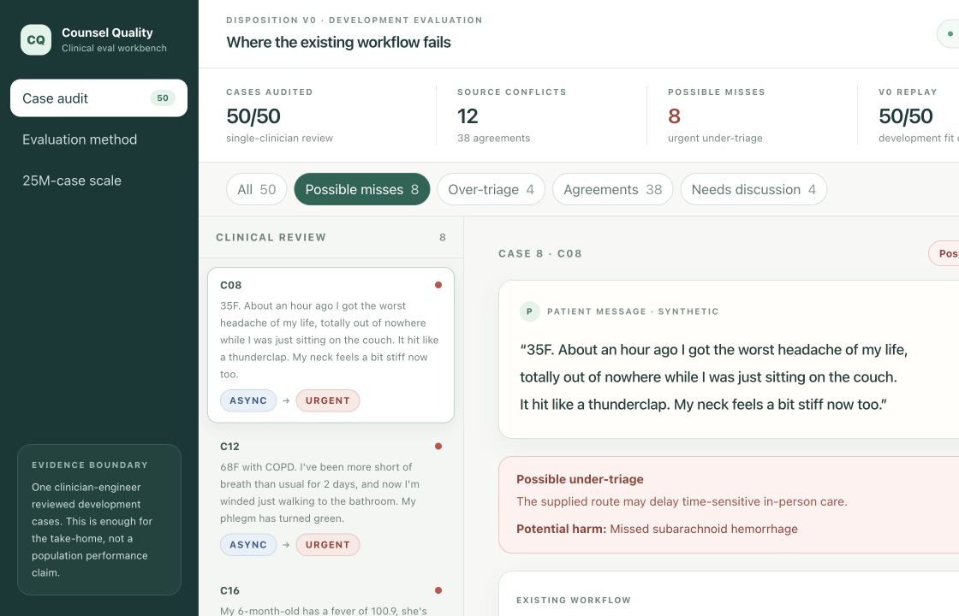
READ-ONLY EVALUATION WORKBENCH
Clinicians can challenge every case decision
06
Notes:
The workbench joins the source message, supplied label, clinician development review, and V0 trace by case ID.
It opens on possible urgent misses, supports disagreement and over-triage filters, and includes method and 25-million-case views.
The application is static and read-only. There is no identity store, clinical database, or mutation API in this exercise.
Source: apps/evaluation and docs/EVALUATION_WORKBENCH_VERIFICATION.md.

Slide 7
CLAIMS LEDGER
The evidence boundary stays visible
Evidence | Observed | Permitted interpretation
Single-clinician case review | 50 of 50 | Complete take-home development target
Supplied-label agreement | 38 of 50 | Audit signal on this synthetic slice
Possible urgent misses | 8 cases | Named failures requiring investigation
V0 development replay | 50 of 50 | Code fits its authored specification
Untouched representative holdout | None | Clinical performance remains unestimated
Perfect replay is expected in development. It is not evidence of perfect medicine.
07
Notes:
This slide is the central accounting. The 50 visible messages support software verification and a clinician-engineer's defended target. They do not support confidence intervals or release-readiness claims.
The next meaningful clinical experiment is an untouched patient-and-episode holdout with a frozen rubric and calibrated review process.
Source: docs/EVALUATION.md and outputs/metrics.json.

Slide 8
TEST AND RED-TEAM DESIGN
Verification follows the risk, not the framework
Layer | Executable evidence | Failure it exposes
Contracts | Schema, determinism, postconditions | Malformed and unstable outputs
Clinical regression | 50 reviewed cases | Known route failures
Adversarial | Negation, mixed intent, Unicode, injection | Bypass and parsing failures
Fault injection | Model, tool, schema, trace failures | Unsafe fail-open behavior
Mastra graph | Parallelism, gate order, full trajectory | Framework integration drift
Computer use | Studio graph and web workbench | Rendered topology and UI defects
Clinical claims require a separate study. Software claims must remain continuously executable.
08
Notes:
Deterministic properties use deterministic checks. Subjective handoff qualities can use a rubric judge only after meta-evaluation against clinician ratings.
Computer use is valuable here for confirming the actual Studio topology and the clinician-facing browser workflow. It does not substitute for automated workflow assertions.
Mastra recommends tracing, versioned datasets, scorers, cost and latency monitoring, OpenTelemetry, and explicit sensitive-data filtering: https://mastra.ai/ai-agent-observability
Mastra workflow guidance covers typed steps, parallel branches, suspend and resume, offline datasets, and online monitoring: https://mastra.ai/articles/agentic-workflows

Slide 9
MECHANISM EVIDENCE
Ablation separates safety from utility
Development variant | Urgent misses | Urgent recall | Escalation rate | Interpretation
Full V0 | 0 of 22 | 100% | 44% | Fits authored set
No emergency gate | 22 of 22 | 0% | 0% | Safety collapses
Retrieval unavailable | 0 of 22 | 100% | 44% | Fails closed
Always urgent | 0 of 22 | 100% | 100% | No routing utility
Inversion
Urgent recall alone rewards the useless always-urgent policy. Safety and capacity must be measured together.
09
Notes:
These are in-sample development ablations against the clinician-authored set. They are mechanism tests, not clinical comparators.
Removing the emergency branch misses all 22 urgent development cases. Disabling retrieval preserves the urgent floor because retrieval does not own disposition. Always urgent preserves recall and destroys routing utility.
Source: outputs/component-ablation-v1.json and docs/TRACE_AND_ABLATION.md.

Slide 10
CLINICAL QUALITY AT SCALE
At scale, automate coverage and sample judgment
Stream | Selection rule | Output
Automated coverage | Safety rules and validated rubric judges on every thread | Signals and audit trail
Incident | Every severe near miss and safety event | Root cause and correction
Estimation | Risk-stratified probability sample | Weighted metrics and intervals
Discovery | Disagreement, uncertainty, novelty, drift | New failure modes
Regression | Frozen sentinels and resolved failures | Every-release gate
Use multiple clinicians to calibrate the instrument and resolve high-stakes ambiguity, not to label every case.
10
Notes:
Counsel's public quality work describes specialized LLM judges that evaluate every thread against clinician-defined rubrics. At scale, automated coverage and human sampling solve different problems.
Probability samples estimate population quality. Incident and active-learning queues discover failures but cannot estimate prevalence without known inclusion probabilities and weighting.
Multi-clinician overlap belongs on a calibration subset and on high-severity ambiguity where disagreement changes the reference.
Source: https://www.counselhealth.com/blog/scaling-clinical-quality-assurance-with-ai-judges
Source: https://www.counselhealth.com/ai-report/llm-as-a-judge
Source: docs/CLINICAL_EVALUATION_PROTOCOL.md.

Slide 11
STACK JUDGMENT
Every technology decision has an admission test
Decision | V0 | Admission test | Why
Mastra | Use | Typed graph and trace verification | Workflow is the product surface
RAG and vectors | Exact source only | Better recall and citation fidelity | Tiny reviewed corpus needs no vector index
Model bakeoff | Protocol frozen | Better handoff with no safety regression | GPT and Claude compare downstream only
Tailwind | Use | Responsive review workflow | Fast, inspectable clinician UX
Kubernetes | Defer | Load, isolation, and ops need justify it | Deployment theater adds no take-home evidence
Proposed bakeoff budget: under $10 pilot, $100 hard maximum. No external spend has occurred.
11
Notes:
Counsel's published stack includes custom RAG, Kubernetes private cloud hosting, Next.js, shared TypeScript, and Mastra Studio. This V0 reproduces the architectural principles and declines infrastructure that cannot improve this experiment.
The provider-neutral comparison is preregistered for clinician-handoff quality after deterministic disposition. The hard safety route cannot change between models.
Current candidates are the cost-balanced OpenAI GPT-5.6 Terra and Anthropic Claude Sonnet 5. The experiment is proposed and has not been run.
Source: https://mastra.ai/customers/counsel-health
Source: https://developers.openai.com/api/docs/models
Source: https://docs.anthropic.com/en/docs/about-claude/model-deprecations
Source: configs/model-bakeoff.json and docs/MODEL_BAKEOFF.md.

Slide 12
RECOMMENDATION
The next milestone is evidence from unseen care
Gate | Next evidence | Decision it enables
Freeze | Holdout protocol and labeling manual | Prevent development leakage
Retrospective | Patient-independent representative sample | Estimate safety and utility
Shadow | Completed handoff, overrides, latency, drift | Validate operations and human factors
Controlled release | Governance, monitoring, rollback drills | Approve a narrow intended use
Today
Keep V0 in a synthetic or shadow sandbox. Use it to test whether safer routing creates a faster completed handoff.
12
Notes:
The decision is to keep the workflow in a synthetic or shadow environment until an untouched study measures urgent sensitivity, precision, destination accuracy, severe false negatives, workload, latency, subgroup behavior, and completed handoff.
The mission metric is not a model score. It is a safer and faster completed care transition that increases access without displacing clinical accountability.
Counsel emphasizes physician supervision, constrained domains, traceable evidence, deterministic escalation logic, hard stops, and continuous monitoring: https://www.counselhealth.com/blog/responsible-ai-governance
Source: docs/EVALUATION.md, docs/CLINICAL_EVALUATION_PROTOCOL.md, and docs/ROLE_EVIDENCE.md.

