Slide 1
PHYSICIAN AI ENGINEER TAKE-HOME
A safer front door
for asynchronous care
Disposition V0 | Mastra 1.64.0 | 50 synthetic messages
Decision support only. No diagnosis, treatment, chart write, or autonomous dispatch.
Notes:
Open with the product decision: this is a narrow, auditable routing workflow, not an AI doctor and not a clinical performance claim.
The goal is to improve the care handoff: the right message reaches the right accountable person at the right time.
Source: Counsel Physician AI Engineer Take-Home Project 8.7.26 (supplied PDF).

Slide 2
CURRENT STATE
The first discovery was a data-quality problem
20
50
12
messages in the brief
rows in the supplied CSV
label disagreements to adjudicate
Review finding | Count | Examples
Possible missed urgent | 8 | TIA, thunderclap headache, cauda equina, GI bleed
Possible false urgent | 4 | Stable refills, localized dermatitis
Use all 50. Preserve the supplied labels. Call the new set provisional, not gold.
02
Notes:
The brief says 20 messages. The delivered CSV has 50, so I kept and evaluated all 50 rather than silently choosing a subset.
I performed a case-by-case safety review and found 12 disagreements: eight possible under-triage errors and four possible over-triage errors. These are hypotheses for clinician adjudication, not new truth labels.
The rules were written with the full slice visible. That is useful for regression testing and invalid for a generalization claim.
Source: supplied PDF and CSV. CSV SHA-256: d17771ed706c6866d2b13f2d7f5344824acf51aaf281b8af6368637586d71a15.
Source: https://www.counselhealth.com/ (current public product describes support for adults 18+; the supplied data includes pediatric rows).

Slide 3
PRODUCT CONTRACT
V0 stops at routing
Output | Operational meaning | Accountable owner | V0 action
URGENT_ ESCALATION | May not safely wait | Safety ops / clinician | Lock route; show directive
ASYNC_ PHYSICIAN | Clinical judgment needed | Licensed clinician | Place in review queue
SELF_CARE | Named low-risk pattern only | Approved content owner | Route; do not send advice
Excluded: diagnosis, prescribing, orders, chart mutation, patient messaging, emergency dispatch.
03
Notes:
A route is not a diagnosis. Each label must map to a time window, an accountable owner, and an observable operational action.
SELF_CARE does not mean an unreviewed generative message goes to a patient. In V0, it is only a routing result.
Unknown inputs go to a clinician. A safety-system failure goes to urgent human review.
Source: supplied take-home PDF; implementation contract in README.md and docs/TAKE_HOME_ACCOUNTING.md.

Slide 4
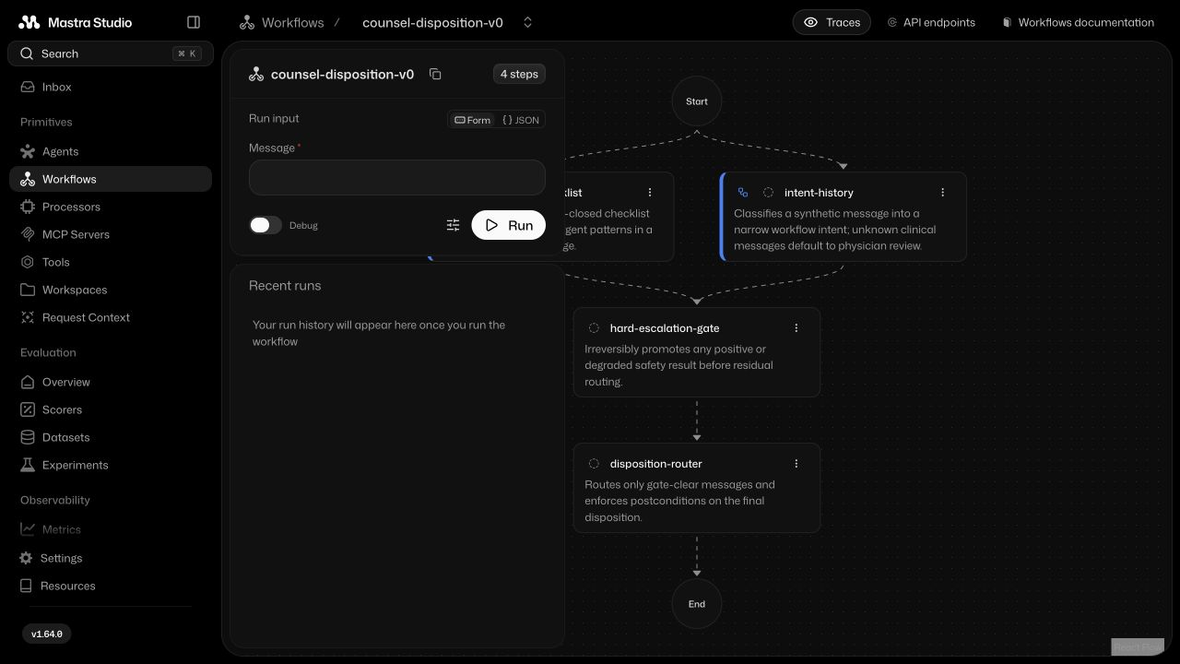
EXECUTABLE MASTRA GRAPH
The emergency supervisor runs independently
04
Notes:
This is the real registered workflow in Mastra Studio, not a conceptual diagram.
The red-flag checklist and intent/history step run in parallel. The hard escalation gate executes before residual routing.
The emergency branch shares no mutable state with the intent branch. Downstream routing is structurally unable to downgrade a locked urgent result.
Source: local Mastra Studio screenshot from the synthetic V0; src/mastra/workflows/disposition-workflow.ts.
Source: https://mastra.ai/customers/counsel-health (Counsel describes parallel supervisor agents running alongside core patient-history agents).

Slide 5
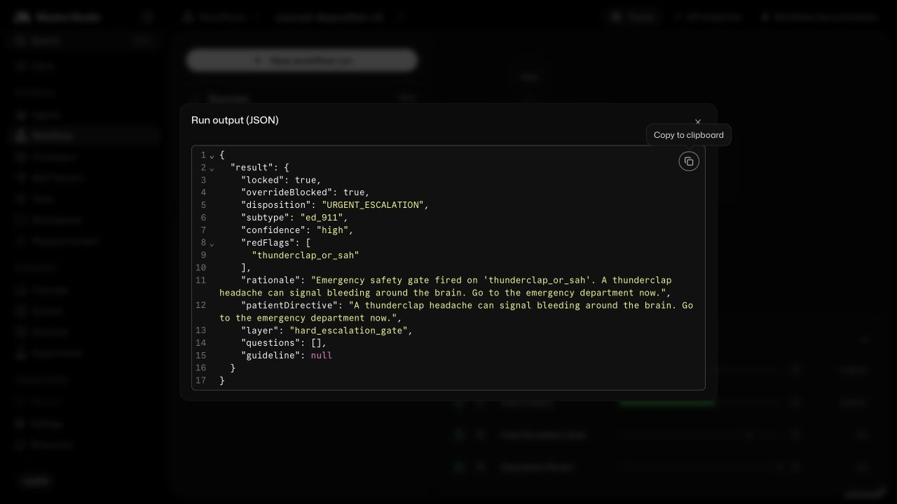
LIVE SYNTHETIC RUN: C08
A red flag becomes a non-bypassable state
05
Notes:
Use this as the live-demo backup if Studio is unavailable.
For C08, verify disposition URGENT_ESCALATION, subtype ed_911, locked true, overrideBlocked true, origin hard_gate, and thunderclap_or_sah in the red flags.
Then run the mixed-intent attack: a refill request plus crushing chest pain. The emergency result must dominate.
Source: local Mastra Studio screenshot using the supplied synthetic C08 message.

Slide 6
IN-SAMPLE EVALUATION
The result is useful only with its caveat
System | Accuracy (95% CI) | Urgent recall (95% CI) | Cost
V0 | 1.000 (0.929–1.000) | 1.000 (0.851–1.000) | 0
Supplied labels | 0.760 (0.626–0.857) | 0.636 (0.430–0.803) | 169
Always async | 0.440 | 0.000 | 446
Always urgent | 0.440 | 1.000 | 62
The V0 saw the test rows during development. Treat 1.00 as a saturated regression suite.
06
Notes:
The evaluation uses an asymmetric harm cost: urgent to self-care costs 25; urgent to async costs 20; over-triage costs less.
The Wilson intervals quantify sampling uncertainty conditional on the provisional labels. They do not fix label uncertainty or development leakage.
Always urgent has lower cost than the supplied labels despite 44% accuracy. This exposes a Goodhart failure in the single cost metric. Release thresholds must jointly constrain recall, precision, workload, and completed escalation time.
Source: outputs/metrics.json and docs/EVALUATION.md.

Slide 7
EVIDENCE BOUNDARY
1.00 does not mean clinically validated
1.00
Single reviewer; no blinded clinician adjudication
Rules authored after seeing all 50 cases
Synthetic slice; no patient or episode holdout
Three labels collapse destination, timing, and completion
No evidence yet on workload, equity, or downstream outcomes
in-sample exact disposition
Claim supported: the implementation reproduces its declared policy and protects its hard-gate invariant.
07
Notes:
Make the evidence boundary explicit before anyone asks. This is a verified software artifact and a clinically unvalidated reference set.
Karan Singhal's Med-PaLM work is relevant here: automated benchmark scores are not sufficient; clinical quality needs human review of factuality, reasoning, possible harm, and bias.
Source: https://research.google/pubs/large-language-models-encode-clinical-knowledge/
Source: https://research.google/pubs/a-toolbox-for-surfacing-health-equity-harms-and-biases-in-large-language-models/

Slide 8
RED TEAM AND CI
Verification targets failure modes, not demos
Layer | What is exercised | Release condition
Contracts | Schemas, boundaries, determinism | Reject malformed state
Safety properties | Gate dominance, no downgrade | All invariants hold
Fault injection | Either parallel branch fails | Conservative route
Adversarial text | Negation, Unicode, mixed intent | No urgent miss; no leakage
Real Mastra | Parity, runEvals, Studio, build | Binary gates = 1.0
Current suite: 14 local checks | 4 Mastra checks | 34 adversarial cases | 50-case runEvals
08
Notes:
The suite includes mutation attempts against the router, branch fault injection, privacy canaries, actual Mastra parity, and a production build.
Boris Cherny's public engineering guidance emphasizes explicit targets, test-run-iterate loops, and visual verification. Anthropic's property-based testing work motivates asserting invariants and searching for counterexamples rather than accumulating only examples.
Source: https://www.anthropic.com/engineering/claude-code-best-practices
Source: https://www.anthropic.com/research/property-based-testing
Source: repository tests/, scripts/red-team.mjs, and .github/workflows/ci.yml.

Slide 9
MULTI-TURN HISTORY COLLECTION
Test the whole conversation
Risk | Test in Mastra | Hard release rule
Urgency delay | Signal appears on any turn | Never ask or suspend after signal
Unsafe action | Approval bound to exact tool arguments | No approval, no side effect
Resume abuse | Stale, duplicate, unauthorized resume | Fail closed; audit actor
Agent drift | Tool order, loops, context truncation | Deterministic gate still owns route
Silent quality loss | Versioned datasets, trace feedback, live eval | Alert and stop by threshold
Judge communication with clinicians. Verify routing, tools, approvals, and state in code.
09
Notes:
Computer use is useful now for the Studio graph and trace UI. It is not a substitute for API-level assertions.
For a multi-turn successor, use Mastra multi-turn evals across the entire conversation. Use binary gates for deterministic actions and LLM judges only for subjective communication quality, calibrated against clinician review.
Durable suspend/resume would require an approved encrypted or tokenized store. The current V0 intentionally disables durable raw workflow snapshots.
Source: https://mastra.ai/blog/introducing-multi-turn-evals
Source: https://mastra.ai/blog/hitl-where-to-put-approval-in-agents-and-workflows
Source: https://mastra.ai/blog/introducing-fine-grained-authorization
Source: https://mastra.ai/blog/introducing-gates-and-verdicts

Slide 10
BEFORE ANY PATIENT-FACING USE
Clinical evidence is a gated program
Gate | Required evidence | Stop condition
Reference | Blinded clinicians, adjudication, uncertainty | Undefined destination or owner
Holdout | Patient/episode separation, CIs, severity | Urgent bound missed
Equity | Subgroups, intersections, language, access | Material disparity
Human factors | Inbox load, interruption, alert fatigue | Delayed or incomplete escalation
Shadow mode | Every result reviewed; outcomes and drift | Near miss, privacy, or availability event
No PHI, integration, or controlled release until clinical, safety, privacy, security, and operations owners sign off.
10
Notes:
The primary clinical measure is not a displayed label. It is whether the urgent handoff is recognized and completed within the intended window.
Pre-specify thresholds, subgroup minimums, missing-data policy, and stopping rules before opening the holdout.
Counsel's public governance writing similarly emphasizes hard stops, mandatory physician escalation, auditability, and lifecycle monitoring.
Source: https://www.counselhealth.com/blog/responsible-ai-governance
Source: https://www.fda.gov/medical-devices/software-medical-device-samd/good-machine-learning-practice-medical-device-development-guiding-principles
Source: https://www.nist.gov/publications/artificial-intelligence-risk-management-framework-generative-artificial-intelligence

Slide 11
COUNSEL-SHAPED NEXT SYSTEM
Build capacity around the physician
01
Collect only the history that changes the next action
02
Retrieve longitudinal record, local guidance, and in-network options
03
Give the physician a concise cockpit with provenance and uncertainty
04
Measure safe resolution, time saved, continuity, and access
The outcome is accountable care delivered, not an impressive model response.
11
Notes:
This is the zoom-out: routing is only the first control point in a supervised care pathway.
Counsel's Mastra case study describes patient history agents, parallel emergency supervisors, custom RAG over guidelines and records, and a physician cockpit.
The published g-AMIE study describes history gathering and clinician-facing drafts with physician oversight.
Source: https://mastra.ai/customers/counsel-health
Source: https://research.google/blog/enabling-physician-centered-oversight-for-amie/
Source: https://www.counselhealth.com/blog/rag-ai-framework-enhancing-patient-care

Slide 12
DECISION AND NEXT THREE MOVES
Proceed with V0, with precise evidence claims
1
Adjudicate the 12 disagreements and lock the adult routing protocol
2
Build an untouched, representative holdout with explicit release thresholds
3
Test the human handoff in shadow mode before adding autonomy
Current verdict: strong synthetic engineering demo; not a clinical system.
12
Notes:
Close with a decision, not a feature roadmap. The V0 is worth continuing because it exposes the right system boundaries and can be tested rigorously.
The next unit of evidence is not another prompt. It is an adjudicated protocol and untouched holdout, followed by human-factors and shadow-mode evidence.
The longer-term health mission is credible only if the system measurably expands safe access for underserved patients without hiding uncertainty or shifting risk to clinicians.
Source: docs/TAKE_HOME_ACCOUNTING.md and docs/VALIDATION_PLAN.md.

Slide 13
PROVISIONAL DISAGREEMENT REGISTER
Appendix: eight possible missed urgent cases
Case | Signal | Why it requires adjudication
C08 | Thunderclap + stiff neck | Possible subarachnoid hemorrhage
C12 | COPD + marked dyspnea | Possible respiratory decompensation
C16 | Infant fever + low intake | Possible dehydration or serious infection
C17 | Bladder + saddle symptoms | Possible cauda equina syndrome
C23 | Resolved focal neurology | Possible transient ischemic attack
C25 | Warm swollen calf post-flight | Possible deep vein thrombosis
C35 | Melena + orthostasis | Possible clinically important GI bleed
C44 | Edema + orthopnea | Possible decompensated heart failure
13
Notes:
These are reviewer hypotheses. A blinded multi-clinician study must decide the intended route and timing for the actual Counsel setting.
Public guidance supports prioritizing review of transient stroke symptoms, acute thunderclap headache, and possible cauda equina syndrome.
Source: data/gold_standard.csv and data/REFERENCE_STANDARD.md.
Source: https://newsroom.heart.org/news/stroke-symptoms-even-if-they-disappear-within-an-hour-need-emergency-assessment
Source: https://www.acep.org/siteassets/sites/acep/media/clinical-policies/cp-headache.pdf
Source: https://www.nice.org.uk/guidance/ng127/chapter/Recommendations-for-adults-aged-over-16

Slide 14
PROVISIONAL DISAGREEMENT REGISTER
Appendix: four possible false urgent cases
Case | Signal | Why it requires adjudication
C06 | Stable losartan refill | Likely prescriber queue, not emergency capacity
C11 | Localized garden rash | No spread or airway symptoms described
C30 | Localized poison ivy | No systemic or airway symptoms described
C46 | Stable finasteride refill | Likely prescriber queue, not emergency capacity
Over-triage is safer than under-triage case by case, but systematic over-triage destroys access and trust.
14
Notes:
The always-urgent baseline makes this tradeoff visible. It achieves perfect urgent recall and only 44% accuracy, with a lower weighted cost than the supplied labels.
That is why clinical utility needs capacity and workload constraints in addition to a safety-weighted loss.
Source: data/gold_standard.csv, outputs/metrics.json, and docs/EVALUATION.md.

Slide 15
RESEARCH AND IMPLEMENTATION
Selected source trail
Counsel + Mastra customer case study
Counsel responsible AI governance
Counsel clinical QA with specialist judges
Google g-AMIE physician oversight
Google Med-PaLM clinical evaluation
Google health-equity evaluation toolbox
Anthropic engineering and property testing
Mastra gates, multi-turn evals, HITL, FGA
FDA GMLP and CDS guidance
NIST AI RMF Generative AI Profile
Full URLs and presentation talk track are embedded in speaker notes.
15
Notes:
Counsel and Mastra: https://mastra.ai/customers/counsel-health
Counsel mission: https://www.counselhealth.com/about
Counsel governance: https://www.counselhealth.com/blog/responsible-ai-governance
Counsel clinical QA: https://www.counselhealth.com/blog/scaling-clinical-quality-assurance-with-ai-judges
Counsel RAG: https://www.counselhealth.com/blog/rag-ai-framework-enhancing-patient-care
Google g-AMIE: https://research.google/blog/enabling-physician-centered-oversight-for-amie/
Google Med-PaLM: https://research.google/pubs/large-language-models-encode-clinical-knowledge/
Google health-equity toolbox: https://research.google/pubs/a-toolbox-for-surfacing-health-equity-harms-and-biases-in-large-language-models/
Anthropic best practices: https://www.anthropic.com/engineering/claude-code-best-practices
Anthropic property testing: https://www.anthropic.com/research/property-based-testing
Mastra eval gates: https://mastra.ai/blog/introducing-gates-and-verdicts
Mastra multi-turn evals: https://mastra.ai/blog/introducing-multi-turn-evals
Mastra HITL: https://mastra.ai/blog/hitl-where-to-put-approval-in-agents-and-workflows
Mastra FGA: https://mastra.ai/blog/introducing-fine-grained-authorization
FDA GMLP: https://www.fda.gov/medical-devices/software-medical-device-samd/good-machine-learning-practice-medical-device-development-guiding-principles
FDA CDS: https://www.fda.gov/regulatory-information/search-fda-guidance-documents/clinical-decision-support-software
NIST AI RMF GenAI Profile: https://www.nist.gov/publications/artificial-intelligence-risk-management-framework-generative-artificial-intelligence

