Slide 1
Implementation of christofides algorithm
Jayakrishnan B 181IT120 (Ph.9446373615)
V R Sandeep 181IT151 (Ph.9148310096)
M Shiva Krishna 181IT225 (Ph.9573891760)
Shashikantha 181IT242 (Ph.7349490485)

Slide 2
Introduction
The Christofides algorithm is used for finding approximate solutions to the travelling salesman problem, which is defined as follows : "Given a list of cities and the distances between each pair of cities, what is the shortest possible route that visits each city exactly once and returns to the origin city?”.
It is an approximation algorithm that guarantees that its solutions will be within a factor of 3/2 of the optimal solution length.
Christofides algorithm only works on graph instances which follow these conditions:
All the edges have a non-negative weight
For every three vertices u, v and w, it should be the case that the edges formed should follow the triangle inequality : w(uv) + w(vw) ≥ w(uw).

Slide 3
Why christofides algorithm?
The travelling salesman problem is NP-hard with no known polynomial time solution. Since it takes exponential time to solve NP, the solution cannot be checked in polynomial time.
The backtracking solution takes O(n!), while the dynamic programming solution takes O(n^2 * 2^n). The christofides algorithm promises a solution within 3/2 of the optimal value in a worst case time complexity of O(n^2 * log(n)). The speedup compared to the dynamic programming version is 2^n / log(n).

Slide 4
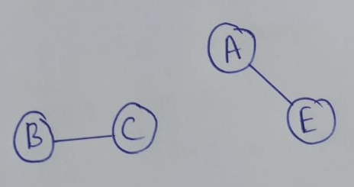

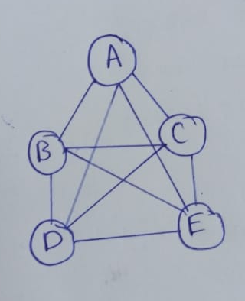

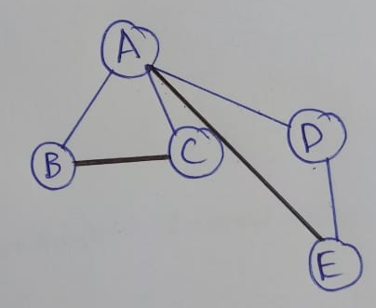
Simulation of the algorithm
1)We start with this graph
2)Find minimum spanning tree
3)Find minimum-weight perfect matchings of odd degree vertices
4)Merge MST and Perfect Matchings graph
5)Take shortcuts making use of triangle inequality

Slide 5
Creating a Graph
We create a graph which obeys the triangle inequality and has non-negative edges
Finding Minimum Spanning Tree
We find the minimum spanning tree of the above graph. We can prove that the minimum-weight hamiltonian cycle has weight sum less than or equal to twice the weight-sum of the hamiltonian cycle formed by merging MST with an edge that connects the last node to the start node. We perform further steps to bring this down to 3/2
Finding perfect matching for odd degree vertices
We can prove using the handshaking theorem that any graph has an even number of odd degree vertices. This means that we will have a minimum weight perfect matching for the graph. We then proceed to union the obtained MST and the minimum-weight perfect matching.

Slide 6
Finding the Eulerian tour of the combined graph
Once we add the perfect matching edge back to the MST we have to shortcut the route. In order to do that we will first find the eulerian tour in the formed multigraph. This graph contain the vertices with even degree and that is always true as in the previous step we have made all odd degree vertices to even by adding minimum weighted perfectly matched edges.
Finding the Hamiltonian cycle of the combined graph
We will find the hamiltonian cycle for the same multigraph in the next step. While doing this we also have the eulerian tour, by using that information we will skip all the vertices in the tour, which is visited multiple times and we will go to the next vertices. Finally we will have the hamiltonian cycle of the graph.

Slide 7
Results
Number of vertices (n) | TSP DP (Path Cost(X)) | Christofides (Path Cost(Y)) | Analysis (Ratio(Y/X)) | TSP DP Time taken (seconds) | Christofides Time taken (seconds)
5 | 15062 | 15639 | 1.038 | 20 microseconds | 67 microseconds
10 | 21378 | 21918 | 1.025 | 479 microseconds | 230 microseconds
15 | 28506 | 30381 | 1.065 | 35391 microseconds | 490 microseconds
20 | 34898 | 38975 | 1.116 | 2642920 microseconds | 832 microseconds
25 | 41220 | 42997 | 1.043 | 187032551 microseconds | 1054 microseconds

