Slide 1
LEAD_SCORE_CASE_STUDY_ASSIGNMENT
Name: B Krishna Prasanth
Data Science Program
Upgrade & IIITB

Slide 2
Business Objective
The X Education company sells the online courses to industry professionals.
The Main objective is to build a model for X Education Company is to assign a lead score between 0 and 100 to each of the leads which can be used by the company to target potential leads.
X Education company wants to find the potential leads before the deadlines .

Slide 3
EDA ANALYSIS
THE MAIN STEPS INVOLVED IN EDA ARE
Understanding the business objective wrt to problem statement
Analyze the given data
Import the useful libraries in python
Load the datasets for which to execute analysis
Check the structure/ metadata of the data
Check the missing values in data frame
Drop the columns which have more missing values and which are not affect the analysis
Impute the missing values with appropriate data and check with data imbalance.
Correct the columns in data frame and divided in to sub-categories for analysis
Check for Outliers
Check for data imbalance

Slide 4
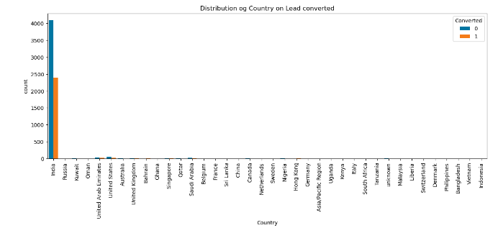
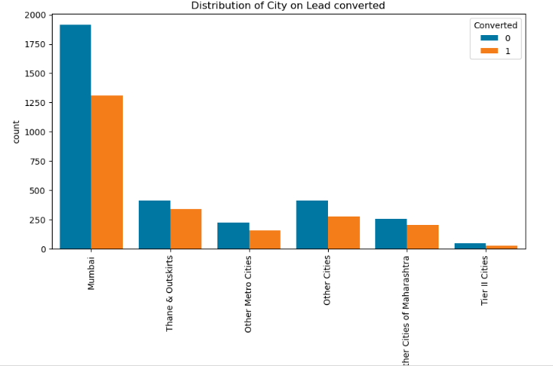
UNIVARIATE ANALYSIS
Country from India is most occurring and conversion rate is also high
Mumbai from india has most occuring and conversion rate is even high wnen compared to other cities

Slide 5
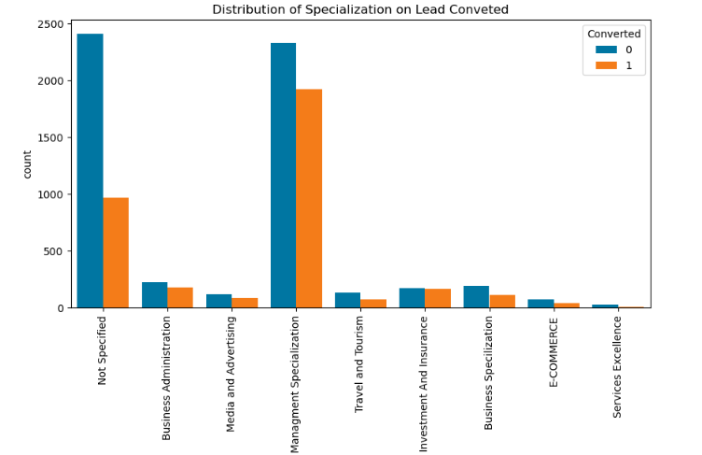
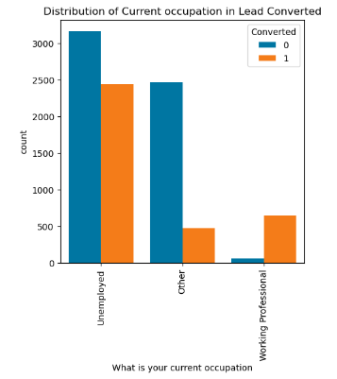
UNIVARIATE ANALYSIS
Management specialization and even whose has not specified has conversion rate when compared to other specializations
Unemployed has high conversion rate when compared with others

Slide 6
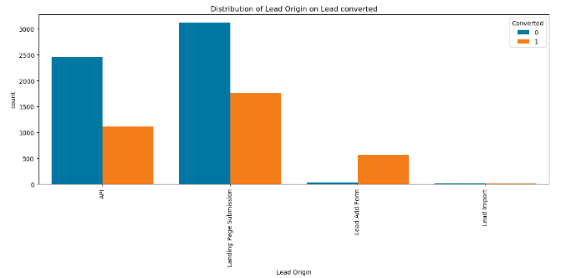
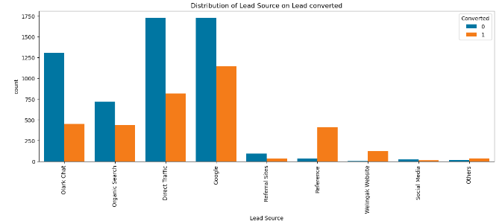
UNIVARIATE ANALYSIS
API and Landing Page Submission bring more number of leads as well as conversion when compared with others
Direct traffic, Google bring more number of leads as well as conversion when compared with others

Slide 7
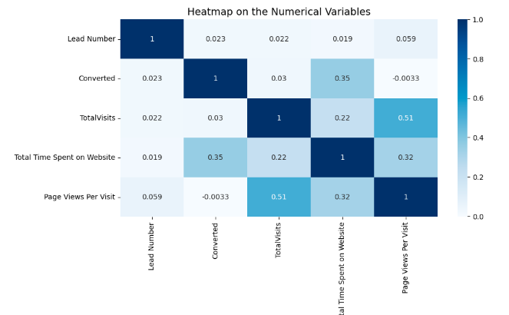
BIVARIATE ANALYSIS
Total Visits and Total time spent on website has good correlation with the target variable and which lead to high conversion.

Slide 8
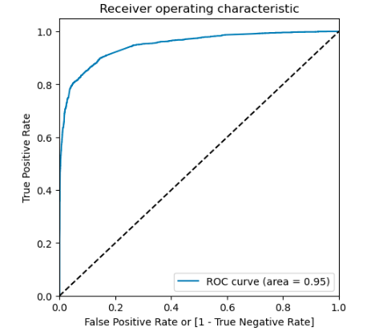
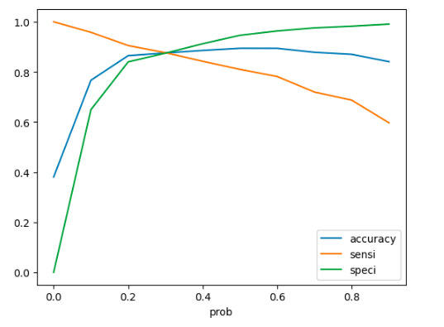
LOGISTIC REGRESSION
By using Logistic regression, model is build with ROC curve area of 95%
Model is build considering Accuracy, Sensitivity and Specificity with optimum threshold cut off propability of 0.3

Slide 9
RECOMMENDATION / CONCLUSION
Potential Lead Conversion:
Total Time Spent On Website has conversion rate.
Tags- Will revert after reading the email has conversion rate.
Occupation – Working Professionals has conversion rate.
Low Conversion Rate:
Occupation- students has low conversion rate.
Tags-Ringing has low conversion rate.
Last Activity – Email bounced has low conversion rate.

