Slide 1


Game Outcome Predictor
Machine Learning-Based Match Winner Prediction System
End-to-End ML Pipeline with CI/CD Automation
KUSHAGRA SHARMA - 23030124190
UDAY PRAVEEN - 23030124196

Slide 2

Problem Statement
The selected game for analysis is League of Legends
Predict match outcome at 10-minute mark using early-game statistics
Formulate as a supervised binary classification problem
Identify key performance indicators influencing win probability
Build automated ML pipeline with deployment capability
Integrate CI/CD for reproducible training workflow

Slide 3
End-to-End Project Workflow
📄 DATASET
📊 EDA & VISUALIZATION
⚙ DATA PREPROCESSING
🧠 MODEL TRAINING
📈 MODEL EVALUATION
🏆 MODEL SELECTION
💾 MODEL SAVE (.PKL)
🌐 FLASK WEB DEPLOYMENT
🔁 CI/CD AUTOMATION (JENKINS)

Slide 4
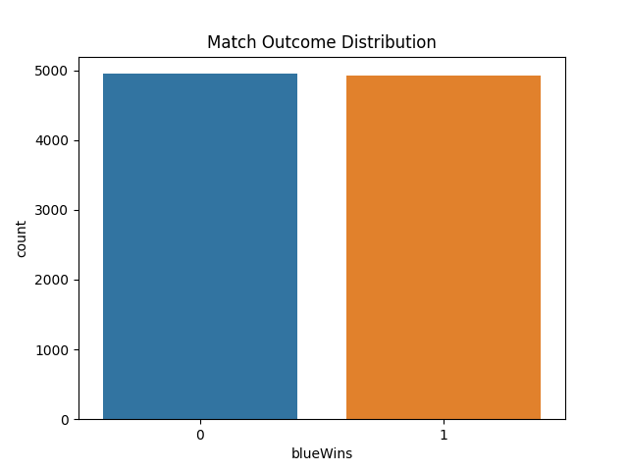
Match Outcome Distribution
Dataset is approximately balanced between wins and losses
0 → ~4950
1 → ~4900
No need for class balancing techniques such as:
SMOTE
Class Weights
Resampling

Slide 5
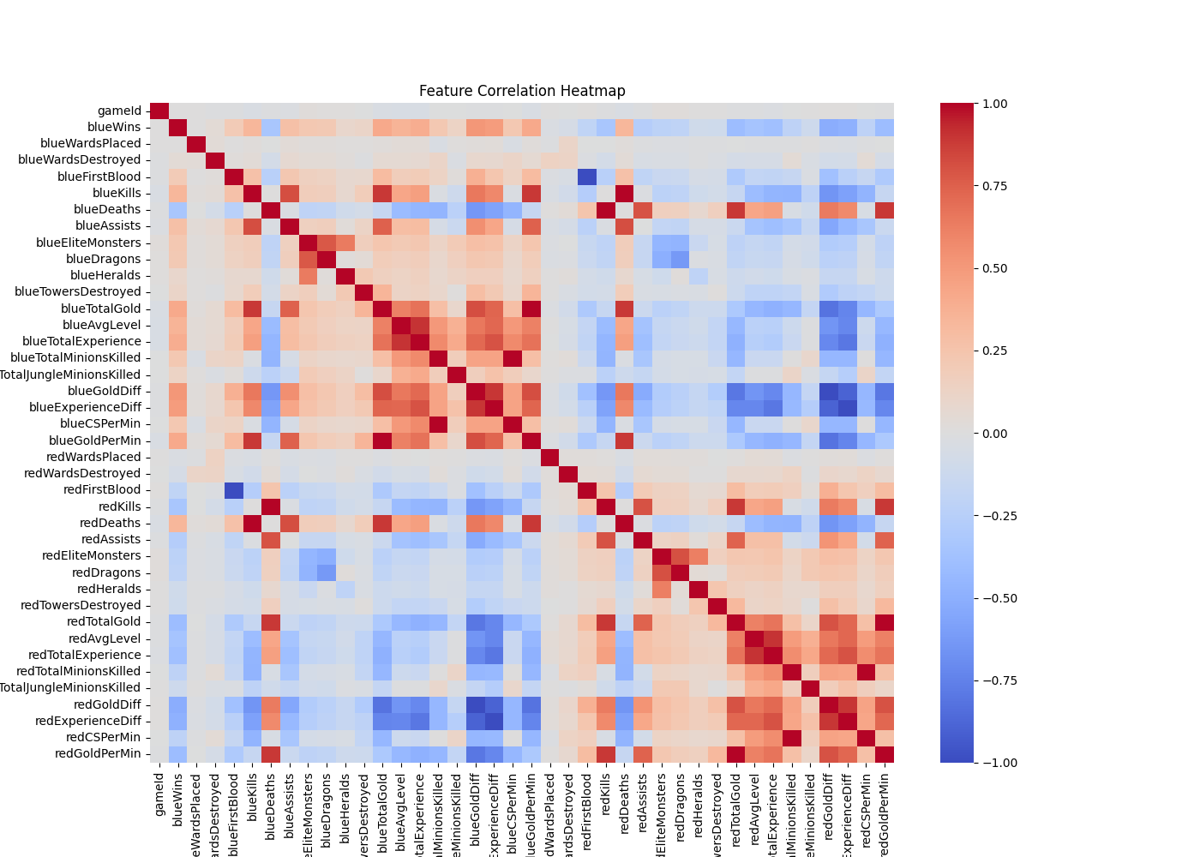
Feature Correlation Analysis
Gold difference and experience difference show strong correlation with win outcome
Objective control metrics significantly influence match results

Slide 6
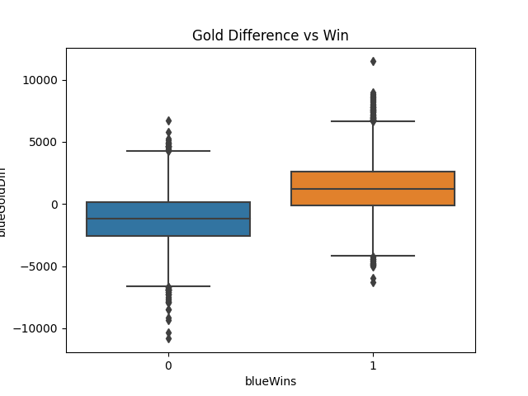
Gold Difference vs Match Outcome
Winning teams show consistently positive gold difference
Losing teams show predominantly negative gold difference
Clear distribution separation confirms strong predictive power

Slide 7
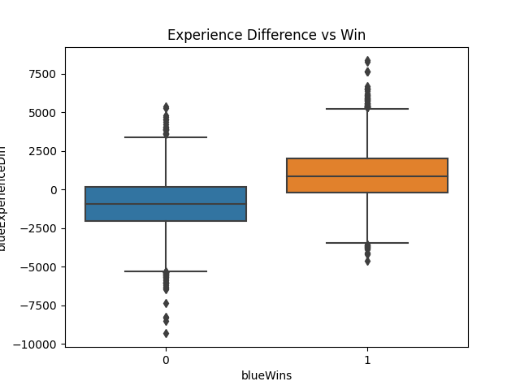
Exp Difference vs Match Outcome
Positive experience difference strongly associated with wins
Clear distribution separation between classes
Early-game experience advantage impacts match momentum

Slide 8
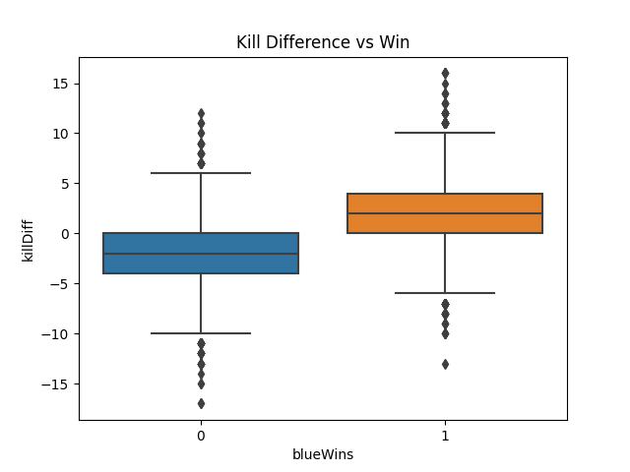
Kill Difference vs Match Outcome
Positive kill difference associated with higher win probability
Separation present but less pronounced than gold/experience
Combat advantage contributes but is not sole determinant

Slide 9
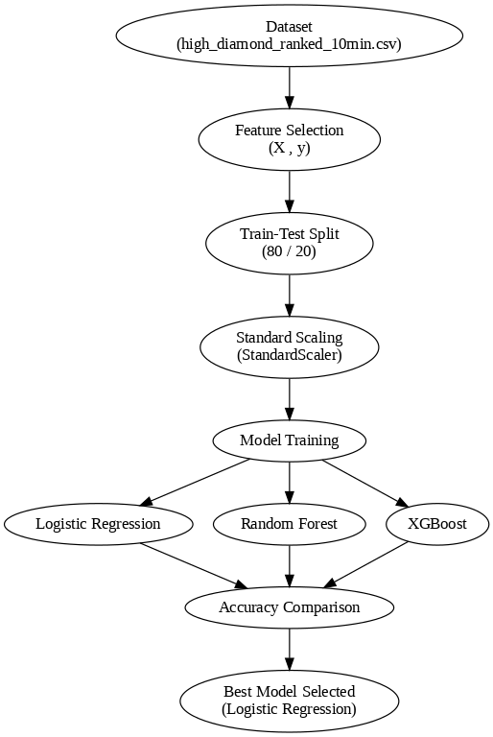
Model Training Strategy
Dataset split into training and testing sets
Logistic Regression, Random Forest and XGBoost models trained
Best model selected based on evaluation accuracy

Slide 10
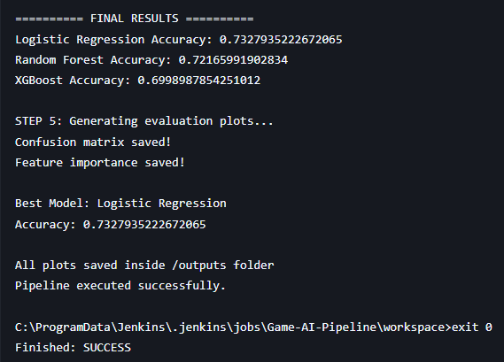
Model Comparison Results
Multiple models trained automatically using Jenkins pipeline
Logistic Regression Accuracy: 73.28%
Random Forest Accuracy: 72.17%
XGBoost Accuracy: 70.00%
Logistic Regression selected as final model

Slide 11
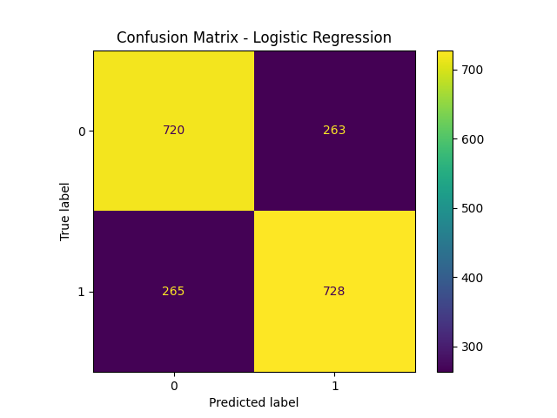
Model Evaluation – Confusion Matrix
Model Performance Analysis
Logistic Regression evaluated on test dataset
Correct Predictions:
True Negatives: 720
True Positives: 728
Incorrect Predictions:
False Positives: 263
False Negatives: 265
Overall Accuracy: 73.3%
Model predicts both classes evenly

Slide 12
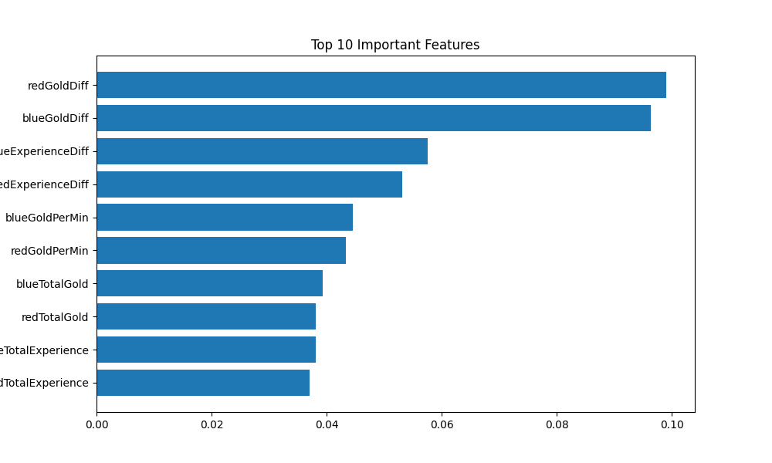
Feature Importance Analysis
Most Influential Features
Gold Difference is among the strongest predictors
Experience Difference significantly impacts outcome
Gold Per Minute contributes to prediction
Total Gold and Experience are important indicators
Objective metrics also influence predictions
Model decisions align with EDA findings

Slide 13
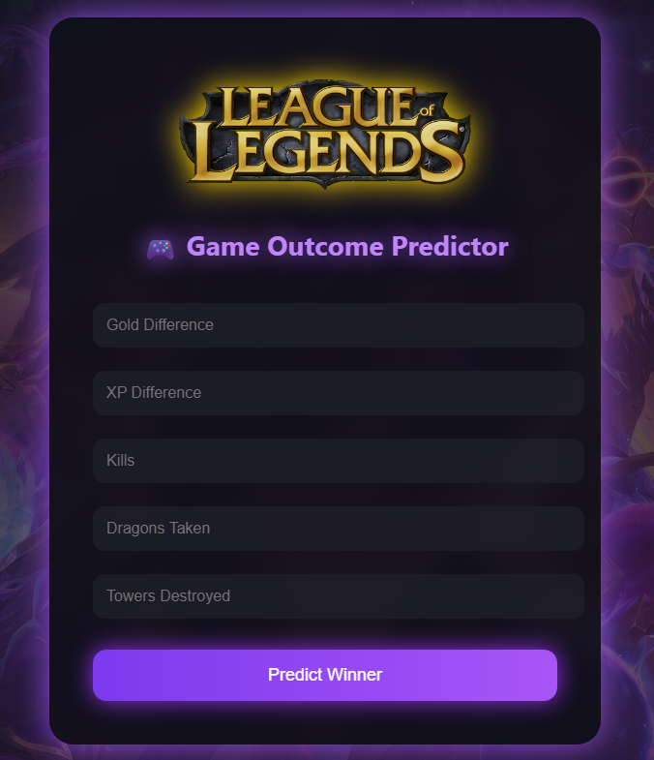
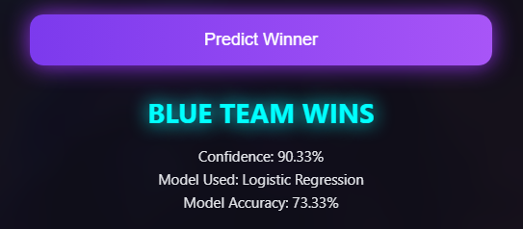
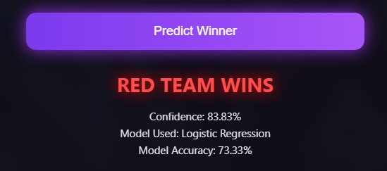
Web Application Interface
User Prediction Interface
Web interface built using Flask
Users input early-game statistics
Model predicts match winner
Real-time prediction results displayed
Input Features
Gold Difference
Experience Difference
Kill Difference
Dragons Taken
Towers Destroyed
Output
Predicted Winner
Confidence Score
Model Used
Accuracy

Slide 14
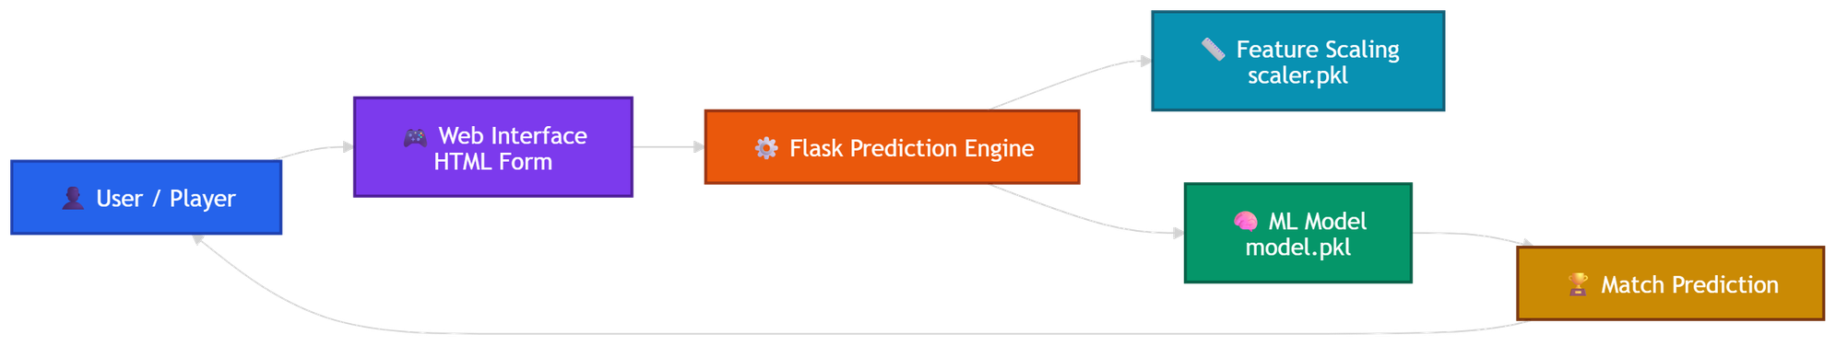
Web Application Architecture
Prediction Workflow
User enters early-game match statistics
Input data sent to Flask prediction server
Features scaled using saved scaler
Trained ML model generates prediction
Result returned to web interface

Slide 15
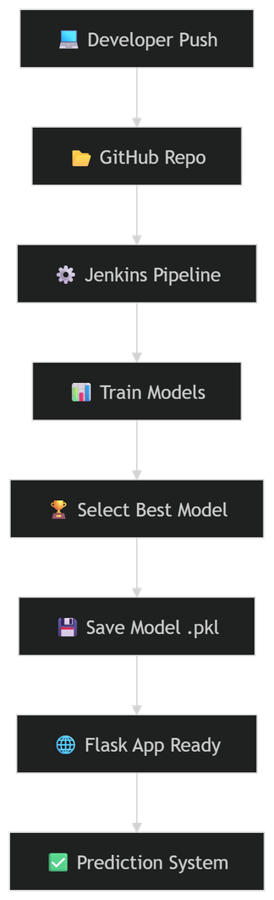
CI/CD Pipeline Automation
CI/CD Automation
Code pushed to GitHub
Jenkins runs pipeline automatically
Models trained automatically
Best model saved
Web app uses trained model

Slide 16
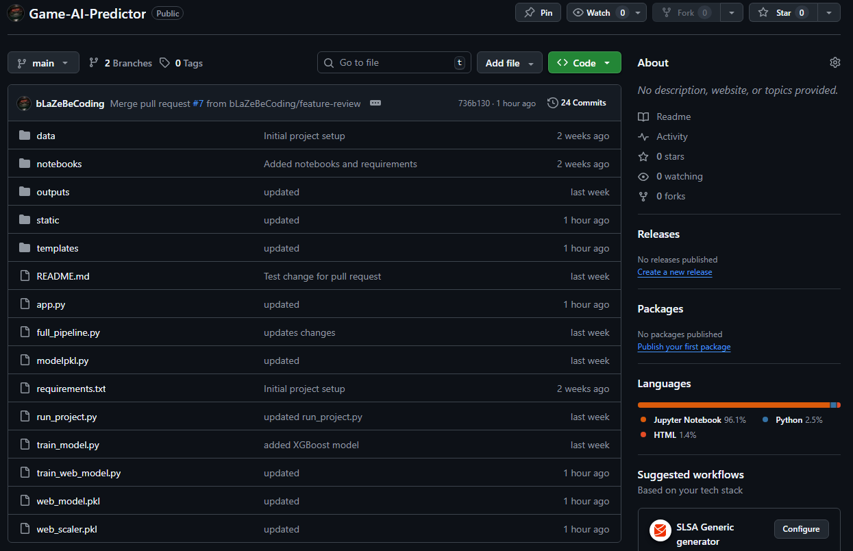
GitHub Integration
Repository Structure
data → dataset file
notebooks → EDA analysis
outputs → generated plots
templates → web interface
app.py → Flask backend
full_pipeline.py → ML pipeline
Version Control System
Project hosted on GitHub repository
All code version controlled
Dataset and outputs organized
Supports collaboration
Enables CI/CD integration

Slide 17
Conclusion & Future Scope
Project Achievements
Successfully predicted match outcomes using Machine Learning
Built an end-to-end ML pipeline
Automated training using Jenkins CI/CD
Developed interactive Flask web application
Achieved ~73% prediction accuracy
Future Improvements
Use full feature set instead of reduced inputs
Improve accuracy using advanced models
Deploy system on cloud server
Real-time match prediction system
Support multiple games
THANK YOU.

