Slide 1
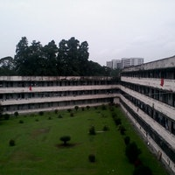
BUET RESIDENTIAL HALL MANAGEMENT SYSTEM

Slide 2
Prepared By
Abhik Bhattacharjee
Student ID: 201505040
Bishal Basak Papan
Student ID: 201505043

Slide 3

Supervised By
Md. Aashikur Rahman Azim
Assistant Professor,
Department of Computer Science & Engineering,
BUET

Slide 4
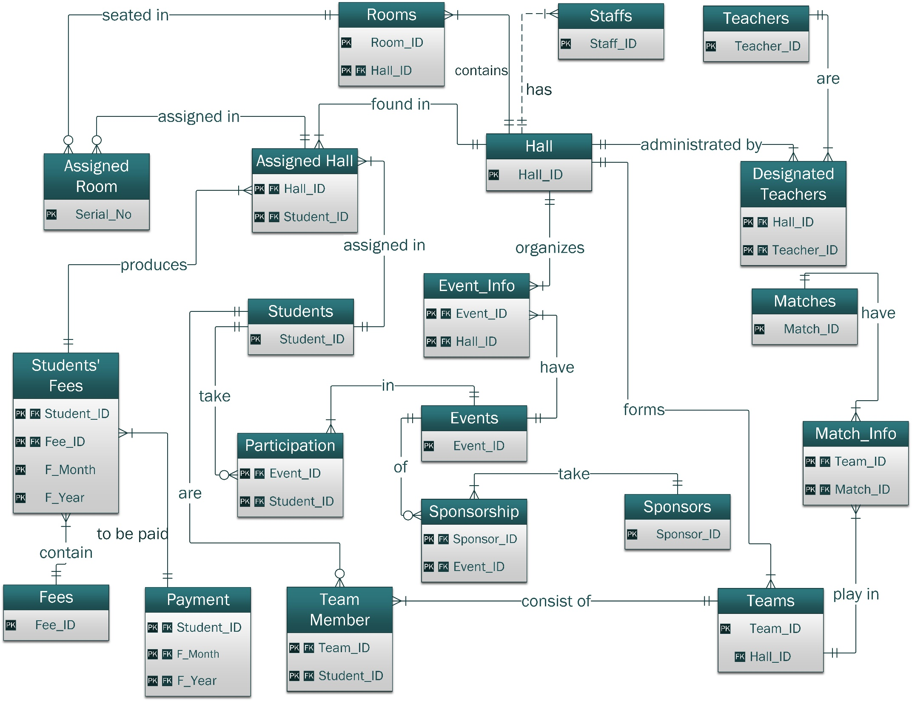

Slide 5
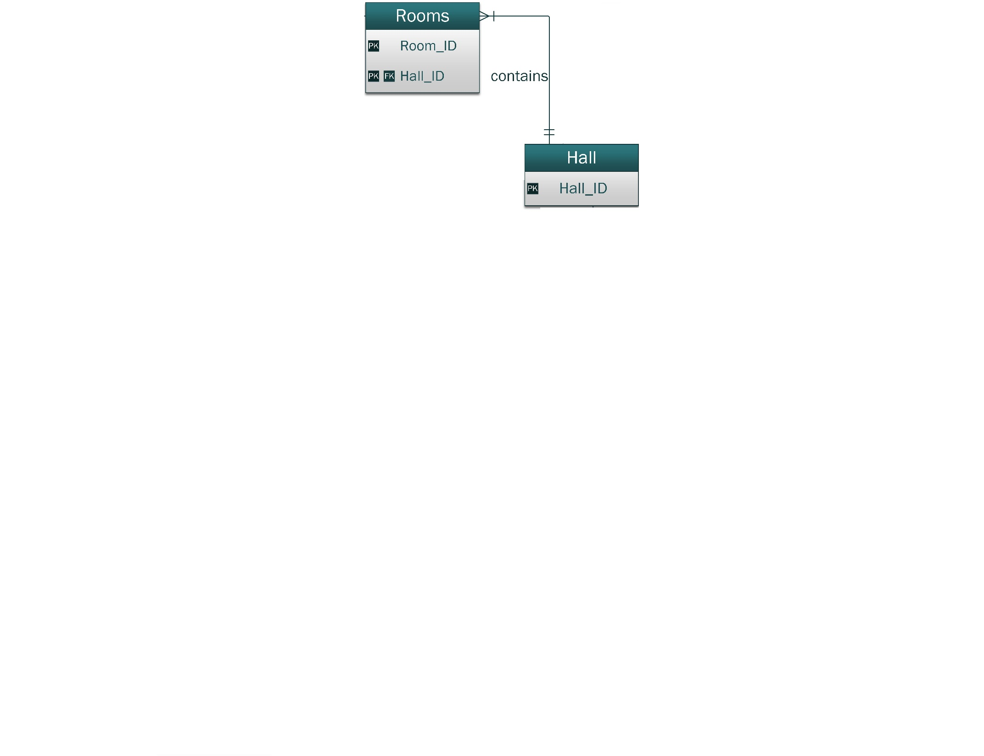

Slide 7
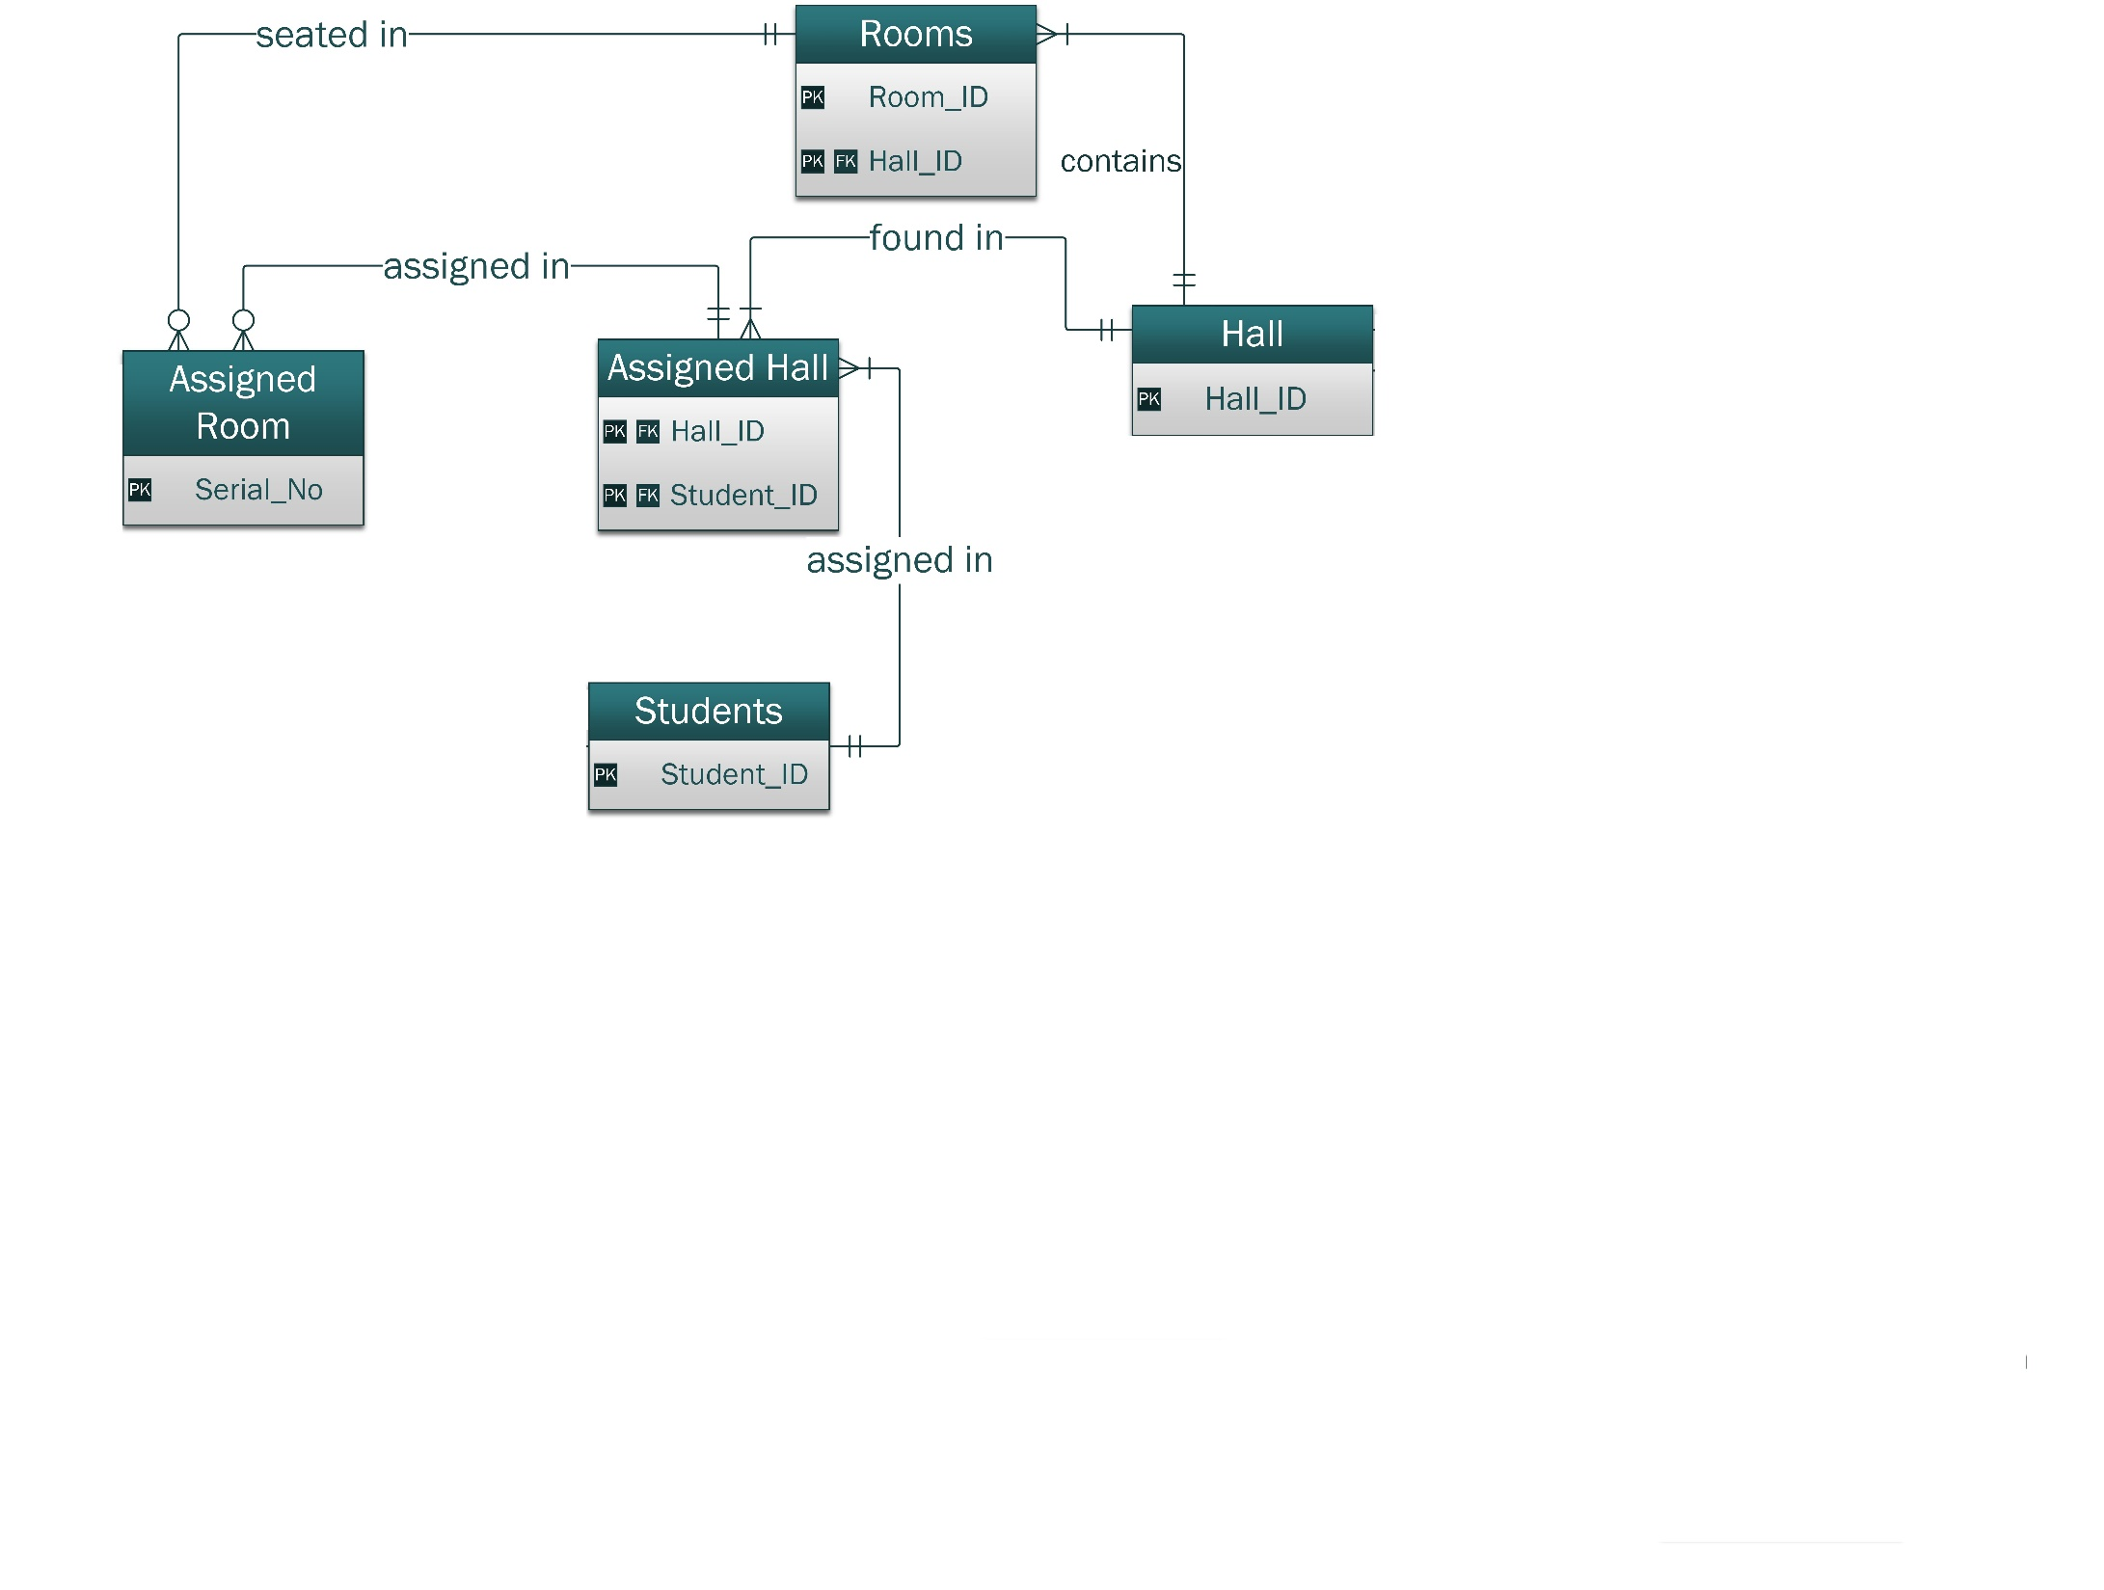

Slide 9
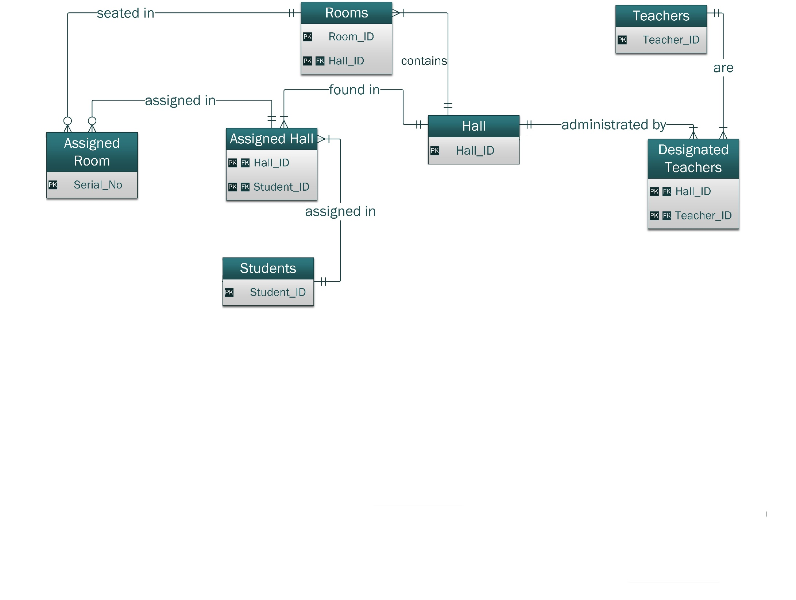

Slide 11
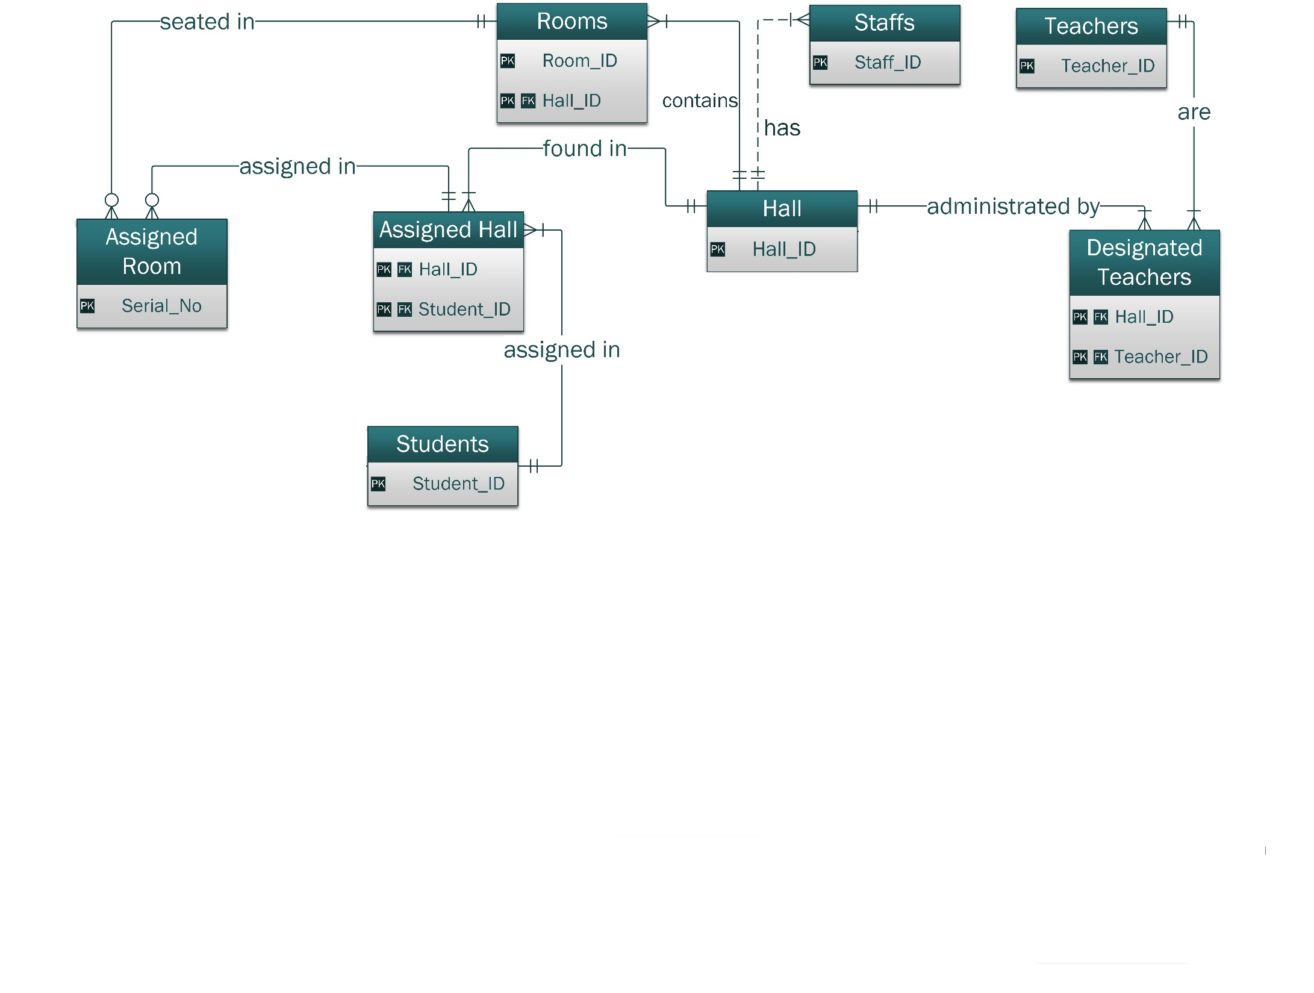

Slide 13
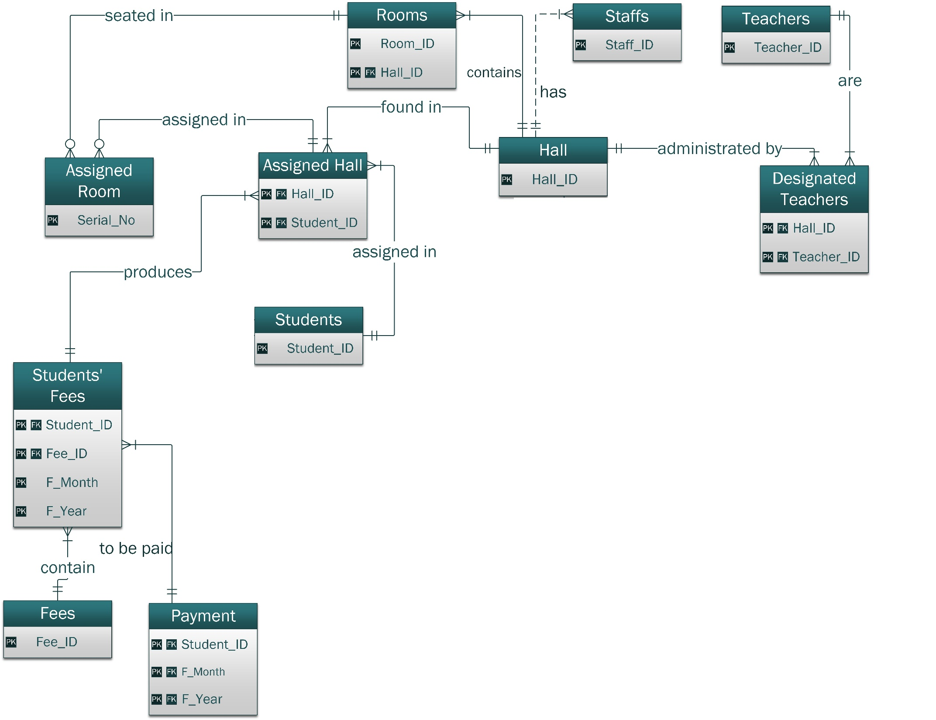

Slide 15
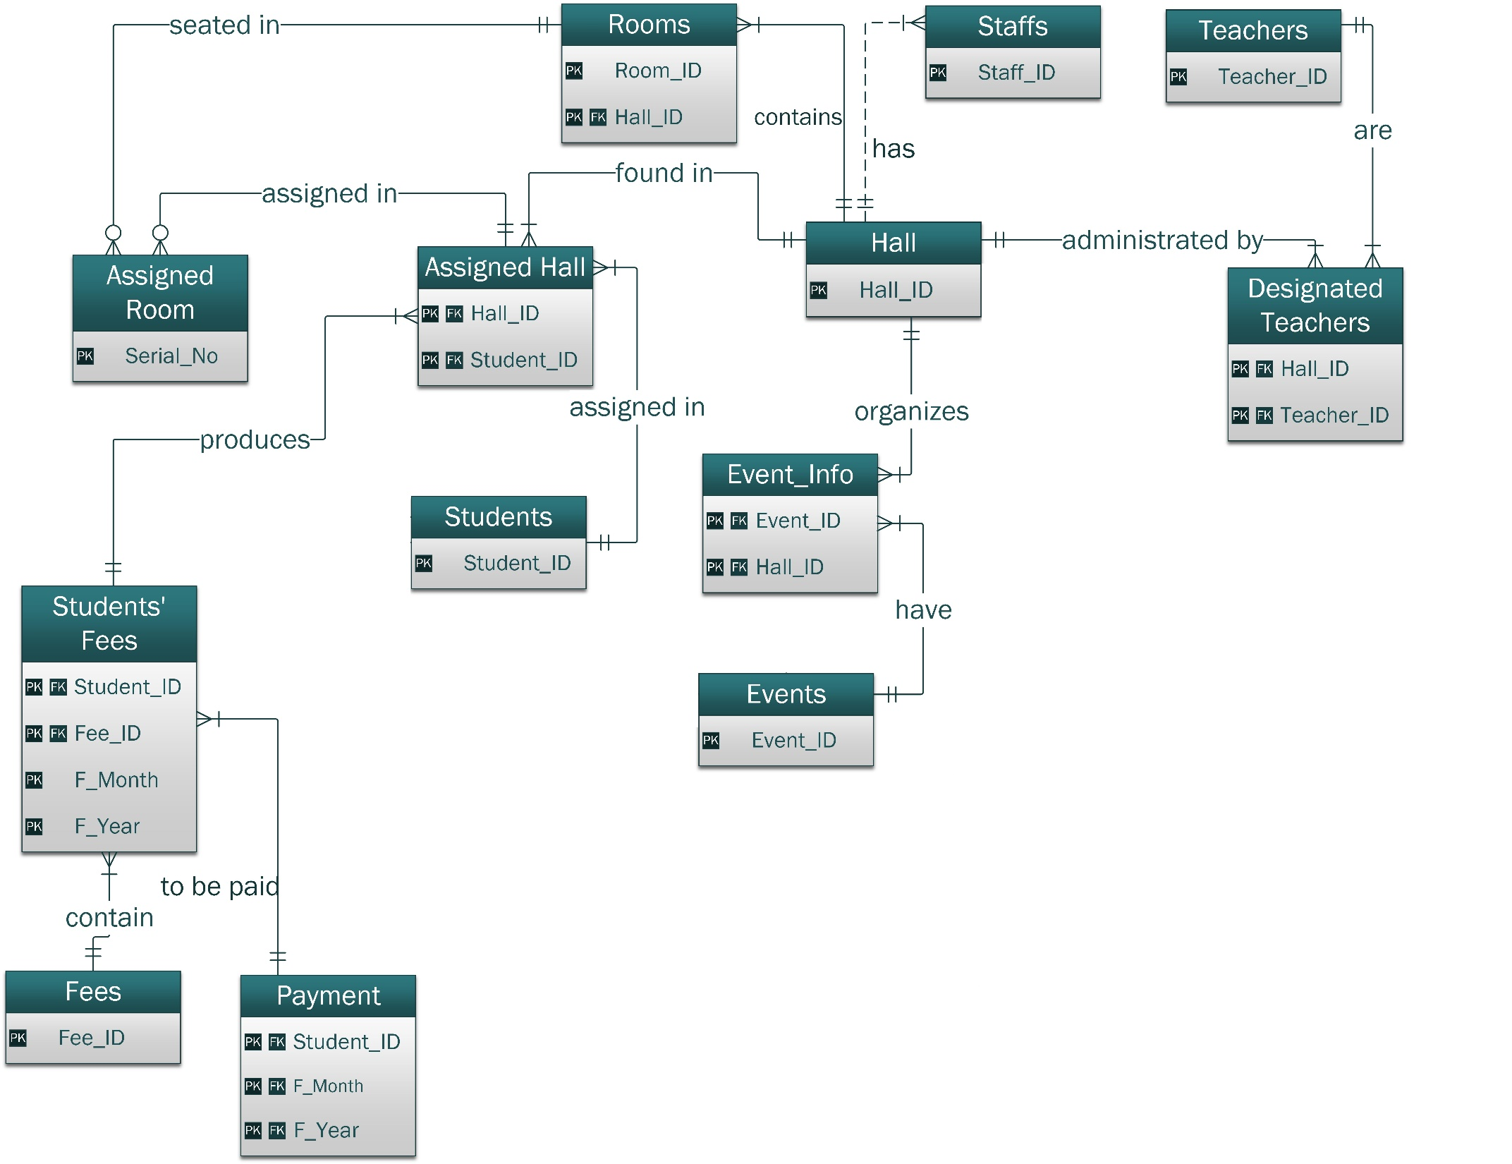

Slide 17
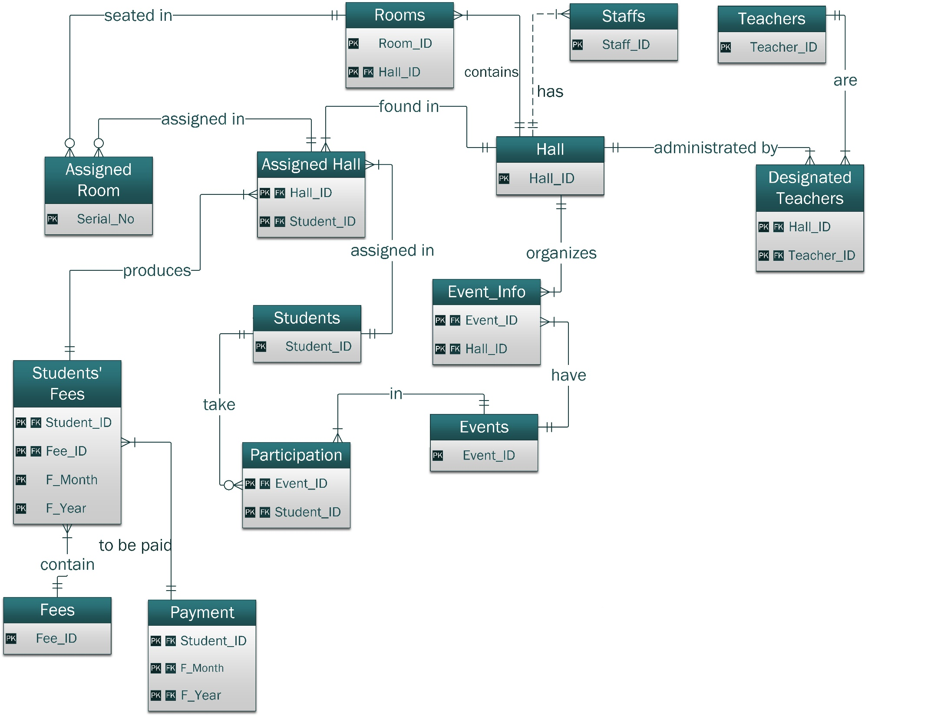

Slide 19
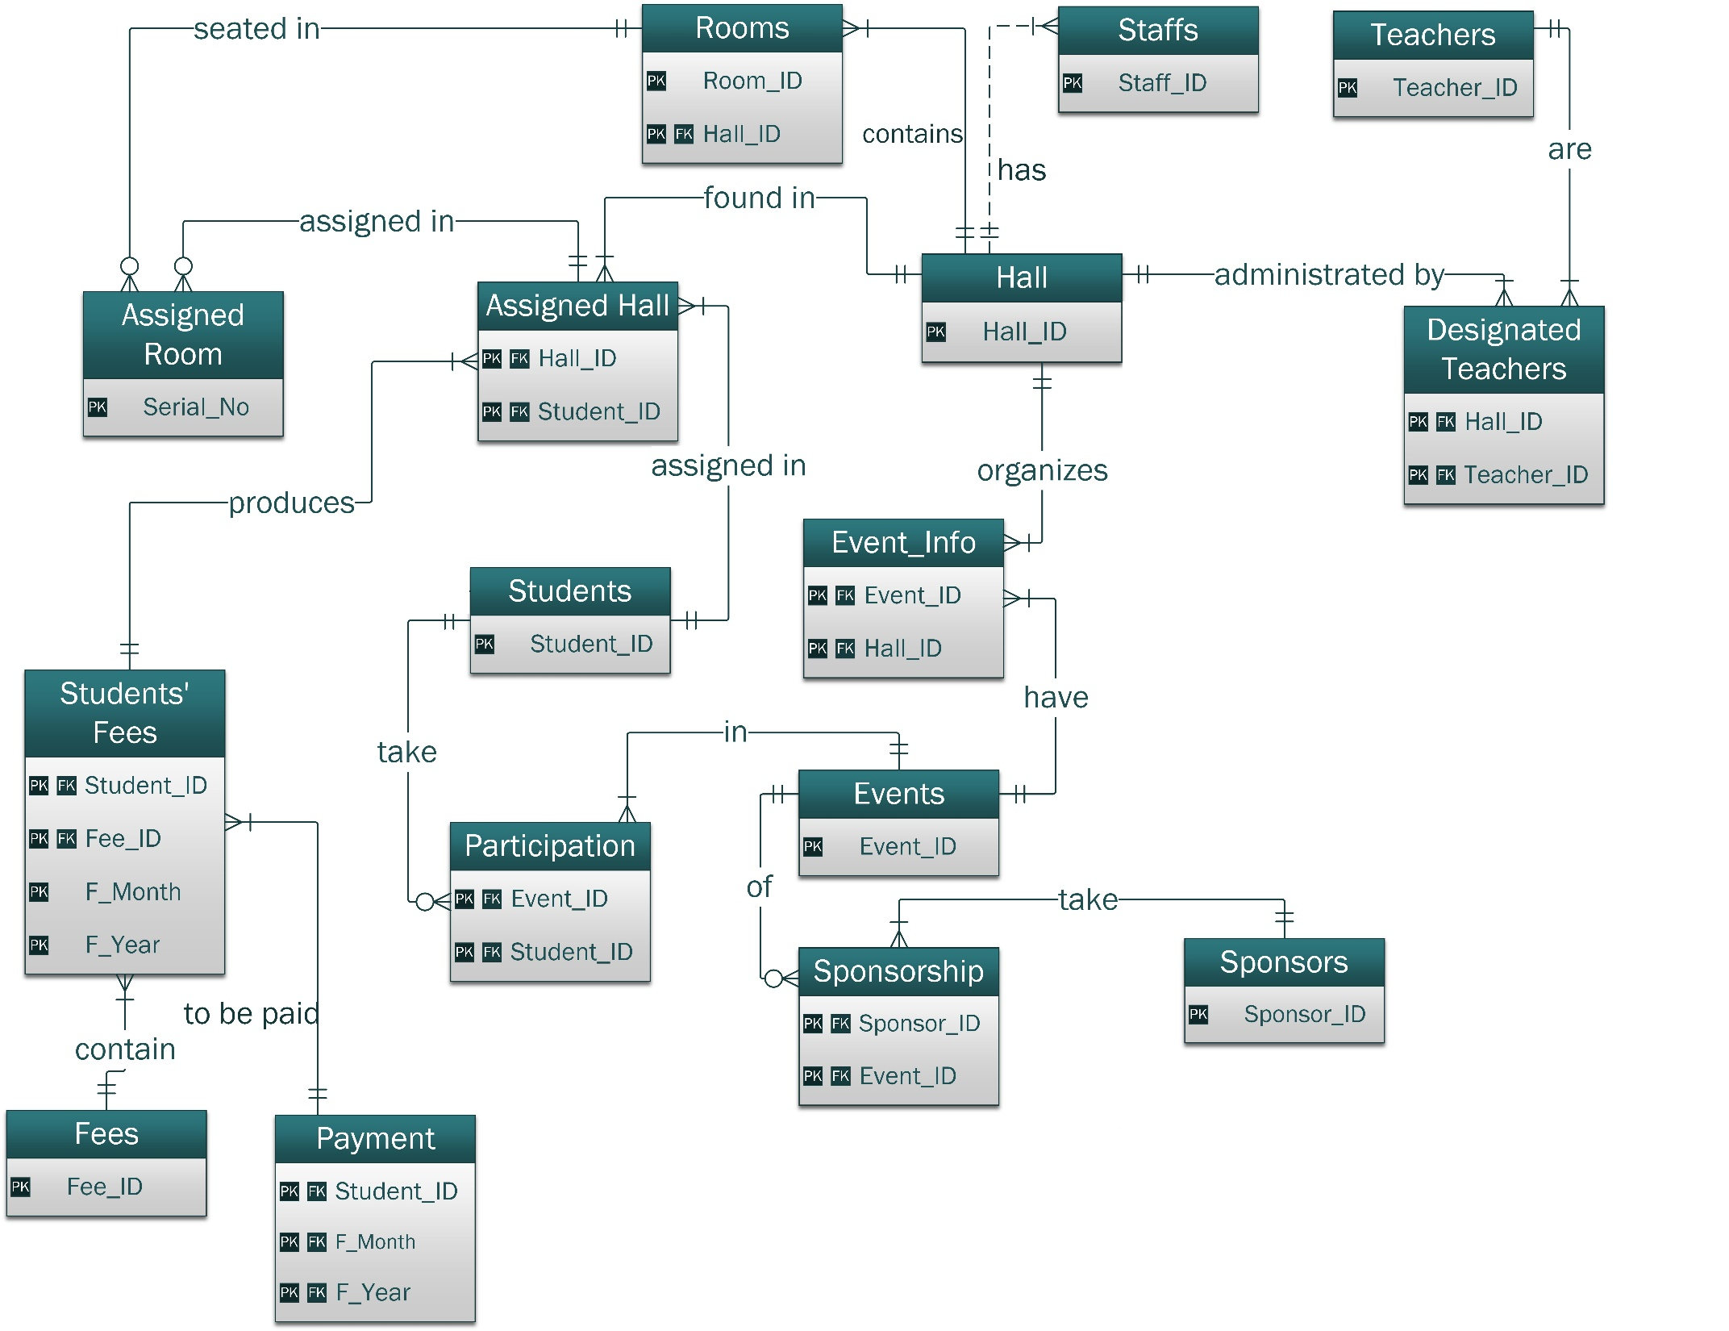

Slide 21
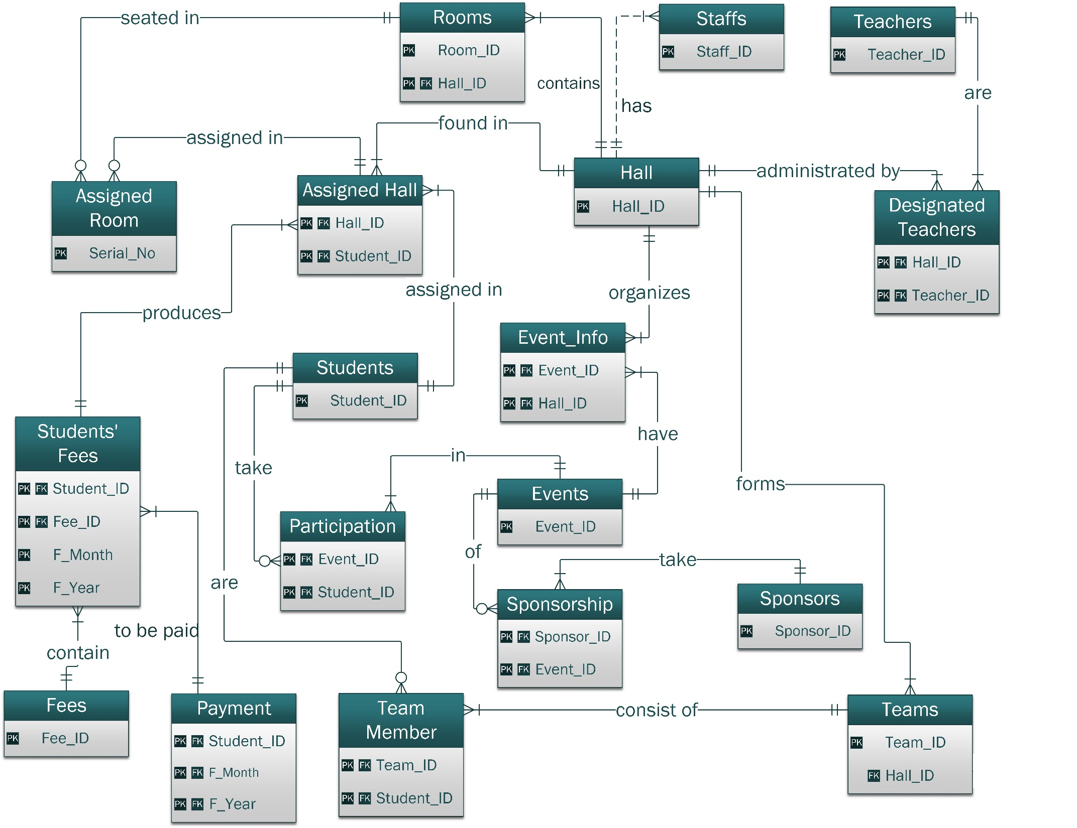

Slide 25
THANK
YOU

