Slide 1

HEART DISEASE PREDICTION
DSCI 6007-02 DISTRIBUTED AND SCALABALE DATA ENGINEERING
Team 9
PRATHYUSHA BEEMANABOINA
VARSHITHA DANE
SIRAJUDDIN MOHAMMED
MANI KUMAR
NIKHIL SAI

Slide 2
What is the most precious and important aspect for every single human ????
•Health.
•Emotional stability.
•Healthy diet.
•And many more.
There are further factors we take into account in order to keep the human body functioning properly every morning, but there are a million to one chances to discover what we overlooked while pursuing each individual's promising future. The major goal of this study is to predict the approximate class at which a person may be affected by a heart problem using RAW data, even if we may not be able to determine exactly when and where it went wrong. This prediction was evaluated using the user's predetermined responses (which we will see in the following presentation).

Slide 3
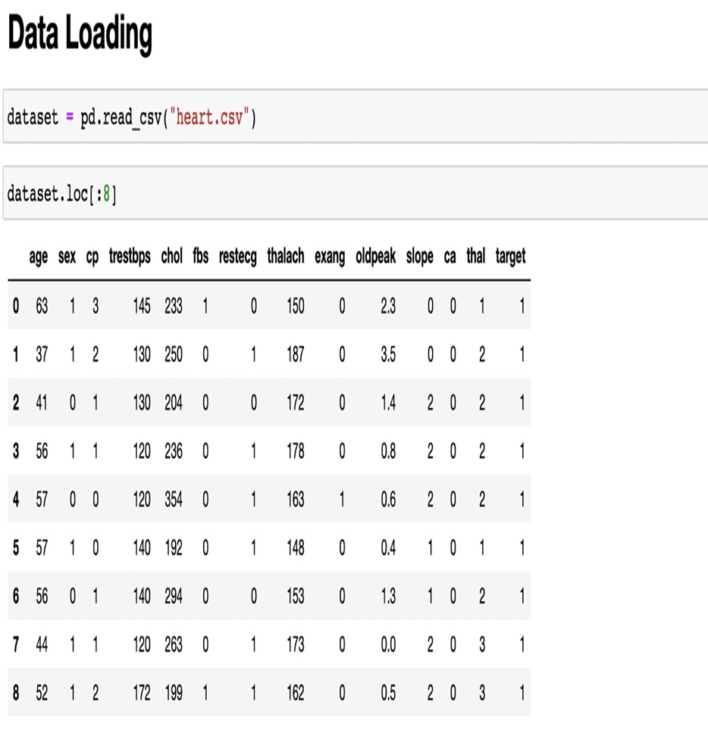
DATA UNDERSTANDING
We have used a variety of tools, including Numpy, Pandas, Matplotlib, and Seaborn, to import the data from the data collection. We read the dataset after loading the data. These comprise the data loading components. Age, sex (Male = 1, Female = 0), chest pain type, trestbps, chol, fasting blood sugar (fbs), resting electro cartography findings (rest ECG), thalach, exercise including angina (exang), oldpeak, slope, ca, thal, and target are the thirteen columns that make up our dataset. We can determine whether the patient has heart-related disorders by having them fill out all the necessary fields. If our final result is an integer valued 0 then the patient in question does not have heart disease, and if it is an integer valued 1 then the patient does.

Slide 4

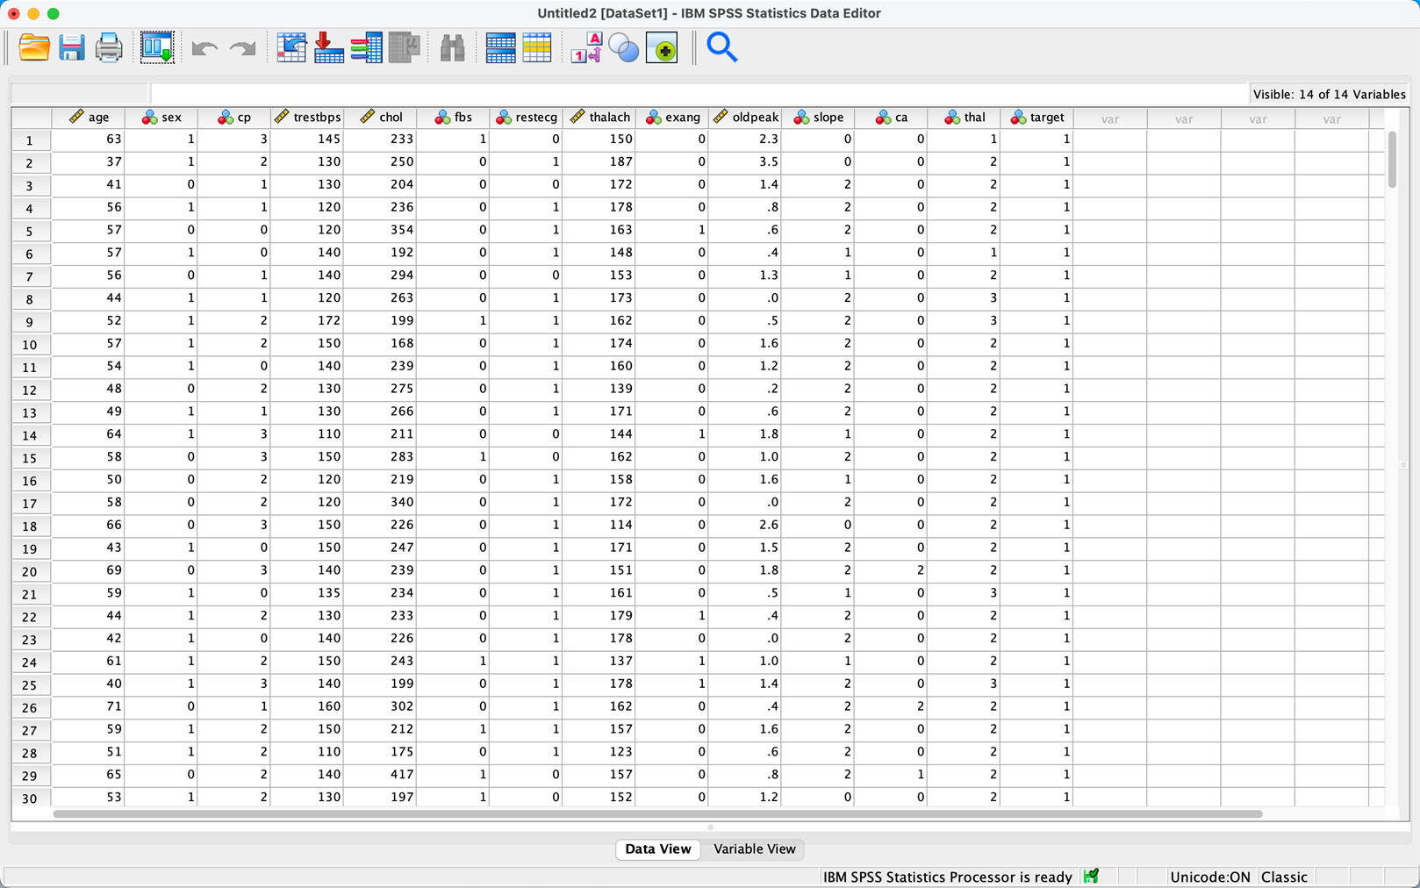
Sample data

Slide 5
Exploratory Data Analysis (EDA) and Data Preparation
•The aim of EDA is to find underlying patterns within the data, detect outliers and test assumptions with the final aim of finding a model that fits the data well.
•There are four main types of EDA:
•Univariate non-graphical: make observations of the population and understand sample distributions of a single variable. (e.g. the measure of spread, the measure of central tendency, outlier detection)
•Univariate graphical: graphical analysis on a single variable. (e.g. Histograms, Boxplots, Stem and leaf)
•Multivariate non-graphical: techniques which show the relationship between two or more variables. (e.g. covariance, correlations)
•Multivariate graphical: graphically show the relationship between two or more variables. (e.g. bar plots, scatterplots)

Slide 6
MODELLING
In this project, we used data modeling to develop the most effective way to identify the results based on the accuracy rates of our four models, which include decision tree classifiers, random forest classification, and logistic regression. The best model for predicting the patient's heart illness is the one with the highest accuracy rate.
This covers the following subjects: how we modified the data and added information to give clients accurate predictions.
•Random forest classifier
•Logistic regression classifier
•Decision tree classifier

Slide 7
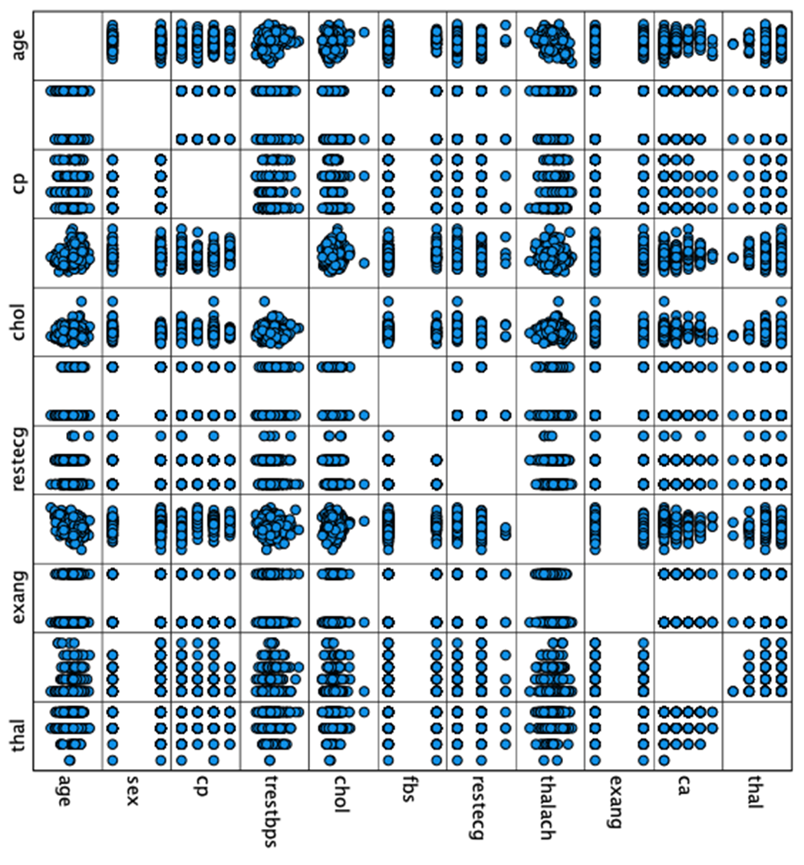
3-D graph:
A three-dimensional graph of sample data that was utilized to forecast the intended outcome.
As can be seen from the graphic, we used SPSS software to create bulk combination parameters like age vs. cp.

Slide 8
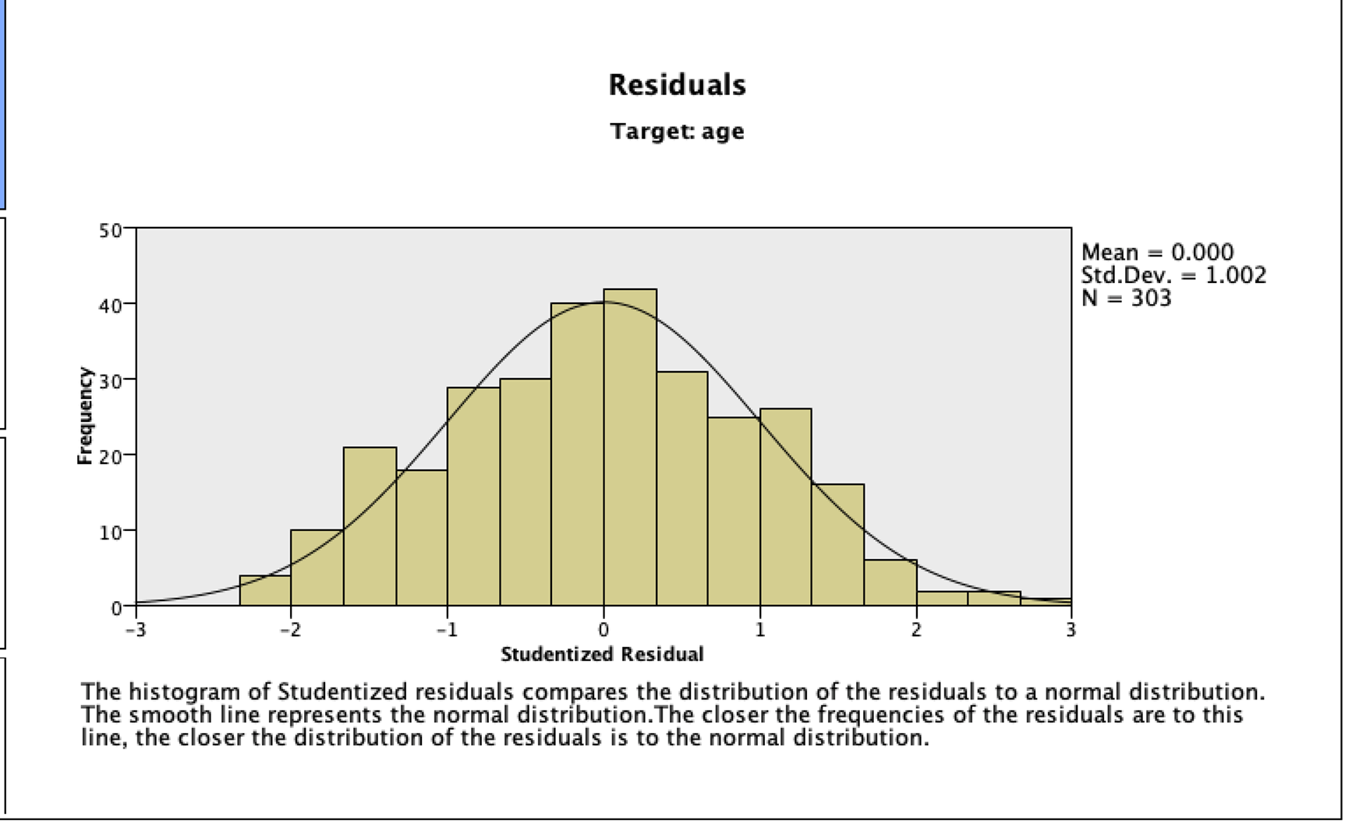
Histogram analysis form Spss software:

Slide 9
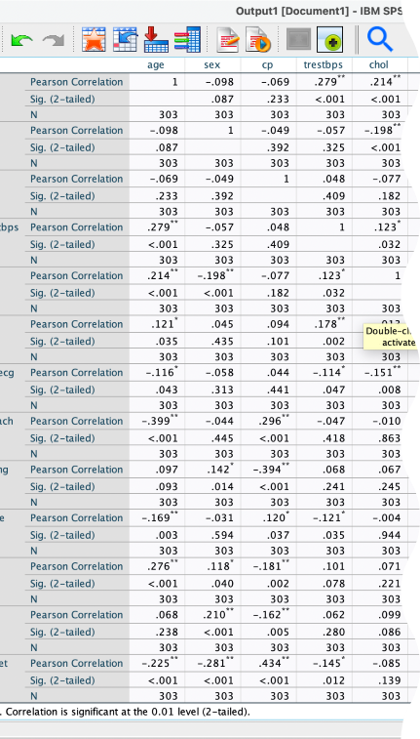
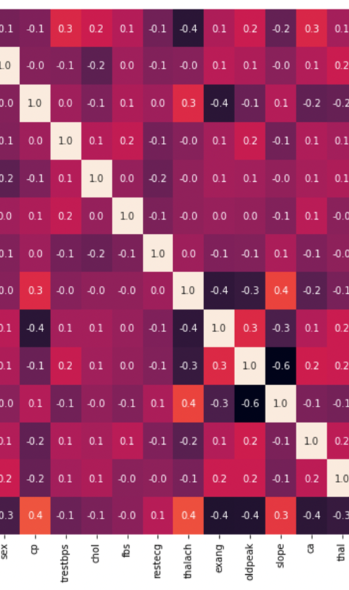
Correlation data of same data in two different software such as :
1.SPSS
2. Jupyter Notebook

Slide 10
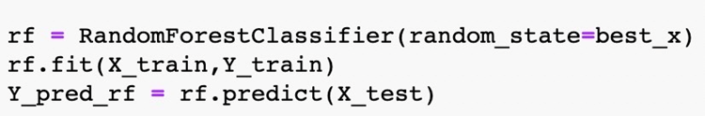
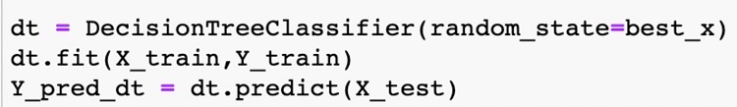
We are performing a train test split on our dataset. We are providing the test size as 0.20, that means our training sample contains 320 training set and test sample contains 80 test set.
And then we train the models on the training set and then we predicted the test results. Then we compared the predicted value and actual value
And then we train the models on the training set and then we predicted the test results. Then we compared the predicted value and actual value

Slide 11
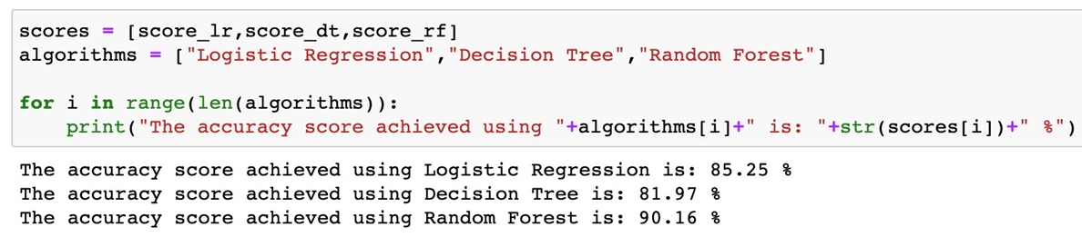
Evaluation:-
Final point, which is also rather significant.
We go through numerous stages during the evaluation process, including:
By performing multiple analyses on the raw csv file using different software programs and uploading the data to Jupiter notebook, we can anticipate the output value (class).
After modeling each method, we calculated the four models' accuracy ratings. Of the three models, Random Forest has the best accuracy rating (90.16%), followed by Logistic Regression (85.25%). Decision trees, with an accuracy rate of 81.97%, had the lowest accuracy rate.

Slide 12
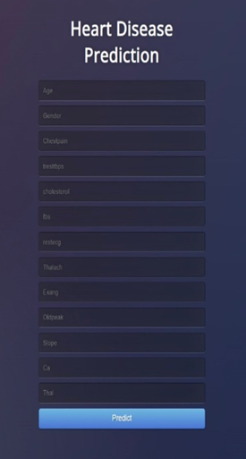
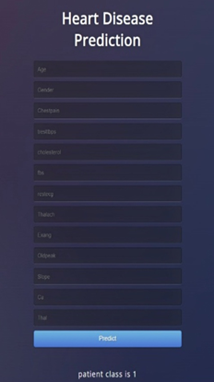
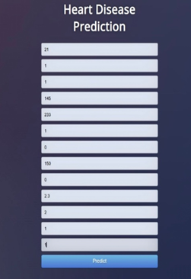

Visualization
•As the image that describes the what and how the page works.
•First the user required to provide the accurate data in respective positions.
•For a sample output we described a required info.
•After that the webpage will revert the data to source code and produce the predicated heart conduction class that a user is present. The output we produced from the sample data the provided in the previous stage
•The output data indicates one out of two described class , such as:
•Output-0 which indicates no heart disease
•Output-1 which indicates there is heart disease
SAMPLE DATA
REQUIRED INFO
OUTPUT

Slide 13

conclusion
Medical organizations can determine if patients are likely to have any cardiac ailments in the future using such very accurate models.
Such models can be used to a variety of medical illnesses, including cancer, diabetes, and patient mental health.
By foreseeing, medical professionals can alert their patients to take preventative measures to prevent cardiac arrests.

Slide 14
REFERENCES
•https://www.kaggle.com/kralmachine/analyzing-the-heart-disease
•https://towardsdatascience.com/simple-linear-regression-model-using-python-machine-learning-eab7924d18b4
•https://www.atmosera.com/blog/creating-a-simple-linear-regression-machine-learning-model-with-scikit-learn/
•https://www.ibm.com/support/pages/producing-line-graph-dual-y-axes-spss-statistics
•https://www.open.ac.uk/socialsciences/spsstutorial/files/tutorials/graphs.pdf
•https://jakevdp.github.io/PythonDataScienceHandbook/

Slide 15


