Slide 1

TERM PROJECT - INTRO TO ARTIFICIAL INTELIGENCE - PROF VAHID BEHZADAN

Slide 2
SHOULDER BONE CLASSIFICATION USING CNN MODELS

Slide 3
TEAM: Mohammed Sirajuddin Prathyusha Beemanaboina

Slide 4
ABSTRACT :
Fractures develop in the shoulder region, which has a more excellent range of motion than other joints in the body.
Computed tomography (CT) or magnetic resonance imaging (MRI) are used to identify these fractures, whereas X-ray is utilised to examine the bones.
The purpose of this research is to aid clinicians by using artificial intelligence to categorize shoulder pictures obtained from X-ray machines as fracture/non-fracture.
In this project, three different convolution neural network-based models are trained and built to identify the shoulder fractures using a modified version of the extensive MURA dataset that includes pictures of the shoulders.
A random split was done so that the testing and training sets included 563 and 8379 photos, respectively. These testing and training set consist of positive (Fracture) and negative (non - fracture).

Slide 5
Main Idea:
Three topics have been identified as the main topics covered in this project which are as follows:
• Different kinds of studies carried on the shoulder crack X-ray images and their classification techniques performed to obtain the efficiency of the deep learning models.
• Usage of MURA dataset for this research and investigations directed utilising the dataset.
• Study of the Ensemble learning

Slide 6
Highlights of this project :
1.Tool setup
2.Cleansing dataset and performing Data Augmentation for better performance
3. Building different convolutional neural network models and discussing their prediction performance and accuracy individually.
4. Ensembling these models and predicting the performance accuracy.

Slide 7
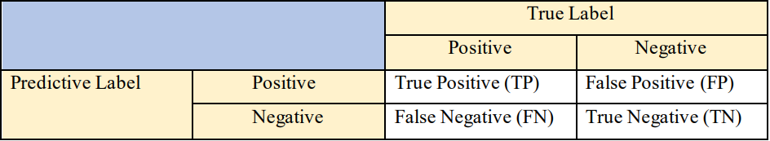
EVALUATION METRICS:
The MURA dataset used consists of bone X-ray images of the shoulder region. This dataset consists of two classes, i.e., positive and negative, also called binary classification. A commonly used binary classification measurement is shown in the table below. TP = true positive (all samples correctly classified as positive); TN = true negative (all samples correctly classified as negative); FP = false positive (some samples incorrectly classified as positive); FN = false negative (some samples incorrectly classified as negative).

Slide 8
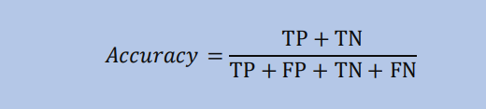

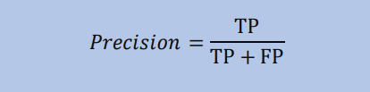
EVALUATION METRICS - contd
We calculate the below parameters:
Accuracy :
Recall :
Precision:

Slide 9

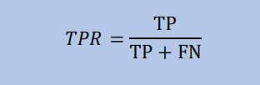
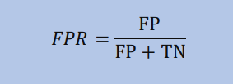

Evaluation Metrics : contd
F1 Score:
Area Under Curve (AUC)
Cohen's Kappa score:

Slide 10
MODELS USED:
RESNET34 : The ResNet34 network comprises 33 convolutional layers, a maximum pooling layer with a size of 3, an average pooling layer, and a fully connected layer. A classic ResNet 34 model has 63.5 million parameters, where batch normalisation (BN) and non-linearity (ReLU) activation is applied in all the rear "Basic-Block" convolution layers and softmax in the final layer.
MOBILENet MobileNet is the initial model for TensorFlow's mobile computer vision meant to be utilised in mobile apps. MobileNet uses profoundly separable convolutions. Compared to a network with standard convolutions with the same depth of networks, it dramatically reduces the parameters, leading to light deep neural networks. MobileNet is a CNN class that Google open-sourced, which provides us with an ideal starting point for training our insanely small and insanely fast classifiers. The MobileNet model is built on depth wise separable convolutions, a type of factorised convolution that factorises a regular convolution into a depth wise convolution and a 1x1 convolution known as pointwise convolution

Slide 11
MODELS USED - contd
ResNet50V2: ResNet50V2 has been amended to provide superior performance on the ImageNet dataset, compared with ResNet50 and ResNet101. In addition, the propagation equation for the connections between blocks has been modified in ResNet50V2. As a result, the ResNetV2 architecture also delivers a significant influence on the ImageNet dataset. This version of ResNet emphasises the utilisation of pre-activation of weight layers rather than post-activation.
MultiModel (Ensemble) : Ensemble learning refers to the processes used to train and integrate the outputs of many learning machines, considering them as a "committee" of decision-makers. The premise is that when the committee members' decisions are pooled, on average, the committee's decisions will be more accurate than the individual member's forecasts. No less than several empirical and theoretical investigations have proven that ensemble models have been shown to achieve superior accuracy than single models.

Slide 12
Experiment:
All the models used in this report follow the same pattern, which is as follows:
• The base model is among pre-trained models with weights used from the model trained on the ImageNet dataset and removal of top layers as we would be adding our designed layers to it. 33
• Next, the output from the base model is flattened and passed on to the next layer, which is a dense layer with 256 neurons.
• The output of this dense layer is passed on to the activation layer to add non-linearity to the system.
• A dropout of 50% is applied to the layer.
• The Next layer is the final layer with a dense layer with two neurons and a softmax activation function.
• The dependent variable is categorical, 'categorical cross entropy' is selected as loss function and metrics as 'accuracy‘’.
• Finally, all the models are trained using five epochs

Slide 13
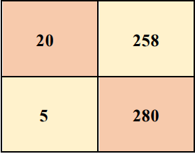
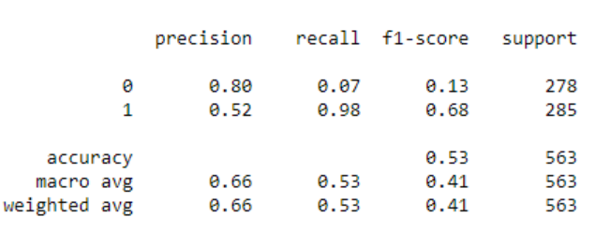
Result
Resnet34 : The time taken for training this model was approximately 500 seconds per epoch. This model resulted in a training accuracy of 76.90%, while the validating accuracy is 51.65%. Therefore, the model seems to be over-fitting the data. Thus, this proves that the model performs better on the training data than the unseen data.
From the confusion matrix
20 people are correctly predicted as shoulder fracture (TP),
280 people are correctly predicted as non-fracture (TN).
258 shoulder fracture people are incorrectly predicted as no fracture,
whereas 5 non-fracture people are incorrectly predicted as shoulder fracture.
This model is not great in predicting shoulder fracture.

Slide 14
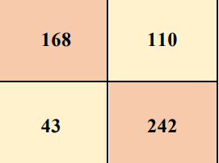
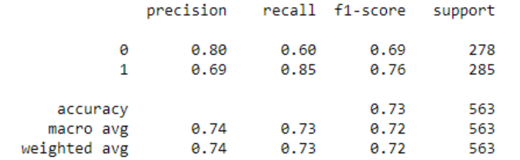
Result - contd
MobileNet: The time taken for training this model was approximately 440 seconds per epoch. The model has achieved a training accuracy of 75% and 72.2% validation accuracy. The model seems to be fitted well without underfitting or overfitting the data. The model performs well on both the training and testing set.
168 people are correctly predicted as shoulder fracture (TP), and 242 people are correctly predicted as non-fracture (TN). However, 110 shoulder fracture people are incorrectly predicted as no fracture, whereas 43 non-fracture people are incorrectly predicted as shoulder fracture.

Slide 15
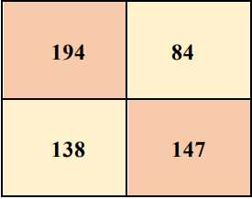
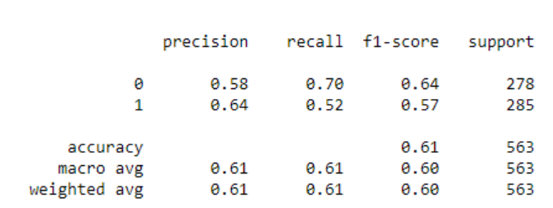
Result - contd
RESNET50V2: The time taken for training the model was approximately 440 seconds per epoch. The model has achieved a training accuracy of 75.16% and 60.2% validation accuracy. Therefore, the model slightly seems to be underfitting the data. However, the model performs well on the training data compared to the validation data.
194 people are correctly predicted as shoulder fracture (TP), and 147 people are correctly predicted as non-fracture (TN). However, 84 shoulder fracture people are incorrectly predicted as no fracture, whereas 138 non-fracture people are incorrectly predicted as shoulder fracture

Slide 16
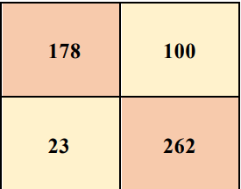
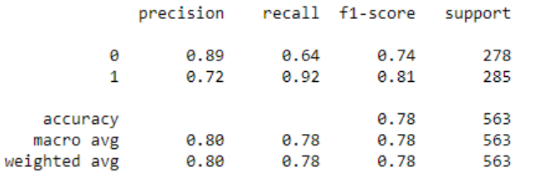
Result - contd
ENSEMBLE : The training time for this model was approximately 450 seconds per epoch. The model showed a training accuracy of 86.25% and validation accuracy of 77.3%. Thus, the model seems to fit the data well without showing neither overfitting nor underfitting the data. The model also appears to be working well on both the training and testing set.
178 people are correctly predicted as shoulder fracture (TP) and 262 people are correctly predicted as non-fracture (TN). However, 100 shoulder fracture people are incorrectly predicted as no fracture, whereas only 23 non-fracture people are incorrectly predicted as shoulder fracture.

Slide 17
CONCLUSION
In Addition to the training accuracy, the ensemble model Tested all the models in the validation accuracy with 77.3% .Thus, the analysis shows that the ensemble model has outperformed all the other models, while the next closest model was MobileNet.
This information will result in advancements in medical imaging technology, which will classify any breakage of the specific regions of the body for diagnosis.
Future Enhancements : The ensemble classifier may be further improved by using a weighted vote -based technique to include more deep learning networks. Consequently, a better ensemble classifier might be developed based on the weighted vote-based method, and better ensemble results may be achieved.
Furthermore, a real-time mobile application for detecting shoulder bone fractures may be created to assist physicians in conducting emergency treatments.

Slide 18
References :
https://www.researchgate.net/publication/335013263_Abnormality_Detection_in_Muscul oskeletal_Radiographs_with_Convolutional_Neural_NetworksEnsembles_and_Performance_Optimization [Accessed 27 March 2021]
Bakhsh, W., Nicandri, G., 2018. Anatomy and Physical Examination of the Shoulder. Sports Medicine and anthroscopy Review [online], 26(3):e10-e22. DOI: 10.1097/JSA.0000000000000202 [Accessed 28 March 2021]
Chung S.W., Han, S.S., Lee, J.W., Oh, K.S., Kim, N.R., Yoon, J.P., Kim, J.Y., Moon, S.H., Kwon, J., Lee, H.J., Noh, Y.M., and Kim, Y., 2018. Automated detection and classification of the proximal humerus fracture by using deep learning algorithm. Acta Orthopaedica [online], 89(4), 468–73. [Accessed 27 March 2021]

