Slide 1
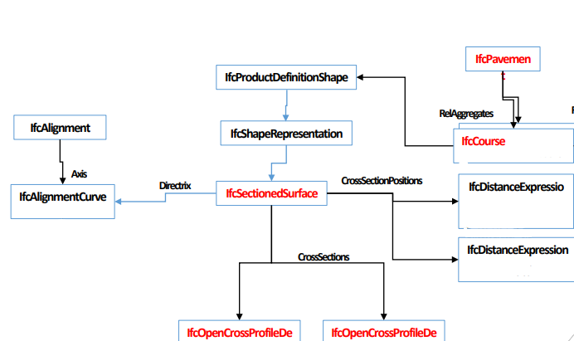
IfcPavement Example
Diagramm

Slide 2
IfcAlignment
IfcAlignmentHorizontal
X = 513220.00000
Y = 5454120.00000
DistanceAlong = 14.142
PredefinedType = LINE
StartDirection = 0.785
SegmentLength = 14.142
X = 513210.00000
Y = 5454110.00000
DistanceAlong = 0.0

Slide 3
IfcAlignment
IfcAlignmentVertical
X = 14.142
Y = 92.0
StartDistAlong = 0
StartGradient = 0.0707
EndGradient = 0.0707
PredefinedType = LINE
StartHeight = 91.0
HorzontalLength = 14.142
X = 0.0
Y = 91.0

Slide 4
IfcPavement
IfcSectionedSurface at DistanceAlong = 0
Tag = AX
Width = 3
Slope = -3.006
Tag = -1AL
Width = -3
Slope = -3.006
Tag = +1AL
Width = 3
Slope = -3.006
DistanceAlong = 0.0
OffsetVertical = 91.0

Slide 5
IfcPavement
IfcSectionedSurface at DistanceAlong = 14.142
Tag = AX
Width = 3
Slope = -3.006
Tag = -1AL
Width = -3
Slope = -3.006
Tag = +1AL
Width = 3
Slope = -3.006
DistanceAlong = 14.142
OffsetVertical = 92.0

Slide 6
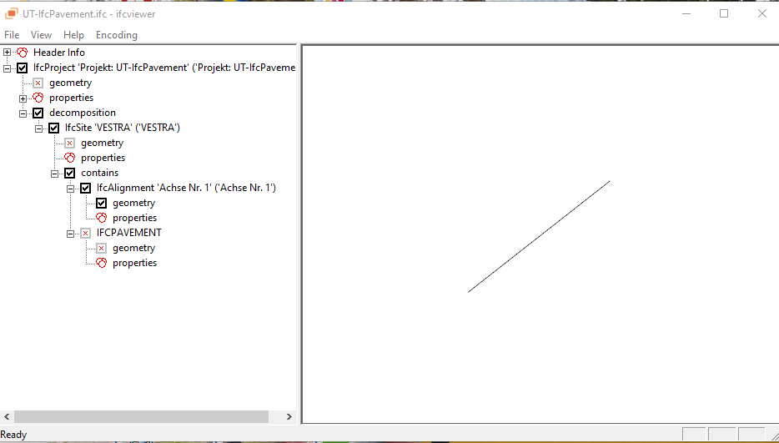
RDV IFC-Viewer

