Slide 1
Introduction
A data exploration project. Explore the features of beers and breweries.

Slide 2
Description of data set.
Data about 2410 different beer types produced by breweries in United States of America.
The features known about each beer type
Brewery name
the city and state.
IBU ( international bitterness unit)
ABV ( Alcohol by volume)
Style
Ounces

Slide 3
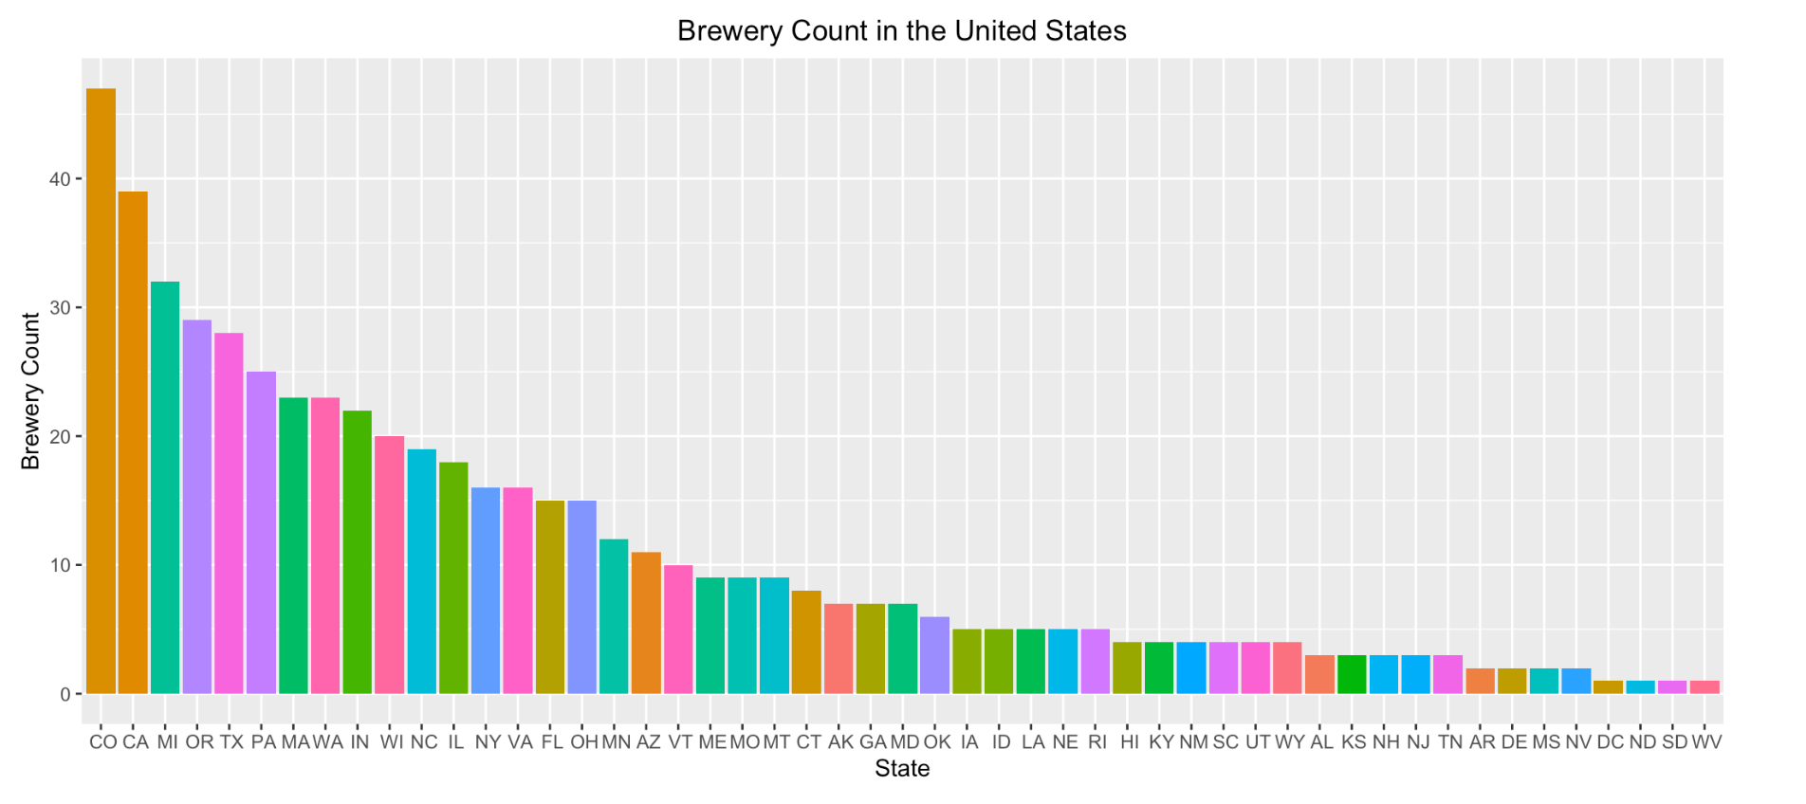
Breweries across the geography
Want to setup a new brewery. Which state could be the best?
From the plot below , Colorado and California rank the 1st and the 2nd. This indicates that conditions are conducive to run a brewery in these states.

Slide 4
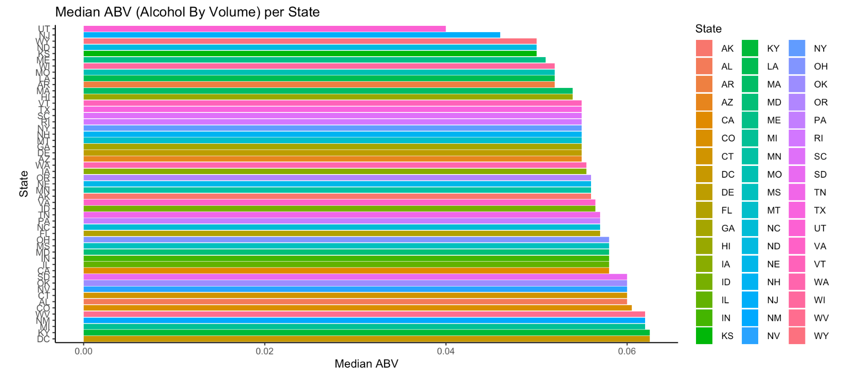
Alcohol by Volume
Which state produces beers with high median alcohol volume?
DC and KY are topping the chart in the bar plot below

Slide 5
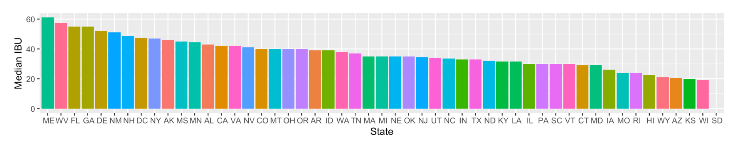
Bitterness of the Beers
Which state produces the least median bitterness.
Median bitterness of Beers from Kansan and Wisconsin are lowest.

Slide 6
Maximum bitterness and Alcohol content
Upslope Brewing Company Boulder , Colorado produces beer with alcohol content at 0.128 which is the highest alcohol content among all types of beers. The name of the beer is “Lee Hill Series”. Surely you will be on top of the hill.
Astoria Brewing Company in the city of Astoria , Oregon produces beer with IBU value of 138 which has the highest bitter score among all the beers. It has be aptly named as “Bitter Bitch Imperial”.

Slide 7
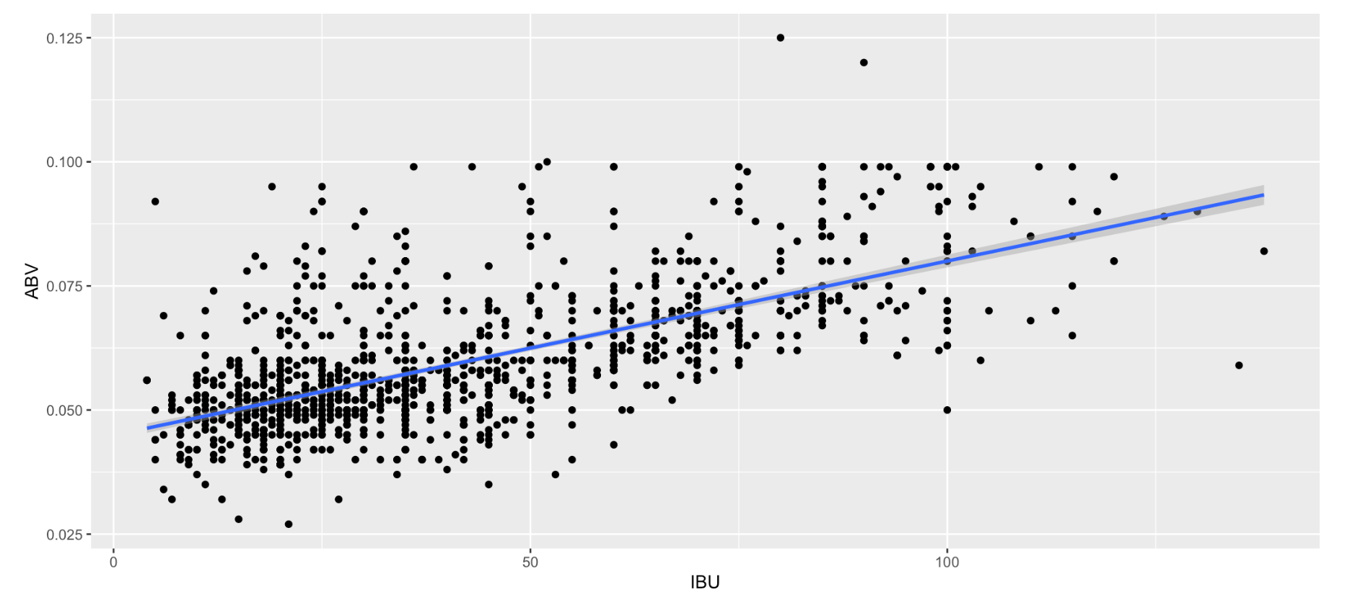
Alcohol by volume and Bitterness unit
Is there a relation between ABV and IBU
The scatter plot below suggests that there a positive correlation between ABV and IBU. As alcohol content goes up, the bitterness also goes up.

Slide 8
Beer with high alcohol under bitterness of 50
Beer named Bourbon Barrel Batch 666: Sympathy for the Devil has highest alcohol content at 0.099 and IBV value at 36

