Slide 1
EMPLOYEE ReTention
Exploratory analysis of skilled JOBS and EMPLOYEES data

Slide 2
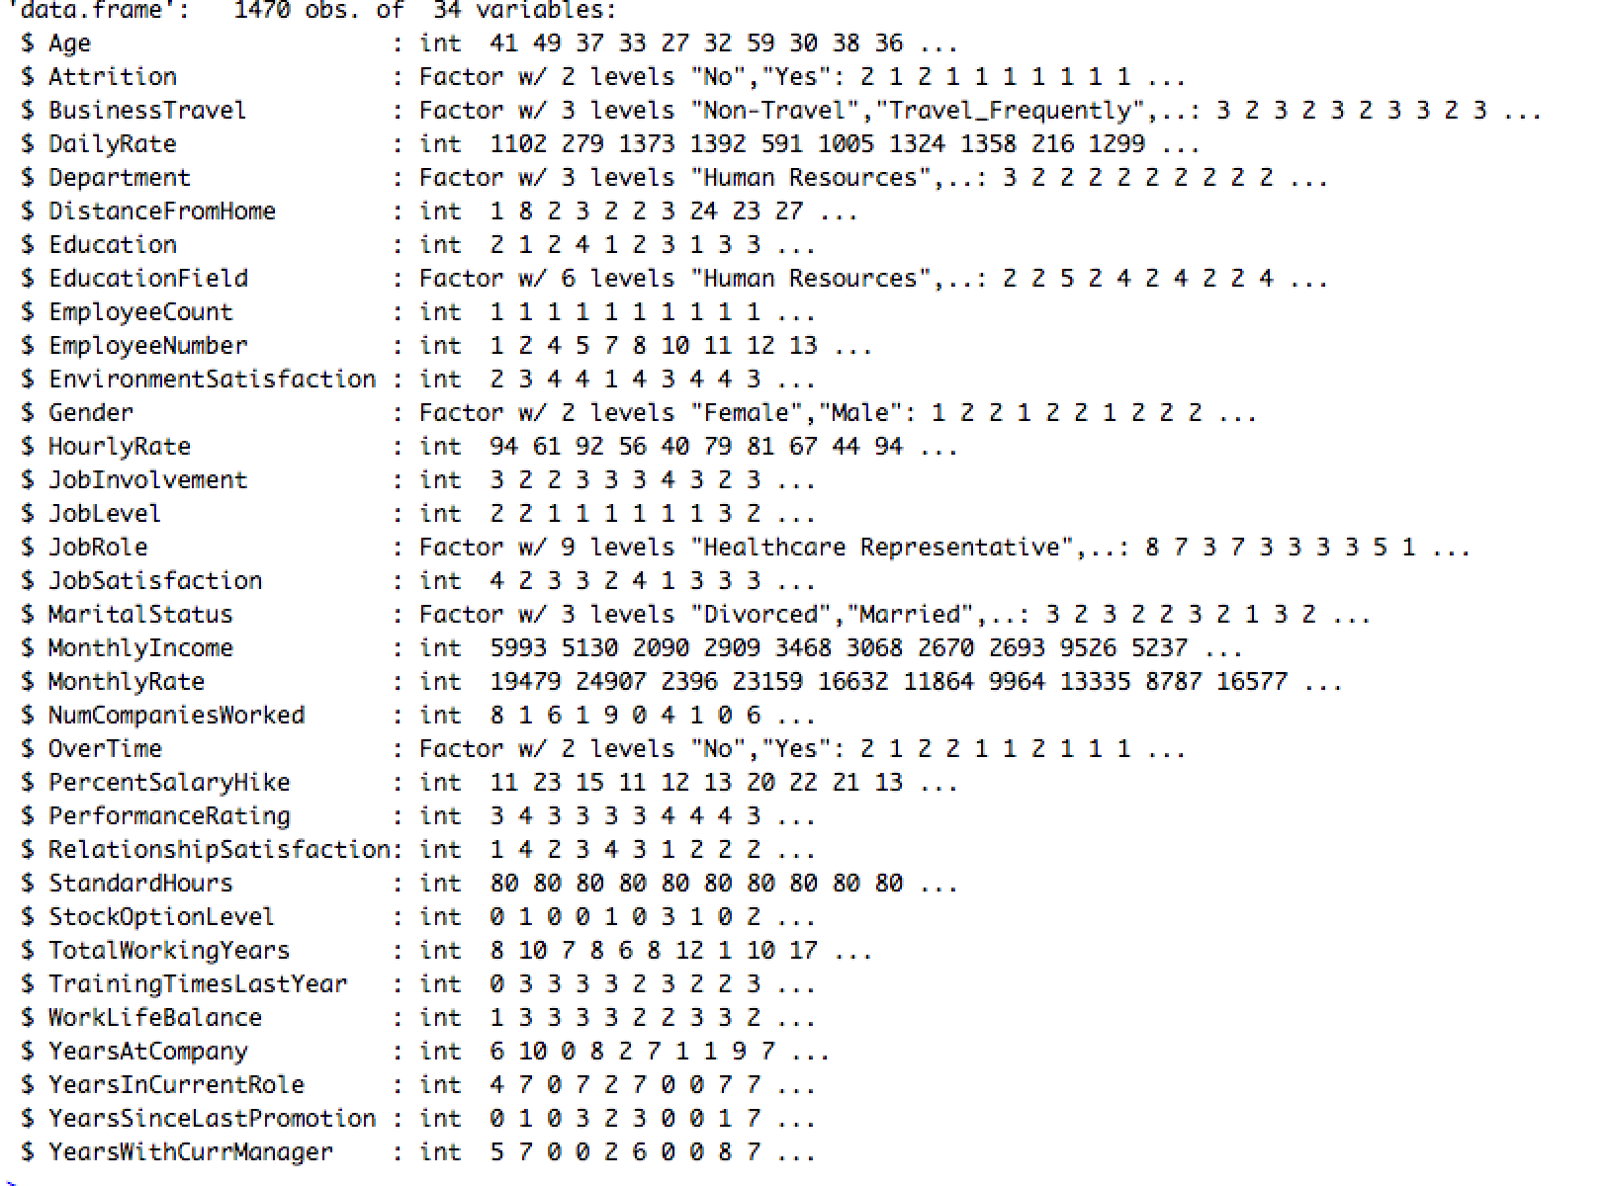
The data contains 34 features total
26 of them are continuous features
8 are categorical variables

Slide 3
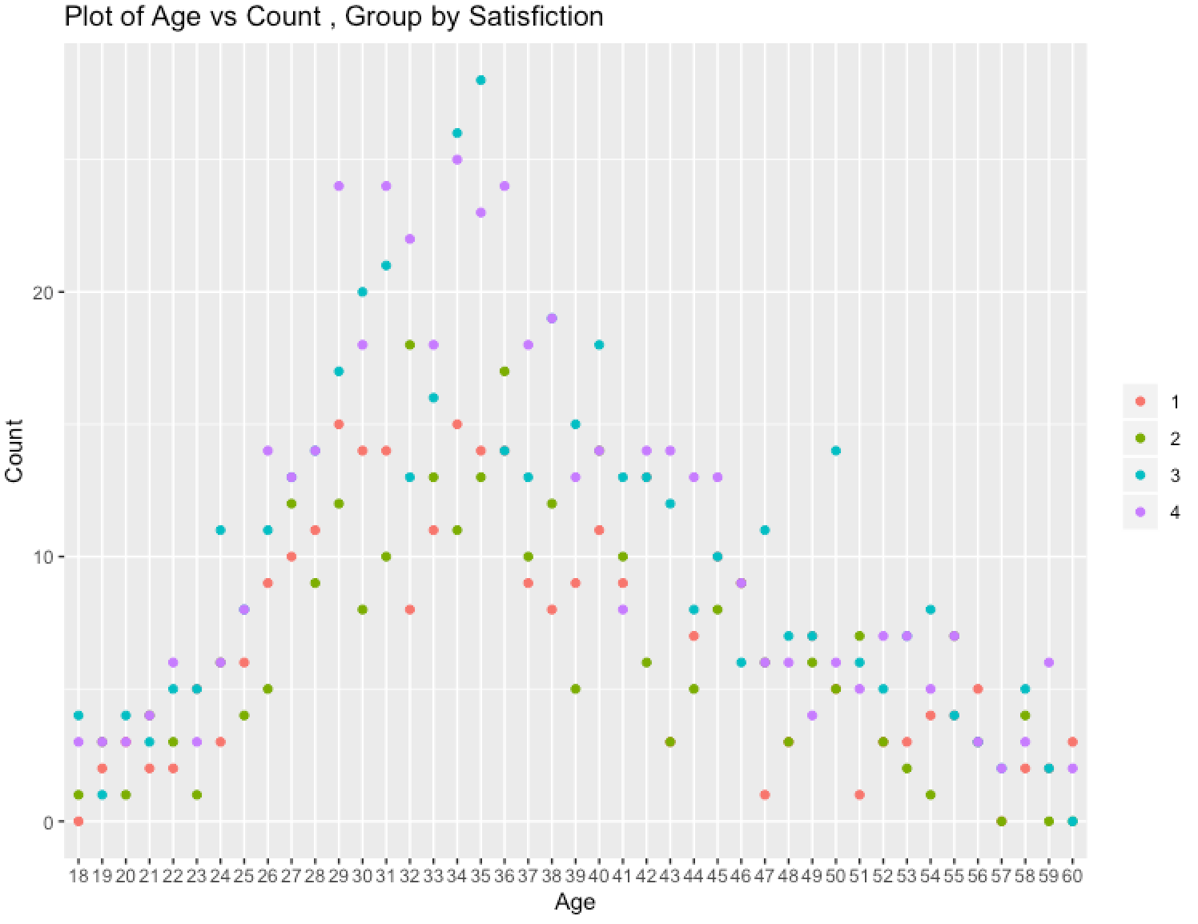
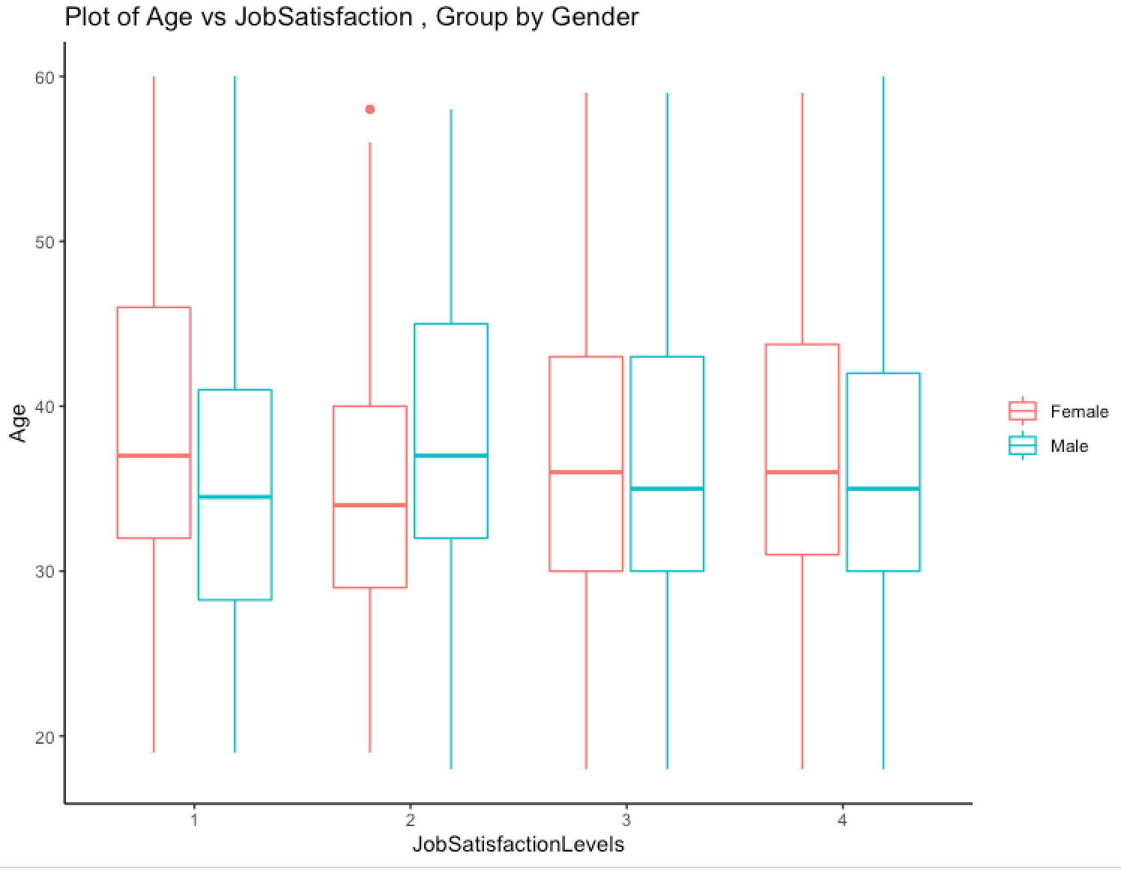
Explore Job satisfaction and Age , Grouped by Gender and Satisfaction LEVEls
Job Satisfaction levels go down as
employees ages for both men and women
Peak Job satisfactions around age 35

Slide 4
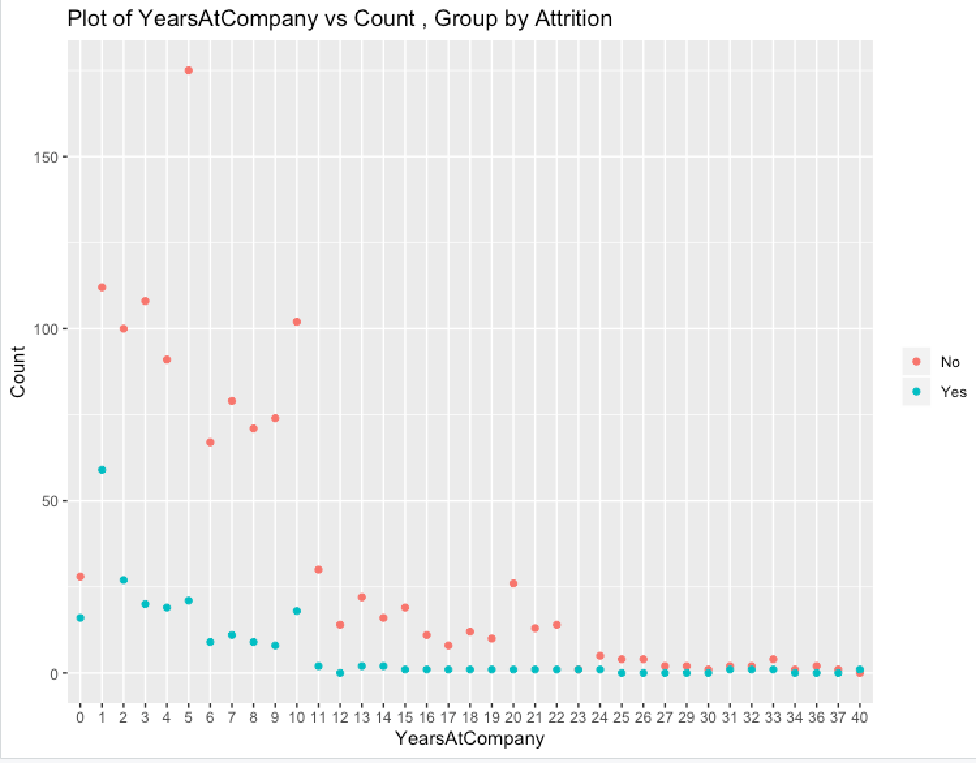
Attrition is high aROUND first year and stabilizes after 11+ years of employment

Slide 5
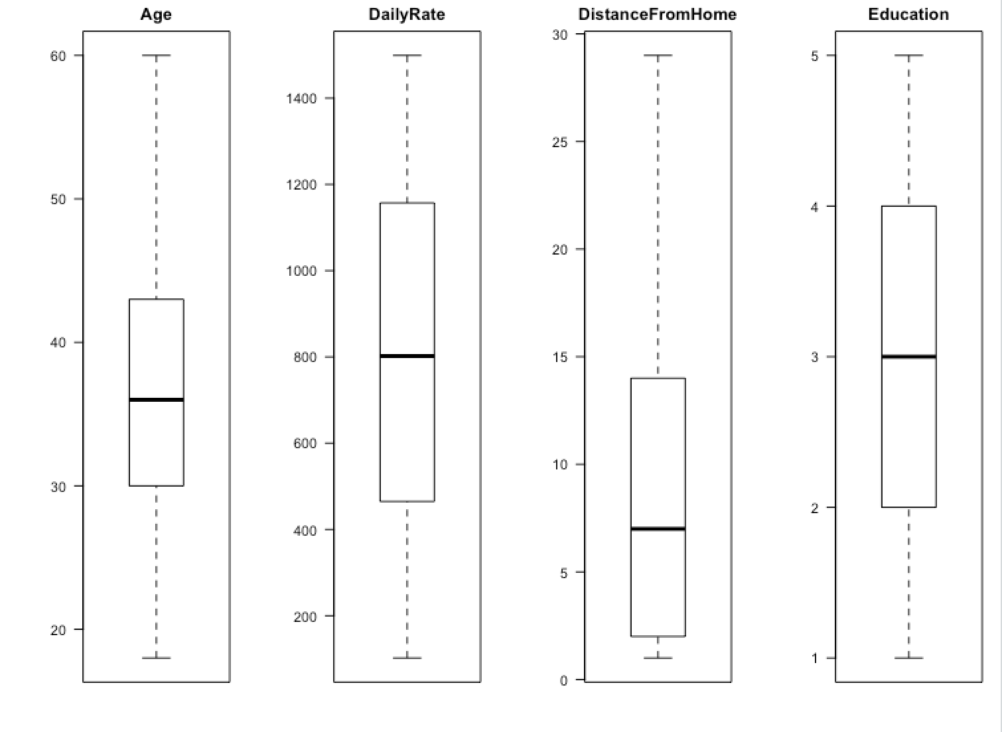
Box plots to visualize the distribution
Distribution among explanatory variables
Distance from home is right skewed

Slide 6
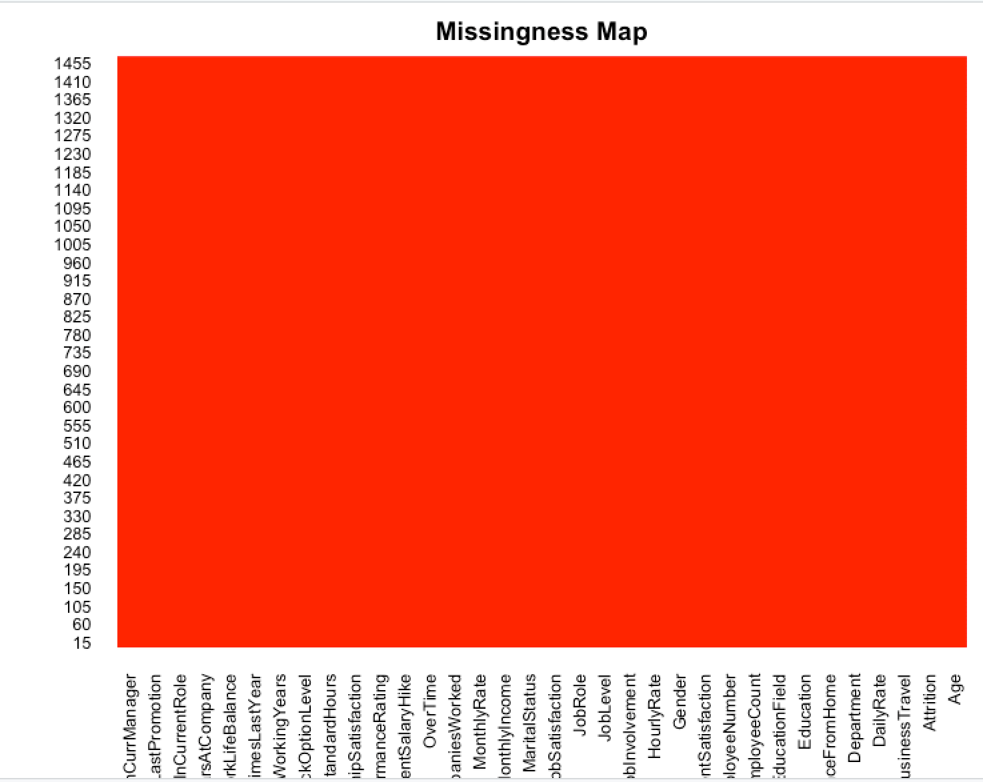
Missing data needs to be handled.
Check is there is any data missing
Missingness maps shows no data missing

Slide 7
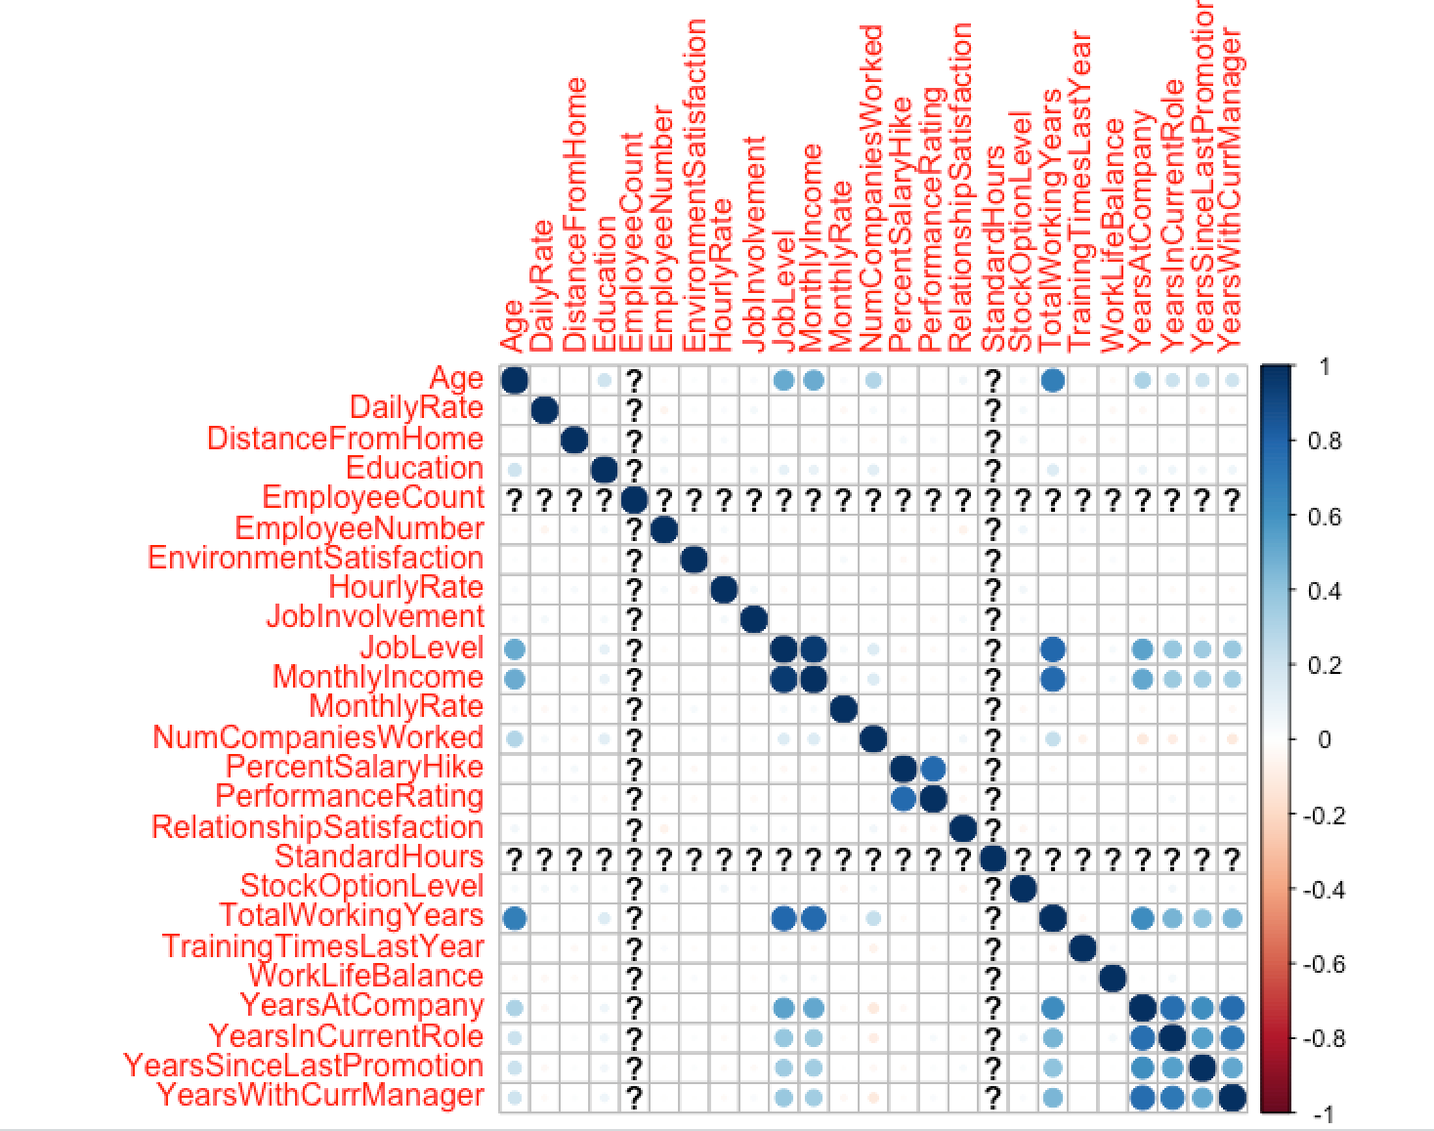
Blue for positive correlation and red for negative
Darker colors indicate more correlation.
Correlation among continuous explanatory variables
JobLevel and MonthlyIncome have correlation > 0.7
TotalWorkingYears and JobLevel are correlated .
Remove TotalWorkingYears and Performance rating to avoid high variance inflation factor

Slide 8
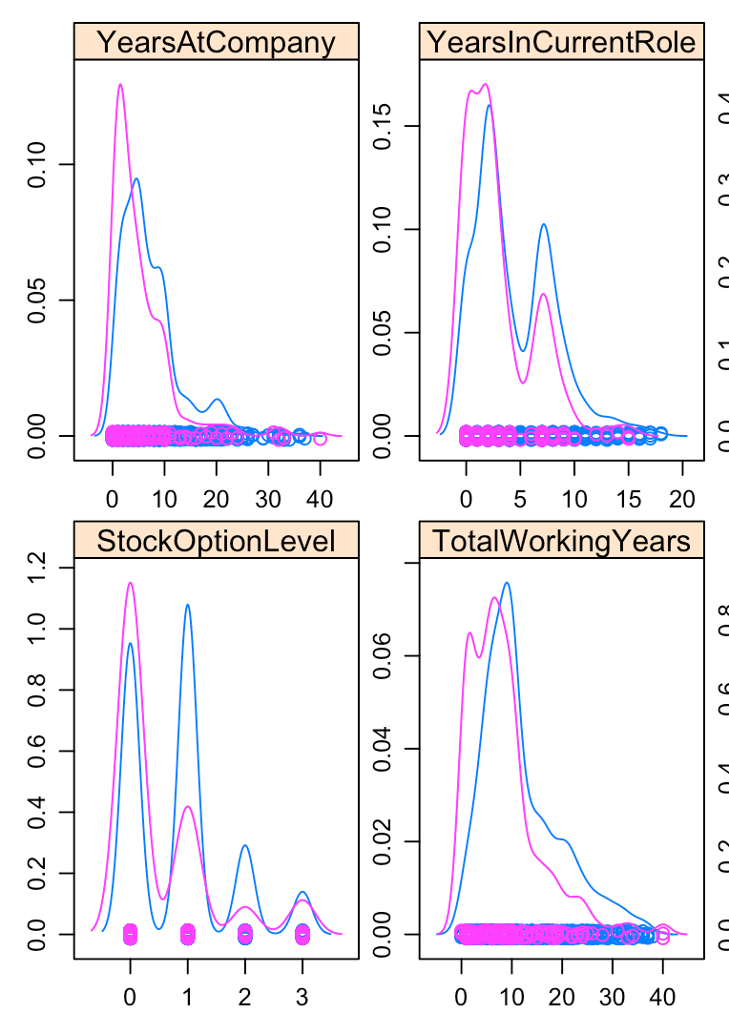
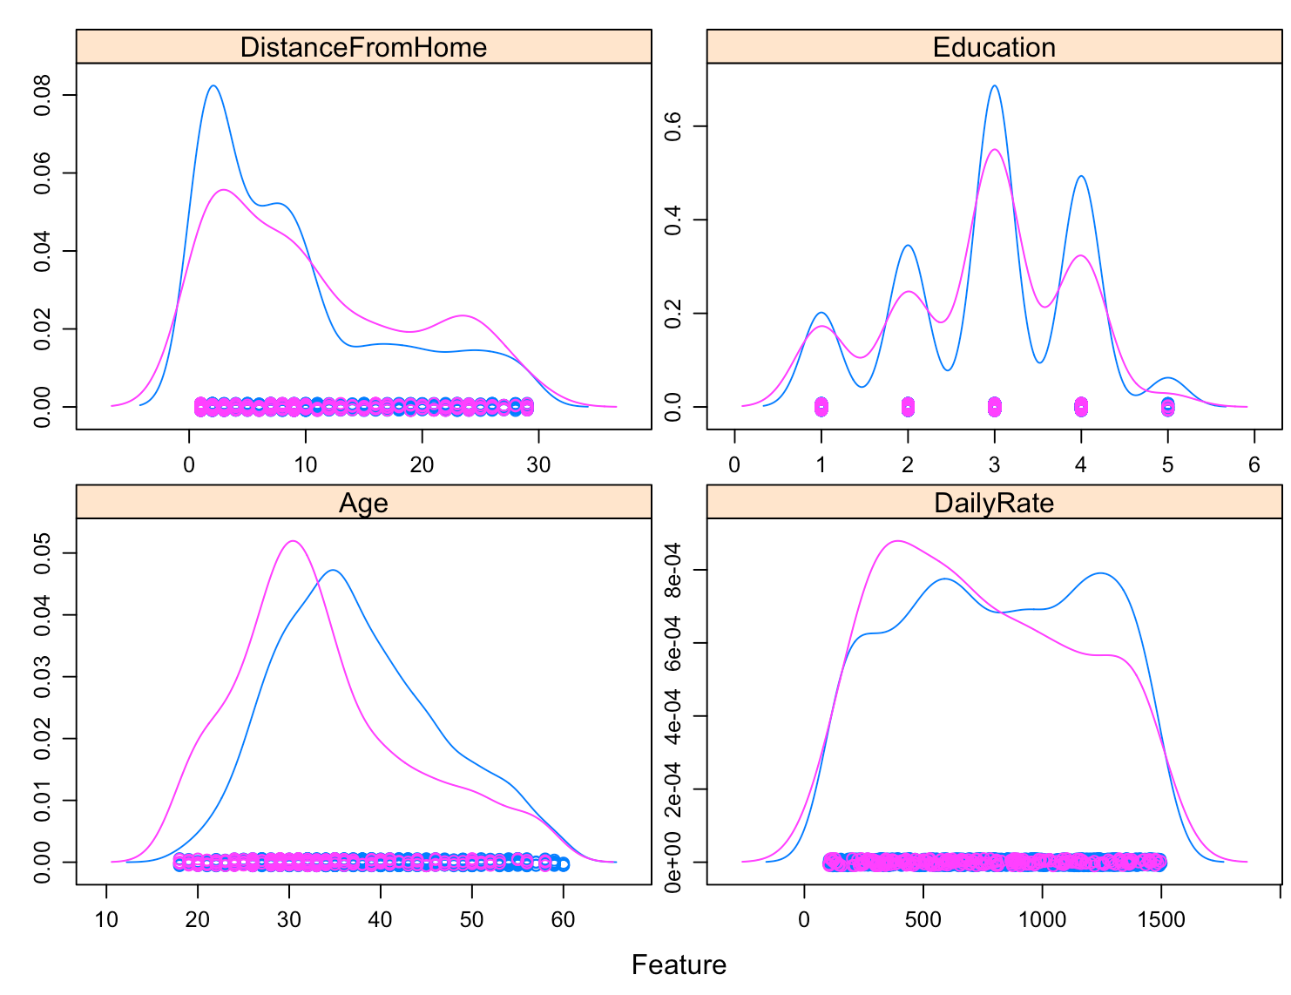
Checking the Explanatory variable relation to Attrition
The variables overlap with attrition levels but not completely.
They can be used to predict attrition

Slide 9
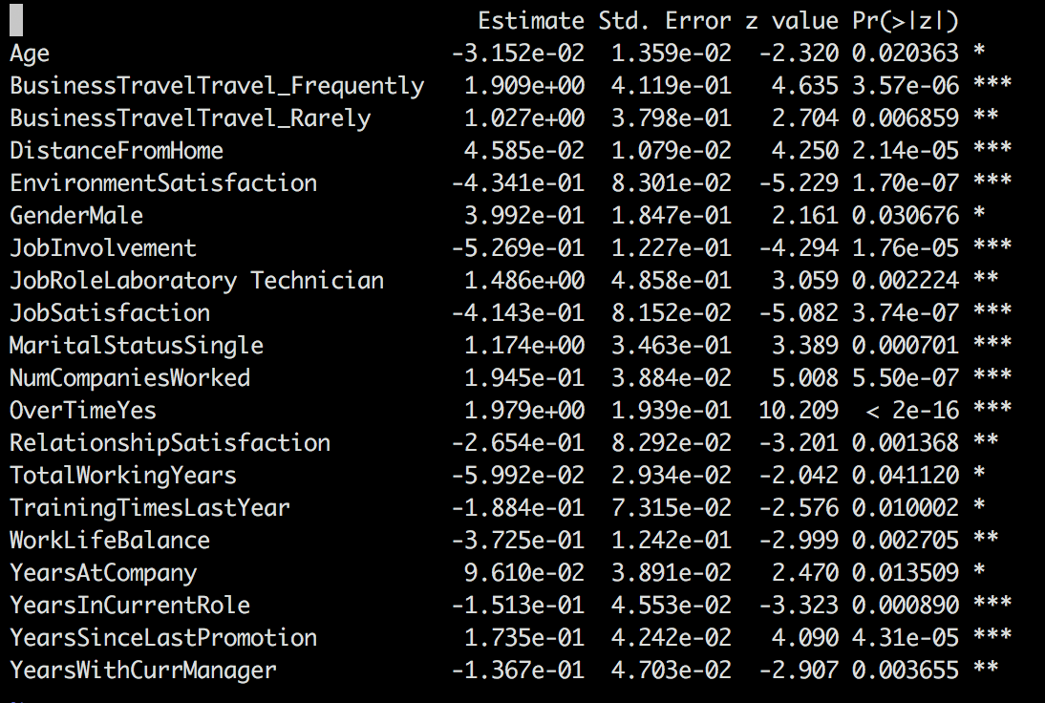
Logistic Regression model with logit link function

Slide 10
Interpretation of the parameters
The logistic regression coefficients give the change in the log odds of the outcome for a one unit increase in the predictor variable.
EXAMPLE: AGE is -3.152E ⁻⁰²
For every one unit increase in AGE, the log odds of attrition increases by -3.152E⁻⁰²

Slide 11
The model was able predict the attrition based on parameters like
BusinessTravelFrequency
DistanceFromHome
EnvironmentSatisfaction
JobInvolvement
NumCompaniesWorked
overtime
yearsInCurrentRole
yearsSincelastPromotion

Slide 12
Suggestion to the Employer
To retain top talent,
Reduce the frequency of Business Travel
Allow work from Home
Provide good office environment
Involve the employees in important decisions
Avoid frequent over times
Proactively identify the eligible candidates for promotion.
Avoid hiring candidates who change jobs frequently
Complete Research at https://github.com/bSharpCyclist/MSDS-6306---Case-Study-2.git

