Slide 1

Getting Started
Setting Up GitHub Account
Visit and Sign UP https://www.github.com

Slide 2
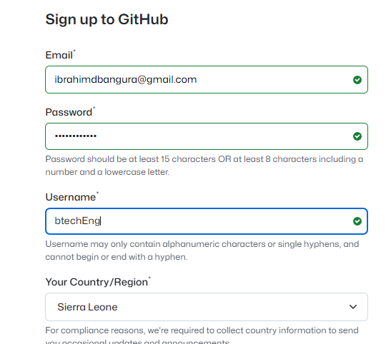

Slide 3
Enter your user name credentials
Now that your account has been successfully been created, crate repositories
Download the newly created repository to have it on your local machine

Slide 4
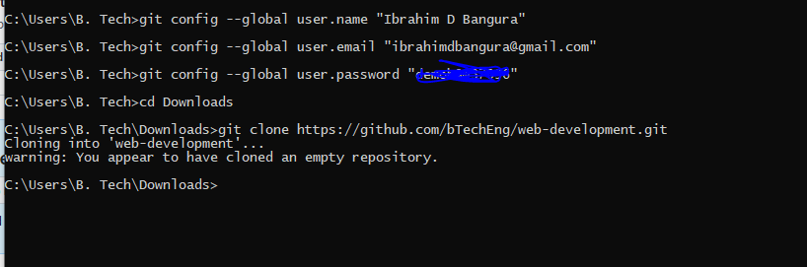
Configure Git Hub on Local Machine with Git Bash
Now clone the remote repository to your local machine
On the git bash open type
cd Downloads
git clone
This allow you to download the remote project on the download folder

Slide 5
Visit https://www.w3schools.com
Visit https://www.freecodecamp.org

