Slide 2


(0,1)
$$90°$$
$$90°$$
(-1,0)
(0,0)
(1,0)
(0,-1)

Slide 3

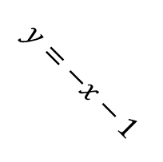

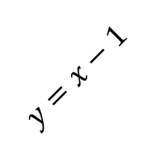
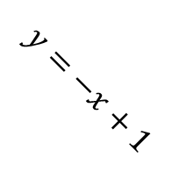
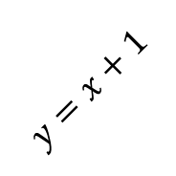

(0,1)
$$x^{2}+y^{2}=1$$
$$90°$$
$$y=x+1$$
$$y=−x+1$$
$$r=1$$
$$90°$$
(-1,0)
(0,0)
(1,0)
$$y=−x−1$$
$$y=x−1$$
(0,-1)

Slide 4
(0,1)
$$x^{2}+y^{2}=1$$
$$90°$$
$$y=x+1$$
$$y=−x+1$$
$$r=1$$
$$90°$$
(-1,0)
(0,0)
(1,0)
$$y=−x−1$$
$$y=x−1$$
(0,-1)

