Slide 1
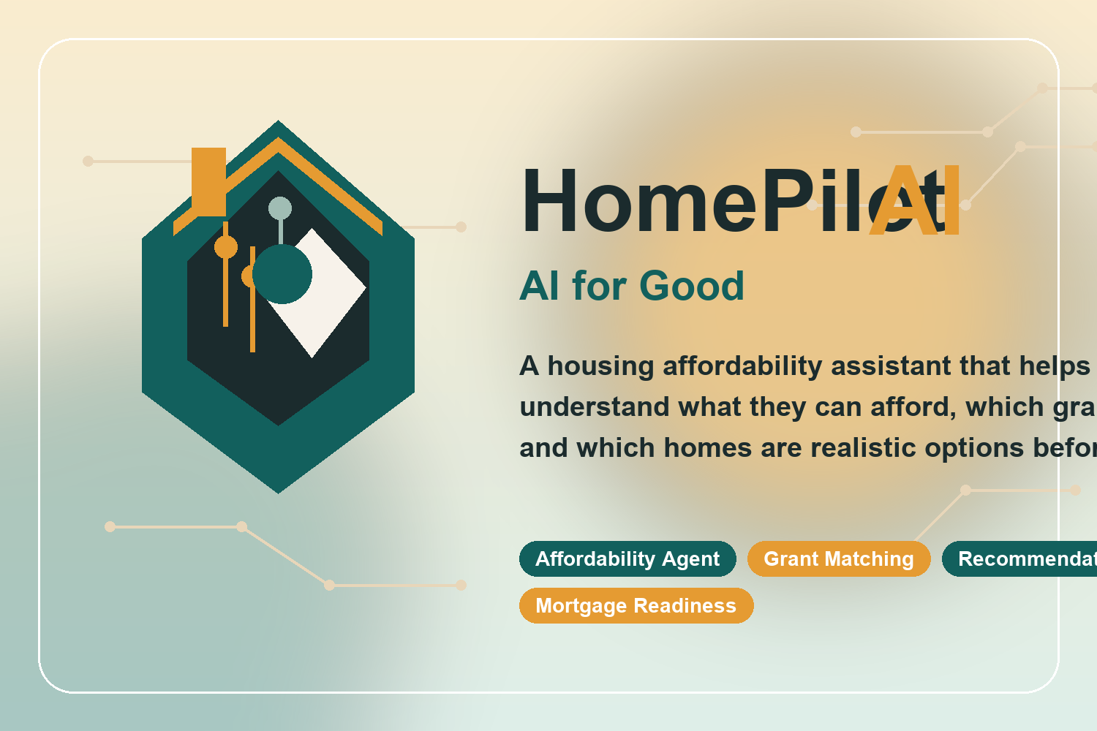
HomePilot AI
AI for Good: helping people make safer, fairer housing decisions.
Hackathon MVP deck

Slide 2
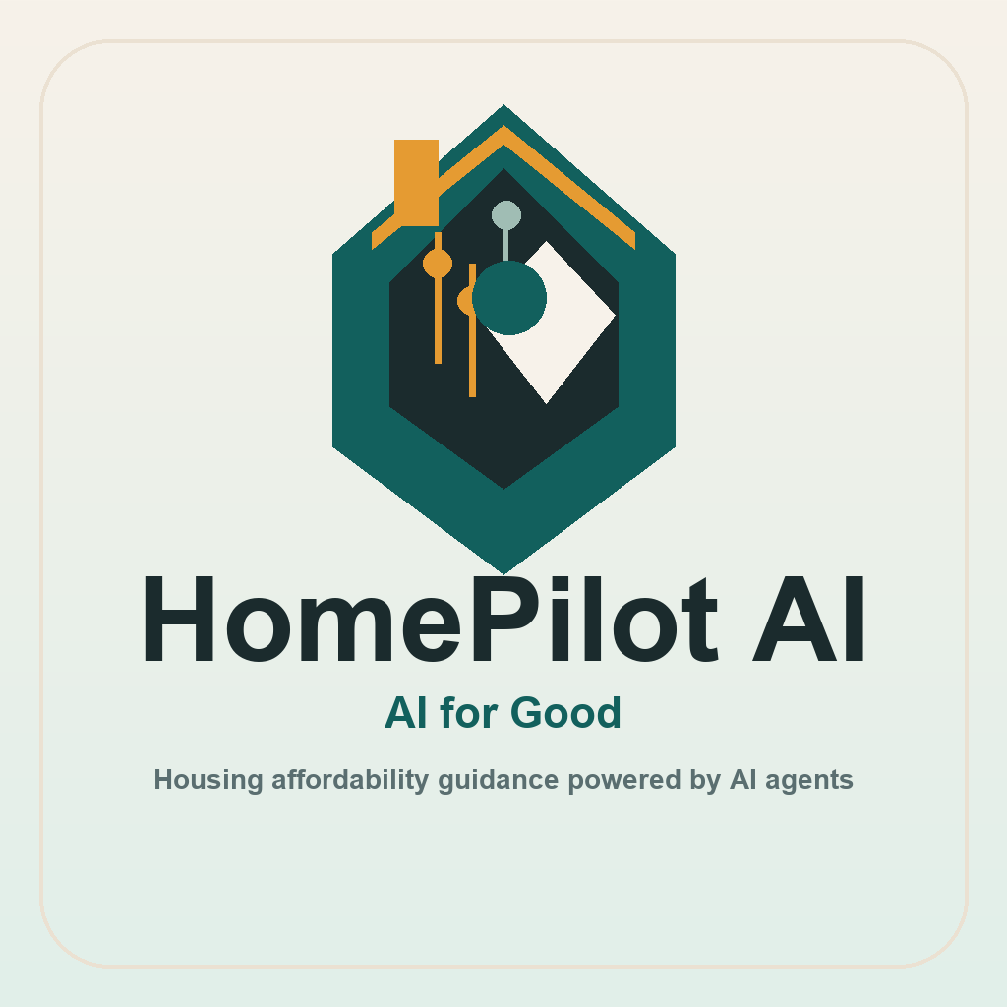
The Problem
Housing affordability is confusing, fragmented, and time-consuming.
Renters and first-time buyers often do not know what they can safely afford.
Grant and assistance programs are hard to discover and even harder to compare.
Listing platforms show inventory, but not whether a home is realistic for a specific budget and household.
That creates wasted applications, delayed decisions, and less equitable access to stable housing.

Slide 3
Our Solution
HomePilot AI turns financial inputs into practical housing guidance.
Users create a profile with income, employment, household size, location, credit estimate, and rent-or-buy preference.
AI agents estimate affordability, rank listings, surface grants, and score mortgage readiness.
The dashboard gives a fast answer to the question: What can I actually pursue right now?
Affordability
Grants
Recommendations
Mortgage

Slide 4
Why This Is AI for Good
The demo addresses a real-world challenge outside college life.
We focus on housing equity, not convenience for its own sake.
The AI helps people avoid unaffordable choices before they invest time, money, and emotional energy.
It improves access to grants and assistance that users might otherwise never find.
The outcome is clearer, fairer, and more informed housing decisions for everyday households.

Slide 5
Product Demo Flow
What judges can see in under two minutes.
1. Log in with the seeded demo account or use offline fallback mode if the backend is unavailable.
2. Review the dashboard for rent range, purchase range, grants, and top listings.
3. Open recommendations and listings to compare budget fit and match scores.
4. Check the mortgage estimate and grant eligibility views for next-step guidance.

Slide 6
Architecture
Built as a full-stack MVP with future AI integrations in mind.
Flutter frontend with login, profile setup, dashboard, listings, grants, saved homes, and mortgage views.
Spring Boot backend with JWT auth, REST APIs, repository/service architecture, and seeded datasets.
Modular agent connectors for affordability, grants, recommendations, and mortgage estimation.
Designed to plug into Google Maps, Plaid, Zillow/Realtor data, and Vertex AI or Gemini later.
Flutter App
Spring Boot API
Agent Connectors
Future APIs

Slide 7
Demo Reliability
We built fallbacks so the presentation still works under pressure.
Seeded demo credentials: demo@homepilot.ai / HomePilot123!
Backend defaults to embedded H2 for local startup, with PostgreSQL still supported for deployment.
Flutter automatically uses platform-aware local API hosts for Android, iOS, macOS, and web.
If the API is temporarily unreachable, the demo account switches to local sample data for a smooth walkthrough.

Slide 8
Why This Matters
HomePilot AI can grow from MVP to real housing-support product.
Immediate use cases: hackathon demo, research tool, civic-tech prototype, or prop-tech portfolio piece.
Next upgrades: live listings, geospatial search, bank data, document parsing, and grant-policy expansion.
North star: give more people a trustworthy path to stable housing.
HomePilot AI makes housing guidance more accessible, actionable, and equitable.

Slide 9
Revenue Model
Landlords and agents pay to reach pre-qualified renters and buyers.
① Landlord or agent taps "List your property" on the login screen.
② They choose a subscription tier and create an account.
③ Their listings are posted alongside platform inventory and ranked by the AI.
④ Tenants and buyers see property photos, descriptions, and budget-fit scores.
⑤ Landlords get direct exposure to the most financially qualified users.
Free Trial $0
1 listing · 30 days
Basic $29 / mo
Up to 5 listings
Premium $79 / mo
Unlimited + featured placement
Demo landlord account: landlord@homepilot.ai / Landlord123! — Basic tier, "Peach State Properties"

