Slide 1
Auto-Antenna Control
Design an antenna that tracks UAVs

Slide 2
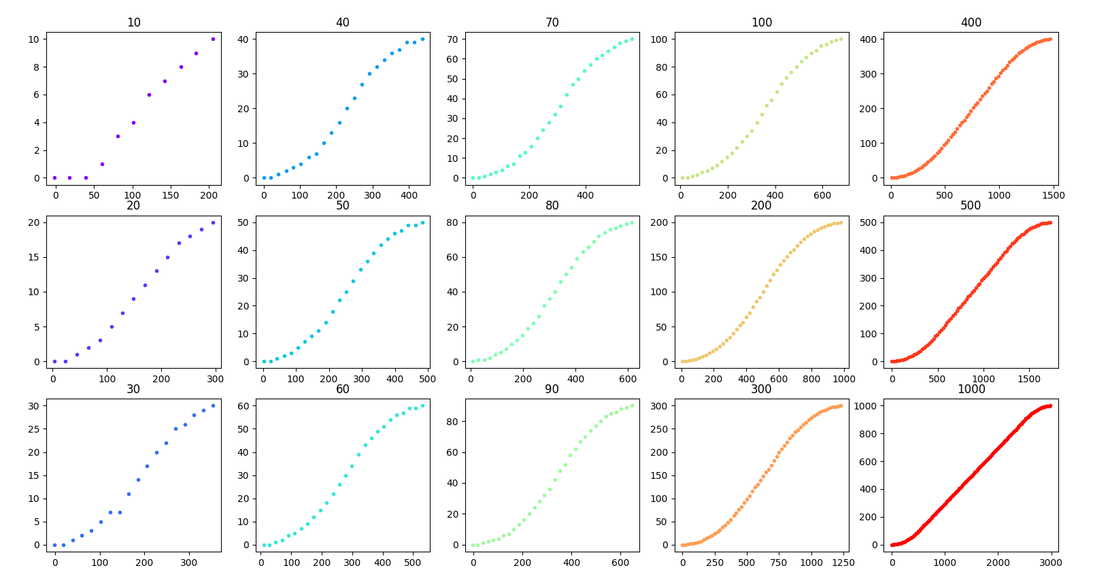
Motor Position System Modelling

Slide 3
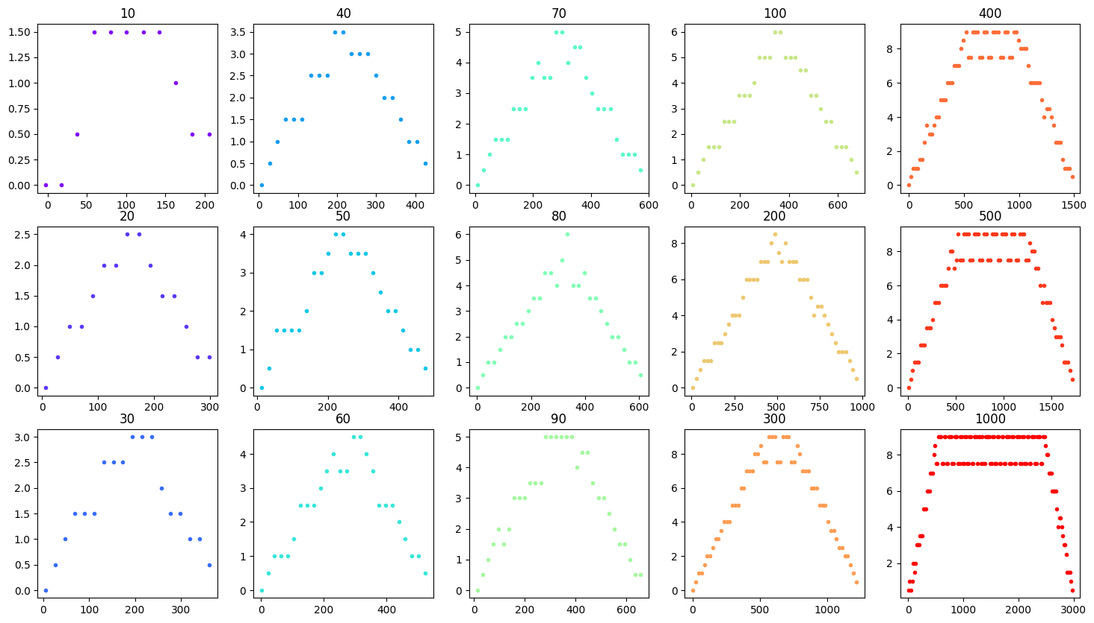
Windowed Velocity looks promising to fit

Slide 4
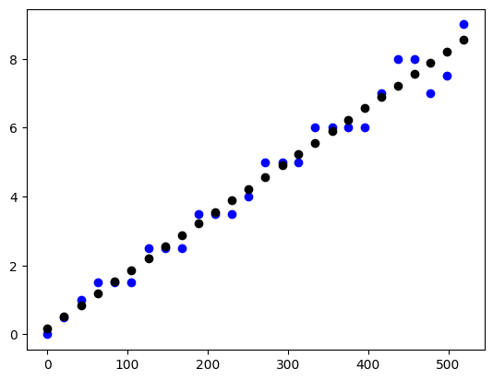
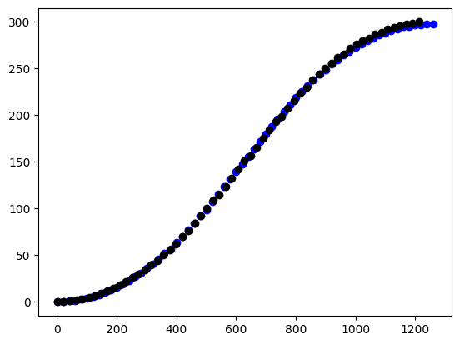
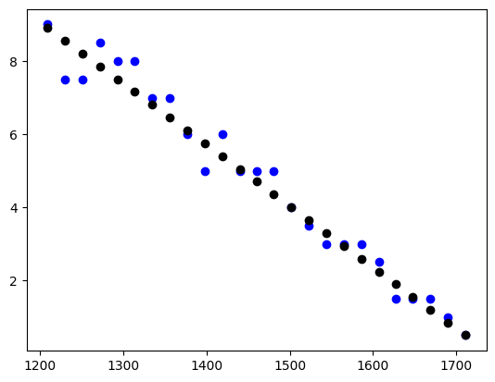
Given target, can now predict the trajectory of motor pose

Slide 5
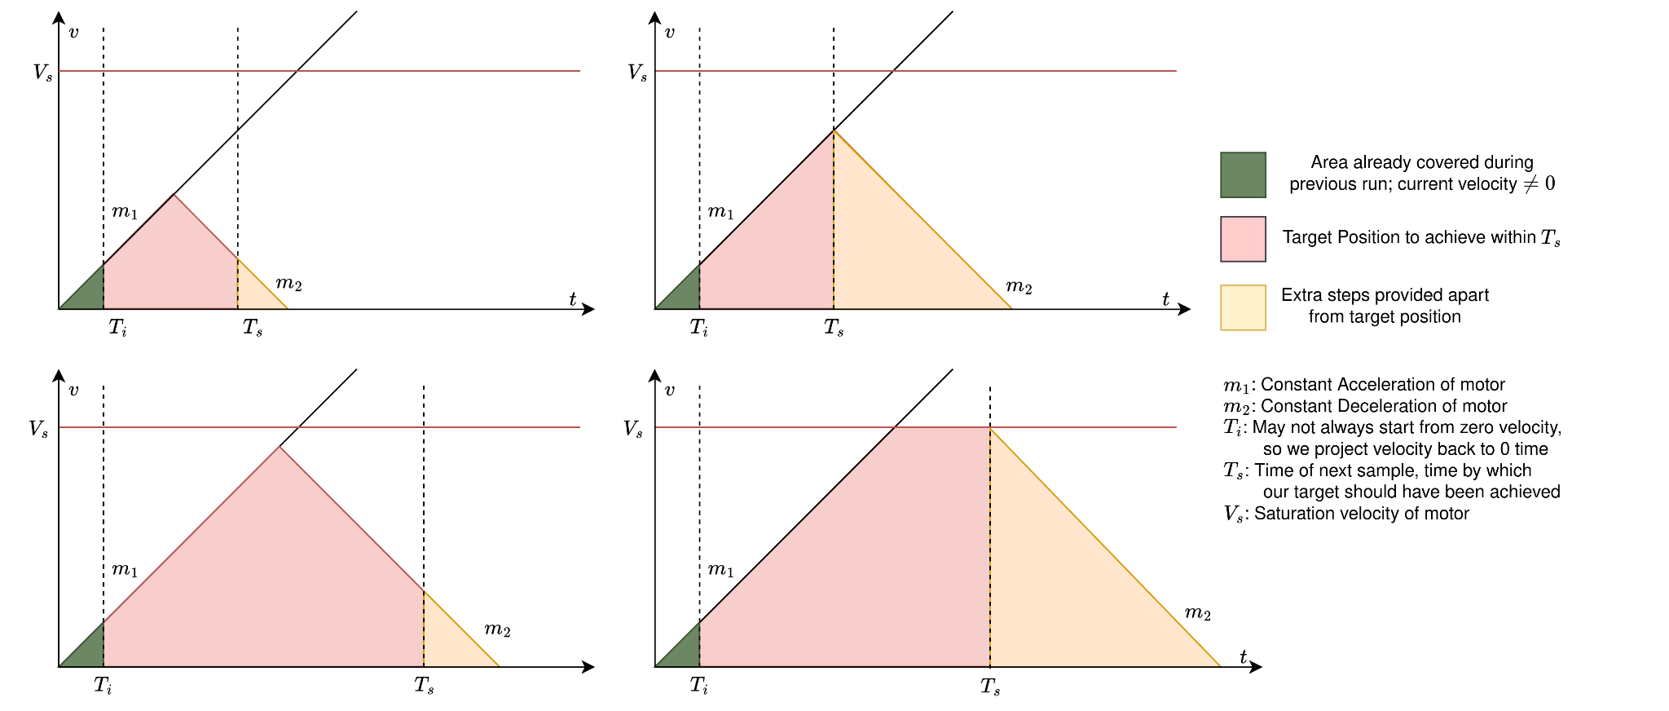

Slide 6
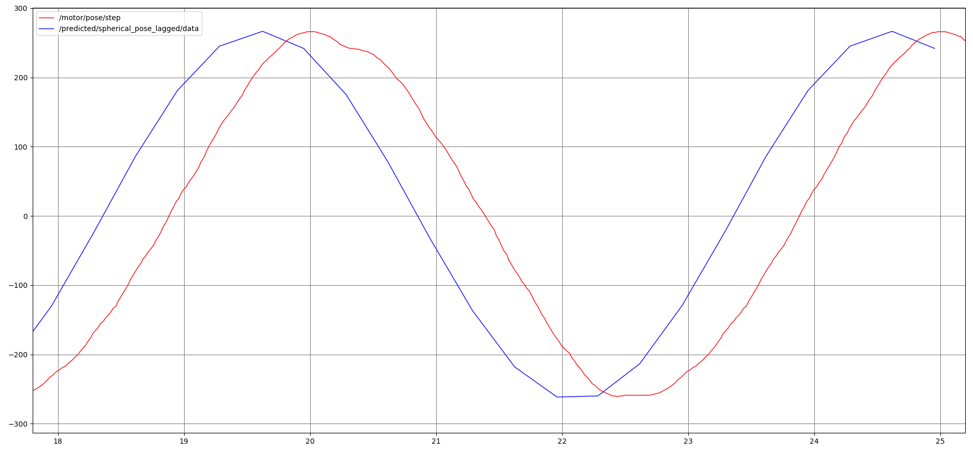
No open loop control, passing target as is

Slide 7
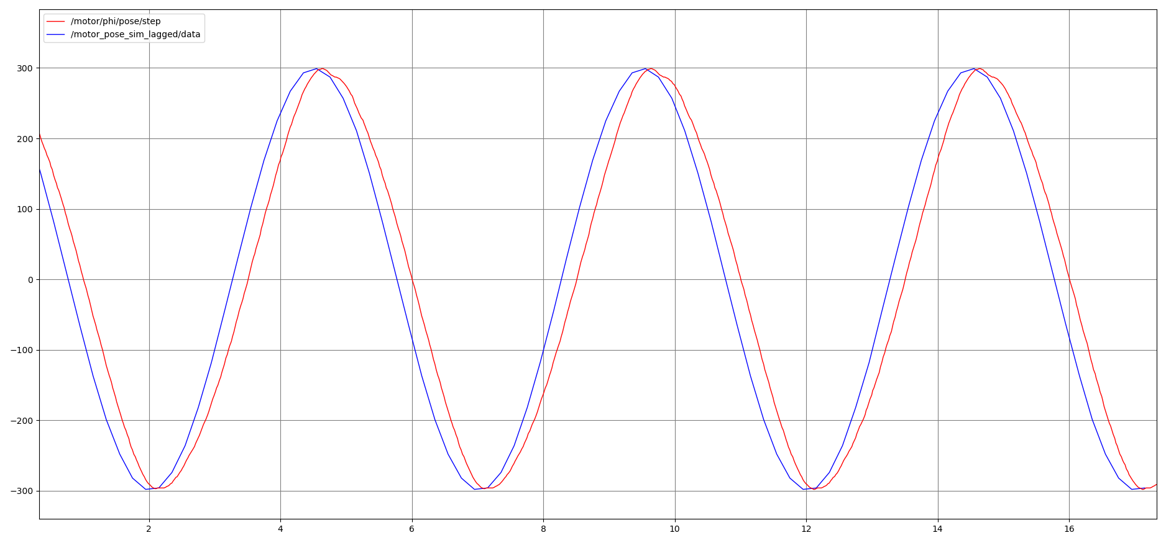
No predictor, max lag ~0.5s

Slide 8
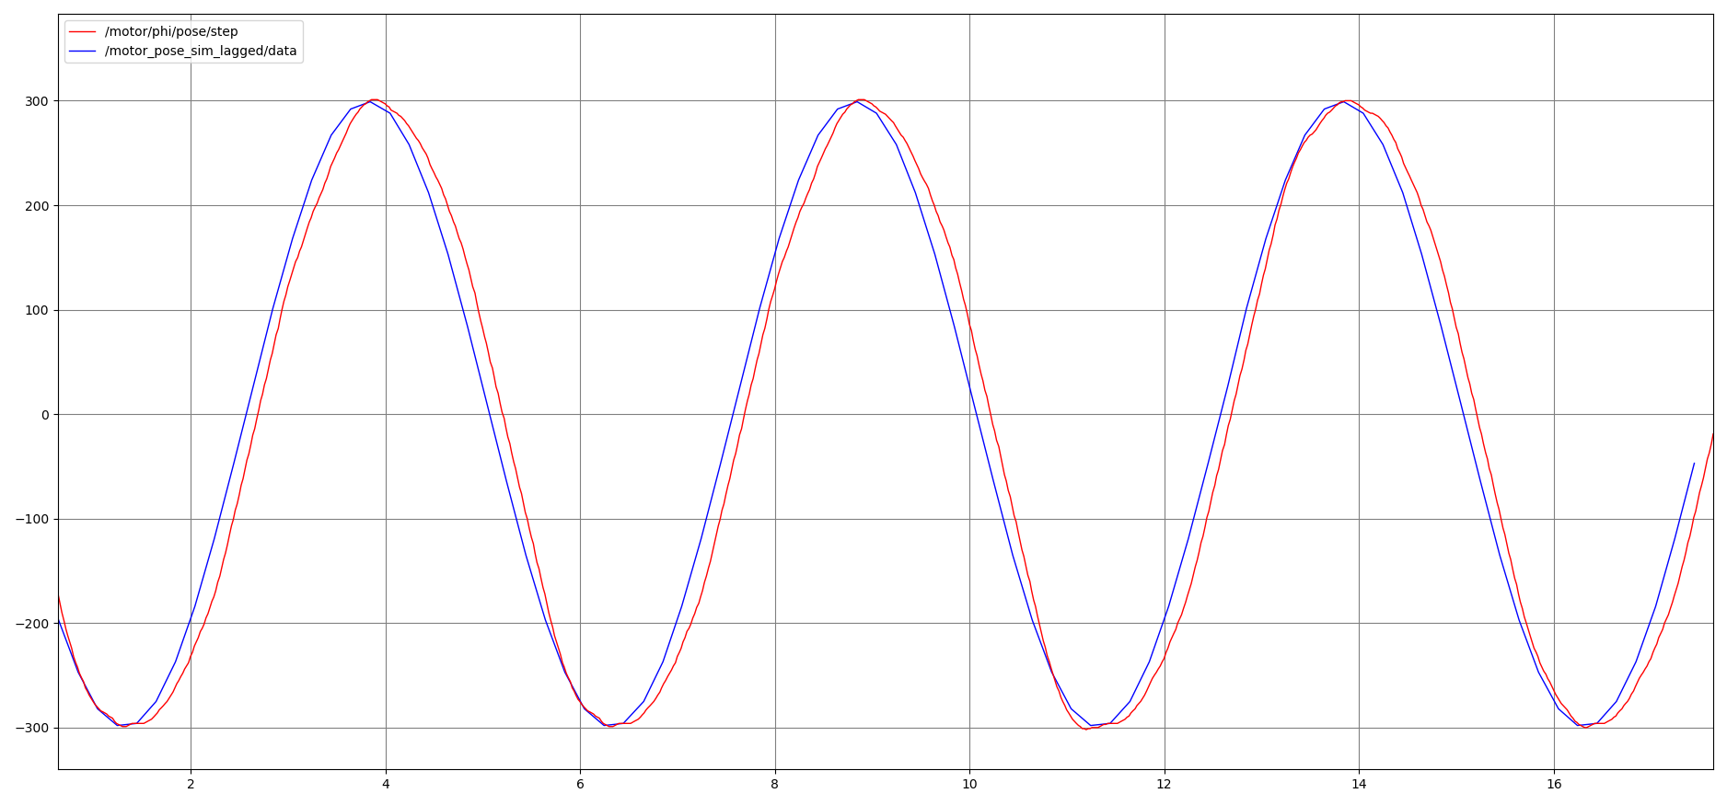
With predictor, max lag ~0.2s

Slide 9
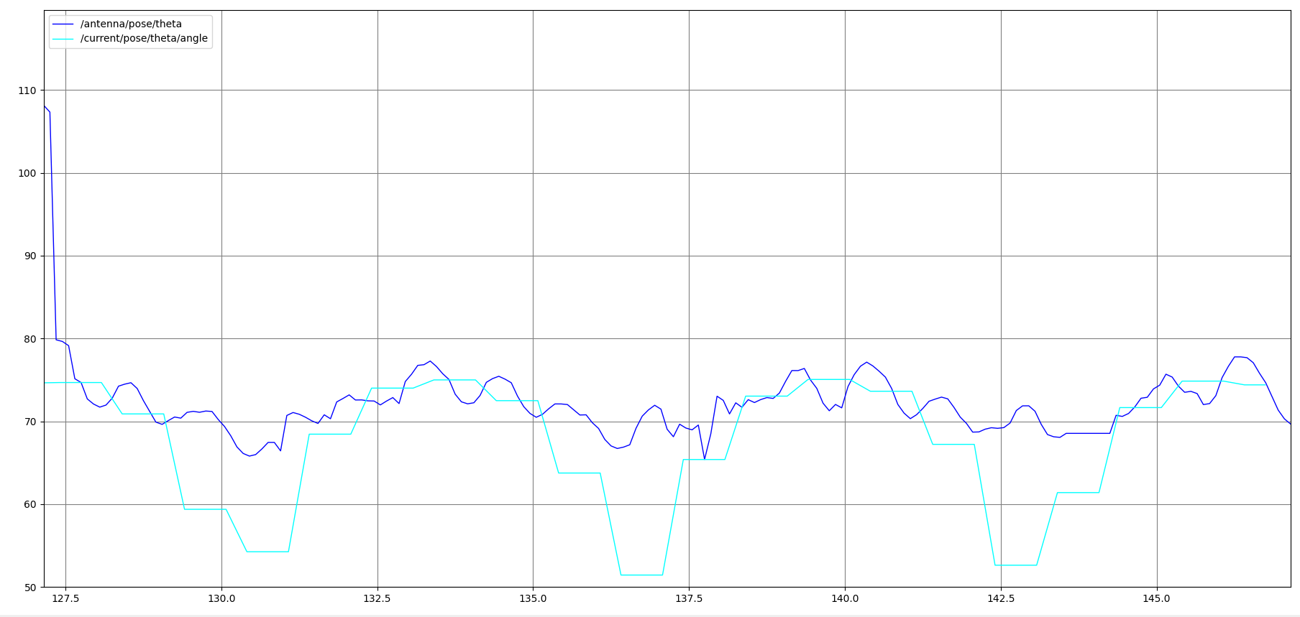
Given feedback of steps, we observe actual orientation deviates heavily

Slide 10
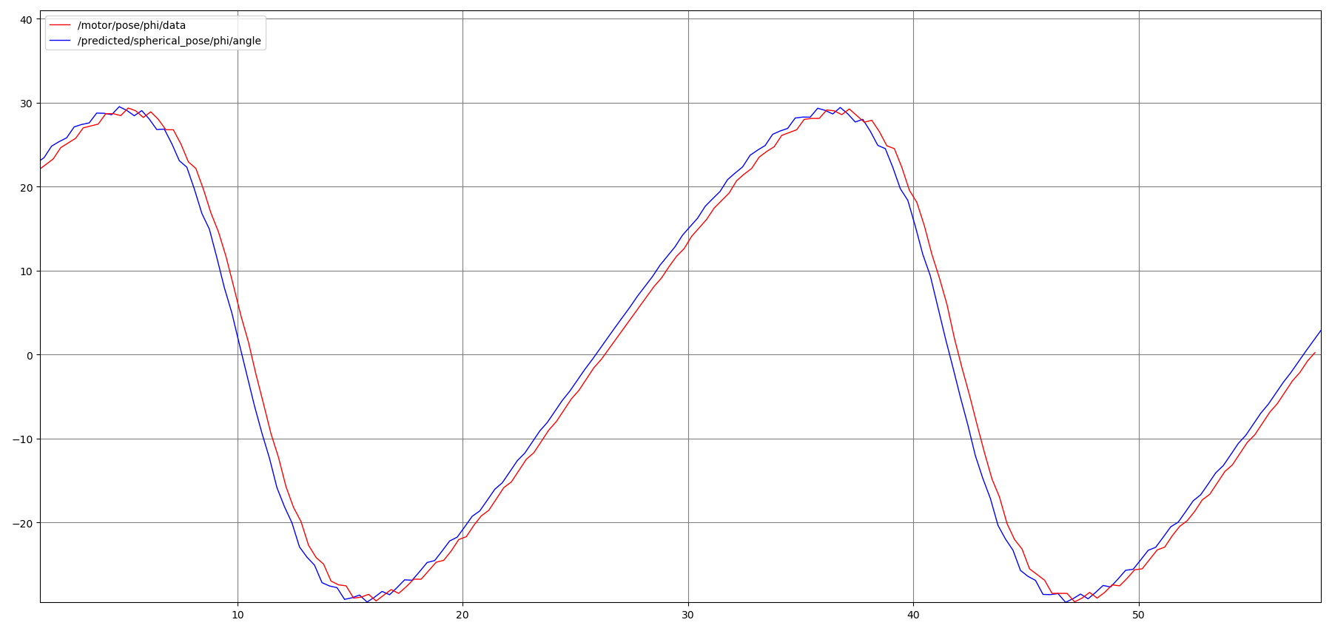
Pose when seen with respect to steps tracked by motor

Slide 11

Initialization of elevation angle
Followed by tracking a virtual UAV circular trajectory.
Following slides contains the target and obtained trajectories

Slide 12
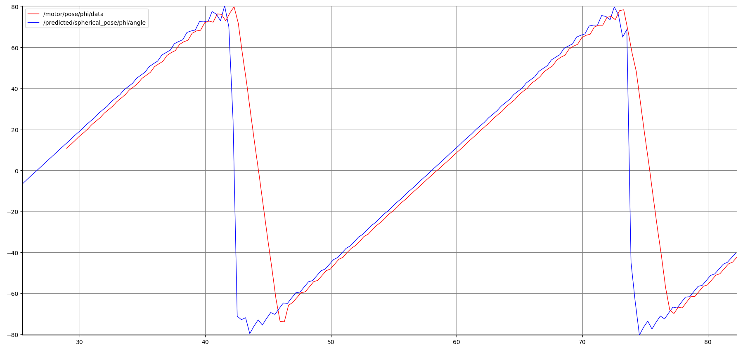
Motor tracks steps nicely, except when it’s unfeasible (velocity saturates)

Slide 13
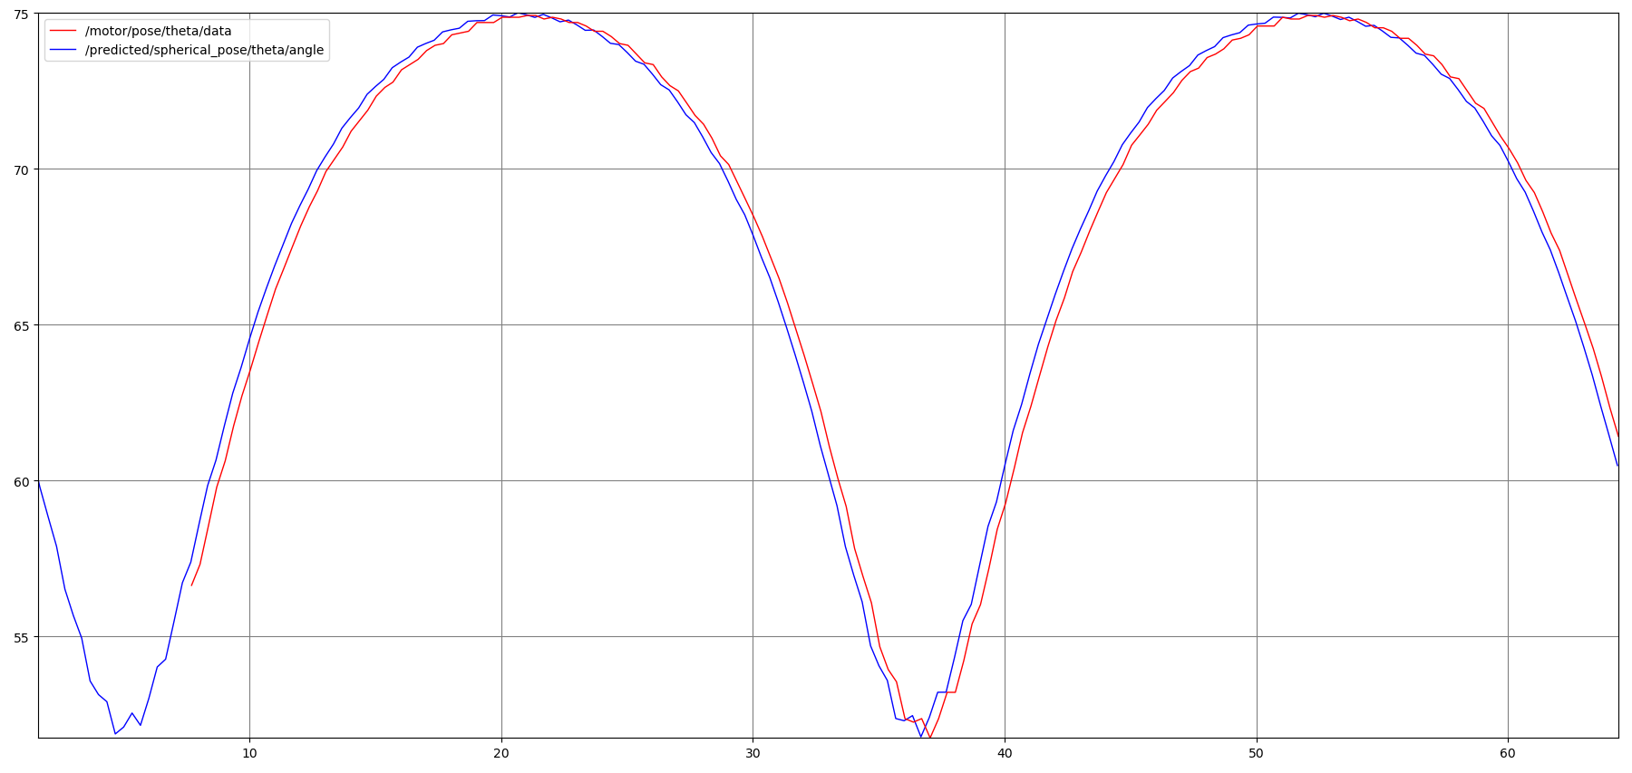
Overall tracking with respect to steps feedback is nicely tracking

Slide 14
Pose Predictor
Apart from proper tracking, we observed that pose feedback from UAVs are usually at low rates of 1-4Hz. We built a pose predictor that up-samples the incoming pose stream by fitting a parabola using higher order moments (velocity and acceleration) at that given moment. Upsampling rate is set as a config parameter.
This predictor takes care of the lag introduced by propagation delay of the pose message from the UAV to the predictor, and updates it’s prior afresh every time a new pose message is received.

Slide 15
Find the codebase here: GitLab

