Slide 1
AU Project Overview

Slide 2
Data Sources
Linksbridge:
  Detailed_Demand_Forecast_data
    Countries and vaccines that participated in 2021 procurement
    Countries that are part of Gavi or PAHO
  Country-data
    All countries in ‘WHO Region’ = ‘AMR’ procure through PAHO, except USA
      and Canada

Slide 3
Gavi Market (no AU)
Exclude all countries in PAHO
'Current WB Status & Current Gavi Eligibility':
  ‘Gavi Eligible’
  ‘Gavi Fully Self-Financing’
  ‘Gavi Transitioning’
    Procure ALL their vaccines through Gavi
    Pay the same price per dose

Slide 4
Gavi Market (AU independent)
Exclude all countries with 'WHO Region'=
  AMR/AFR
'Current WB Status & Current Gavi Eligibility':
  ‘Gavi Eligible’
  ‘Gavi Fully Self-Financing’
  ‘Gavi Transitioning’
    Procure ALL their vaccines through Gavi
    Pay the same price per dose

Slide 5
Prices (1)
''99_PAHO_Pricing_data'':
    Minimum price per dose in 2021 (most economic vial size)
'910_UNICEF_Pricing_data':
    Minimum price per dose in 2021 (most economic vial size)
Ignore countries not in Gavi/PAHO
Calculate GNI-vaccine coefficients

Slide 6
Prices (2)
Use calculated vaccine/GNI coefficients:
  Mean GNI in PAHO
  Mean GNI in Gavi
    GNI in Gavi changes dramatically without AU countries
  Mean GNI in AU

Slide 7
Unknown Values
AU:
  Manufacturing capacity
    Not currently addressed
  Manufacturing costs
    Addressed through minimum prices
  Mandatory internal demand
    Factor determining what percentage of the AU demand must be fulfilled
    with AU-produced vaccines (0%, 25%, 50%, 75%, 100%)

Slide 8
AU Manufacturing
Vaccines offered
  Greatest Gavi Market Share:
      DtwP-HepB-Hib'
      'MR'
      'PCV13'
      'Rota'
      HiB
Vaccine prices:
  Baseline price = equivalent non-AU vaccine x α

Slide 9
AU Pricing
Hyperparameter α:
  Scenarios in which local manufacturing is more/less competitive
    than foreign production.
    90% to 200% of the MP of equivalent Gavi vaccine

Slide 10
Notation

Slide 11
Mathematical Formulation (TSS)

Slide 12
Mathematical Formulation (TCS, TPF)

Slide 13
Experimental Factors
Factors | Levels
AU Existence | AU participates in the negotiation independently |  | AU does not exist
AU Production | AU produces vaccines |  | AU does not produce vaccines
AU Purchase Commitment | 0% | 25% | 50% | 100%
Minimum Price Rate (MPR) for Vaccine Production | 90% | 100% | 150% | 200%
Negotiation Order | AU-Gavi-PAHO | AU-PAHO-Gavi | Gavi-AU-PAHO | (...)
Market | AU |  | Gavi | PAHO
150 data instances randomizing Reservation Prices between 90% and 110% of the
estimated baseline

Slide 14
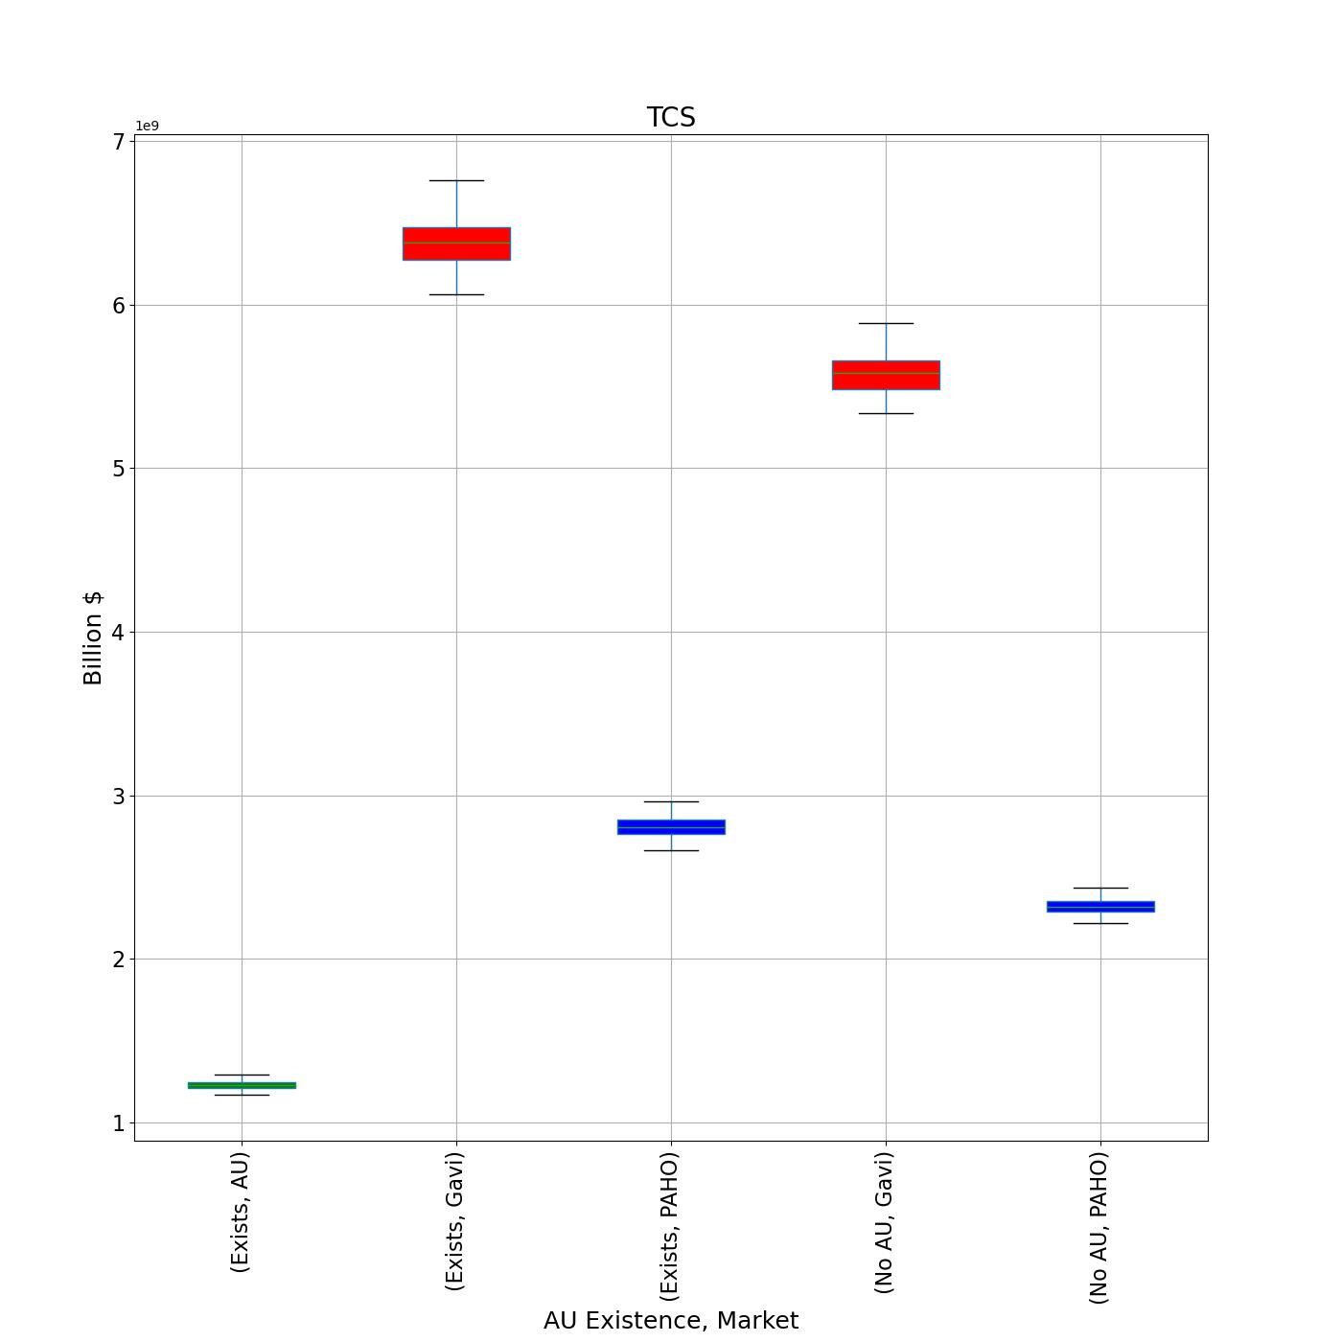

Effect of Creating the AU
Savings increase for
Gavi and PAHO

Slide 15
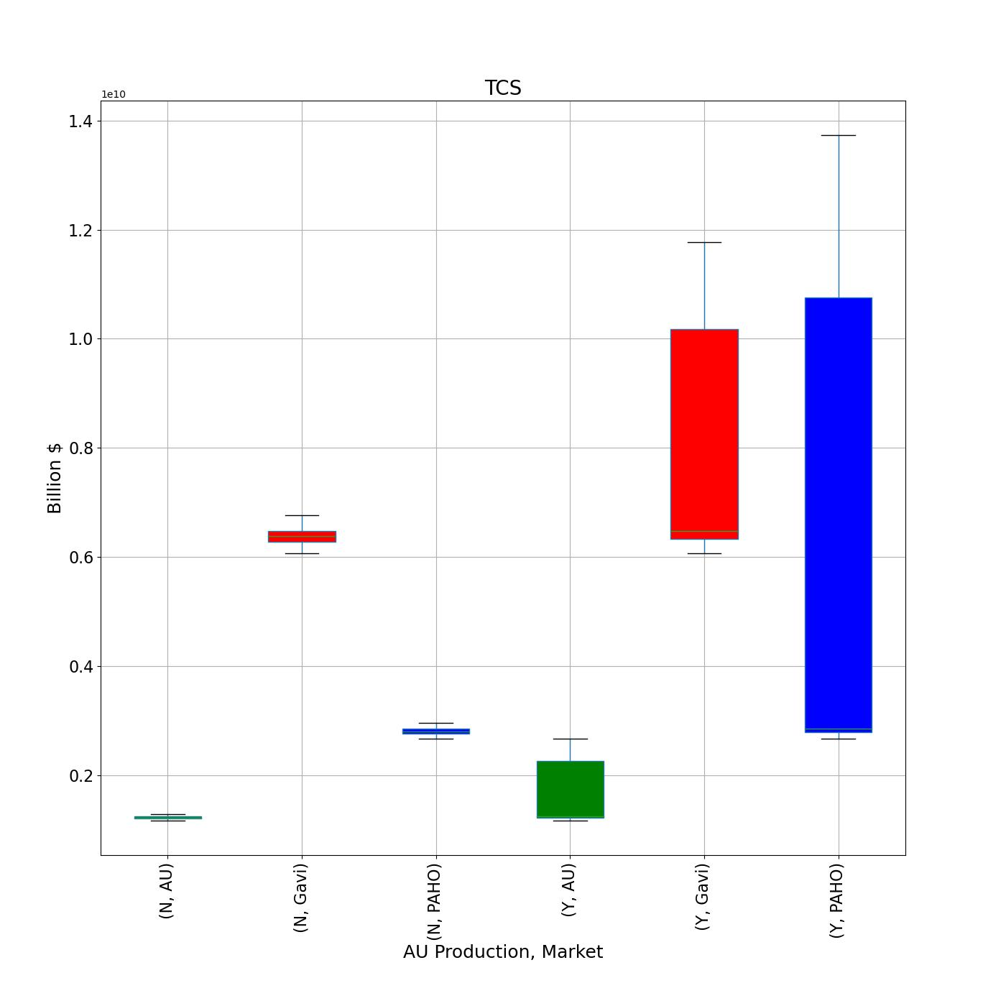
Effect of Producing in the AU
Given the AU exists,
potential savings
increase for all

Slide 16
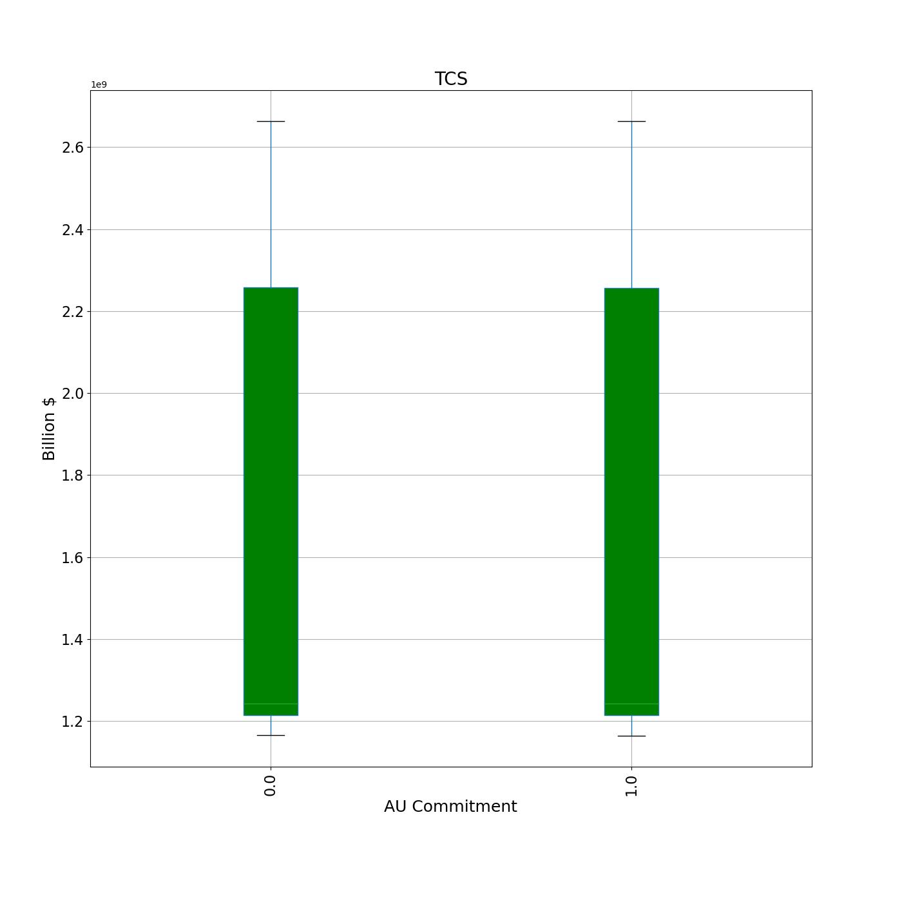

Effect of purchase commitment
Given the AU exists and
produces vaccines,
purchase commitment
is not significant.

Slide 17

Significance of Factors to TCS
When AU exists and produces vaccines, the
following factors are statistically significant:
    Market
    Order
    Minimum Price Rate (MPR)

Slide 18
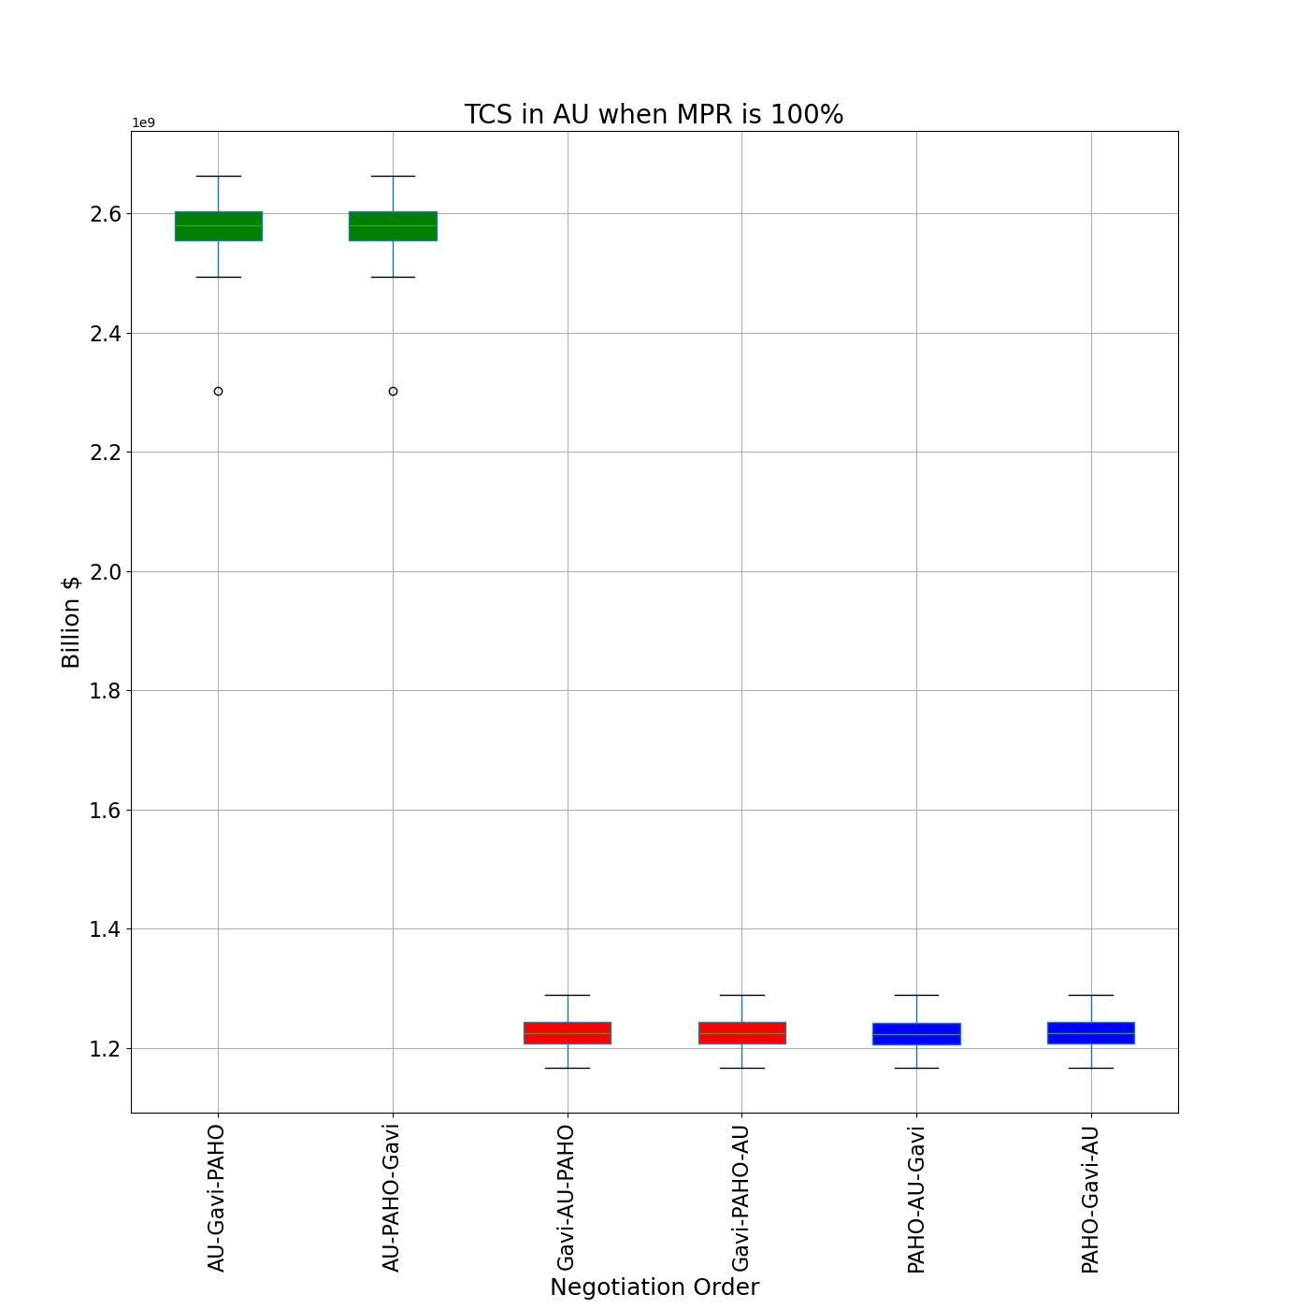
TCS with AU production (1)
All markets want to
negotiates first
regardless of other
factors

Slide 19
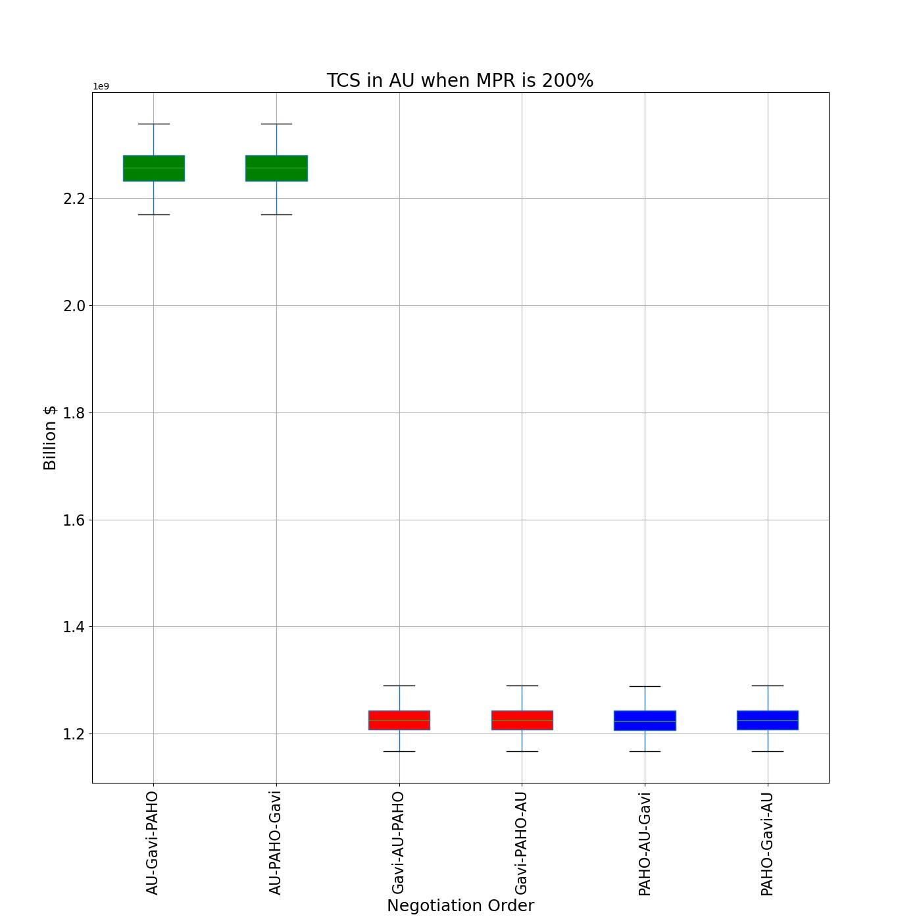
TCS with AU production (2)
Minimum Price Rate does
not affect shape of
savings, only magnitude
(up to 18% less)

Slide 20
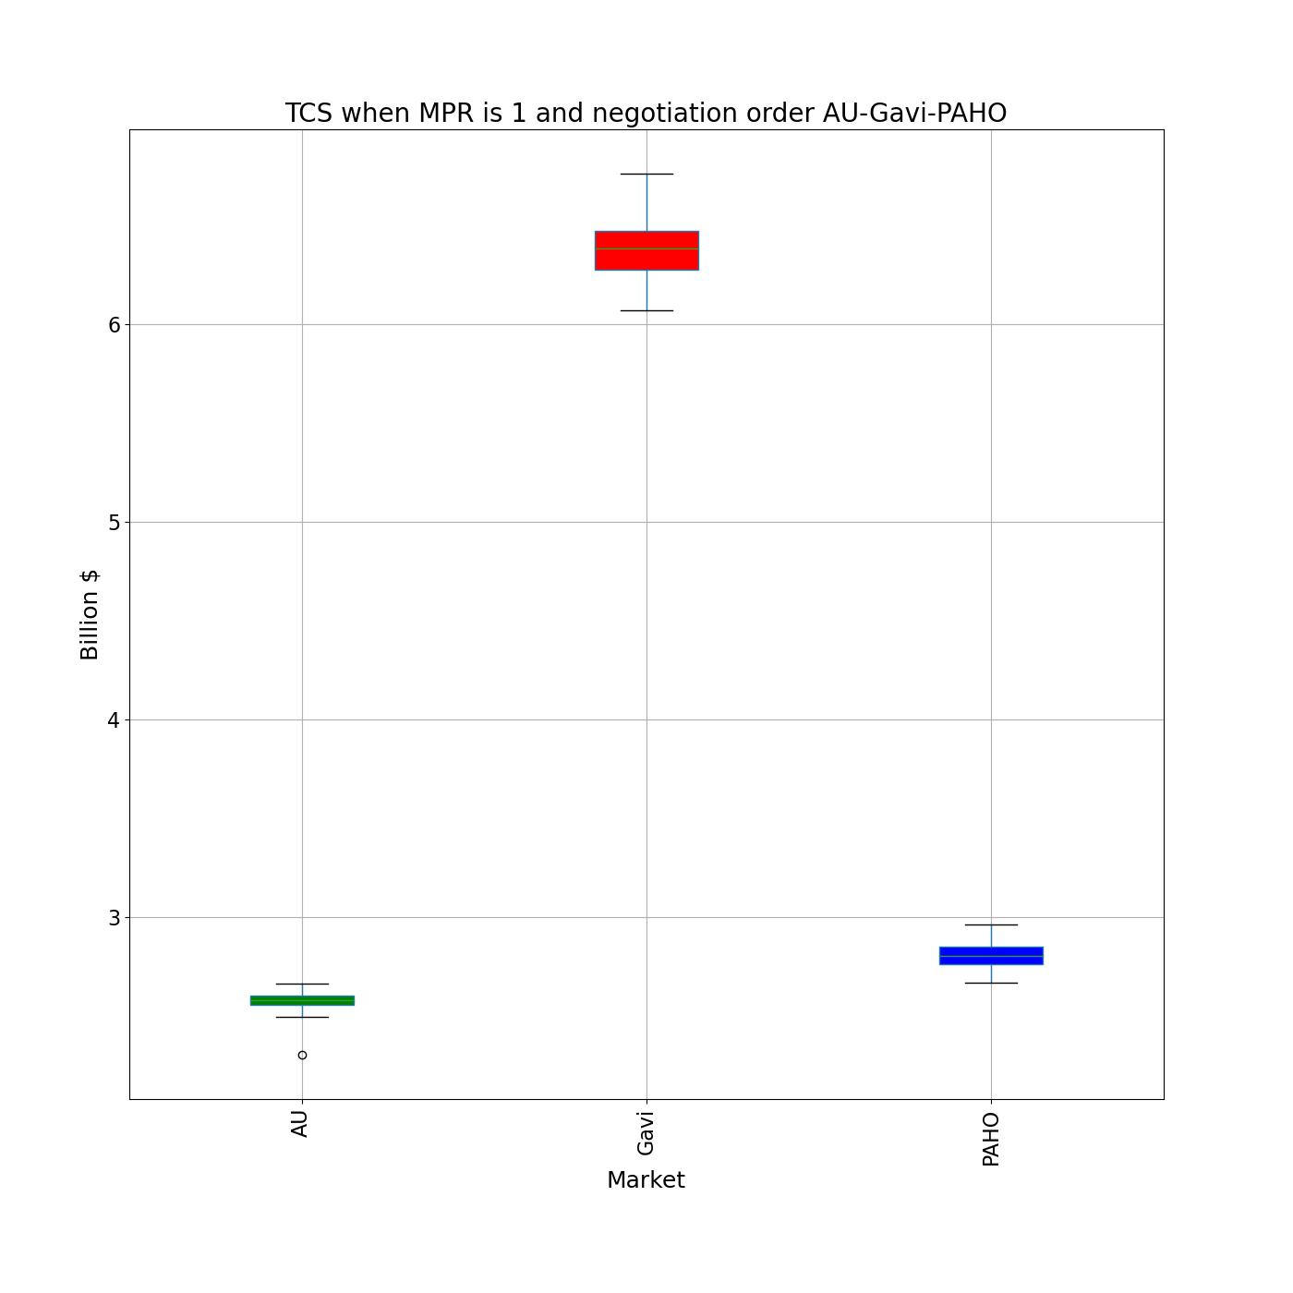
TCS with AU production (3)
Gavi and PAHO always
outperforms the AU.
Gavi outperforms PAHO
unless PAHO is the first
to negotiate

Slide 21
Conclusions (1)
AU countries lose overall savings when separating from UNICEF
All countries benefit from initiating the negotiation
Gavi always outperforms other groups, whereas PAHO outperforms the AU

Slide 22
Conclusions (2)
Even if AU vaccines are more expensive, it is still possible to achieve savings
Prioritizing the purchase of internal vaccines does not impact the savings in the AU

Slide 23
Next Steps
Expand sensitivity of the model to elasticity relationships in vaccine pricing
Evaluate impact by country
Incorporate profits in the analysis

