Slide 1

OVH Academy
Lab Guide
Discovery scenario
OVH Analytics Data Platform
We will size and deploy a big data Hadoop cluster, then perform a use case allowing us to discover basic features : user and rights, dashboard, ingest data, queries on data.

Slide 2
ALL the credentials, useful links, and code,
We be available on
https://github.com/baaastijn/workshops

Slide 3

Discover the ADP product !
Infrastructure
Launch a cluster
Discover the Ambari dashboard
First steps with user management
First steps with data security

Slide 4









Step 1: Estimate your needs, size you cluster
We will explain it live :
Size the Workers
Size the Edges
Site the Storage
Bastion & Gateway
Private Network (vRack)
Utility
Masters
Edges
Workers

Slide 5
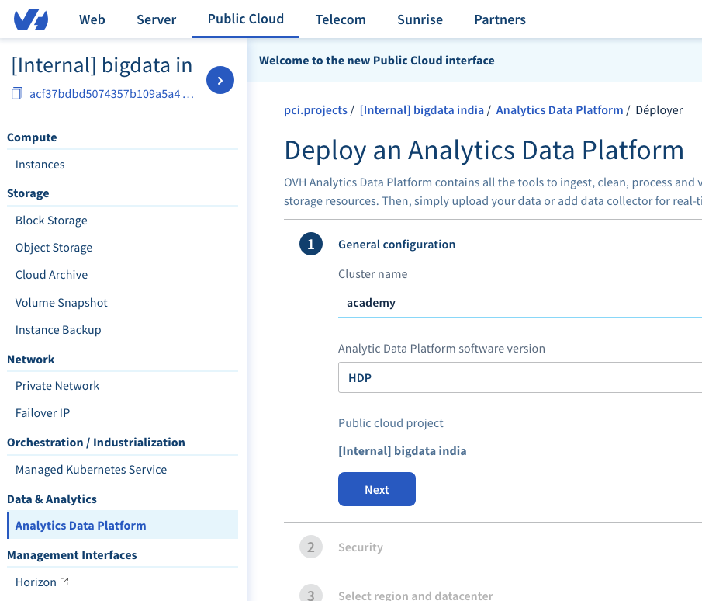
Step 2 : launch your OVH cluster (live demo)
A cluster deployment takes approximately 40 minutes.
https://www.ovh.com/fr/public-cloud/big-data-hadoop/
OVH will deploy ADP cluster for you ☺
You will find the credentials on the OVH control panel

Slide 6
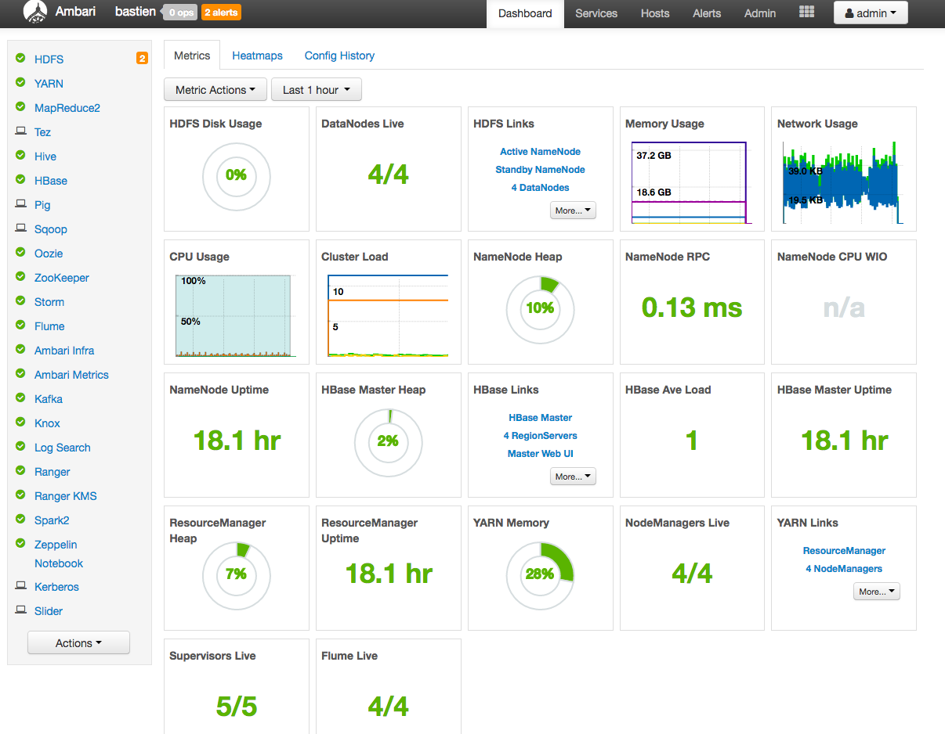
Step 3 : Connect to you cluster, discover Ambari
Browse the Control Panel and find the Ambari cluster URL
Connect to Ambari dashboard with your given credentials
Discover Ambari dashboard :
Left menu, top menu
HDFS infos and config
Alerts

Slide 7
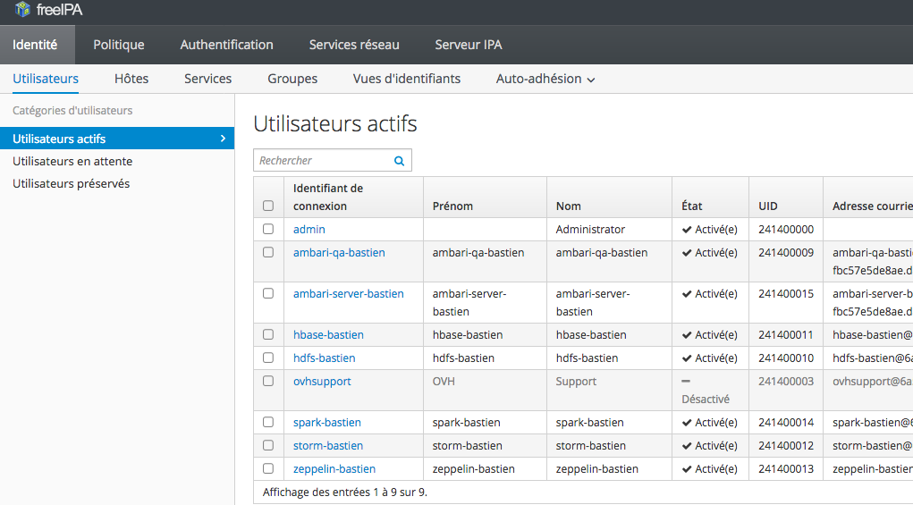
Step 4 : Discover FreeIPA, the users manager
Ambari is a dashboard to manage your cluster
To manage the users, please connect to FreeIPA (find the URL in control panel)
Login/password : same as Ambari

Slide 8
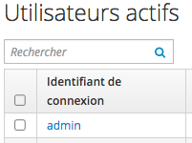
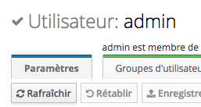
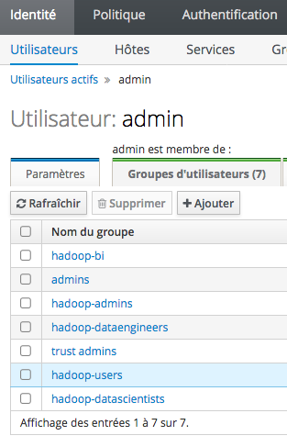

Modify your account
Click on your account
Check on which groups your are
in the “paramètres” tab
Add your SSH public Key if you have one

Slide 9
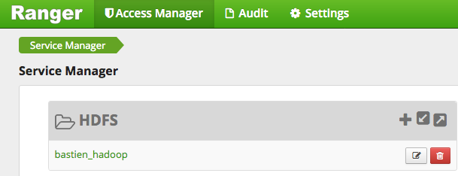
Step 5 : discover data management
FreeIPA is for managing users, Ranger is for data security
To manage the data, please connect to Apache Ranger (find the URL in control panel)
Login/password : same as Ambari
Then, discover for example HDFS rights ➔ live demo

Slide 10
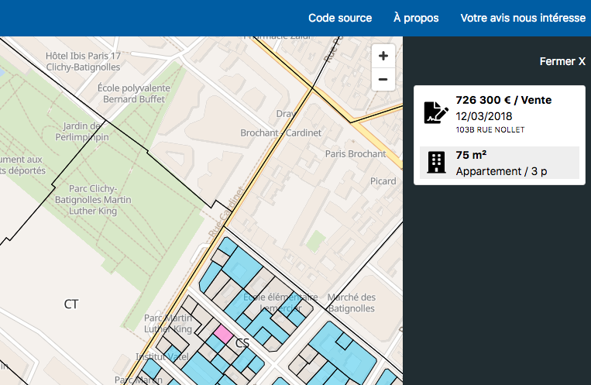
Use case : let’s play with real estate market in France !
France government releases a lot of data (“open data”)
In 2019, they proposed the DVF datas, the “Demandes de Valeurs Foncières”.
= Amount of money for each real estate transaction in France since 5 years.
Example : in blue the sales in 2018 in Paris 75017 , with the prices
https://app.dvf.etalab.gouv.fr/

Slide 11
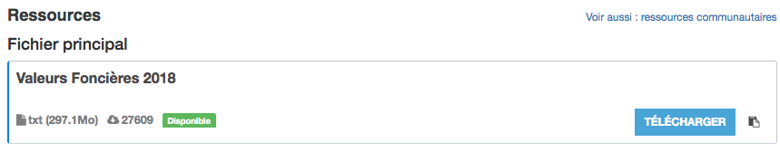
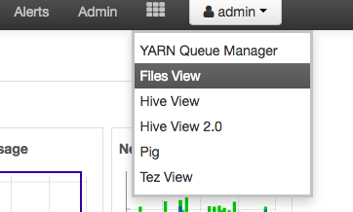
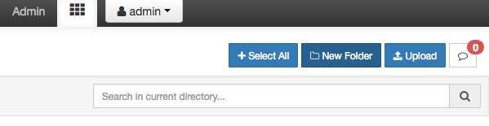
Step 1 (1/2) : ingest static data
Go in github link, find the DVF website, download DVF data 2018
Go back in Ambari dashboard
Click on Files View :
go in /user/<your_login>
Create a new directory called “ovh”
You should have : /user/<your_login>/ovh
Notes:
https://www.data.gouv.fr/fr/datasets/demandes-de-valeurs-foncieres/

Slide 12
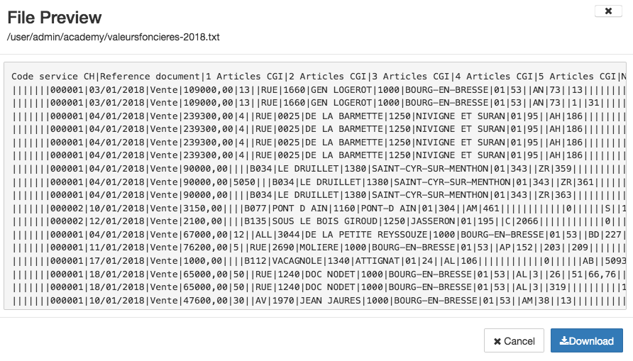
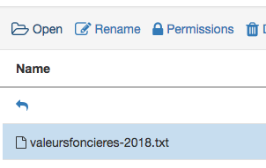
Step 1 (2/2) : ingest static data
Now we will ingest static data, the TXT file previously downloaded.
Click on upload and add the TXT file « valeursfoncieres-2018.txt »
Once uploaded, you can select your file then click on « Open » to have a file preview

Slide 13
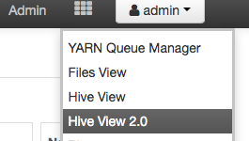
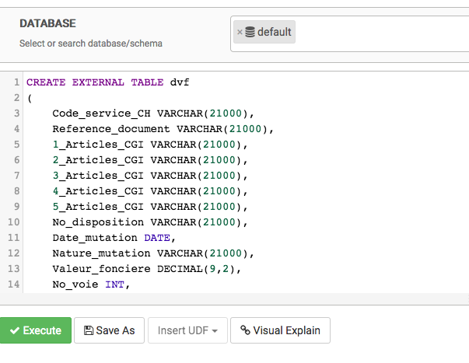
Step 2 : Prepare the data with Hive
Hive allow you to query the data with a language very similar to SQL
We will create a new table in Hive to “load” the TXT file data.
Go in Hive view 2.0
Copy paste the SQL code to create a table
WARNING : change the path with your login
Click on “Execute”
Notes:
CREATE EXTERNAL TABLE dvf
(
Code_service_CH VARCHAR(21000),
Reference_document VARCHAR(21000),
1_Articles_CGI VARCHAR(21000),
2_Articles_CGI VARCHAR(21000),
3_Articles_CGI VARCHAR(21000),
4_Articles_CGI VARCHAR(21000),
5_Articles_CGI VARCHAR(21000),
No_disposition VARCHAR(21000),
Date_mutation DATE,
Nature_mutation VARCHAR(21000),
Valeur_fonciere DECIMAL(9,2),
No_voie INT,
B_T_Q VARCHAR(21000),
Type_de_voie VARCHAR(21000),
Code_voie VARCHAR(21000),
Voie VARCHAR(21000),
Code_postal VARCHAR(21000),
Commune VARCHAR(21000),
Code_departement VARCHAR(21000),
Code_commune VARCHAR(21000),
Prefixe_de_section VARCHAR(21000),
Section VARCHAR(21000),
No_plan VARCHAR(21000),
No_Volume VARCHAR(21000),
1er_lot VARCHAR(21000),
Surface_Carrez_du_1er_lot DECIMAL,
2eme_lot VARCHAR(21000),
Surface_Carrez_du_2eme_lot DECIMAL,
3eme_lot VARCHAR(21000),
Surface_Carrez_du_3eme_lot DECIMAL,
4eme_lot VARCHAR(21000),
Surface_Carrez_du_4eme_lot DECIMAL,
5eme_lot VARCHAR(21000),
Surface_Carrez_du_5eme_lot DECIMAL,
Nombre_de_lots VARCHAR(21000),
Code_type_local VARCHAR(21000),
Type_local VARCHAR(21000),
Identifiant_local VARCHAR(21000),
Surface_reelle_bati INT,
Nombre_pieces_principales INT,
Nature_culture VARCHAR(21000),
Nature_culture_speciale VARCHAR(21000),
Surface_terrain DECIMAL
)
ROW FORMAT DELIMITED FIELDS TERMINATED BY '|'
LOCATION "/user/admin/academy/"
TBLPROPERTIES ("skip.header.line.count"="1");

Slide 14
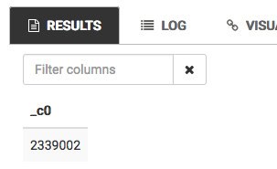
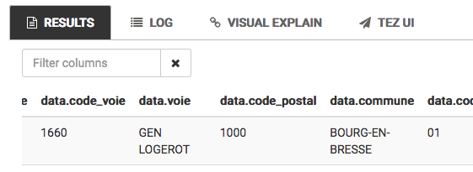
Step 3 : simple queries to verify if everything is ok
For each step, enter the query in HIVE window then execute it (see previous step)
Let’s check the amount of lines in the file
SELECT count(*) FROM dvf_<your_login>
Let’s verify the data inside hive
SELECT * FROM dvf_<your_login> LIMIT 20
And more !
SELECT * from dvf_<your_login> WHERE code_postal = "75017" AND type_local = "Appartement" LIMIT 100

Slide 15
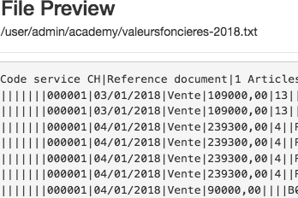
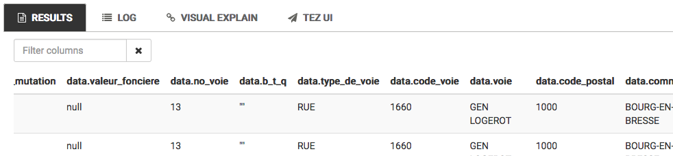
?! Where are the prices for transactions ?
In the files view, we had the amount of money for each transaction
In Hive, we don’t have it, NULL everywhere
Issue : in the file; prices are with commas (virgules), instead of periods (points)
➔ let’s fix it with Apache Pig !

Slide 16
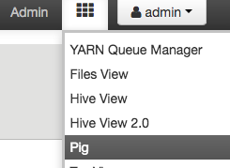
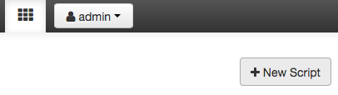
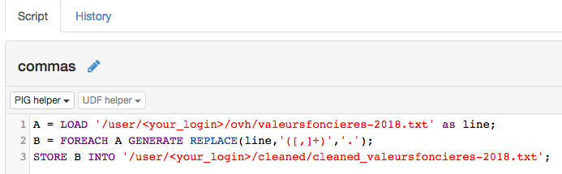
Step 4 : create script in Apache Pig
First, create a new folder in ”Files view” in /user/<your_login>/cleaned/”
Then go in Pig :
Create a new script called “commas” :
Add 3 lines of code (see github) :
Save

Slide 17
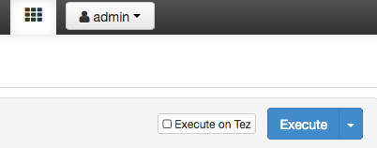
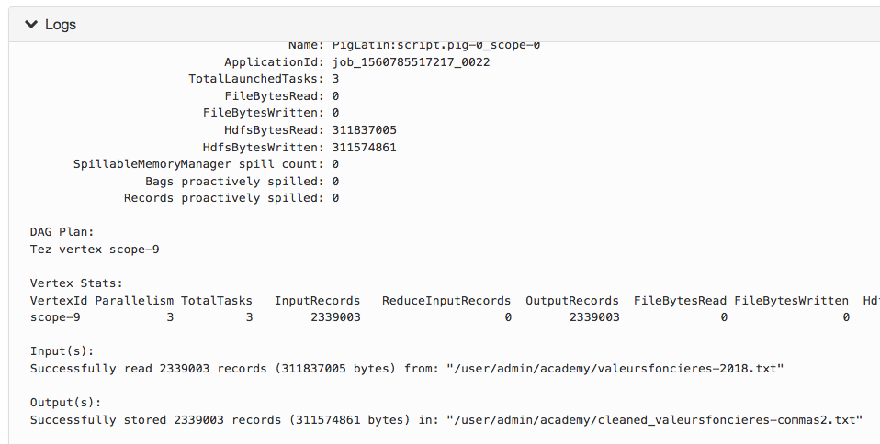
Step 5 : launch your script
The script will load your data, replace “,” by “.” then store it in another folder
Execute the script :
Watch the logs, wait for completion
Verify your files in “Files view”
Your TXT file is now a folder with 3 sub files containing cleaned data

Slide 18
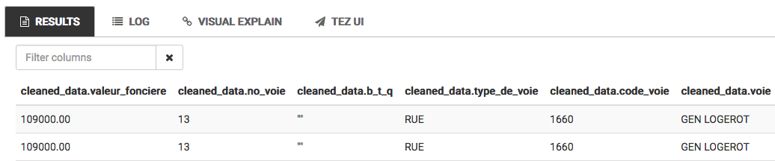
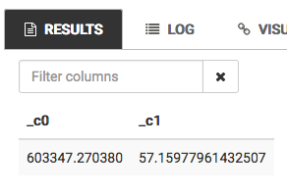
STEP 6 : Calculate average apartment price
Go back in “Hive View 2.0”
Create a new table called “cleaned_data” by copy/paste code (in Github)
WARNING : change the path with your login
Verify that ”Valeur_Fonciere” is now here, with periods (points)
Query the data to find the average price of appartment sold in 2018 in Paris 17
SELECT AVG(valeur_fonciere), AVG(Surface_reelle_bati) FROM cleaned_data_<your_login> WHERE code_postal = "75017" AND type_local = "Appartement"
Average price is 603’347€
Average square meter is 57 m2
= 10’526€ per square meter in 2018
Notes:
SELECT AVG(valeur_fonciere),AVG(Surface_reelle_bati) FROM cleaned_data WHERE code_postal = "75017" AND type_local = "Appartement"

Slide 19
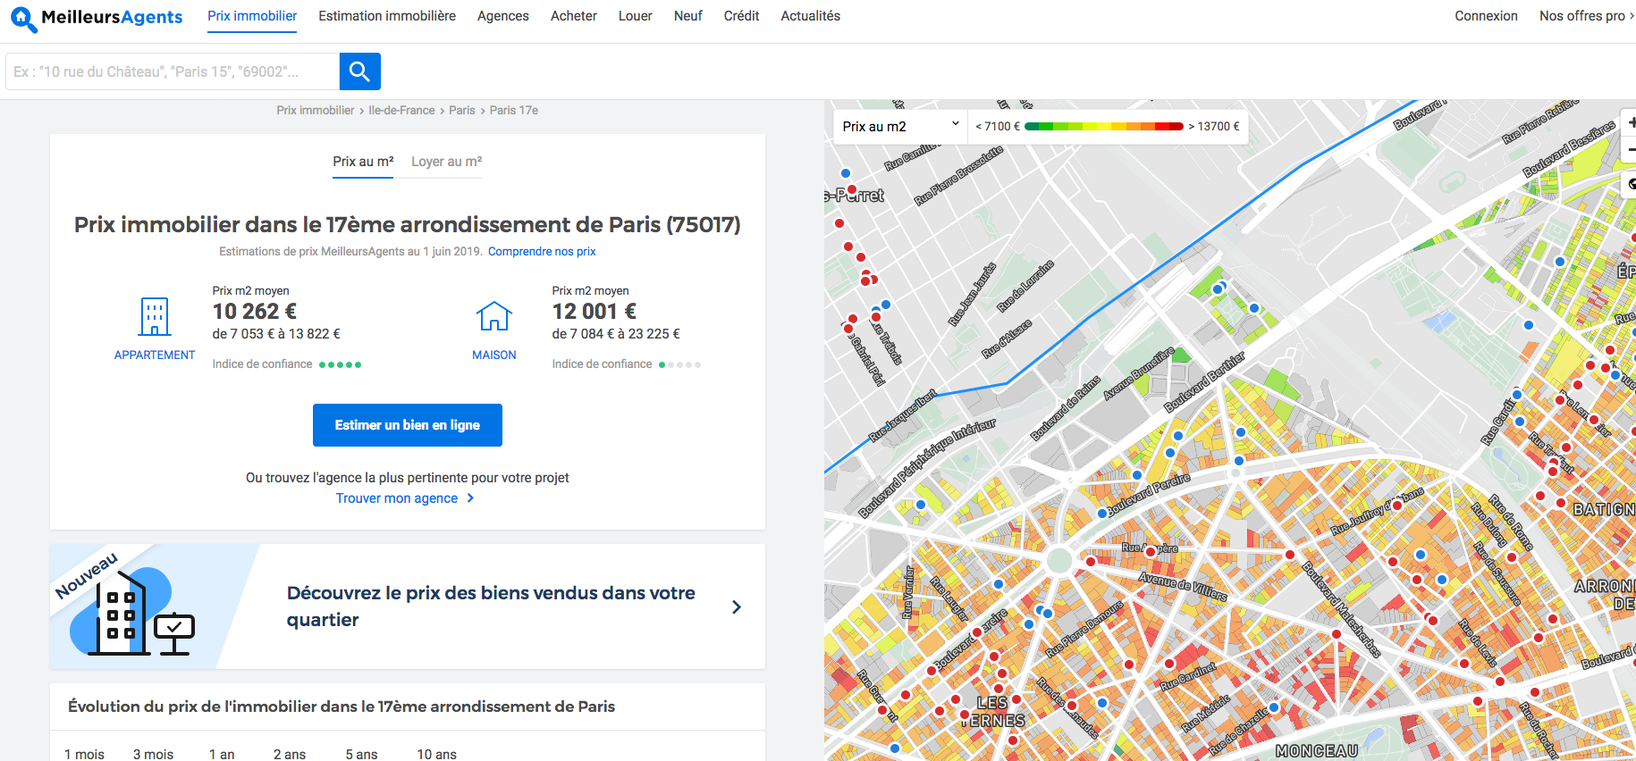
This use case is real for businesses !
https://www.meilleursagents.com/prix-immobilier/paris-17eme-arrondissement-75017/

Slide 20
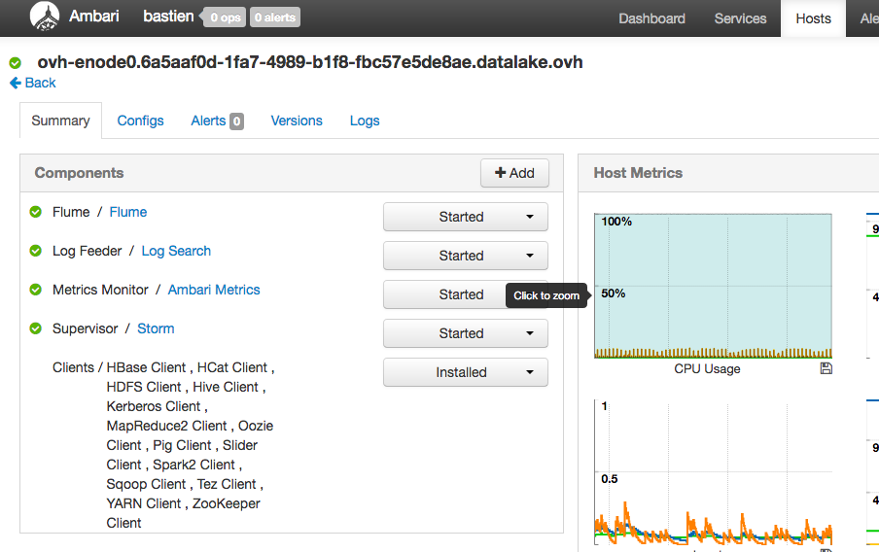
(bonus) STEP 7 : connection in SSH to your Edge node
Warning : make sure you added your SSH Public key in your profile in FreeIPA.
Propagation time +- 20mins
Connect to the cluster Bastion
ssh -A <user_login>@{bastion_IP}
Then connect to your Edge node, from your bastion
ssh <user_login>@ovh-enode0
You can now use all the clients available on your Edge node
You can find the list in Ambari / Hosts

Slide 21
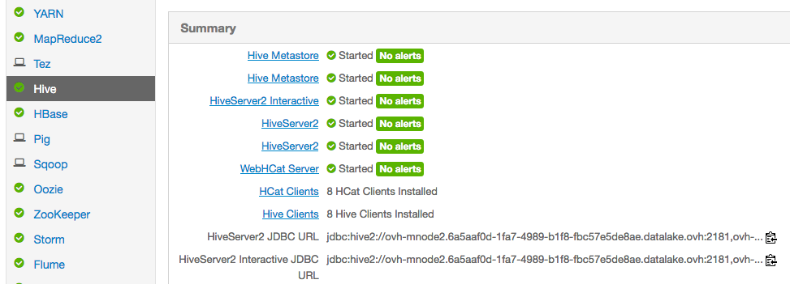
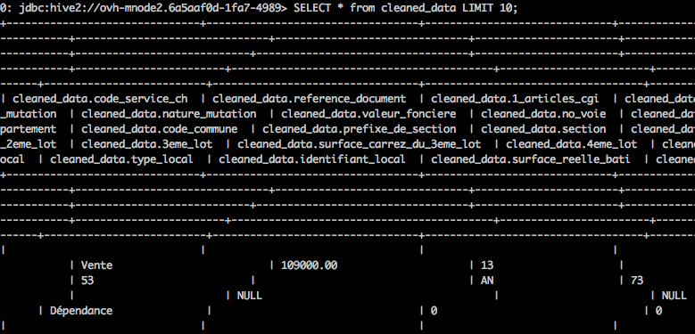
(bonus) Step 8 : submit a Hive job via CLI
Once you are logged in SSH on you Edge node, launch Apache Beeline
beeline
Then connect to Hive
!connect <Hive_server_URL>
(You will find your Hive server URL in Ambari)
Now you can submit queries, exactly like inside the Hive UI

Slide 22
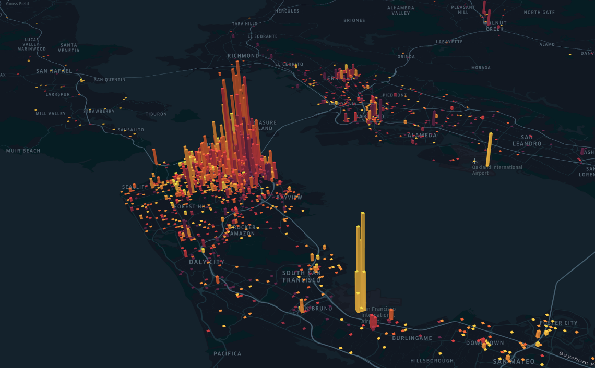
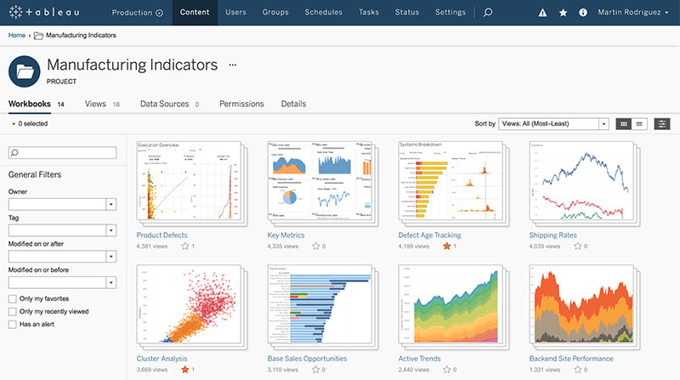

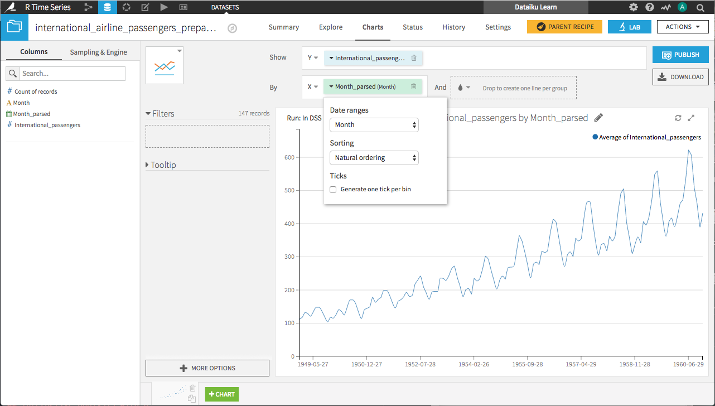


Now Imagine the same queries from various softwares…
Big data queries are usually made from third-party softwares
You “connect” them to a big data cluster

Slide 23
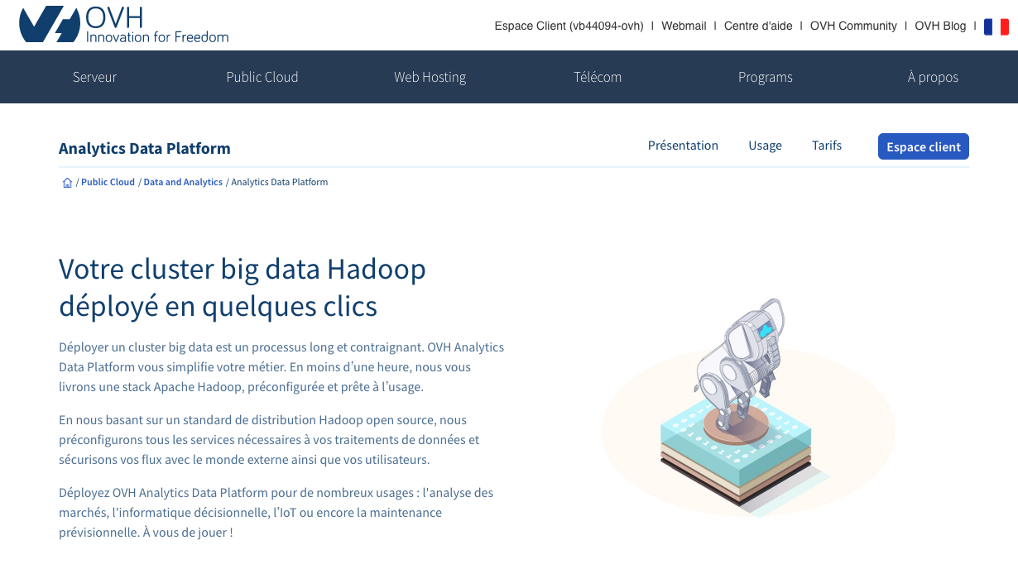
THANK YOU ! LAB DONE ☺
Offer page : https://www.ovh.com/fr/public-cloud/big-data-hadoop/
Credits : Bastien Verdebout / https://twitter.com/BastienOvh

