Slide 1
Methods of making and receiving payments
Notes:
This presentation provides an overview of the key points in this chapter.
Note for tutors:
If you wish to print out these slides, with notes, it is recommended that, for greater clarity you select the ‘pure black and white’ option on the PowerPoint print dialogue box.

Slide 2
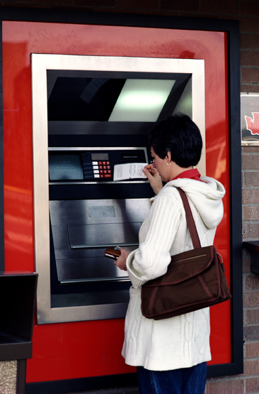
Banks and bank accounts
All businesses have bank accounts
Even sole traders are sensible to keep their business account and personal bank account separate
Bank accounts are located at
a particular branch to allow
cash deposits and withdrawals.
Notes:
The key reason why businesses keep their business account separate is for tax reasons. Even a small shopkeeper would have far more problems preparing his/her accounts if revenue for the business was confused with personal income on which no tax is due (eg a small win on the lottery!) Today internet banking and telephone banking is common. However, businesses will need to deposit monies received in a specific branch.

Slide 3
Bank services to business
Accepting payments into the account
Processing withdrawals from the account
Keeping transaction records and maintaining up-to-date payments
Providing regular bank statements
Allowing overdrafts and loans (by arrangement)
Providing advice for business start-ups
or expansion
Notes:
This slide summarises the main services offered by banks. Banks make most of their money by charging for services, including charging interest on overdrafts. Students should be clear about the term ‘overdraft’. This is an arrangement whereby a customer can spend more than he/she has got in the bank. Without an arrangement, if the transaction is allowed, interest charged is very high. An overdraft is different from a loan, where the customer borrows money for a specific period. Overdrafts are usually only a short-term measure.

Slide 4
Methods of payment
Credit card
Cash
Payment methods
Cheque
Debit card
Credit transfer/
direct debit
Notes:
This slide summarises the main methods of payment which are covered on the following slides.

Slide 5
Cash payments
For the customer:
Easy and straightforward
Must obtain cash first from bank or ATM
Carrying large amounts is risky
If receipt lost, no proof of purchase
For the business:
Payment is definite – no problems with fraud
Storing large amounts of cash is risky
Transporting cash to bank may also be risky
Notes:
All students will be familiar with cash payments. The method is most suitable when small amounts of money are involved. Businesses rarely make cash payments except for small items. This system is normally called ‘petty cash’ where ‘petty’ means for ‘small transactions’ eg taxi fares. It is suggested students are asked to identify which of the above points is an advantage (either for the customer or the business) and which is a disadvantage. This can then prompt a wider debate on the advantages and disadvantages of cash as a method of payment.

Slide 6
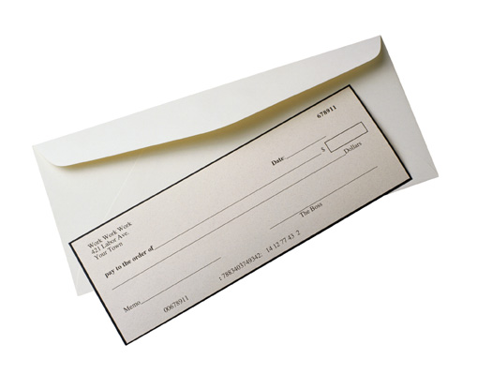
Cheque payments
For the customer:
No need to carry cash and can be sent by post
No receipt required
For the business:
Cheques must be taken to bank branch
For both:
Transfer of money takes a few days
Cheque guarantee card ensures payment
A mistake on cheque makes it invalid
Notes:
Cheques have already been covered in 3.17b. A discussion of the basic clearing process might be useful – asking the students to suggest the stages involved, starting with a customer receiving a new cheque book through the post. Again it is useful to discuss the advantages and disadvantages of cheque payments both from the customer’s point of view and that of the business.

Slide 7

Credit cards and debit cards
Debit cards issued by banks
Credit cards issued by credit card companies – Mastercard and Visa are best known types
Debit cards are an alternative to cheques and cash – money is transferred immediately
Credit cards allow customer to
pay later – interest is charged
if amount not paid in full when
statement is received.
Notes:
This slide summarises the key differences between credit and debit cards. It would be helpful if examples of both types of cards could be shown to the students.

Slide 8
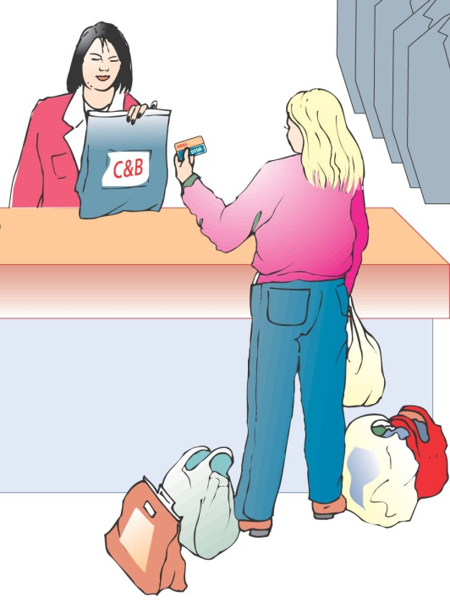
Credit card payments
For the customer:
Easy and convenient
Ideal for ‘at a distance’ purchases
Monthly statement issued, interest
paid if balance not paid in full
For the business:
Money transfer automatic
Swipe system recognises stolen/invalid cards
Businesses pay for service
Corporate cards can be used by certain staff
Notes:
Credit cards are generally considered to be a more convenient way of paying for goods or services than cash and cheques. They may be essential for buying goods on-line or over the telephone (if the company does not accept debit card payments). The main problems are fraud – said to amount to over £400 million a year in the UK – and individuals spending more than they can afford. In some cases, people can get to the point where they cannot even afford the interest payments. The fact that it is so easy to get into debt can provoke an interesting discussion on the ethics of offering credit so readily. In relation to fraud, the new ‘chip and pin’ system could be discussed (see Student Handbook).

Slide 9
Debit card payments
For the customer:
Simple and straightforward
Money transferred automatically/quickly
For the business:
Swipe system checks transaction valid, payment then guaranteed
Same terminals used as for credit cards
Handling charges cheaper than for credit cards
Less prone to fraudulent use
Notes:
Debit cards should be compared to cheques and cash as they involve a direct transfer of money between the two bank accounts. The fact that credit, and therefore the temptation to overspend, is not involved could be mentioned. Students could be asked why they think that debit cards are becoming the most popular method of payment.

Slide 10
Direct credit and direct credit
Both systems allow automatic transfers of money from one account to another
Both are operated by BACS – Bank Automated Clearing System
Direct credit often called credit transfer – money is transferred to the individual
Direct debit is the mirror image – money transferred from the individual to the business.
Notes:
This slide summarises the final two methods of payment. Students who work part-time may be paid by credit transfer (or have been offered this as an option). The family may pay regular bills by direct debit. In both case it is the fact there is no need to remember to transfer payments that is useful – once the system is set up it is operated by the bank until new instructions are given.

Slide 11
Credit transfer (direct credit)
For the customer:
After providing bank details, no further
action needed
For the business:
Can give bank instruction to transfer money
to several accounts (eg to pay wages)
Transactions appear on bank statement
Very secure and cheap to operate
Notes:
It should be emphasised that this system is normally set up by businesses which need to make many, regular payments. BACS is sent instructions in advance of who to pay, how much and on what date. For salaries, a standard list of employees and their bank details is supplied and the actual amounts due plus additions/changes are then sent to the bank at regular intervals (e.g. monthly for monthly salaries). Once these arrangements have been made, the process is almost automatic, very secure and very efficient.

Slide 12
Direct debit payments
For the customer:
No action required after providing bank details
Business must give advance notice of
payments due
Arrangement can be cancelled at any time
For the business:
Allows automatic transfer of money from customer’s account for regular bills
(eg electricity or gas)
Amounts can be varied
Notes:
As with direct credit, it should be emphasised that this system is mainly used for regular and routine payments. The easiest examples to use are gas, electricity and telephone payments which apply equally to domestic and business users. Today direct debits can be set up, amended or cancelled using Internet banking, which is another example of how computers can be used in business finance.

