Slide 1


Présentation des projets
Balkiss Krifa
Notes:
Bonjour

Slide 2


L’Architecture Micro-service réalisé
User-Service
Cloud API
Gateway
/users/
Port : 9093
Hystrix
Dashboard
Cloud Config
Server
user
CreditCard-Service
/creditcards
Port : 9296
Port : 9191
Port : 9092
Zipkin
Server

Slide 3


Technical Use
Fast and easy development of Spring-based applications
Simplifies the maintenance and debugging
The ability to create standalone applications
Helps in improving the scalibility of the project
Provides many plugins that developers can use to work with embedded and in-memory databases smoothly and readily.
Eases the dependency and comes with Embedded Servlet Containe
Netflix Eurka Service and Registry
Used to enables client-side load-balancing and decouples service providers from consumers without the need for DNS
Cloud Gateway:
Able to match routes on any request attribute.
Predicates and filters are specific to routes.
Circuit Breaker integration.
Cloud Config Server :
Used to store all default configuration by a git file uri , For example the eurka client configuration
Zipkin Server to correlate activity between servers and get a much clearer picture of exactly what is happening in our services.
Hystrix Dashboard
For Monitoring services :
Used to watching methods for failing calls to related services. If there is such a failure (4 second wait) , it will open the circuit and forward the call to a fallback method.

Slide 4
#creditcard Service
Spring Boot REST API for credit card processing This Api should allow to add new credit card accounts and view them as a list.
REST Endpoints was be implemented
“SaveCreditcard" will create a new credit card for a given cardNum,name,email, securityCode, expiration, maxCredit, availableCredit and status
Card numbers are be validated using Mod 10 algorithm (Hand code , didn’t use a library)
New cards start with a £0 balance
for cards not compatible with Mod 10 , return an error
"GetByName" returns all cards in the system for the user name given
"Get all" returns all cards in the system
Use an in-memory DB to store the information while the API is running, so that it can store the credit card information
Don’t achieve yet : Create a pattern given in Card_Type class to differentiate between Visa_Card and Master_Card
Validation
All input and output will be JSON
Credit card numbers may vary in length, up to 19 characters
Credit card numbers will always be numeric

Slide 5
#User Service
Spring Boot REST API for User credit card ,This Api should allow to add new User credit card accounts and view them as a list.
Two REST Endpoints was be implemented
“SaveUser" will create a new User for a given name,email and password
email is verified
Name can't be empty
Accept strong password
"Get credit card for specific user " returns all cards in the system for this user passed in path
Don’t achieve yet : users can manage their credit cards
Validation
• All input and output will be JSON

Slide 6
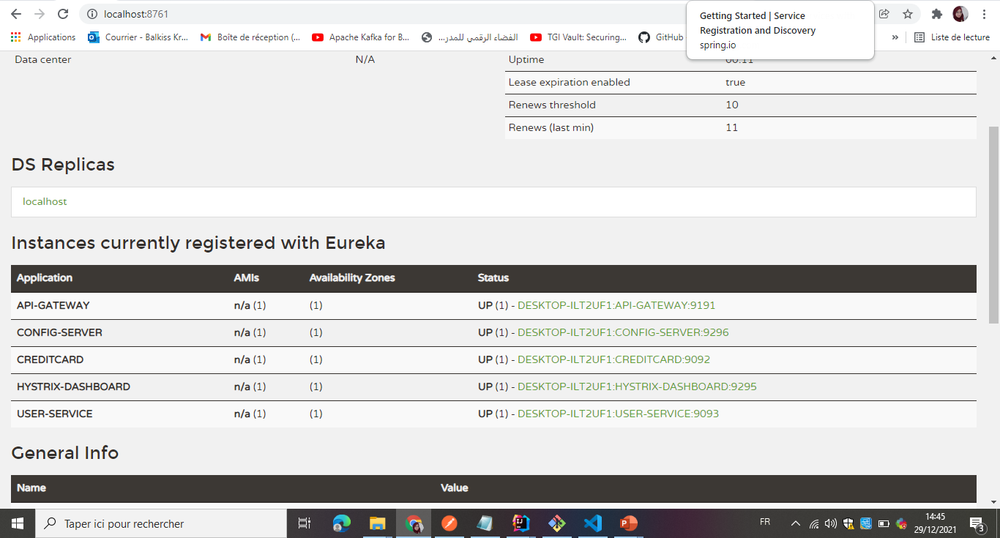
# Registry Service

Slide 7
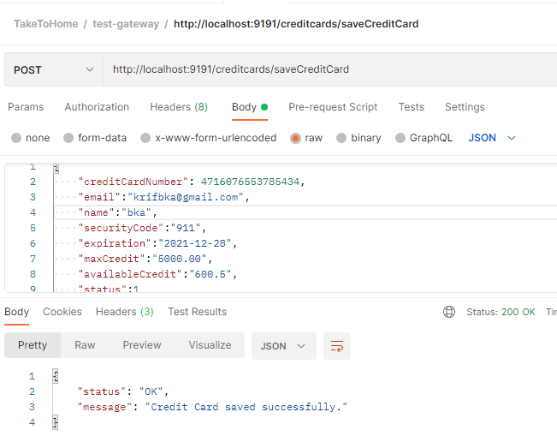
#Gateway Test with Postman

Slide 8
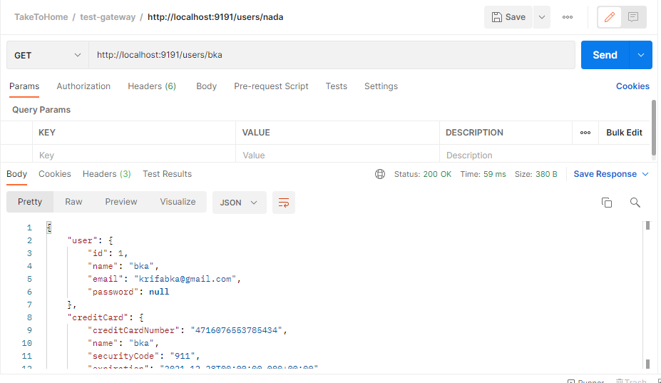
#Gateway Test with Postman

Slide 9
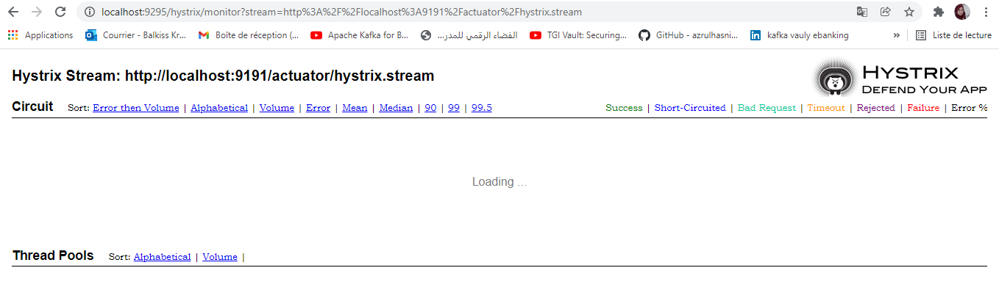
Hystrix Dashboard

Slide 10
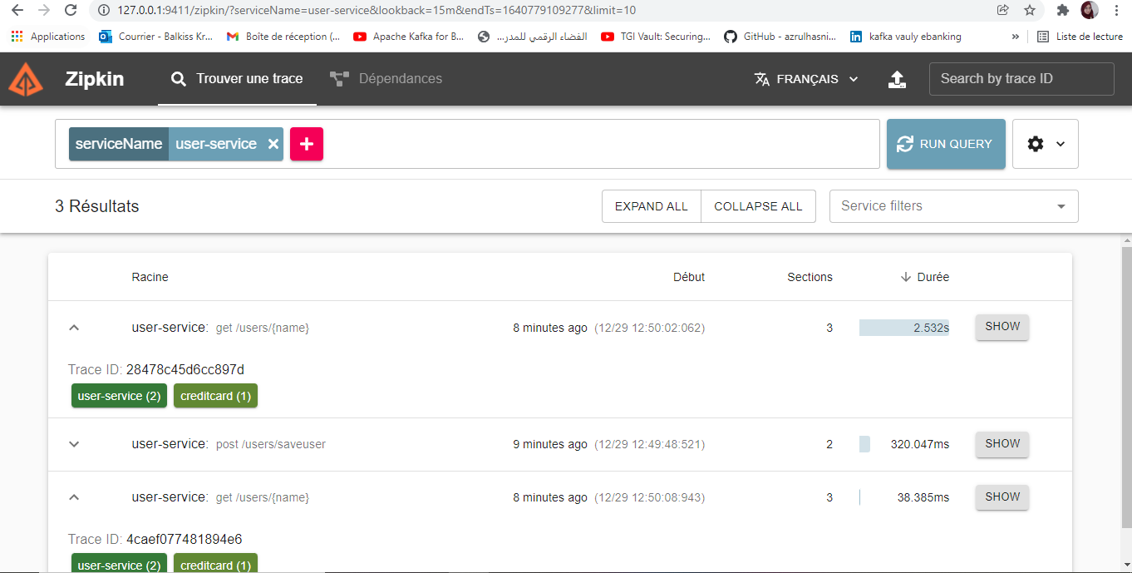
#Zipkin Server for user-service application

Slide 11
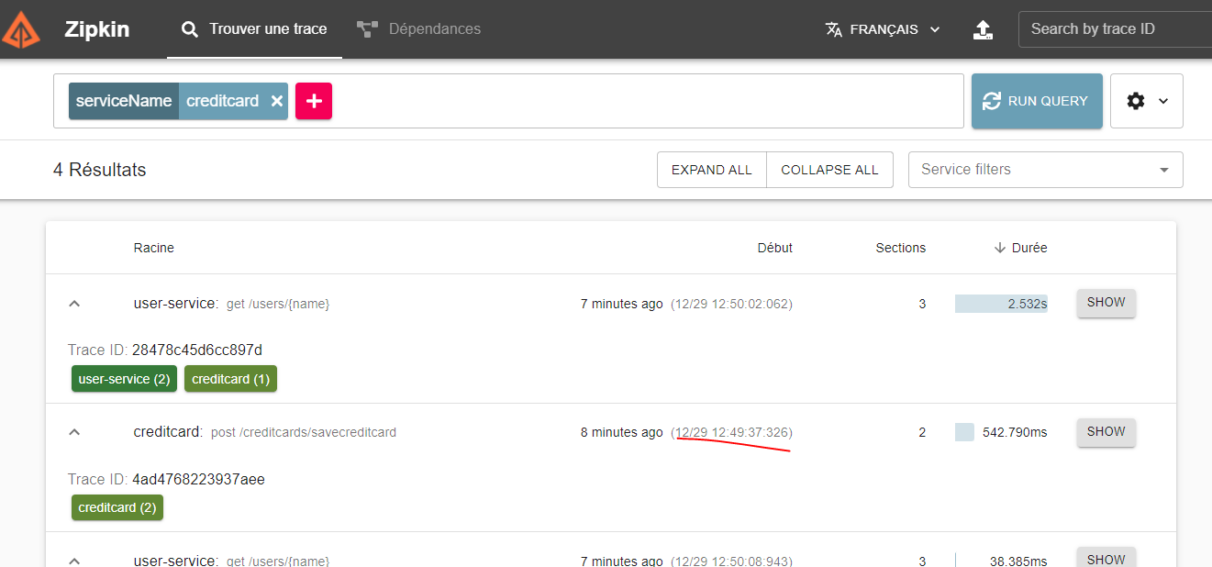
#Zipkin Server for creditcard application

Slide 12

THANKS!

