Slide 1


NovaDimension
DotMVC Framework
WebForm / MVC cross-platform framework for Microsoft ASP.NET
Copyright © 2013 . All Rights Reserved.
NovaDimension

Slide 2
Agenda
DotMVC Framework
Feature List
Component Model
Examples
Conclusions
AJAX Support
Copyright © 2013 . All Rights Reserved.
NovaDimension

Slide 3

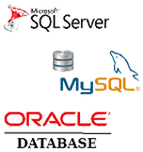
DotMVC Framework feature List
✓
WebForm postback Model
✓
Cross-Platform Database (SQL Server, ORACLE, MySQL)
Model
Controller
View
✓
Model-View-Controller
Copyright © 2013 . All Rights Reserved.
NovaDimension

Slide 4



DotMVC Framework feature List
✓
Multi-Language / Localization
✓
Cross-Browser Compatible
✓
Multi-Client (write once, sell many times)
Copyright © 2013 . All Rights Reserved.
NovaDimension

Slide 5


DotMVC Component Model
Web.UI.dll
NovaDimension
Data.Client.dll
DotMVC
Data.dll
Data.SQLServer.dll
Data.MySQL.dll
Data.Oracle.dll
Component.dll
Web.Mvc.dll
*Web.RBAC.dll
*Web.UI.RBAC.dll
*RBAC: Role-Based-Access-Control
Copyright © 2013 . All Rights Reserved.
NovaDimension

Slide 6
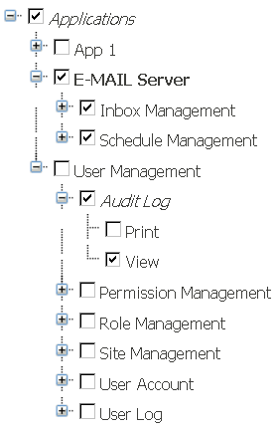
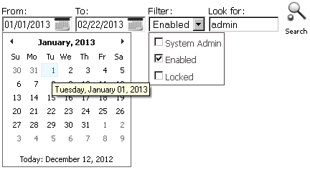
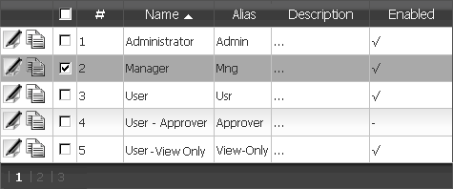
AJAX Support
Ajax Controls, Advanced Filtering, Content Search
DataGrid
TreeView
Advanced Filtering
(pagination, sorting)
Copyright © 2013 . All Rights Reserved.
NovaDimension

Slide 7
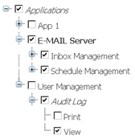
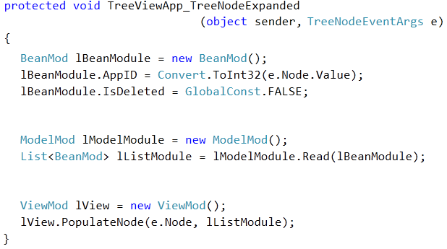
DotMVC Example
TreeView Control
Bean
Create a Module bean object.
Set attributes …
(set Application ID, exclude deleted Modules)
1
Model
Create a Module model object
Read list of Modules with specified attributes
2
View
3
Create a Module view object
Populate Module list in TreeView node
Data Model: Application has a Module
Copyright © 2013 . All Rights Reserved.
NovaDimension

Slide 8
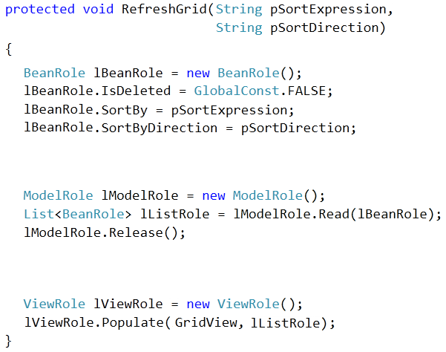
DotMVC Example
DataGrid
Create a Role bean object.
Set attributes …
(set sorting, exclude deleted Roles)
Create a Role model object
Read list of Roles with specified attributes
Create a Role view object
Populate Role list in GridView control
Copyright © 2013 . All Rights Reserved.
NovaDimension

Slide 9
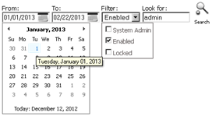


DotMVC Example
Advanced Filtering
Date
Set date attribute:
Filter
Create filter:
Content Search
Set content search:
Copyright © 2013 . All Rights Reserved.
NovaDimension

Slide 10
Conclusions
DotMVC Framework
ASP.NET WebForm Postback Model Compatible
- No learning curve
- Easily migrate your WebForm application(s) to MVC-style
Cross-Platform Database Support
- Database transparency for developer
- Deploy your application on client’s choice of database system
SQL Server
ORACLE
MySQL
Copyright © 2013 . All Rights Reserved.
NovaDimension

Slide 11
THANK YOU!
support@novadimension.com
Copyright © 2013 . All Rights Reserved.
NovaDimension

