Slide 1



Data Mining with Weka Putting it all together
Team members:
Hao Zhou, Yujia Tian, Pengfei‎ Geng,
Yanqing Zhou, Ya Liu‎, Kexin Liu
Director:
Prof. Elke A. Rundensteiner
Prof. Ian H. Witten
Notes:
Liu, Kexin‎; Geng, Pengfei‎; Liu, Ya‎; Tian, Yujia‎; Zhou, Hao
Ian H. Witten, Elke A. Rundensteiner

Slide 2
5.1 The data mining process
By Hao

Slide 3
5.1 The data mining process
Feel Lucky:
- Weka is not everything I need to talk about in my part (Know how rather why when use Weka)
Maybe Not so Lucky:
- Talking about Weka is time-consuming. =)

Slide 4
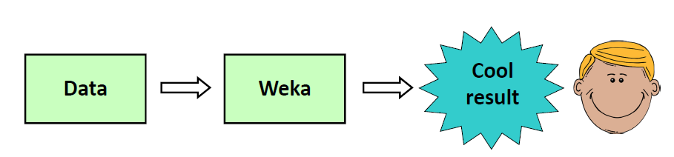
From Weka to real life
When we use weka for MOOC, we never care about the dataset, as it has been already collected.

Slide 5
Procedures in real life
Why we do data mining in real life?
- for course projects (This is my current situation)
- for solving real life problem
- for fun
- for …
Now, we have specified our “question[1]”, then what we do is to gather the data[2] we need.

Slide 6
Real life project
This summer vacation, I worked as volunteer programmer(no payment) for a start-up, whose objective is to provide article recommendations for developers[1].
In this case, we must keep our database, which will index all the up-to-date articles we gather from the whole Internet(mongoDB).
We use many ways to gather articles, and I just focused on one of them – Get articles links from influencers’ tweets thought APIs.

Slide 7
Procedures in real life
Do all the links I gathered work?
- Never, even I wish they did
1. Due to algorithm issue, some links I got are in bad format.
2. Even links are correct, I cannot get articles from all links, as some of them are not links for articles.
[3. More problems when getting articles from links]
-- We must do some clean up[3], after we gathered our data, to better use it.

Slide 8
Procedures in real life
OK, assume that now we have all the [raw] data(articles here) we need.
The most important jobs comes – one of them is how to rank articles for different keywords [how to define keywords collection]. (It is more about mathematics issue than computer science here, and I did not participate in this part)
-- Define new features

Slide 9
Procedures in real life
After new features defined, the last step is to generate a web app, so that users can enjoy “our” work.
Now the last step of this project is still under construction, which means “we” still need more time to “deploy the result”.
We will go to section 5.2 now -->

Slide 10
5.2

Slide 11



5.3 Data mining and ethics
Information privacy laws
Anonymization
The purpose of data mining
Correlation causation
Source: www.zerohedge.com
Source: www.ediscoveryreadingroom.com
Source: www.mum.edu
Notes:
Information privacy laws
Anonymization
The purpose of data mining
Correlation causation

Slide 12


Information privacy laws
In Europe
Purpose; Keep secret; Accurately update;
Provider can review; Deleted asap;
Un-transmittable (for < protection)
No sensitive data (sexual orientation, religion )
In US
Not highly legislated or regulated
HIPAA, FCRA, ECPA, etc.
But hard to be anonymous...
Be aware ethical issues and laws
Source: www.livingwithgod.org
Source: www.adigaskell.org
Notes:
❖ A purpose must be stated for any personal information collected
❖ Such information must not be disclosed to others without consent
❖ Records kept on individuals must be accurate and up to date
❖ To ensure accuracy, individuals should be able to review data about themselves
❖ Data must be deleted when it is no longer needed for the stated purpose
❖ Personal information must not be transmitted to locations where equivalent
data protection cannot be assured
❖ Some data is too sensitive to be collected, except in extreme circumstances
(e.g., sexual orientation, religion)
No sensitive data, example:Scandinavia
(US) Information privacy law
http://en.wikipedia.org/wiki/Information_privacy_law#United_States
Sum:
Data privacy is not highly legislated or regulated in the U.S.. In the United States, access to private data contained in for example third-party credit reports may be sought when seeking employment or medical care, or making automobile, housing, or other purchases on credit terms. Although partial regulations exist, there is no all-encompassing law regulating the acquisition, storage, or use of personal data in the U.S. In general terms, in the U.S., whoever can be troubled to key in the data, is deemed to own the right to store and use it, even if the data were collected without permission. For instance the Health Insurance Portability and Accountability Act of 1996 (HIPAA), the Children's Online Privacy Protection Act of 1998 (COPPA), and the Fair and Accurate Credit Transactions Act of 2003 (FACTA), are all examples of U.S. federal laws with provisions which tend to favor information flow efficiencies and operational profits over the rights of individuals to control their own personal data.
The Supreme Court interpreted the Constitution to grant a right of privacy to individuals in Griswold v. Connecticut. Very few states, however, recognize an individual's right to privacy, a notable exception being California. An inalienable right to privacy is enshrined in the California Constitution's article 1, section 1, and the California legislature has enacted several pieces of legislation aimed at protecting this right. The California Online Privacy Protection Act (OPPA) of 2003 requires operators of commercial web sites or online services that collect personal information on California residents through a web site to conspicuously post a privacy policy on the site and to comply with its policy.
The safe harbor arrangement was developed by the United States Department of Commerce in order to provide a means for U.S. companies to demonstrate compliance with European Commission directives and thus to simplify relations between them and European businesses.

Slide 13



Anonymization
It is much harder than you think.
Story: MA release medical recods
Re-identification technique
Public records:
City, Birth, gender: 50% of US can be identify
One more attribute – zipcode: 85% identification
Netflix
Use movie rating system to identify people
99% 6 movies
70% 2 movies
Source: eofdreams.com
www.resteasypestcontrol.com
Notes:
Re-Identification is powerful and make it hard to anonymize
Anonymization is harder than you think
When Massachusetts released medical records summarizing every state
employee’s hospital record in the mid‐1990s, the governor gave a public
assurance that it had been anonymized by removing all identifying information
such as name, address, and social security number. He was surprised to receive
his own health records (which included diagnoses and prescriptions) in the mail.
Reidentification techniques. Using publicly available records:
Netflix movie database: 100 million records of movie ratings (1–5)
❖ 50% of Americans can be identified from city, birth date, and sex
❖ 85% can be identified if you include the 5‐digit zip code as well
❖ Can identify 99% of people in the database if you know their ratings for 6
movies and approximately when they saw the movies ( one week)
❖ Can identify 70% if you know their ratings for 2 movies and roughly when
they saw them

Slide 14
The purpose of data mining
The purpose of data mining is to discriminate …
who gets the loan
who gets the special offer
Certain kinds of discrimination are unethical, and illegal
racial, sexual, religious, …
But it depends on the context
sexual discrimination is usually illegal
… except for doctors, who are expected to take gender into account
… and information that appears innocuous may not be
ZIP code correlates with race
membership of certain organizations correlates with gender

Slide 15
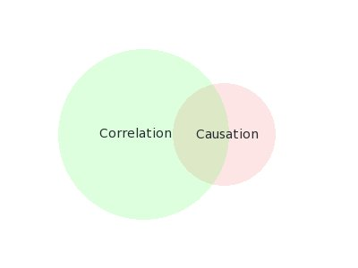
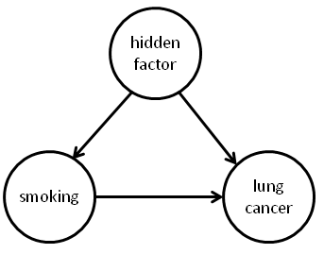
Correlation and Causation
Correlation does not imply causation
As icecream sales increase, so does the rate of drownings.
Therefore icecream consumption causes drowning???
Data mining reveals correlation, not causation
but really, we want to predict the effects of our actions

Slide 16
5.3 Summary
Privacy of personal information
Anonymization is harder than you think
Reidentification from supposedly anonymized data
Data mining and discrimination
Correlation does not imply causation

Slide 17
Lesson 5.4 SUMMARY (Part A)
There’s no magic in data mining – Instead, a huge array of alternative techniques
There’s no single universal “best method” – It’s an experimental science! – What works best on your problem?

Slide 18
Lesson 5.4 SUMMARY
Produce comprehensive models
When attributes contribute equally and independently to the decision
Simply stores the training data without processing it
Calculate a linear decision boundary
Avoids overfitting, even with large numbers of attributes
Determines the baseline performance

Slide 19
Lesson 5.4 SUMMARY
Weka makes it easy – ... maybe too easy?
There are many pitfalls – You need to understand what you’re doing!
filters
Attribute selection
Data visualization
classifiers
clusters

Slide 20
Lesson 5.4 SUMMARY
Focus on evaluation ... and significance – Different algorithms differ in performance – but is it significant?

Slide 21


Slide 22
Advanced Datamining with Weka
Some missing parts in the lectures
Filtered Classifier
Cost-sensitive evaluation and classification
Attribute selection
Clustering
Association rules
Text classification
Weka Experimenter

Slide 23
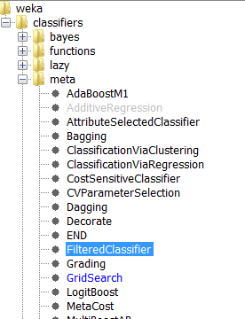
Filtered Classifier
Filter the training data, not testing data
Why do we need Filtered Classifier?

Slide 24
Cost-sensitive evaluation and classification
Costs of different decisions and different kinds of errors
Costs in datamining
Misclassification Costs
Test Costs
Costs of Cases
Computation Costs

Slide 25
Attribute Selection
Uesful parts of Attribute Selection
Select relevant attributes
Remove irrelevant attributes
Reasons for Attribute Selction
Simpler model
More Transparent and easier to understand
Shorter Training time
Knowing which attribute is important

Slide 26
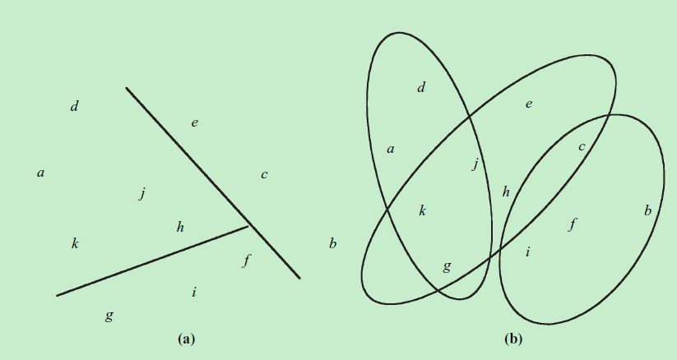
Clustering
Cluster the instances according to their attribute values
Clustering method: k-means k-means++

Slide 27
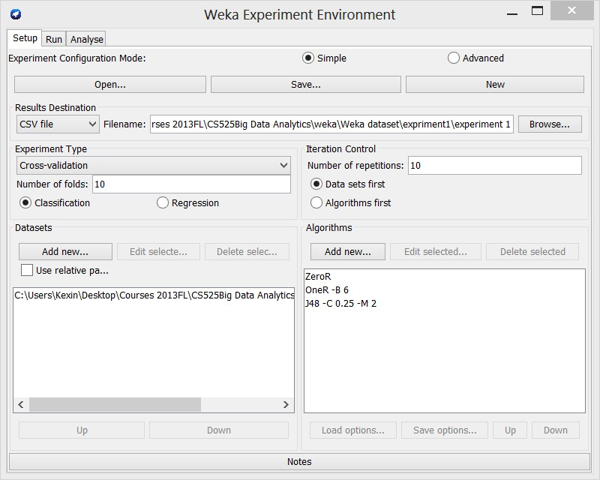
Experimenter

Slide 28
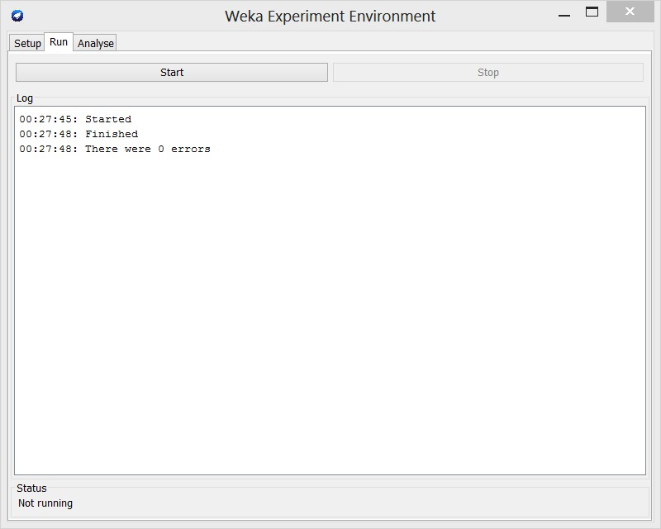
Experimenter

Slide 29
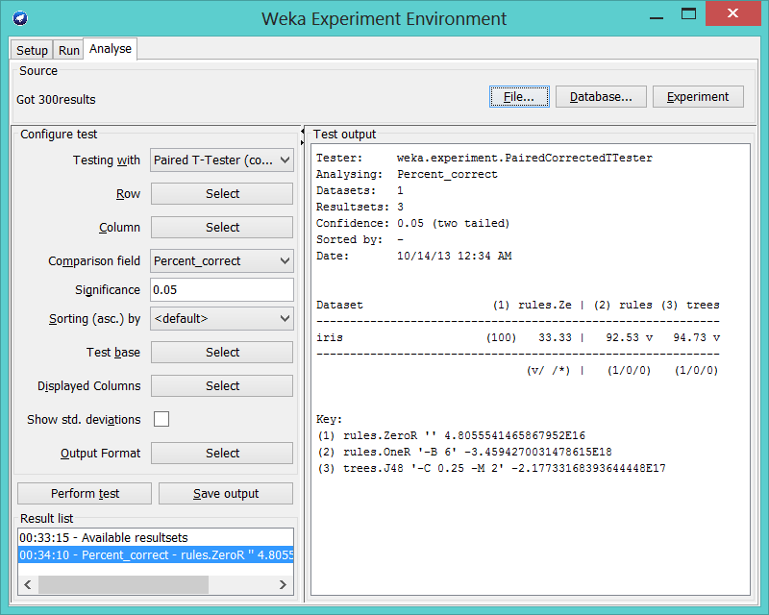
Experimenter

Slide 30

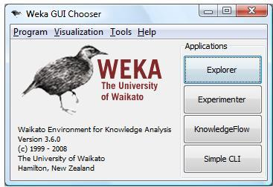
Acknowledgement
Thanks Prof. Ian H. Witten and his Weka MOOC direction.

Slide 31

Thank you for your kind attention
Notes:
Thank you for your kind attention

