Slide 1
AgiBot X2 — Progress Update
Box-Pickup Motion-Retargeting Policy | On-Robot VLM Perception
Whole-body manipulation via human MoCap retargeting + vision-language perception benchmark

Slide 2
NEW POLICY
Box-Pickup Policy — Objective & Approach
• Task: whole-body box pickup — walk up, two-hand grasp, lift, carry, and set down a large box.
• Reference source: human motion-capture clip (OmniRetarget dataset, sub3_largebox_003, SMPL-H 52-joint model).
• Embodiment switch: motion authored on a human SMPL-H skeleton is retargeted onto the AgiBot X2 — 31 DOF (6+6 legs, 3 waist, 7+7 arms, 2 head), 1.4 m tall, rigid half-sphere palms (no fingers).
• Status: policy is currently in training; deployment on the physical X2 is planned once this run completes.
Pipeline
Human SMPL-H
MoCap
Interaction-Mesh
Retargeting
X2 31-DOF
Reference Traj.
RL Tracking Policy
(Isaac Sim / PPO)
Deploy on
physical X2
Blind whole-body policy (no cameras); object state used only by the critic during training.

Slide 3
NEW POLICY
Retargeting Logic
• Method: interaction-mesh retargeting solved as a per-frame convex QP with SQP linearization (CVXPY + Clarabel).
• 14-landmark SMPL-H → X2 correspondence (pelvis, hips, knees, ankles, toes, shoulders, elbows, wrists → hand-contact links).
• Synthetic hand-contact link at (0.02, 0, -0.13) m from each wrist so the human wrist maps to the grasp surface.
• Constraints: Laplacian (interaction-mesh) preservation; non-penetration (floor + box); foot-stick / foot-lock; joint limits; trust region; self-collision.
Figure placeholder
Add interaction-mesh / retargeting figure from the paper
Per-frame QP objective
L(·): interaction-mesh Laplacian · δ: trust-region step · q±: joint limits

Slide 4
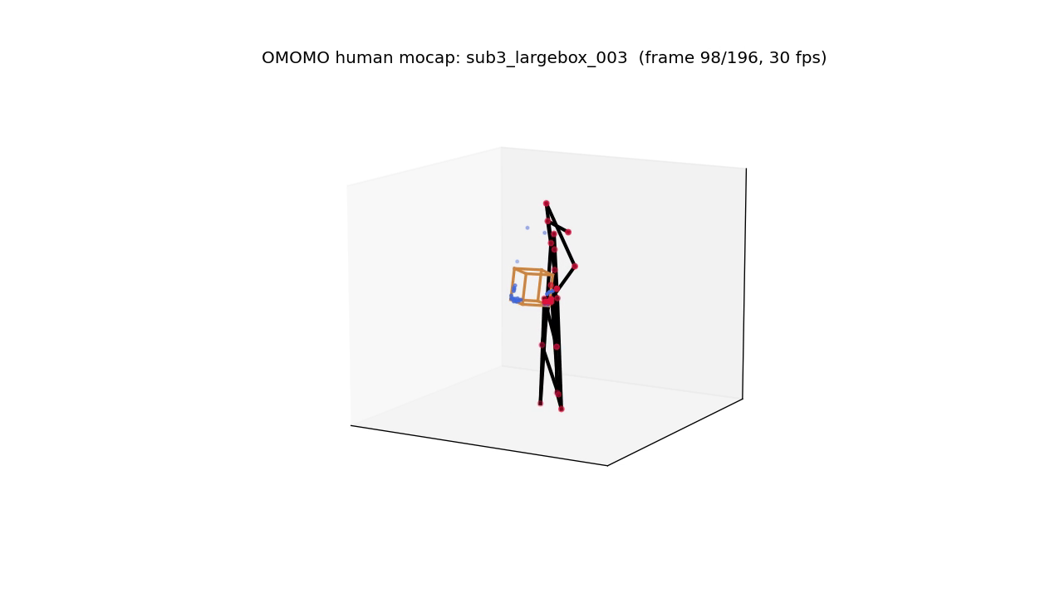
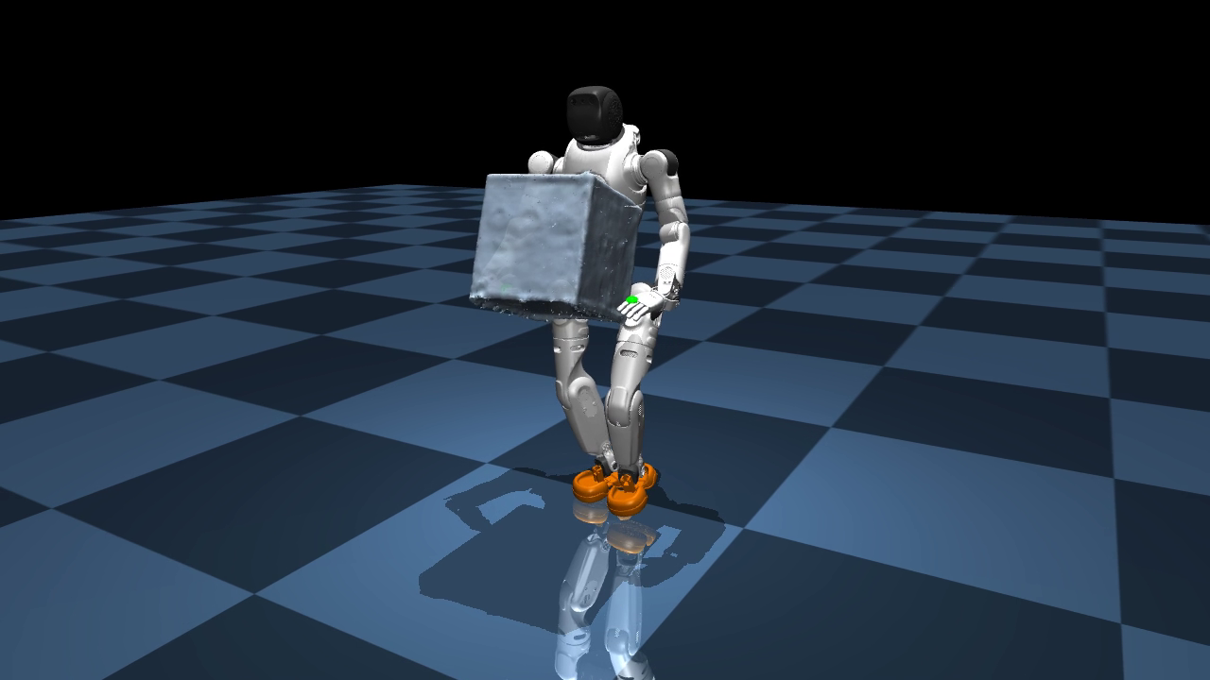
NEW POLICY
Reference Motion: Human MoCap → Retargeted X2
Source — human SMPL-H MoCap
Retargeted — AgiBot X2 (31-DOF)
Same clip before and after the interaction-mesh IK pipeline; contact states corrected post-retargeting. (Click to play.)

Slide 5
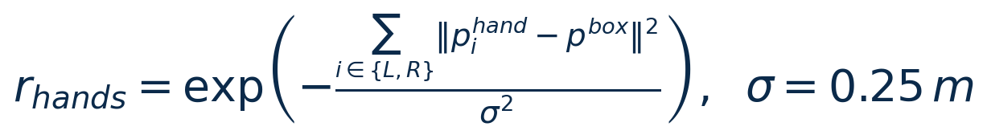
NEW POLICY
Policy Training — RL Tracking
4096
parallel envs
50 Hz
control (200 Hz sim)
31
actuated DOF
PPO
λ=0.95 · γ=0.99
• Framework: IsaacLab (Isaac Sim) + holosoma.
• Actor: blind MLP 512-256-128 (ELU) — prev action, base ang-vel, dof pos/vel, motion phase, ref orientation.
• Critic: privileged obs adds base lin-vel + object & body state.
• Key reward: two-hand-to-box proximity as a product term — both palms must reach the box simultaneously.
• Status: currently training; deploy on physical X2 after the run.
Actor (blind) → 512-256-128 → 31 DOF
Critic (privileged: + object & body state)
Two-hand grasp reward
Product (not mean) over hands forces bimanual contact.

Slide 6
PERCEPTION
VLM Perception — Setup
• Goal: scene understanding from the X2 head RGB camera; frames streamed to a workstation for evaluation.
• Three VLMs served locally via Ollama: Qwen2.5-VL 7B, Qwen2.5-VL 3B, Moondream (~1.8B).
• Protocol: 15 s clip @ ~20 fps → 12 evenly-spaced frames; identical prompt, temperature 0.2; one model resident at a time (8 GB VRAM).
Prompt (identical for all models)
“You are a robot's vision system. List the main objects and people you see and roughly where they are (left/center/right). Then one short summary sentence. Be concise.”

Slide 7
PERCEPTION
VLM Performance Metrics
Model | Params | Mean lat. | Median | Rate | Gen speed
Qwen2.5-VL 7B | 7 B | 2.87 s | 2.89 s | 0.35 Hz | 51.3 tok/s
Qwen2.5-VL 3B | 3 B | 2.45 s | 2.50 s | 0.41 Hz | 107.6 tok/s
Moondream | ~1.8 B | 0.61 s | 0.62 s | 1.65 Hz | 215.4 tok/s
• Warm, end-to-end latencies on an RTX 5070 (8 GB); 12 frames, single 15 s clip.
• Moondream is ~4-5× faster — the only model near real-time (~1.7 Hz).
• Qwen2.5-VL 7B gives the most accurate scene descriptions; 3B is slower than Moondream yet less accurate on this scene.

Slide 8
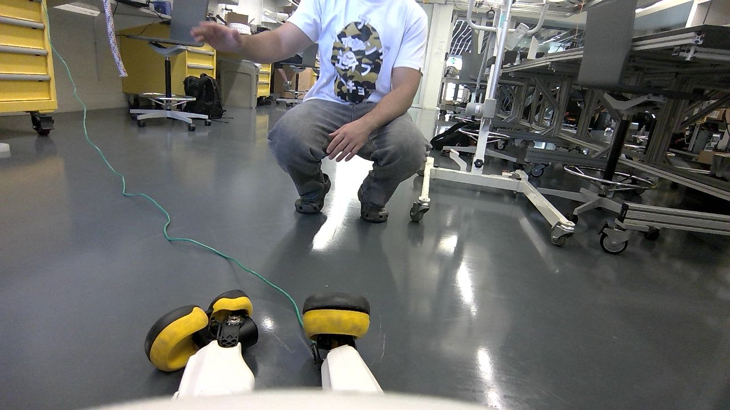
PERCEPTION
VLM Qualitative Comparison — Frame 224 (t = 11.3 s)
Qwen2.5-VL 7B (2.80 s | 51.6 tok/s)
Objects: yellow toolbox, green cord, wheels, white t-shirt with text, gray pants. People: man in white t-shirt squatting. Summary: a person interacting with a wheeled device in an industrial setting.
Qwen2.5-VL 3B (2.60 s | 107.9 tok/s)
A person squatting in the center of the room; yellow and black robotic feet on the floor, likely attached to a robot or machine.
Moondream (0.67 s | 203.4 tok/s)
Person in white shirt, gray pants, black shoes, and yellow shoes standing near a desk with a green cord on it.

