Slide 1
Resilient Humanoid Loco-Manipulation
Learned whole-body policies and online layer adaptation under actuator faults
Baaqer Farhat
Mentor: Mahdi Taheri
Aerospace Robotics and Control Lab (ARCL)
California Institute of Technology
Summer Undergraduate Research Fellowship, 2026
8.7 s
57
+53%
50 Hz
whole-body box pickup
logged hardware runs
survival under a knee fault
online adaptation, numpy
Notes:
Good afternoon. My name is Baaqer Farhat, and this is work done in ARCL with Mahdi Taheri on
the AgiBot X2 humanoid. The summer covers two whole-body behaviors, taken from motion capture
through to the real robot, and then a controlled actuator fault to test whether the
controller can adapt to damage in the robot itself.

Slide 2
THE PROBLEM
A policy is only correct for the robot it was trained on
• Every policy is optimized against one fixed set of dynamics: nominal PD gains, a known payload, a particular contact model.
• Real robots leave that set. Actuators weaken, payloads change, and the sensors the policy trained on are not the sensors the hardware has.
• A frozen policy cannot notice. It keeps issuing the commands that were optimal for a robot it is no longer controlling.
OBSERVED ON THIS ROBOT
Feet on their edges
Sim reported contact force, so the reward counted the foot as planted.
Saturated ankle roll
Frontal-plane correction ran through a joint with 15° of travel.
Wrong base frame
Torso IMU fed into an observation holosoma builds from the pelvis.
Objective
Behaviors that survive conditions outside the training distribution, and a controller that responds to changes in the robot's own dynamics without being told what changed.
Weakened actuator
Right knee at 30% stiffness. Survival falls from 14.7 s to 7.4 s.
SURF 2026 · Baaqer Farhat · Caltech ARCL
2
Notes:
Reinforcement learning gives you a humanoid behavior that works, but you optimize it against
one particular robot: specific actuator gains, a specific payload, a specific contact model.
Real hardware leaves that set almost immediately.
On the right are four failures from this project's run logs. The robot stood on the edges of
its feet. It tried to balance sideways through a joint with fifteen degrees of travel. The
deployment fed the wrong IMU into an observation. And the one introduced deliberately, a
weakened knee.
In every case the policy has no way to know. So the objective is two things: behaviors that
hold up outside the training distribution, and a controller that responds when its own
dynamics change.

Slide 3
SYSTEM AND WORKFLOW
From human motion capture to a policy on the robot
Head RGB → VLM
scene description, open loop
Human MoCap
Retargeting
Reference clip
RL tracking
Export
AgiBot X2
OmniRetarget CMU
interaction mesh → 31 DOF
8.7 s pickup 19 s crawl
IsaacLab + holosoma, PPO
self-contained numpy .npz
ROS 2 50 Hz
Online layer adaptation
50 Hz · numpy · 5.25 ms / step
57 logged hardware runs → new reward terms and observation fixes
4096 parallel envs 200 Hz physics / 50 Hz control blind actor MLP 512-256-128 (ELU) DR: box mass, friction, PD gain, action delay, encoder noise, pushes
SURF 2026 · Baaqer Farhat · Caltech ARCL
3
Notes:
The pipeline is the same for both behaviors. Human motion capture, retargeted onto the thirty
one degree of freedom X2, gives a reference clip. A policy learns to track it with PPO in
IsaacLab, four thousand environments in parallel. The actor is blind: no cameras, only
proprioception and a clock into the reference. It exports to numpy and runs on the robot over
ROS 2 at fifty hertz.
Two things to notice. The red loop is real: fifty seven hardware runs fed back into the
reward design. In green is where the adaptation sits, between the policy and the actuators.
The VLM in orange is off to the side on purpose, because it is not closed on control.

Slide 4
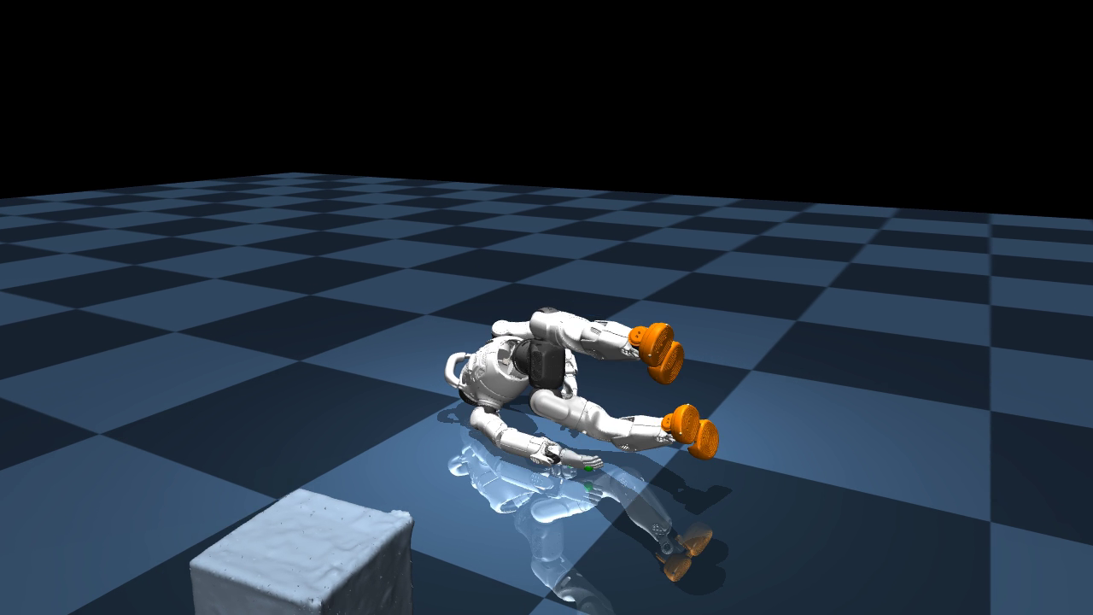
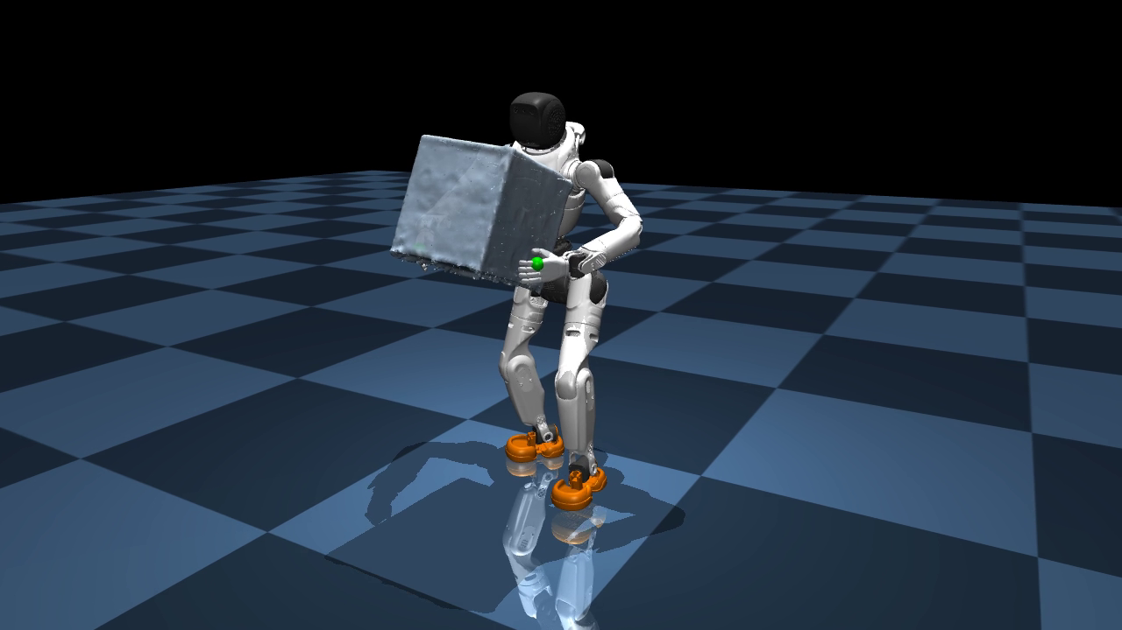
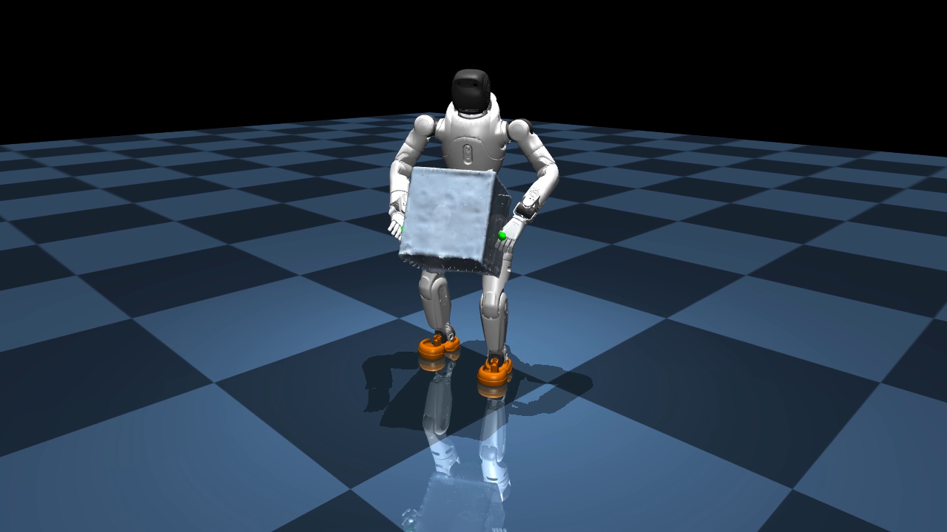
BEHAVIOR 1 · LOCO-MANIPULATION
Box pickup: one policy for the whole 8.7 second motion
From the default standing pose the robot bends to a 45 cm box, squeezes it between two rigid fingerless palms, lifts it to chest height, carries it 1.4 m, and sets it down over planted feet.
No fingers, no cameras, and the payload moves the centre of mass while the robot is bent over.
VIDEO 1 Early · v8, iter 8000
VIDEO 2 Intermediate · v10, iter 28000
VIDEO 3 Current · v33, iter 253000
Balances through the full motion but pantomimes the lift. The box never leaves the floor.
x2_box_v8_iter8000_full.mp4
First complete pickup, carry and set-down in simulation after the two-hand grasp reward.
x2_box_v10_iter28000_final.mp4
Flat planted feet, quiet waist, returns fully upright. This is the deployed policy.
x2_box_v33_waist_track_iter253000.mp4
One continuous reference motion, no state machine
hold upright
bend down
grasp + lift
carry 1.4 m
set down
stand up
0 s
8.7 s
SURF 2026 · Baaqer Farhat · Caltech ARCL
4
Notes:
The first behavior is a box pickup, one policy for the whole motion. No state machine. Bend,
grasp, lift, carry, set down, stand up, in eight point seven seconds.
Three things make it hard. The X2 has no fingers, so the grasp is a squeeze between two rigid
palms. The policy is blind. And once the box comes up the centre of mass moves forward while
the robot is already bent over, which is when it has the least margin.
Left to right. Version eight balances through the whole motion, but watch the box. It never
leaves the ground: the policy found it could collect most of the tracking reward by miming
the motion. The middle, version ten, once a grasp reward was added, is the first time it
completes the task. On the right is the policy running on hardware today.

Slide 5
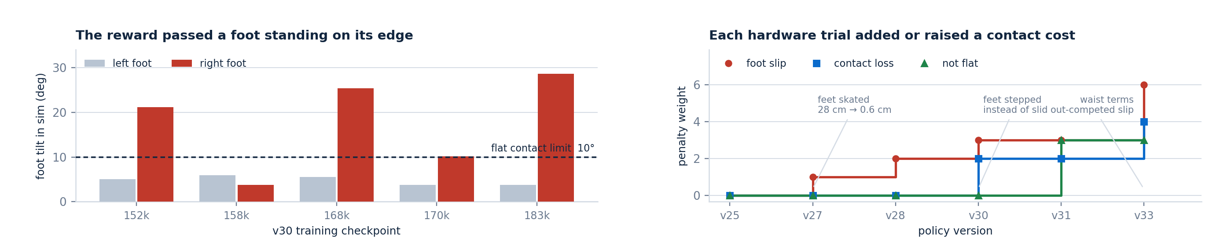
BEHAVIOR 1 · DEVELOPMENT
Most of the work was finding out why it did not work
v8
Forgot the walk-up
Sampler mixed raw failure counts, so the uniform term was a no-op.
Mix normalized probabilities.
v10
Pantomimed the lift
A mean over hands let one palm mask the other hovering away.
Grasp reward as a product over both hands.
v13
Frozen hip, impossible waist
Off-by-one in the retargeter clamped every joint to the previous joint's limits.
Index limits by joint type, retrain.
v24
Crab-walked the carry
The demonstrator turned 65 degrees and shuffled his feet 30 cm.
Straighten the carry, pin the feet.
Then hardware found what simulation could not. A foot on its edge still reports contact force, and a tilted stationary foot has zero slip.
SURF 2026 · Baaqer Farhat · Caltech ARCL
5
Notes:
This is where the actual work was. Each row is a failure that had to be diagnosed before the
next version could improve on it. Version eight kept forgetting the walk-up because the
sampler mixed raw failure counts, which scale with the environment count, so the uniform term
was effectively zero. Ten is the pantomime you just saw.
The plots are what simulation could not find on its own. On the left, foot tilt across five
checkpoints: the right foot sits past twenty degrees, standing on its edge, and no reward
objected, because the engine still reports contact force on an edge.
On the right is the loop that followed. The feet skated, so a slip penalty went in and foot
travel dropped from twenty eight centimetres to half a centimetre. Then they stepped instead
of sliding, which is free under a slip penalty, so a contact loss term went in. Then the
waist rewards out-competed the slip penalty and it had to double again.

Slide 6
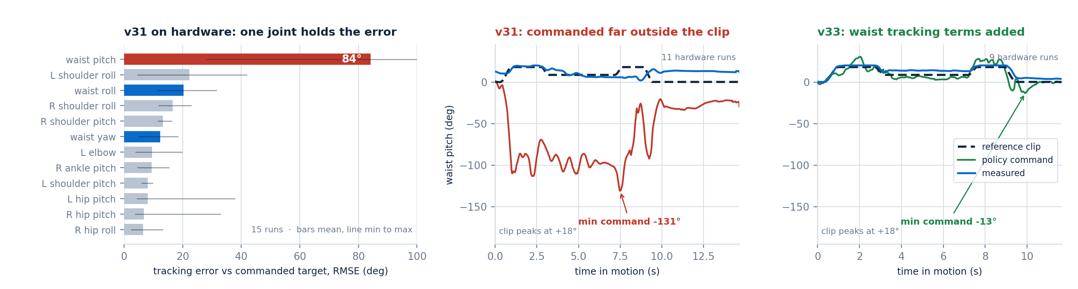
BEHAVIOR 1 · SIM TO REAL
The hardware logs pointed at a single joint
Version 31 was the best policy in simulation and it fell on the robot, 13 of 15 runs, always at the same point in the motion.
SYMPTOM
CAUSE
FIX, V33
Torso pitched forward and collapsed at t ≈ 8.2 s, entering the carry. Leg tracking error stayed near 5° throughout.
The actor drove the waist pitch command to −131° while the reference clip asks for at most +18°. Nothing in the reward priced the waist.
Waist pitch and yaw tracking terms, exponential plus L2. Command back inside the clip and hardware waist error 13.1° to 3.3°.
SURF 2026 · Baaqer Farhat · Caltech ARCL
6
Notes:
This is the sim to real gap, and the clearest example of the whole workflow. Version thirty
one was the best checkpoint in simulation. On the robot it fell thirteen times out of
fifteen, always at about eight seconds, always the same way: the torso pitched forward and
did not come back.
The left plot ranks every joint by tracking error across those runs. The legs sit around five
degrees, which is why the first guess, a leg problem, was wrong. One bar is at eighty four
degrees, and it is the waist pitch.
The middle plot shows what that means. The dashed line is what the reference clip asks for,
at most eighteen degrees forward. The red line is what the policy commanded: minus one
hundred and thirty one degrees, far outside anything in the clip, so the joint saturates.
Nothing in the reward priced the waist, so the policy used it as a dumping ground and
simulation absorbed it.
The right plot is the same measurement after adding waist tracking terms. The command stays
inside the clip and hardware waist error drops from thirteen degrees to three.

Slide 7
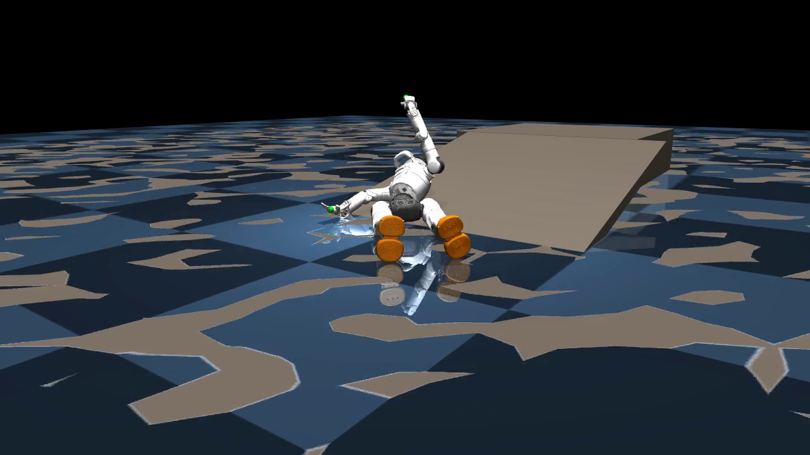
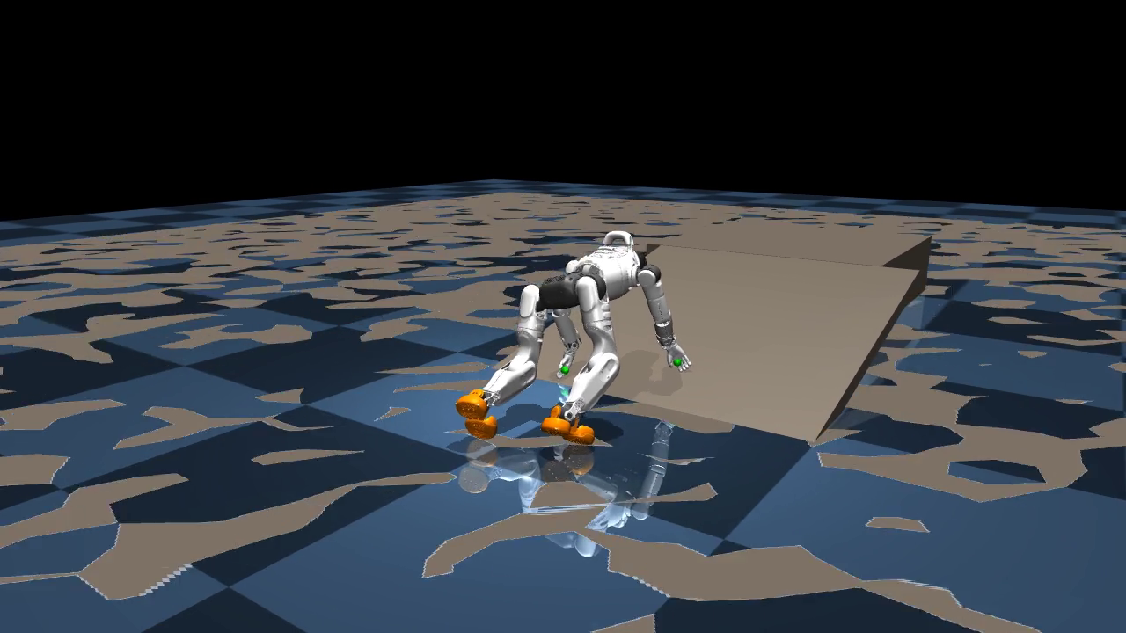
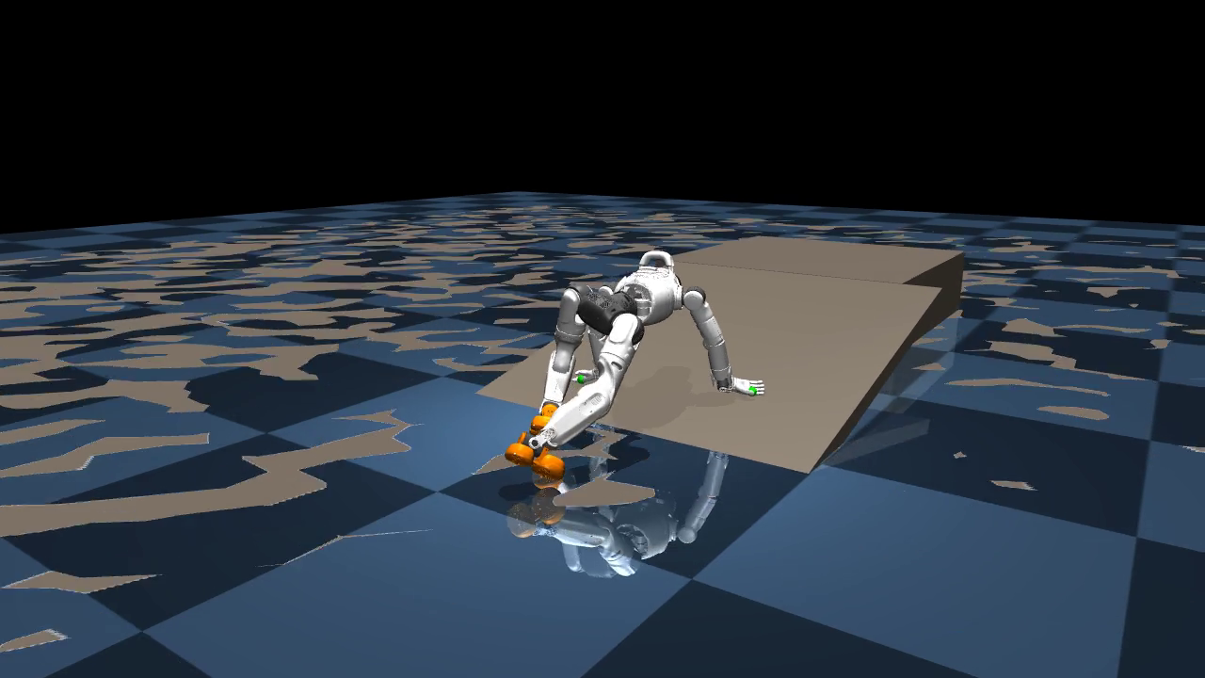
BEHAVIOR 2 · LOCOMOTION
Crawling: a prone gait needs its own reward set
A whole-body prone crawl up a slope, retargeted from a CMU motion capture clip and trained in the same holosoma stack. The robot moves on palms, knees and feet.
The upright reward suite is hostile to crawling. Foot slip penalizes the limb sliding a crawl needs, and contact loss demands both feet stay loaded. The task needs its own reward, contact and observation set.
VIDEO 1 Early · v2, iter 14500
VIDEO 2 Intermediate · v3, iter 49999
VIDEO 3 Current · v5, iter 86000
Crawls for the first time. Tracking is loose and the robot drifts off the slope.
x2_crawl_slope_v2_palmflat_iter14500.mp4
Retuned tracking weights. This checkpoint was exported and run on the physical X2.
x2_crawl_slope_v3_tracking_iter49999.mp4
Position weight raised to 3.0. Mean episode 7.6 s, the best climb so far in simulation.
x2_crawl_slope_v5_track_xyz_iter86000.mp4
Honest limitations. v4 over-smoothed the gait until it could not generate thrust, and v6 multi-clip stand-up training regressed the climb from 24.9 to 16.2 mean reward. Best episode is still 7.6 s of a 19 s clip.
SURF 2026 · Baaqer Farhat · Caltech ARCL
7
Notes:
The second behavior is crawling. Same stack, but prone, climbing a slope on palms and knees.
The technical point is the orange box. The first attempt loaded the slope into the existing
pickup task and failed completely, because the upright reward suite fights a crawl. There is
a foot slip penalty, and sliding your limbs along the ground is exactly what crawling is. So
the task got its own reward set, knees, elbows and palms added to the allowed contacts, and
projected gravity in the actor so the policy can tell it is belly down.
The middle video is the checkpoint that ran on the physical robot. On the limits: version
four over smoothed the gait until it could not climb, version six made the crawl worse, and
the best policy sustains seven and a half seconds of a nineteen second clip. Real, but less
mature than the pickup.

Slide 8
TRANSITION · WHY ADAPTATION
A good policy is still a fixed policy
To test that, the right knee actuator is scaled to 30% of nominal PD stiffness. It still moves, but it sags under load.
Nominal robot
Actuator fault
Frozen policy
Adapted policy
The frozen policy completes the pickup on all six seeds.
Right knee drops to 30% of nominal PD stiffness.
Sags under the payload, loses the set-down, falls early.
Recovers the set-down on all six seeds.
14.68 s
not announced
7.43 s
11.36 s
The fault is never announced. Neither the policy nor the adapter is told that a fault occurred. Both keep using the nominal gains. There is no detector and no trigger.
This is the regime the method is actually for. The same adaptation applied to a healthy robot spends balance margin the task needed and makes things worse. That measurement is in backup.
SURF 2026 · Baaqer Farhat · Caltech ARCL
8
Notes:
Both behaviors work, but they are fixed policies, and that brings us to the main question.
The fault has to be realistic, so the right knee stiffness is scaled to thirty percent of
nominal. It still moves, but it sags whenever it is loaded, which for a robot bent over
holding a box is most of the motion.
Healthy, the frozen policy is essentially perfect. Add the fault and it drops to seven point
four and becomes erratic. With adaptation it comes back to eleven point four.
The point to land is the grey band. Nothing tells the policy a fault happened. No detector,
no trigger. The adapter runs from the first control step and only ever sees tracking error.

Slide 9
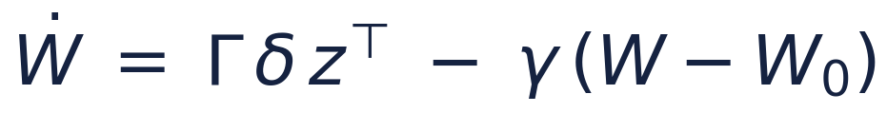
ADAPTATION · METHOD
Adapt one layer, online, from tracking error alone
Ported from Taheri, Chung and Hadaegh, ACC 2026, “Closing the Loop Inside Neural Networks: Causality-Guided Layer Adaptation for Fault Recovery Control” — moved from its MuJoCo testbed into our IsaacLab environment on the v31 policy.
FROZEN
FROZEN
ADAPTED · 32,768 of 251,776 weights
FROZEN
obs 164
W₀
W₁
W₂
W₃
31 joint targets
164 → 512
512 → 256
256 → 128
128 → 31
e = q − qref joint tracking error, measured every 20 ms
Adapted one weight matrix, 13% of the network
Frozen every other layer, the reward, the reference clip
Lyapunov update, leakage toward the trained weights
Needs no plant model, no fault detector, no offline phase
Cost 1.93 ms forward + 3.31 ms update = 26% of the 20 ms budget
Mask which joints enter e. Waist only, against the paper's hips, knees, ankles and waist
Safety resets to W₀ every episode; a norm bound trips a hard revert
Defect found and fixed: the shipped leak pulls the layer toward the origin rather than the trained weights, eroding 13.7% of its norm per episode even with perfect tracking. Fixing it does not change the outcome, but it is a real bug.
SURF 2026 · Baaqer Farhat · Caltech ARCL
9
Notes:
The method is from an ACC paper by my mentor, with Soon Jo Chung and Fred Hadaegh. The work
here was taking it out of the MuJoCo testbed it shipped with, getting it running in our
IsaacLab environment on a real trained policy, and finding out whether the result holds.
The policy is four layers. The adapter changes exactly one weight matrix, about thirteen
percent of the parameters. Everything else is frozen. No retraining, no replay, no model of
the plant, and no fault detector.
The only input is the green path: joint tracking error, every twenty milliseconds, pushed
back through the layers above the adapted one to drive a Lyapunov update, with leakage
pulling the weights toward the trained values.
It costs about five milliseconds per step in numpy, which is why the same code runs on the
robot, and it never persists across episodes. The red band is a defect found and fixed along
the way: the leakage pulled weights toward zero rather than toward the trained values.

Slide 10
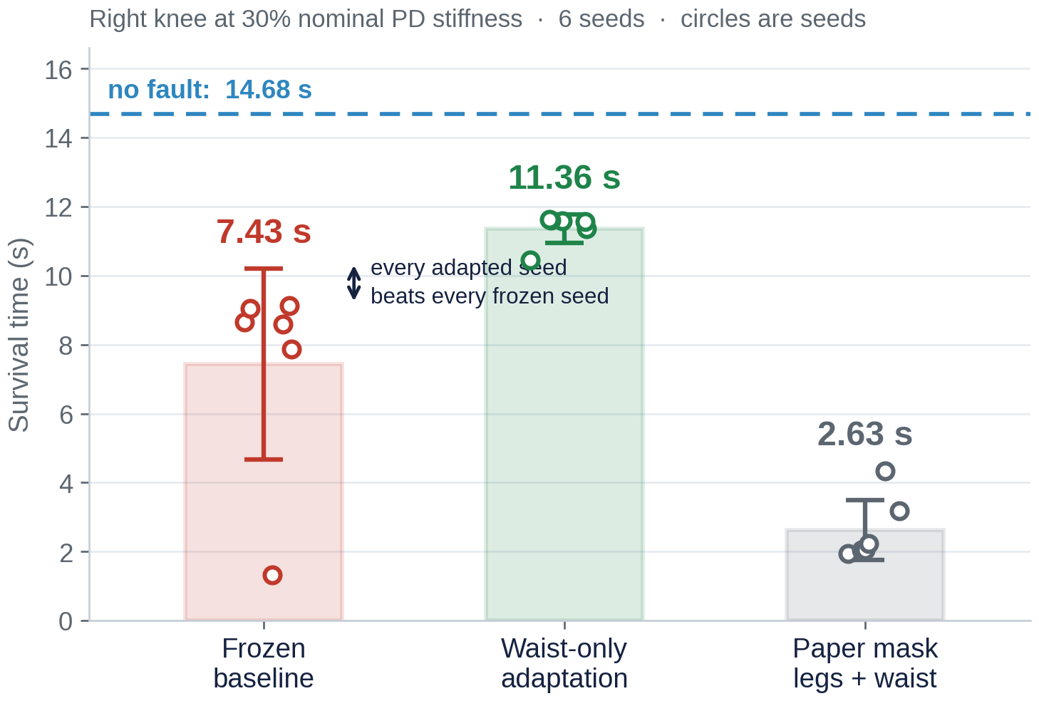
ADAPTATION · RESULTS
Under the fault, adaptation recovers the task
Survival
Set-down
Lifted
Frozen baseline
7.43 ± 2.76 s
4 / 6
5 / 6
Waist-only adaptation
11.36 ± 0.42 s
6 / 6
6 / 6
6 seeds · no domain randomization · observation noise off · v31 policy
• Complete separation. Every adapted seed outlasts every frozen seed. Exact one-sided Mann-Whitney p = 0.0011, the floor for six against six.
• Consistency, not just mean. Spread collapses from ±2.76 s to ±0.42 s. The seed where the frozen policy crumples at 1.3 s is carried to 10.4 s.
• The task comes back. Frozen reaches the set-down on 4 of 6. Adaptation reaches it on all 6.
THE MASK DECIDES, NOT THE GAIN
Waist-only runs the same 3e-4 gain that is catastrophic with the paper's legs-and-waist mask: 2.63 s and never lifts the box. The legs are where balance lives on a floating base, so regulating their tracking error fights the balance the policy is maintaining.
SURF 2026 · Baaqer Farhat · Caltech ARCL
10
Notes:
This is the main result, and it is worth stating precisely. Six seeds, no randomization,
noise off, and the baseline is the same numpy policy with the gain set to zero, so the only
difference between the arms is the adaptation itself.
The dashed line is the healthy robot at fourteen point seven seconds. Red is the frozen
policy under the fault, at seven point four, and look at the spread. One seed dies at one
point three. Green is the same policy with waist adaptation, at eleven point four.
What matters is not the mean, it is the arrow between them. There is no overlap between the
seeds at all: the worst adapted run beats the best frozen run. The spread also collapses from
two point eight seconds to point four, so adaptation removes the catastrophic runs rather than
adding time on average. And the task comes back, from four of six reaching the set down to
all six.
Now the orange box, the unexpected finding. The mask is which joints feed the error signal.
The paper's default includes the legs, and with that mask, at the identical gain, the robot
is on the floor in two and a half seconds having never lifted the box. On a floating base the
legs are where balance lives, so regulating their error fights the balance the policy is
already maintaining.

Slide 11
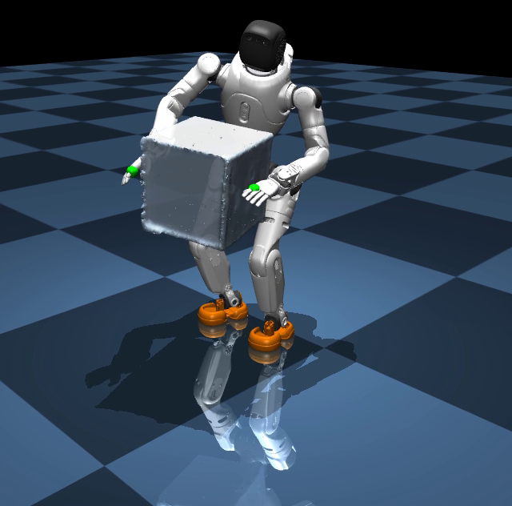
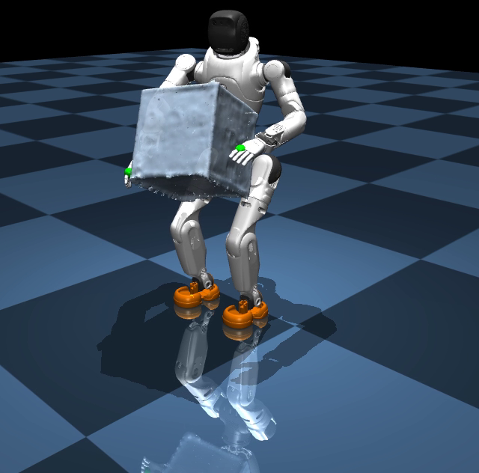
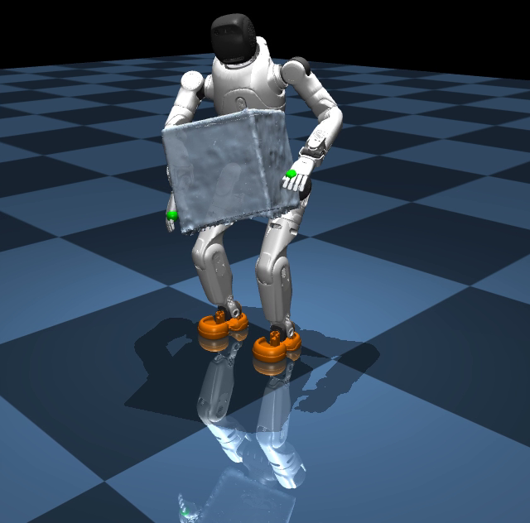
ADAPTATION · SIDE BY SIDE
Same policy, same fault, one difference
All three clips run the v31 box-pickup policy. The only change between the middle and the right is whether the adaptation update is switched on.
VIDEO 1 Nominal, frozen
VIDEO 2 Knee fault, frozen
VIDEO 3 Knee fault, waist adaptation
Healthy robot. Completes the pickup, carry and set-down. 14.68 s, 6/6 seeds.
x2_box_v31_flatfoot_iter202500.mp4
Right knee at 30%. Sags under the payload and falls before the set-down. 7.43 s.
isaac_fault_knee03_frozen_vs_waistadapt.mp4 (left half)
Same fault, adaptation on. Holds the box and reaches the set-down. 11.36 s.
isaac_fault_knee03_frozen_vs_waistadapt.mp4 (right half)
SURF 2026 · Baaqer Farhat · Caltech ARCL
11
Notes:
Same result as a picture.
On the left, the healthy robot with the frozen policy. That is what the behavior should look
like. In the middle, the identical policy with the knee at thirty percent. Watch the right
side. It sags as the box loads the weakened knee, the torso pitches too far, and it goes
down before the set down.
On the right, same fault, same starting weights, and the only difference is that the
adaptation update is running. It holds the box and reaches the set down.
Nothing was retrained. The weights on the right started identical to the middle. The
difference accumulated during the ten seconds you are watching.

Slide 12
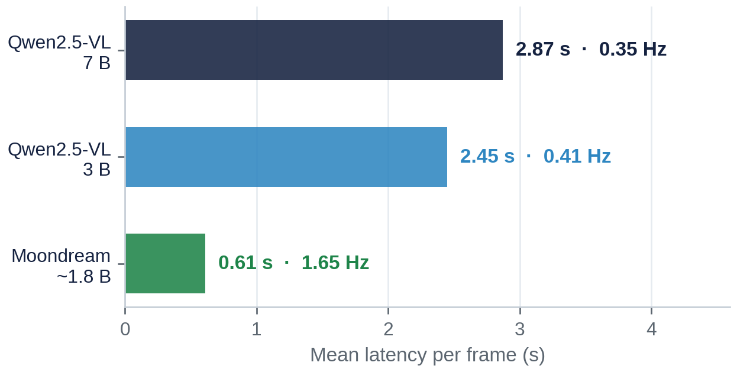
PERCEPTION · LONGER TERM AUTONOMY
VLM perception: built and benchmarked, not yet closed on control
Adaptation handles faults the robot can feel in its own tracking error. Deciding what to do next needs the robot to understand the scene, which is where a vision language model fits.
Orbbec Gemini 335
Camera server on robot
Ollama on workstation
Scene description
head RGB, 1280 × 720
JPEG over HTTP, port 8099
Qwen2.5-VL 7B / 3B, Moondream
objects, people, coarse position
COMPLETED
• Head camera streamed off the robot
• Three models served locally through Ollama
• Latency and description quality measured
CURRENTLY TESTING
• Which model is accurate enough at a usable rate
Warm, end to end, RTX 5070 8 GB. 12 frames from one 15 s clip, identical prompt, temperature 0.2.
NEXT STEP
• Free text into a structured signal the controller can consume
SURF 2026 · Baaqer Farhat · Caltech ARCL
12
Notes:
Briefly on perception. Adaptation handles what the robot can feel in its tracking error, not
something it has to look at. So the other thread is a vision language model on the robot's
own camera, streamed off the robot to a workstation running the model locally.
The benchmark shows a real tradeoff. Qwen at seven billion gives the best descriptions and
runs at a third of a hertz. Moondream is five times faster and the least accurate. Nothing in
this class fits inside a fifty hertz control loop, so this is a deliberative layer, not a
reflex.
To be clear about status: the output is still free text to a terminal. It is not connected to
the controller, and this talk does not claim more than that.

Slide 13
SUMMARY
What this summer produced
Retargeting
Box pickup
Hardware
Crawling
Fault testing
Adaptation
VLM
Fixed two retargeter defects: a joint-limit off-by-one and a 4.6 rad/s transient at the clip start.
8.7 s whole-body pickup, carry and set-down. 33 training runs from first tracking to the deployed policy.
Exported to a numpy-only policy, deployed over ROS 2 at 50 Hz. 57 logged runs on the physical X2.
Prone slope crawl with a purpose-written reward, contact and observation set. Also run on hardware.
Injected a right-knee actuator fault at 30% stiffness. Frozen policy falls from 14.7 s to 7.4 s.
Ported the ACC layer-adaptation law into Isaac and onto the robot. 11.36 s, 6/6 set-down, p = 0.0011.
Head camera streamed to three local VLMs and benchmarked for latency and description quality.
Contributed here: the X2 integration and retargeting fixes, task and reward design in holosoma, every training run, the numpy export and ROS 2 deployment, the fault injection harness, and the adaptation port in both simulation and hardware form.
Built on holosoma for whole-body tracking, the OmniRetarget and CMU motion datasets, and the ACC 2026 adaptation law.
SURF 2026 · Baaqer Farhat · Caltech ARCL
13
Notes:
Stepping back, this is the arc. Retargeting first, which meant fixing the retargeter before
anything downstream worked. That fed the box pickup, thirty three training runs to reach the
policy that runs today, with fifty seven logged hardware runs behind it. Crawling was the
second behavior on the same infrastructure. Then the research question: a fault injection
harness, the frozen policy characterized, and the adaptation law ported into our environment.
On attribution. The tracking framework is holosoma, the motion data is public, and the
adaptation law is my mentor's. The contribution here is the X2 integration, the task and
reward design, the training, the hardware deployment, the fault experiments, and getting that
law working in an environment it had never run in.

Slide 14
CURRENT STATUS AND NEXT STEPS
Where the system stands, and what comes next
WHAT THE SYSTEM DOES TODAY
NEXT STEPS, IN PRIORITY ORDER
Box pickup
8.7 s whole-body motion in simulation and on the physical X2, with flat planted feet and a clean set-down.
1. Generalize the fault result
A hip or ankle fault, and a held-out seed pool.
Crawling
Prone slope crawl trained in simulation, v3 exported and run on hardware.
2. Run the comparison on hardware
Both arms already run on the robot. What is missing is degrading a physical joint.
3. A balance-targeted error signal
Deployment
Numpy-only inference at 50 Hz over ROS 2, with a safety ladder and per-tick logging.
Regulating joint error assumes balance follows. Define the error on a centre-of-mass term instead.
4. Gate the adaptation
Engage above an error threshold to restore a no-worse-than-frozen floor.
Adaptation
Runs online at 50 Hz in simulation and in the hardware deploy loop, and recovers the task under a knee fault.
5. Close the perception loop
VLM output as a structured signal the controller can act on.
SURF 2026 · Baaqer Farhat · Caltech ARCL
14
Notes:
Where things stand is on the left. Both behaviors exist, both have been on the physical
robot, and the adaptation runs online in simulation and in the hardware deploy loop.
On the right, what comes next. First, the honest limitation: this is one fault on one pool of
six seeds. A different joint and fresh seeds would make the claim properly.
Second, and this is the closest, running the comparison on the physical robot. Both arms
already run there. What is missing is degrading a real joint and alternating them enough
times to say something with confidence.
Third is a research direction. The adapter regulates joint error and assumes balance follows,
and the mask result is evidence that on a floating base it does not.

Slide 15
Humanoid policies can learn manipulation and locomotion that works.
Resilience is a different problem. It requires the robot to respond to changes in its own dynamics.
This summer produced the behaviors, the deployment path, and the adaptation framework that gets us there, with evidence that adaptation recovers a task the frozen policy loses.
Baaqer Farhat · Caltech ARCL · SURF 2026
Thank you. Questions welcome.
Notes:
Getting a humanoid to pick up a box or crawl up a slope is a solvable problem, and it was
solved twice this summer, in simulation and on the real robot.
But a policy that works is not the same as a policy that is resilient. The moment the robot
stops being the robot the policy was trained on, and that happens constantly on hardware,
the behavior degrades and the policy cannot tell. Resilience means responding to changes in
your own dynamics.
Under a real actuator fault, adapting a single layer online, from nothing but tracking
error, recovers a task the frozen policy loses, on every seed tested.
Thank you. Happy to take questions.

Slide 16
Backup

Slide 17
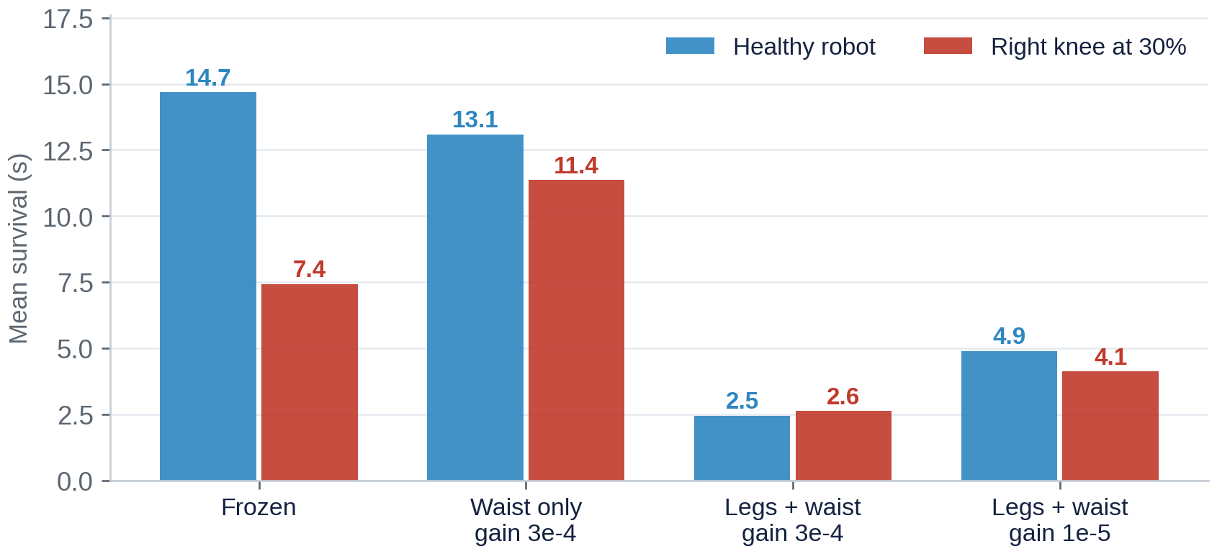
BACKUP · ADAPTATION ON A HEALTHY POLICY
The same law on a healthy robot spends margin the task needed
• The tracking claim reproduces. On the window every variant survived, leg tracking error goes from 14.82° frozen to 8.01° adapted. That is a 40% reduction, against 37% reported in the original MuJoCo testbed.
• What does not transfer is the implication. The published baseline falls at 1.94 s and never completes the motion, so adaptation could only add. Ours survives 14.68 s and completes the task on 6 of 6, and the same law spends that margin buying tracking accuracy the task did not need.
• This is why the fault experiment matters. A recovery controller applied to a healthy robot is outside the domain of the method. The comparison that means something is the one under the fault.
Controls: the numpy export matches the torch checkpoint to 4.2e-6 max action difference over 200 steps, and the baseline is that same numpy policy at gain zero, so the only difference between arms is the adaptation. A 1e-6 action perturbation moves leg error by 1.7° over 2.4 s, so every comparison is multi-seed.
Inverse-inertia weighting (gx level 2) is worse in both regimes. That reproduces the original finding: the weighting aims the correction at the lightest joints, the wrists and head, whose tracking errors are irrelevant to the task.
SURF 2026 · Baaqer Farhat · Caltech ARCL
15
Notes:
This is the backup for the healthy robot claim.
The important honest point is the first bullet. The tracking result from the paper
reproduces cleanly in our environment. Leg tracking error drops forty percent, against
thirty seven percent in the original testbed. The law does what it says it does and it
transfers across simulators.
What does not transfer is the conclusion you would draw. In the original testbed the frozen
baseline falls after two seconds and never finishes the motion, so there was no balance
margin to lose and adaptation could only help. Our frozen baseline survives the full clip
and completes the task on every seed. So the same law is spending balance margin to buy
tracking accuracy that this task did not need, and the result is worse.
That is exactly why the fault experiment is the one that counts.

Slide 18
BACKUP · V33 HARDWARE
Diagnosing a sim-to-real failure with matched simulation
Symptom
All four takes of v33 abort on roll between 27% and 48% of the motion, always in the same direction.
First hypothesis, wrong
Compared against the only rollout on disk, which was a different policy. That pointed at a saturated ankle-roll command.
Matched baseline
Identified the exact v33 reference clip and ran the same policy, same clip, 3 seeds. Simulation clips that joint on 92% of ticks and still succeeds, so saturation is learned behavior, not the gap.
Actual cause
The deployment fed the torso IMU into base_ang_vel, which holosoma builds from the pelvis. The torso sits three waist joints above it, so this substitutes both a different body and a different frame.
Confirmation
Reproducing that substitution in simulation drops the policy from 100% success and 9.8 s to 0% and 1.6 s, falling in the same 1.1 to 1.9 s window as the hardware.
Fix
A pelvis estimator composes the torso IMU with the measured waist joints. Removes 90.8% of the observation error and restores 100% success.
Method that found it: a single tracking-error number conflates command saturation, servo error and task error. Separating the three is what localized this, and reproducing the defect in simulation is what proved it.
SURF 2026 · Baaqer Farhat · Caltech ARCL
16
Notes:
This one is here in case it comes up, because the method matters more than the bug.
Version thirty three worked in simulation and failed on hardware every time, always
aborting on roll at roughly the same point in the motion.
The first diagnosis was wrong, and it was wrong for an instructive reason. The hardware logs
were compared against the only simulation rollout saved at the time, which came from a
different policy version. That mismatched baseline pointed at a saturated ankle joint.
Against a properly matched simulation, same policy, same clip, the saturation explanation
fell apart, because simulation saturates that joint even more than hardware does and still
succeeds.
The real cause was the deployment feeding the torso IMU into an observation the training
environment computes at the pelvis, and the torso sits three waist joints above the pelvis.
Wrong body, wrong frame.
The confirmation is what makes it conclusive. Reproducing that exact substitution inside
simulation, where the pelvis signal is available as ground truth, took the policy from one
hundred percent success to zero, falling in the same time window as the robot did. The
defect explains the failure on its own.

Slide 19
BACKUP · DETAILS
Configuration and reproduction
TRAINING
ADAPTATION
Framework
holosoma whole-body tracking on IsaacLab / Isaac Sim
Law
ACC 2026 causality-guided layer adaptation, W₀ leak
Algorithm
PPO, λ = 0.95, γ = 0.99, 4096 envs
Adapted
layer index 2, 256 × 128 = 32,768 weights
Rates
200 Hz physics, 50 Hz control
Gain
Γ = 3e-4, leak 0.01, engage step 0
Actor
blind MLP 512-256-128 (ELU), 31 joint targets
Mask
waist yaw, pitch, roll
Critic
privileged, adds base linear velocity and object state
Fault
right_knee_joint PD stiffness × 0.3
Pickup DR
box mass 0.4 to 1.6 kg, friction, PD gain, action delay, encoder noise, pushes
Protocol
6 seeds, 734 steps, no DR, no observation noise
Motion
OmniRetarget sub3_largebox_003, CMU crawl_111_03
Baseline
same numpy policy at gain 0
Full reproduction instructions, per-seed results and the hardware protocol are in adaptation/README.md and SETUP_ISAAC.md.
Repository: Agibot-humanoid · box_pickup/ adaptation/ agibot_control_functions/
SURF 2026 · Baaqer Farhat · Caltech ARCL
17
Notes:
Configuration reference. Use if asked about specific hyperparameters, the fault definition, or how to reproduce a run.

