Slide 1
X2 Box-Pickup Deployment Analysis
Hardware run logs · desired vs measured trajectories · reward fixes
19 logged runs · v27 + v30 policies · 50 Hz encoder CSVs

Slide 2
Hardware data logged
Each deploy writes a 50 Hz CSV: phase, frame, base IMU quat/gyro, and per-joint pos_meas / vel_meas / tgt.
Desired trajectory = policy PD target (`__tgt`). Actual = measured encoder (`__pos_meas`).
19 runs analyzed: 4× v27 hybrid (Jul 27), 15× v30 pickup/hybrid (Jul 29).
Primary metrics: foot-edge (ankle-roll deviation), base roll σ, leg tracking RMSE.
X2 box-pickup deployment analysis · hardware run_logs
2

Slide 3
IRL failure modes (v30 deploy)
Feet stand on outer edges; most of the sole off the floor during pickup and hold.
Torso oscillates in roll to rebalance on that narrow contact patch.
Stepping / stance widen during pickup, hold, and set-down (slip penalty alone was insufficient).
Backward fall risk after set-down when post-release upright hold was out of distribution.
Median foot-edge on v30 hardware: 8.2° (target < 3°). Worst run: 13.1°.
X2 box-pickup deployment analysis · hardware run_logs
3

Slide 4
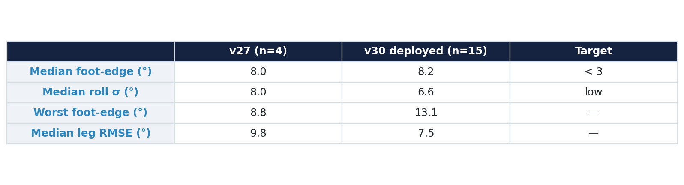
Aggregate hardware metrics
v30 did not fix edge-standing vs v27 — same ~8° median ankle-roll deviation.
Sim contact terms treated an edge-loaded foot as planted; hardware did not.
X2 box-pickup deployment analysis · hardware run_logs
4

Slide 5
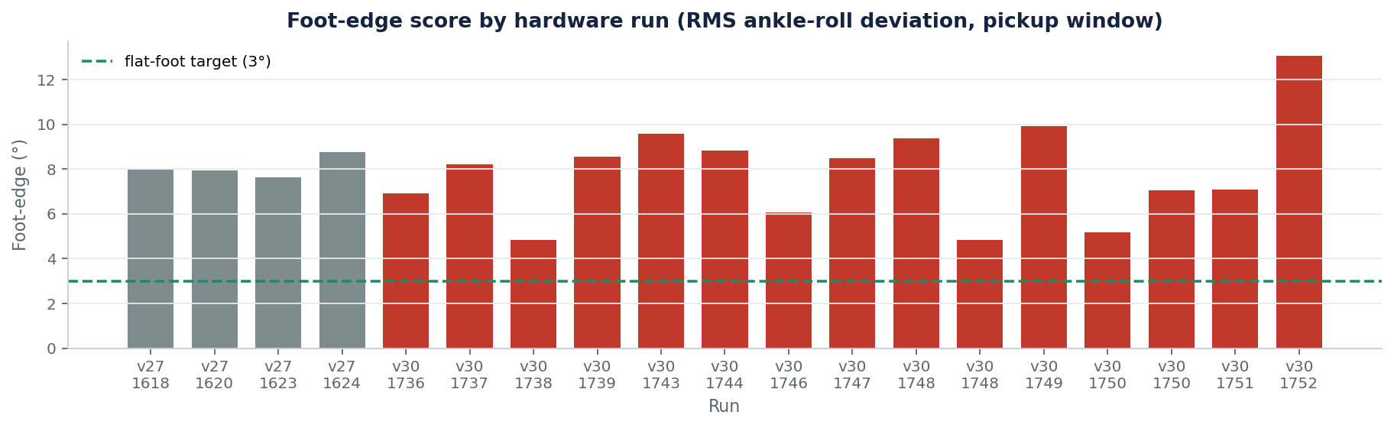
Foot-edge severity across all runs
RMS |ankle-roll| during pickup. Red = v30, gray = v27. Dashed = 3° flat-foot target.
X2 box-pickup deployment analysis · hardware run_logs
5

Slide 6
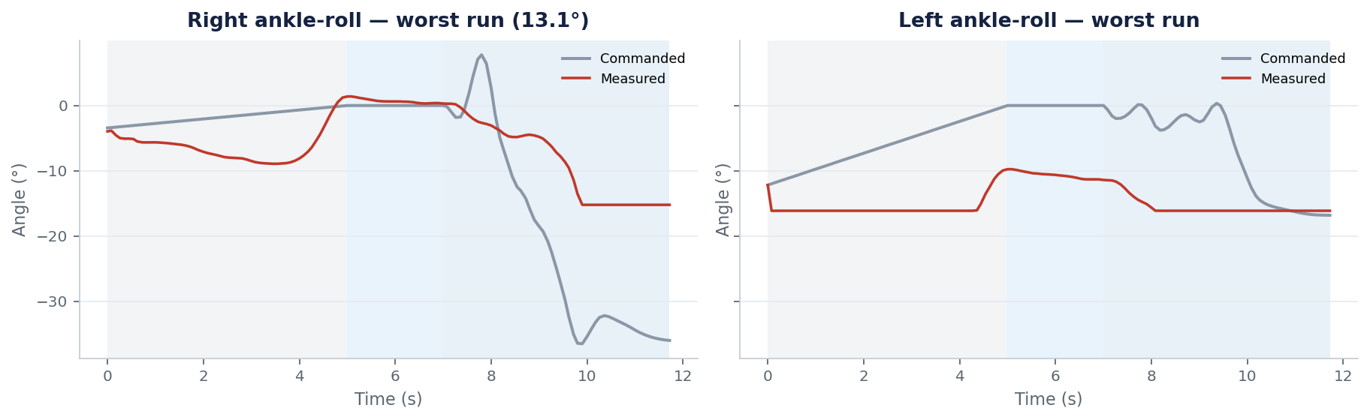
Worst run — edge-standing signature
Run 17:52:22. Commanded ankle-roll nearly flat; measured swings hard onto the edge.
X2 box-pickup deployment analysis · hardware run_logs
6

Slide 7
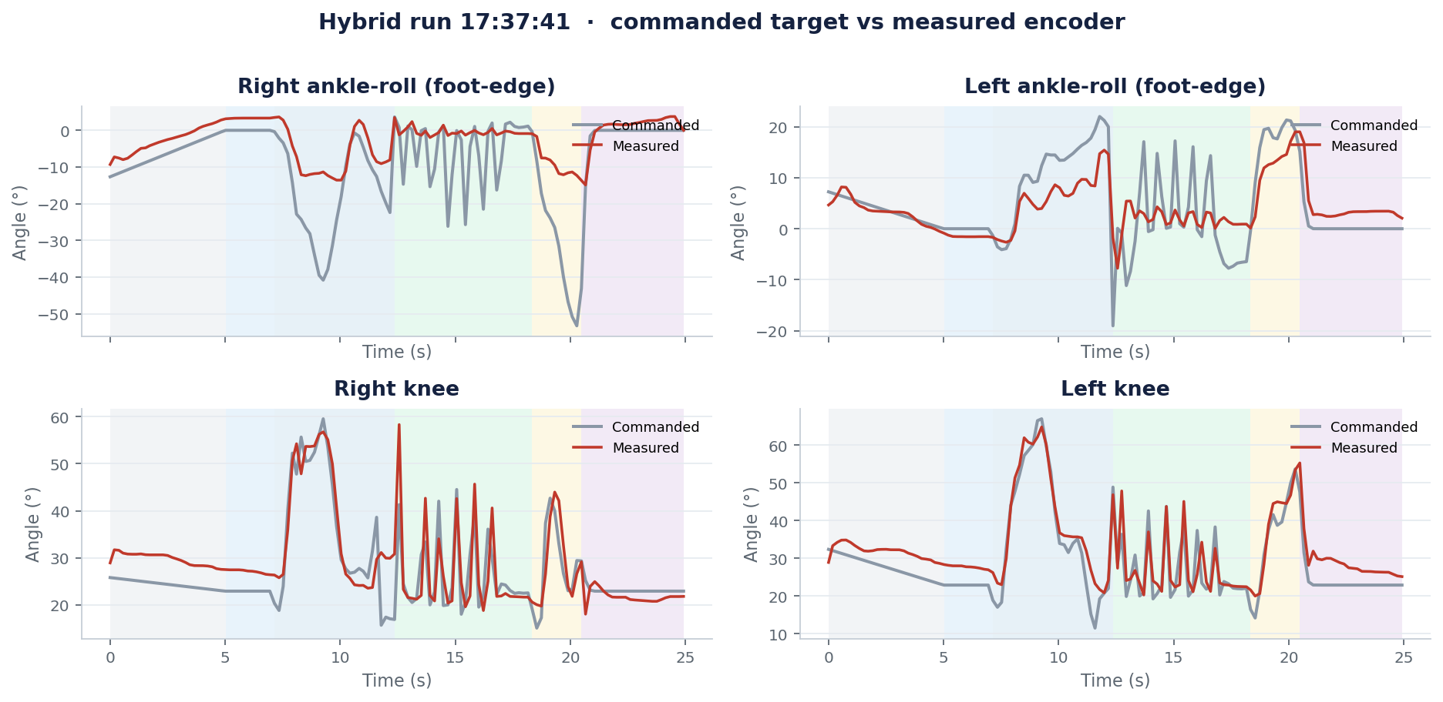
Desired vs actual — ankles and knees
Hybrid run 17:37:41. Shaded bands = ramp / settle / pickup / carry / setdown / done.
X2 box-pickup deployment analysis · hardware run_logs
7

Slide 8
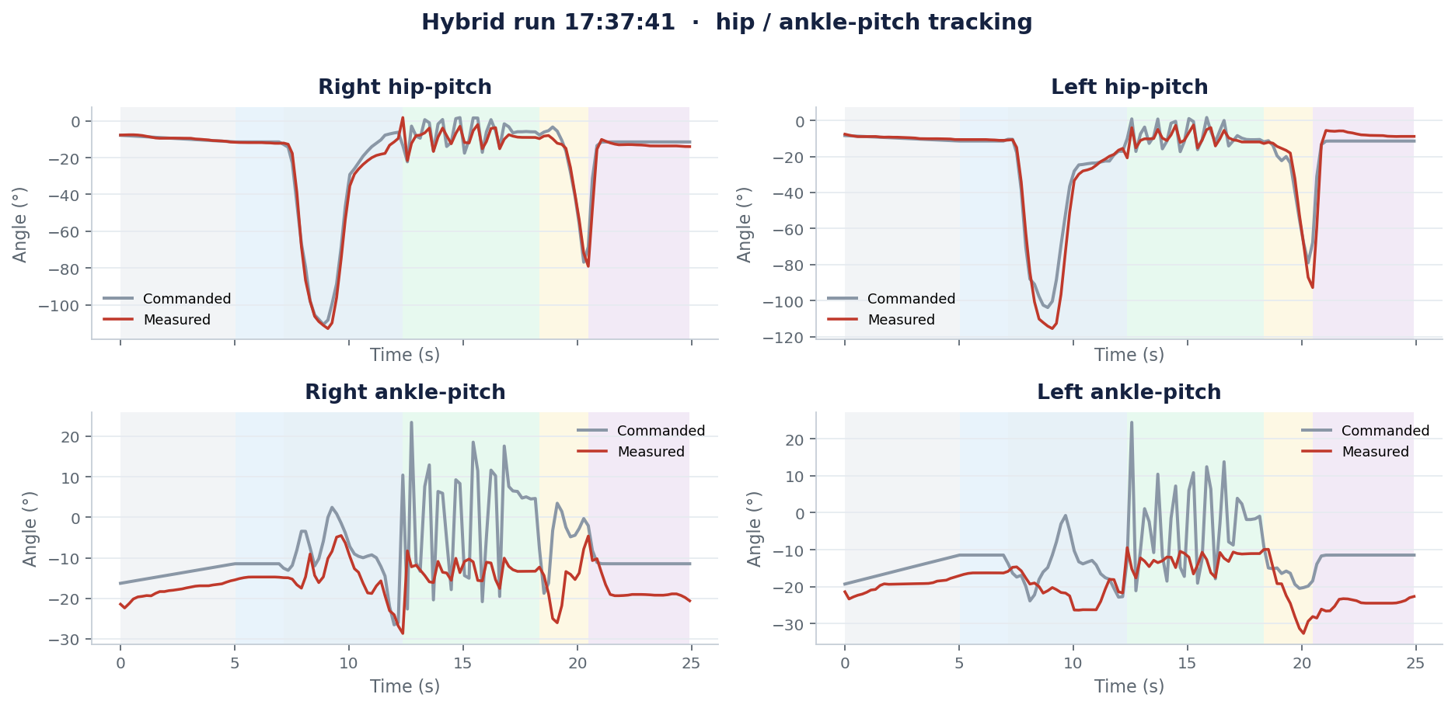
Desired vs actual — hips and ankle-pitch
Same hybrid run. Hip tracking holds better than ankle-roll — failure is concentrated at the foot.
X2 box-pickup deployment analysis · hardware run_logs
8

Slide 9
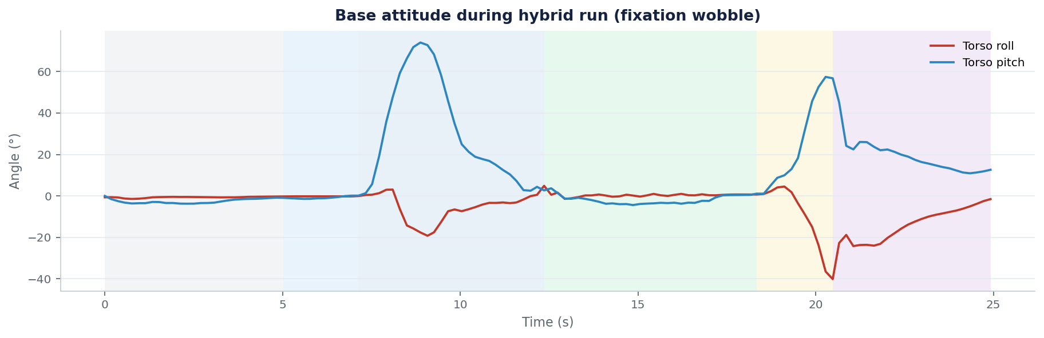
Base attitude — fixation wobble
Repeated roll swings during pickup = rebalancing on foot edges, not a clean plant.
X2 box-pickup deployment analysis · hardware run_logs
9

Slide 10
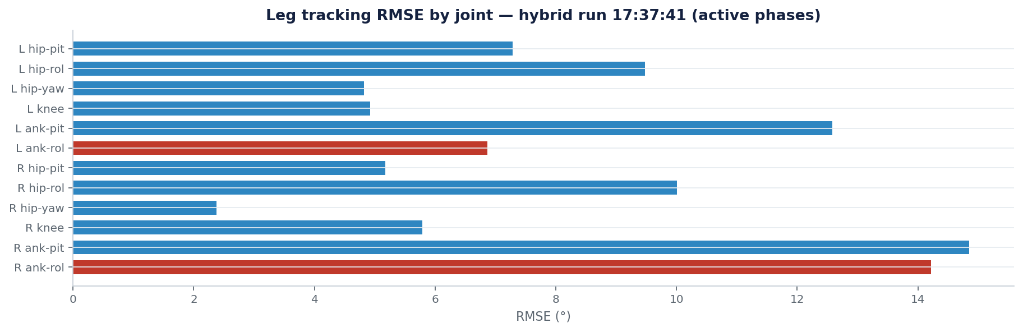
Per-joint tracking error (legs)
Ankle-roll joints (red) dominate leg RMSE — matches the edge-standing observation.
X2 box-pickup deployment analysis · hardware run_logs
10

Slide 11
Why prior rewards missed the failure
`foot_slip`: zero when the foot is tilted but stationary — edge-stand is free.
`feet_contact_loss`: edge still registers force in PhysX, so it counts as planted.
`feet_anchor` / slip: address XY drift and sliding, not foot roll about the edge.
No term measured ankle-roll link tilt → foot-tilt bounced 4°–29° across checkpoints with no trend.
X2 box-pickup deployment analysis · hardware run_logs
11

Slide 12
Penalties added to fix hardware failures
Term | W | What it fixes
foot_slip | −3 | Skating under load (sim → thrash on HW)
feet_contact_loss | −2 | Stepping loophole (lift to evade slip)
feet_anchor | −2→−1 | Stance widen / permanent XY drift
foot_not_flat | −3 | Edge-standing (sin of foot tilt, contact-gated)
feet_edge_contact | −2 | Edge counts as not planted (θ≳10°)
ori tracking | ×2 | Left torso lean during pickup
end-hold in motion | — | Fall after set-down (3 s upright practice)
X2 box-pickup deployment analysis · hardware run_logs
12

Slide 13
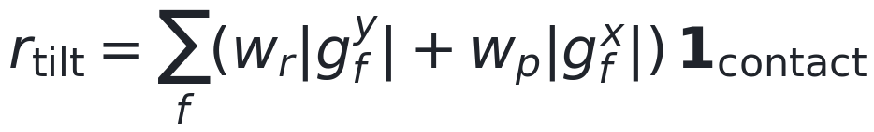
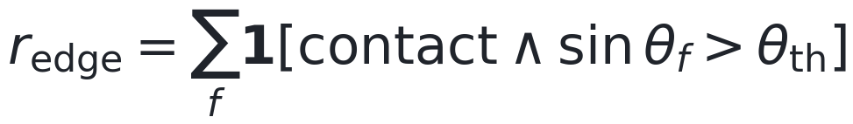
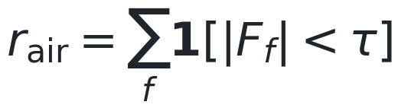

New foot terms (v31)
Foot not flat — smooth tilt cost while loaded
Edge contact — hard count of edge-planted feet
Contact loss — airborne foot (stepping)
Anchor — XY drift from reset plant
X2 box-pickup deployment analysis · hardware run_logs
13

Slide 14
Mapping: symptom → penalty
Edge-standing / oscillating on feet → `foot_not_flat` (−3) + `feet_edge_contact` (−2).
Stepping during pickup/hold/set-down → `feet_contact_loss` (−2) + stronger `foot_slip` (−3).
Stance growing apart → `feet_anchor` (drift from plant pose).
Torso roll left on lift → double `motion_global_ref_orientation` weight.
Fall after drop → bake 3 s end-hold into reference motion variants.
X2 box-pickup deployment analysis · hardware run_logs
14

Slide 15
Deployment notes from the data
Hybrid deploy freezes the WBT clock at hold_frame (~261) for the walk splice — looks like a mid-hold stop.
Full continuous pickup→set-down uses `deploy_x2_box_pickup.py`, not the hybrid script.
Always pass `--box-policy` explicitly; default path previously loaded stale v27.
Judge new checkpoints by foot-tilt + post-set-down upright, not mean reward alone.
X2 box-pickup deployment analysis · hardware run_logs
15

Slide 16
Takeaways
Hardware logs localize the failure to ankle-roll / foot tilt, not a generic tracking miss.
Sim contact force ≠ flat sole — need an explicit flatness / edge objective.
Planted-feet suite + foot-flat terms close the loopholes that produced IRL edge-standing and steps.
Hold and set-down need dedicated sampling; short episodes never reach those phases.
X2 box-pickup deployment analysis · hardware run_logs
16

