Slide 1
Teaching the X2 Humanoid to Walk
Training a walking controller in simulation and running it on the real robot
Baaqer Farhat Mahdi Taheri
AgiBot X2 MuJoCo mjlab Reinforcement learning

Slide 2
Objective
Learn a velocity conditioned walking controller for the 31 DoF X2 humanoid.
Track a commanded forward, lateral, and yaw velocity while keeping the base stable.
Train end to end in simulation with reinforcement learning, then transfer to hardware.
The gait emerges from the reward objective. There are no reference trajectories or scripted state machines.
X2 humanoid walking policy
2

Slide 3
The control policy
A feedforward network mapping proprioceptive state to joint position targets at 50 Hz.
Observation:
Base angular velocity and projected gravity.
Joint positions and velocities, and the previous action.
The velocity command driving the gait.
Action:
A position target per joint, tracked by the actuator PD loops.
Actor and critic share the observation. The critic additionally sees base linear velocity as a privileged, training only signal.
X2 humanoid walking policy
3

Slide 4
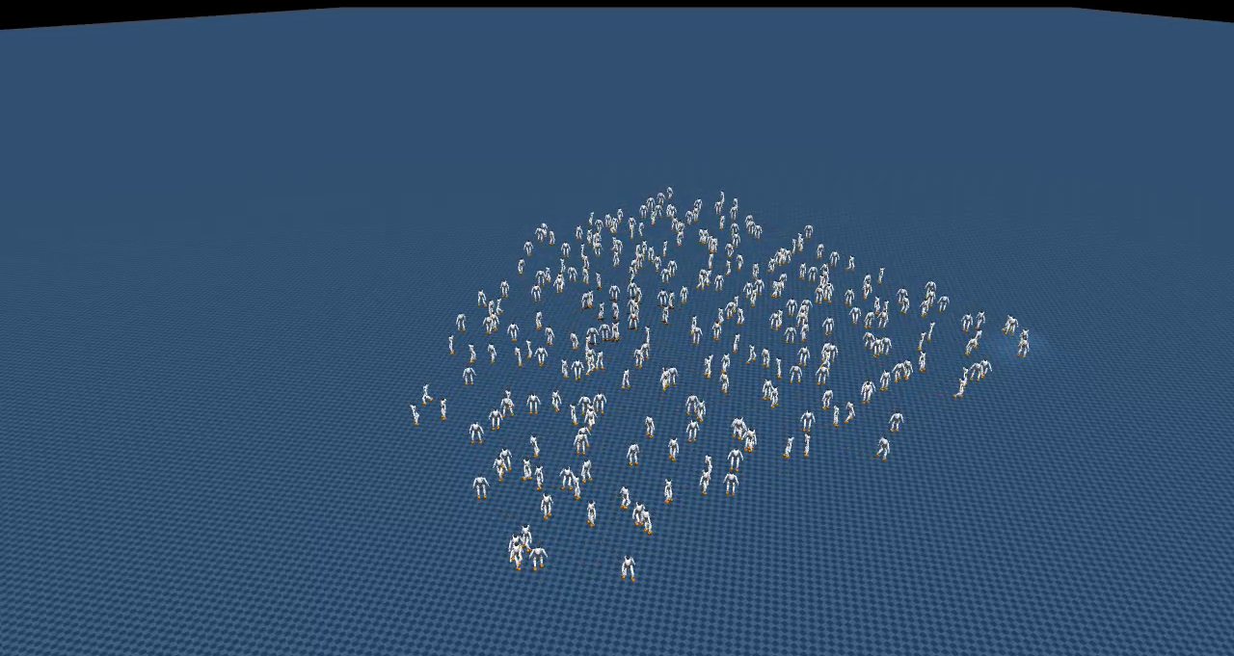
Simulation and training setup
Training runs in MuJoCo Warp through mjlab, entirely on a single GPU.
Roughly 4096 environments step in parallel, each an independent robot on its own terrain.
One shared actor and critic collect experience from all environments at once.
This yields billions of simulated timesteps within a few hours of wall clock training.
A subset of the parallel environments stepping simultaneously.
X2 humanoid walking policy
4

Slide 5
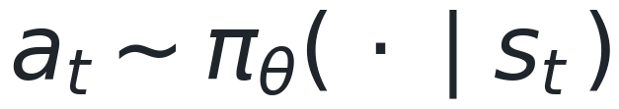
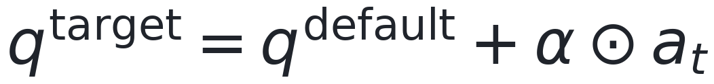
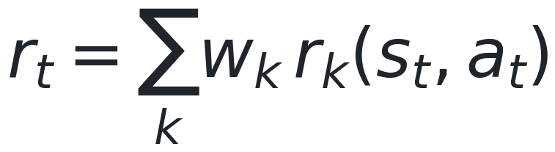
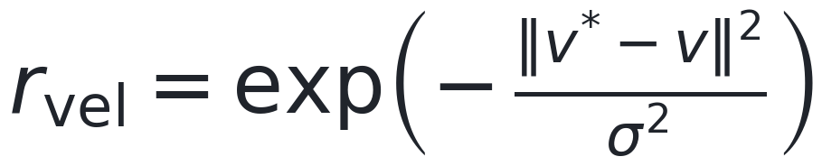
Learning formulation
Stochastic policy over joint targets
Actions define PD position setpoints
Reward is a weighted sum of shaped terms
Velocity tracking via an exponential kernel
PPO maximizes the clipped surrogate
On policy optimization: rollouts are batched across all environments, advantages estimated with GAE, and the policy updated by PPO with a clipped surrogate and entropy regularization.
X2 humanoid walking policy
5

Slide 6
Reward design
Reward term | Purpose
Linear and angular velocity tracking | Match the commanded base velocity
Base orientation and height | Penalize torso tilt and unwanted vertical motion
Foot clearance and air time | Enforce distinct swing and stance phases
Action rate and torque | Regularize toward smooth, efficient motion
Foot slip and contact impact | Penalize sliding and hard landings
Termination on fall | End and penalize the episode when the base drops
X2 humanoid walking policy
6

Slide 7
Robustness and transfer
Velocity curriculum: the command range widens as tracking performance improves.
Domain randomization: ground friction, added base mass, and actuator gains vary per environment.
External perturbations: random base pushes force the policy to learn balance recovery.
Together these reduce the simulation to reality gap and prevent overfitting to one exact setup.
X2 humanoid walking policy
7

Slide 8
Command conditioned locomotion
The policy is conditioned on a velocity command: forward, lateral, and yaw rate.
A single network produces forward, lateral, and turning gaits by varying that command.
At deployment we stream a fixed command, for example 0.3 m/s forward, to drive walking.
X2 humanoid walking policy
8

Slide 9
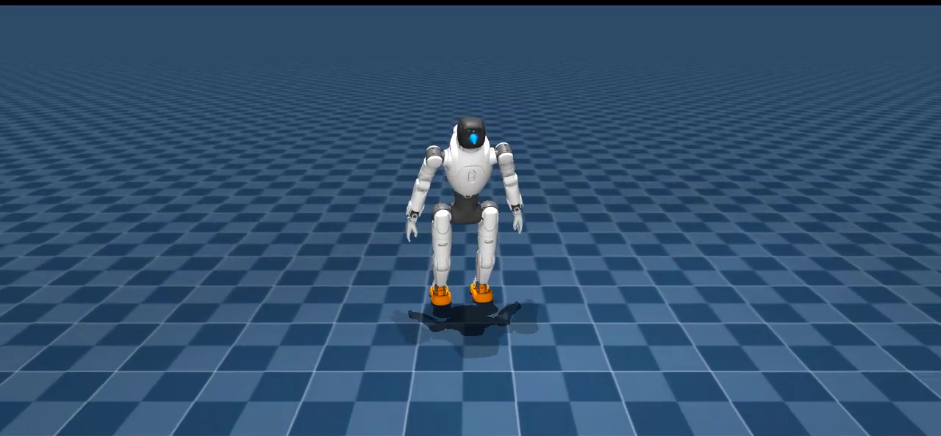

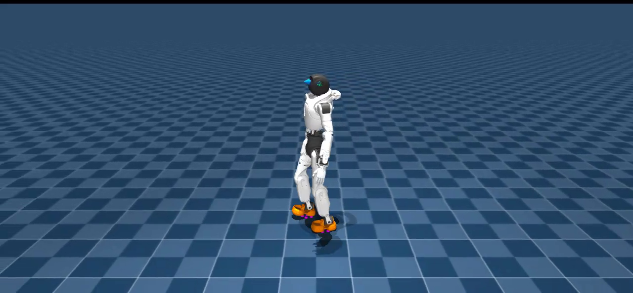
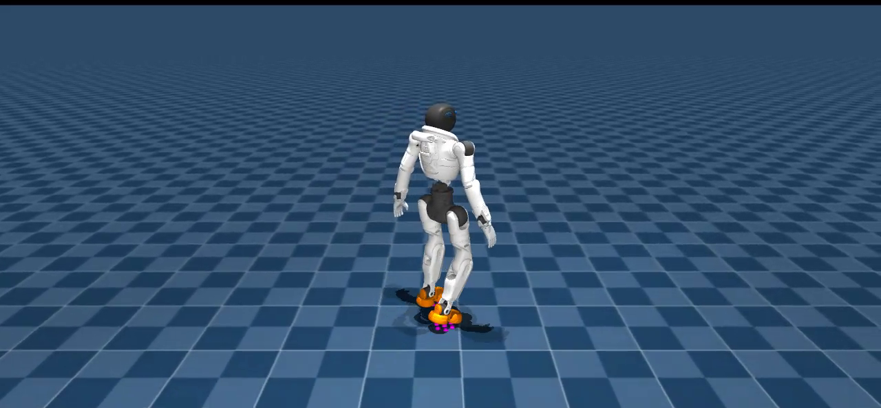
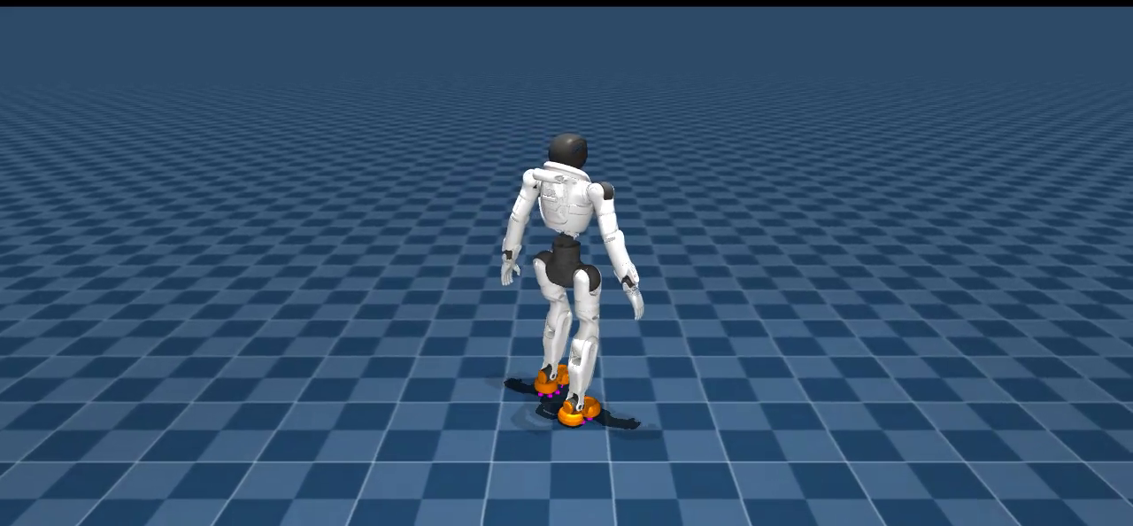
Policy progression over training
Iteration 0
Iteration 100
Iteration 3000
Iteration 6000
Iteration 10000
Untrained, collapses immediately
Unstable, fails to hold balance
Emerging forward stepping
Consistent locomotion
Stable, converged gait
Deterministic rollouts of saved checkpoints under a fixed forward command.
X2 humanoid walking policy
9

Slide 10
Deployment on hardware
The trained actor is exported to a compact model and runs with numpy only on the robot.
The deployment policy drops base linear velocity from its observation, since it is not measurable on hardware. The critic used it only in training.
Inference runs at 50 Hz over ROS 2, and the onboard PD loops track the joint targets.
The velocity command is streamed live, so the same policy walks in any direction on the real robot.
▶
Hardware demo video
insert clip here
Policy running on the physical X2.
X2 humanoid walking policy
10

